Slide 1

引擎發電系統之振噪抑制控制
Control of Engine Power Generation System for Vibration and Noise Reduction
Supervisor: | 謝旻甫教授
Advisor(s): | 蔡明祺教授、張簡樂仁教授
Mentor: | 林維哲學長
研究生: | 陳韋翰
日期: | 2019.07.20(六)

Slide 2
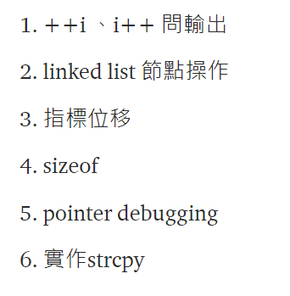
啟碁考題

Slide 3
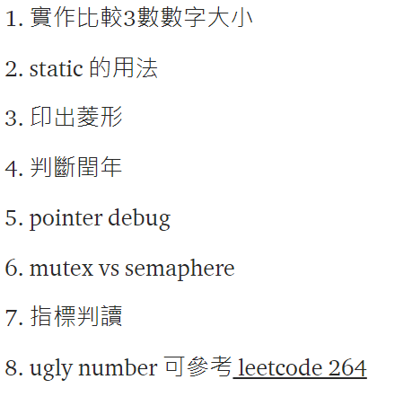
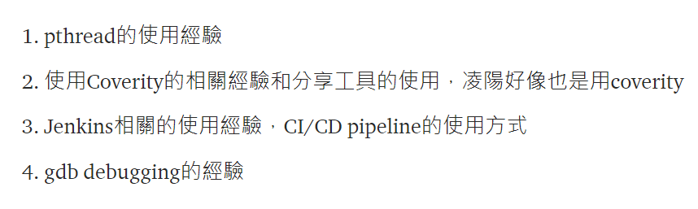
凌楊

Slide 4
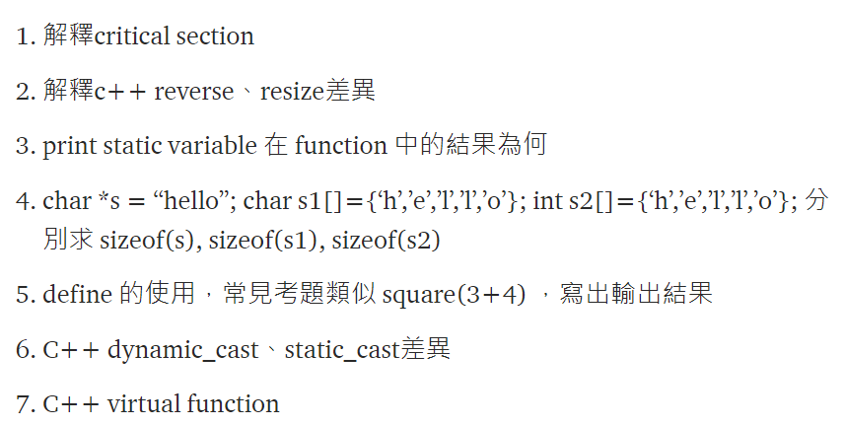
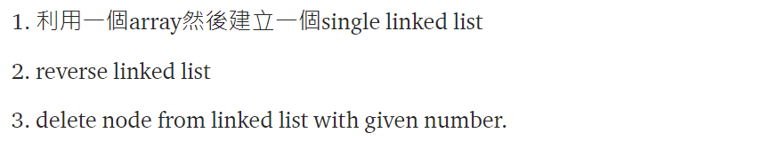
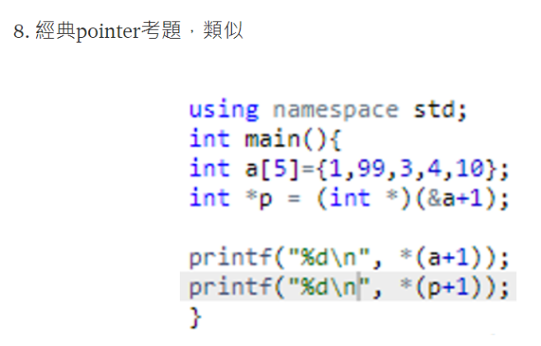
瑞昱

Slide 5
dynamic_cast .vs. static_cast
class B { ... };
class D : public B { ... };
void f(B* pb)
{
D* pd1 = dynamic_cast(pb);
D* pd2 = static_cast (pb);
}
If pb really points to an object of type D, then pd1 and pd2 will get the same value. They will also get the same value if pb == 0.
If pb points to an object of type B and not to the complete D class, then dynamic_cast will know enough to return zero. However, static_cast relies on the programmer’s assertion that pb points to an object of type D and simply returns a pointer to that supposed D object.
即dynamic_cast可用于繼承體系中的向下轉型，即將基類指標轉換為派生類指針，比static_cast更嚴格更安全。dynamic_cast在執行效率上比static_cast要差一些，但static_cast在更寬上範圍內可以完成映射，這種不加限制的映射伴隨著不安全性。static_cast覆蓋的變換類型除類層次的靜態導航以外，還包括無映射變換、窄化變換(這種變換會導致物件切片,丟失資訊)、用VOID*的強制變換、隱式類型變換等...

Slide 6
瑞昱2

Slide 7
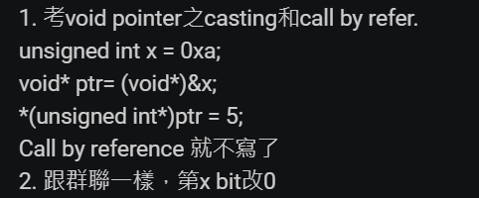

瑞昱3

Slide 8
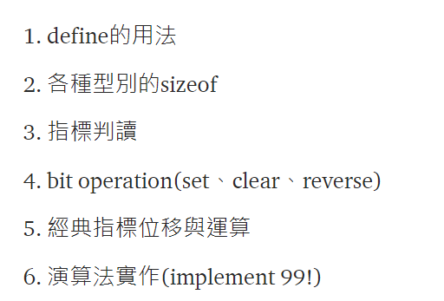
聯陽

Slide 9
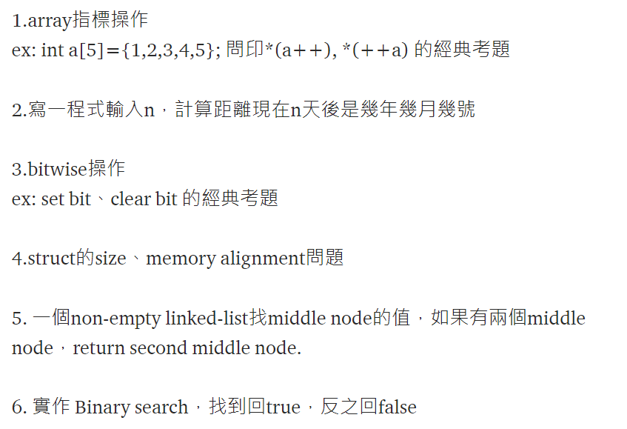
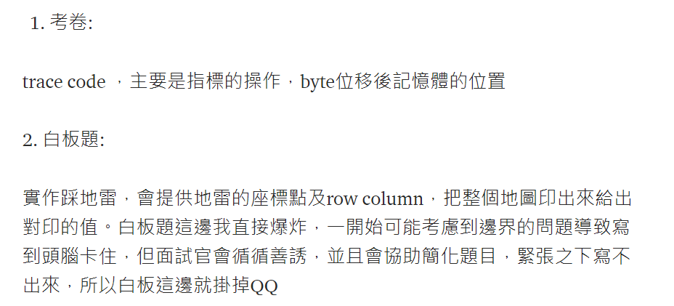
群聯

Slide 10
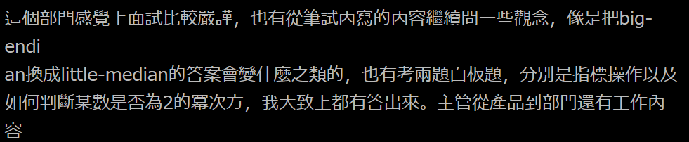
群聯2

Slide 11
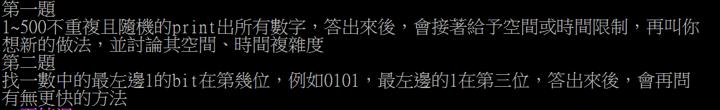
群聯3

Slide 12
立綺

Slide 13
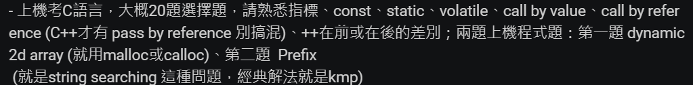
聯發科

Slide 14
http://eeepage.info/interview-c/

