Slide 1
Sparsity Based Noise Robust Speaker Identification Using a Discriminative Dictionary Learning Approach
Christos Tzagkarakis, and Athanasios Mouchtaris
Department of Computer Science, University of Crete, Greece
ICS – Foundation for Research & Technology-Hellas, Crete, Greece
EUSIPCO 2013
9-13 September, Marrakech, Morocco

Slide 2
Outline
Overview of Speaker Identification (SI)
Sparse Representation Classification (SRC) for SI
Discriminative Dictionary Sparse Coding Based on K-SVD for SI
Experimental Results
Conclusions & Perspectives

Slide 3
Overview of speaker identification
?
Goal: estimate speaker identity
Possible applications
Information retrieval from speech databases
Control of financial transactions
Speaker diarization for meetings
Speaker-centric ambient intelligence environments
Focus on current work
Text-independent
Short training speech data
Highly noisy environments
Whose is this voice?

Slide 4

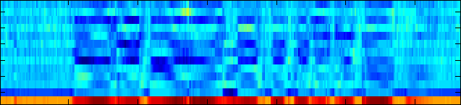


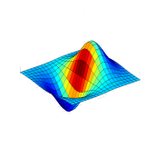


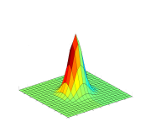


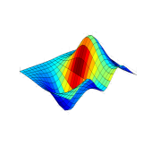
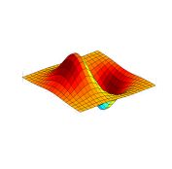


Overview of speaker identification
Model for each
Speaker
Feature Extraction
Build Speaker Models
Enrollment Phase
?
Feature Extraction
Comparison with Speaker Models
Pattern-Matching Classification
Most Likely Speaker Model
Identification Phase
Identified Speaker

Slide 5



SRC for speaker identification
Sparsity concept: test sample represented as a sparse linear combination of an overcomplete dictionary
Assume S speakers in the speech database
n_{i} training samples (or feature vectors) → i^{th} speaker
Total number of training feature vectors: N_{tr} = n₁ + n₂ +…+ n_{S}
Training data matrix V
$$=\left[{\vec{v}}_{1,1}\left|…\left|{\vec{v}}_{1,n_{1}}\right|{\vec{v}}_{2,1}\right|…\left|{\vec{v}}_{2,n_{2}}\right| … |{\vec{v}}_{S,1}|…|{\vec{v}}_{S,n_{S}}\right]∈ℝ^{d×N_{tr}}$$

Slide 6

SRC for speaker identification
Sparsity concept: test sample represented as a sparse linear combination of an overcomplete dictionary
Assume S speakers in the speech database
n_{i} training samples (or feature vectors) per speaker
Total number of training feature vectors: N_{tr} = n₁ + n₂ +…+ n_{S}
Training data matrix V
Assume test feature vector
$${\vec{x}}_{t}∈ℝ^{d}$$
belongs to the i^{th} speaker
speaker i
sparse code

Slide 7
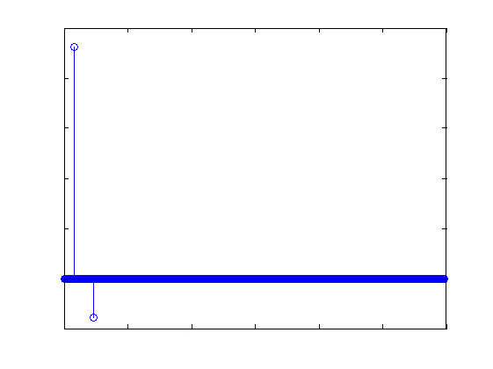
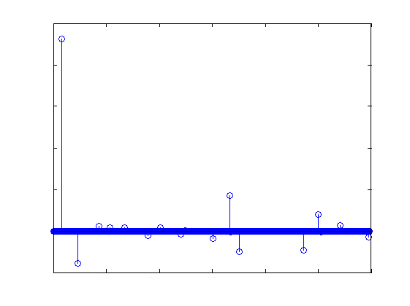
SRC for speaker identification
Given V and estimate sparse code by solving optimization problem (e.g. using OMP)
Ideal case: e.g. 1st speaker is identified
noise/modeling errors
Notes:
The non-zero weights in δ_i( c ) are only those specific to class i. From these,
we construct the set of S approximations and we assign a class-label to x_t simply
by a nearest neighbor criterion
i* := arg min_i || x_t – Vδ_i( c^ ) ||_2
Thus, SRC picks the class of the nearest approximation of x_t in {V δ_i( c^ )}.

Slide 8

SRC for speaker identification
All the training samples form the dictionary V
Large & inefficient dictionary due to noisy training instances
Cost: high complexity sparse solver
Careless choice of dictionary elements
Don’t ensure spanning subspace reasonably well
Learn a dictionary with discriminative and representational power

Slide 9
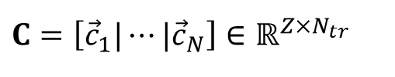
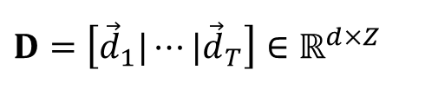
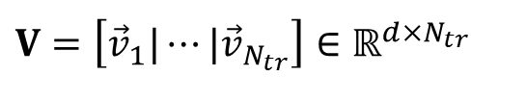
Discriminative dictionary sparse coding
Learn a reconstructive dictionary
$$V=\left[{\vec{v}}_{1}|⋯|{\vec{v}}_{N_{tr}}\right]∈ℝ^{d×N_{tr}}$$
training samples
$$D=\left[{\vec{d}}_{1}|⋯|{\vec{d}}_{T}\right]∈ℝ^{d×Z}$$
dictionary
$$C=\left[{\vec{c}}_{1}|⋯|{\vec{c}}_{N}\right]∈ℝ^{Z×N_{tr}}$$
sparse codes
dictionary size
Learn using K-SVD

Slide 10

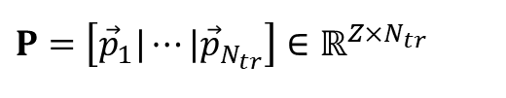
Discriminative dictionary sparse coding
Enhance discriminability of sparse codes
Enforce features from the same class to have similar sparse representation
discriminative sparse codes of
training features V
transforms the original sparse codes in order to enhance discriminative power
$$P=\left[{\vec{p}}_{1}|⋯|{\vec{p}}_{N_{tr}}\right]∈ℝ^{Z×N_{tr}}$$
class 1
class 2
class 3
$$M=\left[{\vec{μ}}_{1}|⋯|{\vec{μ}}_{Z}\right]∈ℝ^{Z×Z}$$
reconstruction error
discriminative sparse-code error

Slide 11
Discriminative dictionary sparse coding
Sparse codes: inputs to a linear classifier
Goal: reduce classification error: class labels of training features V
linear classifier
parameters
e.g. S=3 speakers and N_{tr}=5 training samples
consider classification error
solve using K-SVD
Notes:
λ2 → regularization parameter controlling the relative contribution of the classification error term
V → d x N_tr (where d is the dimension of feature space and N_tr is the number of training samples)
C → Z x N_tr (where Z is the dictionary size)
D → d x Z
P → Z x N_tr
M → Z x Z
B → S x Z (where S is the number of speakers in the database)
H → S x N_tr

Slide 12

Discriminative dictionary sparse coding
Given test sample
Compute sparse representation using estimated dictionary
Estimate speaker’s identity using estimated linear classifier
$$\vec{τ}=\hat{B}\hat{\vec{γ}}∈ℝ^{S×1}$$

Slide 13
Experimental results
Compared methods
SRC
Discriminative dictionary sparse coding
UBM-GMM
Speech database
VOICES corpus: 12 speakers
Original Fs @ 22kHz → downsampling @ 8kHz
Feature extraction
Analysis window: 40 msec
Overlapping: 50%
Notes:
40 msec correspond to 320 samples (for 8kHz sampling rate)

Slide 14
Experimental results
Feature extraction
Mel-frequency spectrogram : bands
Training data: 10 sec
Multicondition training
Before multicondition (clean data) →
After multicondition →
clean training data
add white noise
10 dB
15 dB
20 dB
Notes:
ΩxΤ → 40x499 per speaker
i.e., 40x(499*12)=40x5988 for all speakers
-----------------------------------------------------
After multicondition
ΩxΤ → 40x1996 per speaker
i.e., 40x(1996*12)=40x23952 for all speakers
φ = 1 during the UBM-GMM evaluation process as a consequence of a
more stable behaviour in capturing the discriminative statistics of
lower dimensional features corresponding to short training data as in
our study

Slide 15
Experimental results
Testing data: 15.6 sec
Add noise during testing @ 0, 5, 10, 15, 20 dB
White
Speech babble
Car engine
Factory floor
Performance evaluation
NOISEX-92 database
# correctly identified segments
average correct
identification rate
=
total # segments
Notes:
Εδώ το segment length είναι Q=60 για τη resized περίπτωση.
Το μέγεθος του αρχικού dictionary είναι R_fr*NumOfMelBands = 13*40 = 520

Slide 16
Experimental results
SRC
Sparsity threshold: K=10
Discriminative dictionary sparse coding
Sparsity threshold: K=25
Regularization parameters
λ₁=0.25 & λ₂=2.25
UBM-GMM
diagonal covariance matrix
64 Gaussian mixtures

Slide 17
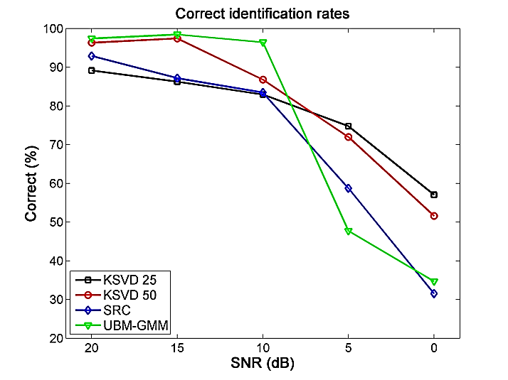
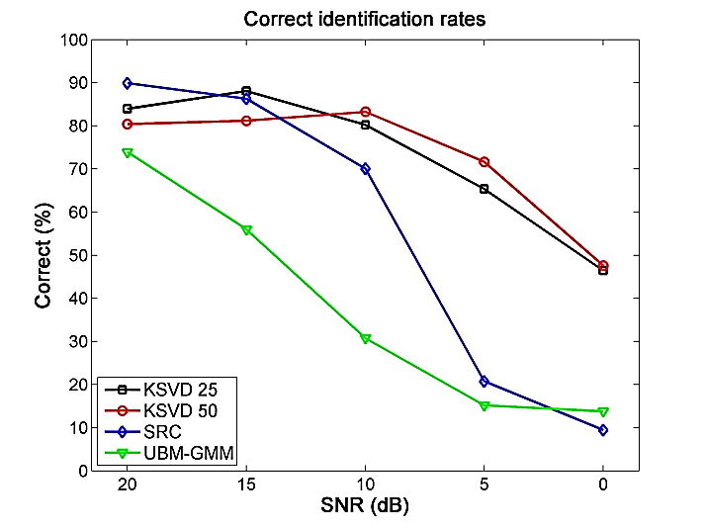
Experimental results
Correct identification rates (%)
white
speech babble
SNR (dB) | K-SVD 25 | K-SVD 50 | SRC | UBM-GMM
20 | 89.11 | 96.32 | 92.89 | 97.41
15 | 86.24 | 97.43 | 87.15 | 98.42
10 | 82.92 | 86.77 | 83.45 | 96.41
5 | 74.75 | 71.96 | 58.71 | 47.70
0 | 57.04 | 51.57 | 31.50 | 34.67
average | 78.01 | 80.81 | 70.74 | 74.92
SNR (dB) | K-SVD 25 | K-SVD 50 | SRC | UBM-GMM
20 | 83.95 | 80.41 | 89.88 | 73.90
15 | 88.05 | 81.18 | 86.28 | 55.99
10 | 80.23 | 83.25 | 70.06 | 30.76
5 | 65.33 | 71.62 | 20.76 | 15.16
0 | 46.43 | 47.55 | 9.46 | 13.77
average | 72.79 | 72.80 | 55.28 | 37.91
Notes:
KSVD-25 corresponds to the discriminative dictionary learning method where the estimated dictionary has a size of one quarter of the original
training data matrix size
KSVD-50 corresponds to the discriminative dictionary learning method where the estimated dictionary has a size of half of the original
training data matrix size

Slide 18
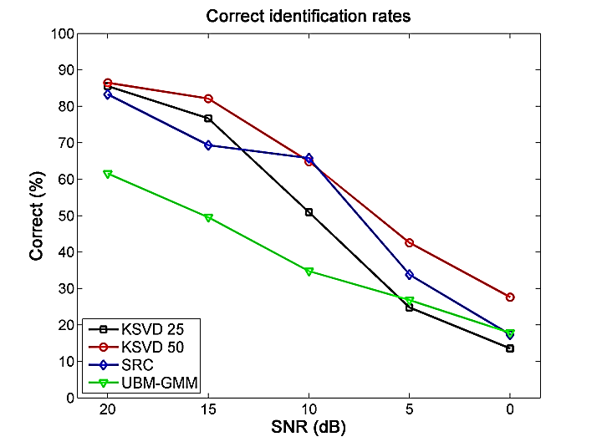
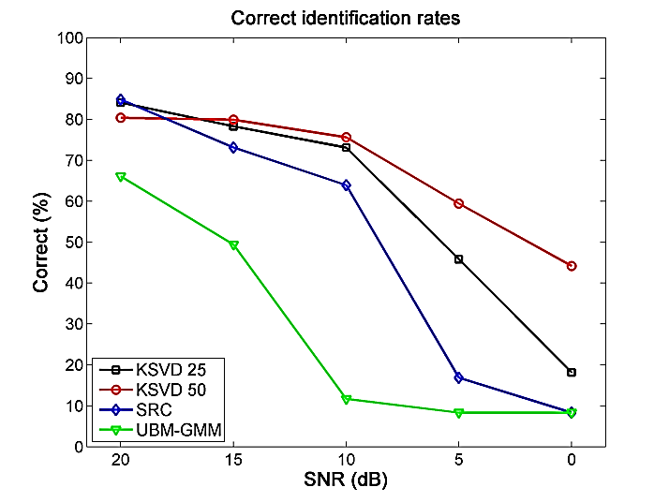
Experimental results
Correct identification rates (%)
car engine
factory floor
SNR (dB) | K-SVD 25 | K-SVD 50 | SRC | UBM-GMM
20 | 85.52 | 86.45 | 83.29 | 61.55
15 | 76.69 | 82.12 | 69.32 | 49.53
10 | 50.92 | 64.84 | 65.74 | 34.75
5 | 24.75 | 42.55 | 33.82 | 26.80
0 | 13.55 | 27.65 | 17.36 | 17.85
average | 50.28 | 60.72 | 53.90 | 38.09
SNR (dB) | K-SVD 25 | K-SVD 50 | SRC | UBM-GMM
20 | 84.10 | 80.39 | 84.84 | 66.09
15 | 78.32 | 79.92 | 73.16 | 49.39
10 | 73.10 | 75.64 | 63.92 | 11.69
5 | 45.83 | 59.41 | 16.87 | 8.34
0 | 18.12 | 44.18 | 8.33 | 8.33
average | 59.89 | 67.90 | 49.42 | 28.76

Slide 19
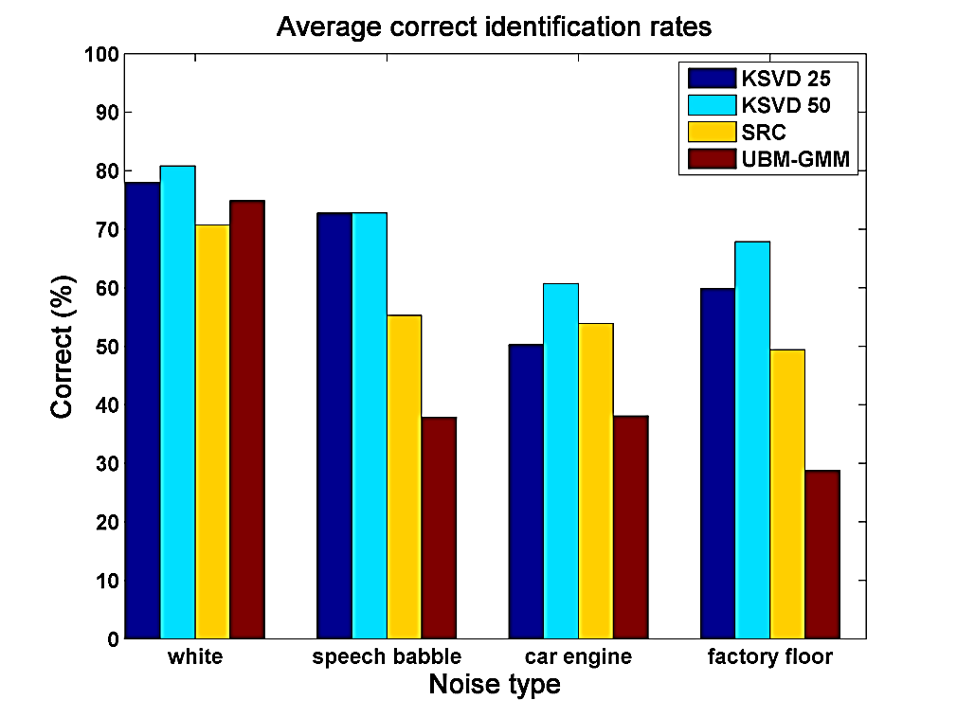
Experimental results
Average correct identification rates (%)
SRC at least 15% better vs. UBM-GMM for 3 noise types
KSVD better vs. SRC & UBM-GMM
KSVD-25 correct rates >=60% for 3 noise types
KSVD-50 correct rates >=70% for 3 noise types
KSVD-25 rates are similar to KSVD-50
Good results using small-size dictionary → important in real-time applications

Slide 20
Conclusions & Perspectives
Speaker identification using a discriminative dictionary learning approach
Text-independent, noise robust & short training data
Future perspectives
Apply on larger speech databases
Introduce non-linear classification error constraints
Examine discrimination performance of other types of features
Acknowledgements:
This work has been co-financed by the European Union (European Social Fund ESF) and Greek national funds through the Operational Program “Education and Lifelong Learning” of the National Strategic Reference Framework (NSRF) - Research Funding Program: Thalis-DISFER
Notes:
consider non-linear classifiers on the objective function of the KSVD approach:
linear classifiers may lead to poor performance on difficult classification tasks
incorporate (faster) dictionary learning algorithms targeted on speech signals
reduce time complexity produced by K-SVD

Slide 21

Thank you!

