Slide 1

IoT challenges: Sparsity at the rescue
Christos Tzagkarakis, Ph.D.

Slide 2

Agenda
Introduction
Motivation & Background
Data description
Sparse representation (SR)
Application of SR in IoT security

Slide 3










Introduction
Introduction
Internet-of-Things (IoT) has advanced the concept of Internet networking
Data
IoT
Users
Devices/Things

Slide 4

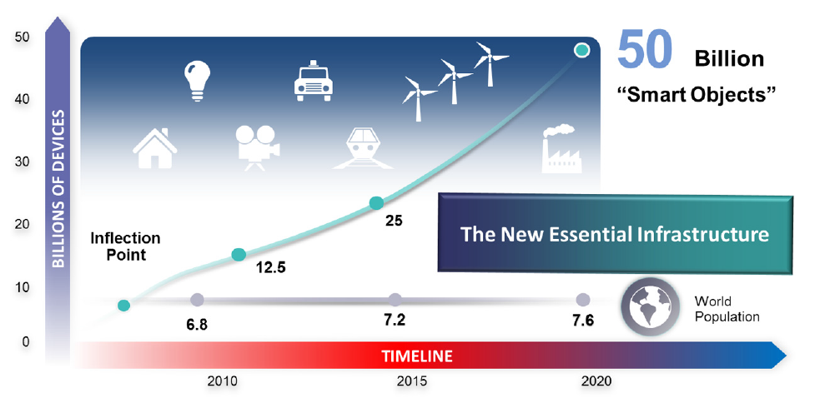
Motivation & Background
Introduction
IoT usage: exponential growth
Autonomous physical/digital objects augmented with sensing, processing and network capabilities
Vermesan and Friess (2014)

Slide 5



Introduction
Internet-of-Things (IoT) has advanced the concept of Internet networking
Smart home
Backend/Cloud
e-Health
Network
Wearables
Predictive maintenance
Edge
Automotive driving

Slide 6

Introduction
Introduction
Rapidly growing use and realization of IoT-based technology comes at the cost of resolving business and technical impediments
Dynamicity
Scalability
Heterogeneity
Security/privacy

Slide 7
Introduction
Introduction
Dynamicity

Slide 8

Introduction
Introduction
Dynamicity
IoT systems are dynamic, ever-evolving and often unpredictable environments
IoT infrastructures
IoT applications
Dynamically adaptive behavior at runtime
Semi-autonomic adaptation at all IoT layers

Slide 9
Introduction
Introduction
Scalability

Slide 10
Introduction
Introduction
Scalability
High scalability requirement
IoT network layer
IoT infrastructure
Efficient programmable connectivity
End-to-end optimizations
Seamless discovery of smart objects
Orchestration, event processing and analytics integration

Slide 11
Introduction
Introduction
Heterogeneity

Slide 12
Introduction
Introduction
Heterogeneity
Recognize and balance heterogeneous smart objects
Data interpretation
Heterogeneous IoT inter-platform connection

Slide 13
Introduction
Introduction
Security/privacy

Slide 14
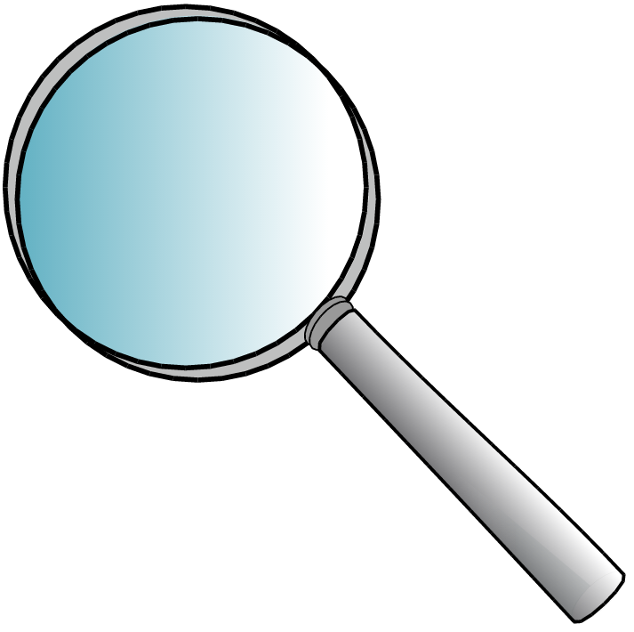
Introduction
Introduction
Security/privacy
Smart objects, IoT applications and platforms
vulnerable to security attacks
Massive personal data generation
Analyzing vulnerabilities
Selecting appropriate controls
End-to-end security & privacy preservation under dynamic conditions
Preserving security and privacy is challenging
Focus: efficient, robust and fast detection of botnet attacks at the IoT edge level

Slide 15

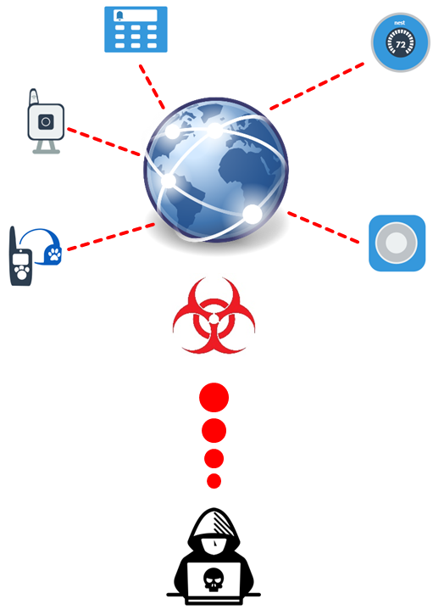
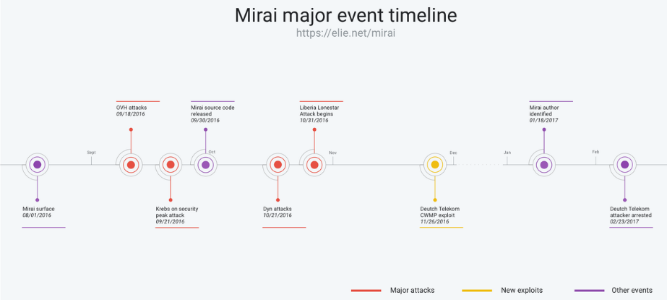
Motivation & Background
Motivation & Background
Security aspects of IoT devices are often neglected leading to exponential risk
2016 Mirai IoT botnet attack at the US east coast

Slide 16
Motivation & Background
Motivation & Background
IoT devices always active
Default use of IoT devices security credentials
Why IoT botnet attacks?
Rare monitoring of IoT devices
Low attacking cost

Slide 17


Motivation & Background
Motivation & Background
Develop diagnosis mechanisms when IoT bots begin launching attacks
Instant detection of IoT botnet attacks
and isolation of compromised IoT devices
Last line of defense security layer
IoT edge devices typically have limited
power, processing, memory capabilities
Employ fast detection on power constrained IoT devices based on small amount of IoT network traffic data to detect compromised IoT devices
IoT gateway might also have similar
technical constraints

Slide 18

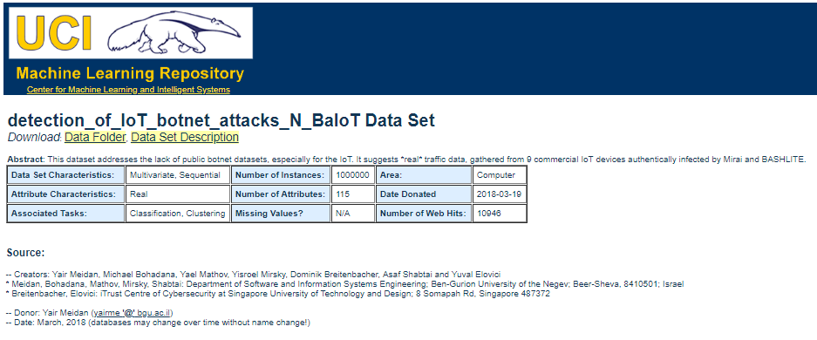
Data description
N-BaIoT dataset
Number of benign instances in UCI dataset
Device Make & Model | Device Type | Number of benign instances
Damnini | Doorbell | 40395
Ennio | Doorbell | 34692
Ecobee | Thermostat | 13111
Philips B120N/10 | Baby Monitor | 160137
Provision PT-737E | Security Camera | 55169
Provision PT-838 | Security Camera | 91555
SimpleHome XCS7-1002-WHT | Security Camera | 42784
Samsung SNH 1011 N | Webcam | 46817

Slide 19

Data description
Data pre-processing
Whenever a packets arrives, obtain a behavioral snapshot of the hosts and protocols that communicated the packet
Extract 23 temporal traffic statistics (features/instances) over a temporal window, summarizing the traffic that:
Value | Statistic | Aggregated by | Total number of features
Packet size (of outbound packets only) | mean, variance | source IP, source MAC-IP, channel, socket | 8
Packet count | number | source IP, source MAC-IP, channel, socket | 4
Packet jitter (the amount of time between packet arrivals) | mean, variance, number | channel | 3
Packet size (of both inbound and outbound together) | magnitude, radius, covariance, correlation coefficient | channel, socket | 8
100 ms
23 features
500 ms
23 features
1.5 sec
23 features
10 sec
23 features
60 sec
23 features

Slide 20
Data description
Data pre-processing
Whenever a packets arrives, obtain a behavioral snapshot of the hosts and protocols that communicated the packet
Extract 23 temporal traffic statistics (features/instances) over a temporal window, summarizing the traffic that:
Value | Statistic | Aggregated by | Total number of features
Packet size (of outbound packets only) | mean, variance | source IP, source MAC-IP, channel, socket | 8
Packet count | number | source IP, source MAC-IP, channel, socket | 4
Packet jitter (the amount of time between packet arrivals) | mean, variance, number | channel | 3
Packet size (of both inbound and outbound together) | magnitude, radius, covariance, correlation coefficient | channel, socket | 8
100 ms
23 features
500 ms
23 features
1.5 sec
23 features
115-dimensional instance
10 sec
23 features
60 sec
23 features

Slide 21




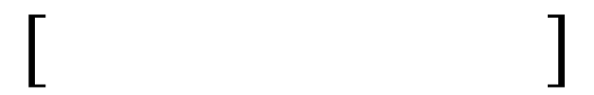






Sparse representation
Assume $S$ IoT devices
115-dimension
115-dimension
$$⋯$$
115-dimension
#n₁ instances of traffic data
#n₂ instances of traffic data
#n_{S} instances of traffic data
$$⋯$$
$$V_{1}$$
$$V_{S}$$
$$V_{1}$$
$$V_{2}$$
$$V_{2}$$
Instances corresponding to benign traffic behaviour

Slide 22

Sparse representation
Assume $S$ IoT devices
115-dimension
115-dimension
$$⋯$$
115-dimension
#n₁ instances of traffic data
#n₂ instances of traffic data
#n_{S} instances of traffic data
$$⋯$$
$$V_{1}$$
$$V_{S}$$
$$V_{1}$$
$$V_{2}$$
$$V_{2}$$
Assume an observed instance belonging to the first IoT device
Does the instance come from a compromised IoT device, or not?

Slide 23




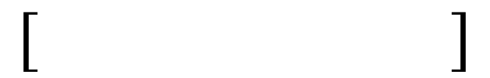

Sparse representation
Assume $S$ IoT devices
115-dimension
115-dimension
$$⋯$$
115-dimension
#n₁ instances of traffic data
#n₂ instances of traffic data
#n_{S} instances of traffic data
Assume an observed instance belonging to the first IoT device
$$⋯$$
IoT device 1
Does the instance come from a compromised IoT device, or not?
$$⋯$$
$$V_{1}$$
$$V_{S}$$
$$V_{1}$$
$$V_{2}$$
$$V_{2}$$

Slide 24
















Sparse representation
Assume $S$ IoT devices
115-dimension
115-dimension
$$⋯$$
115-dimension
#n₁ instances of traffic data
#n₂ instances of traffic data
#n_{S} instances of traffic data
$$⋯$$
$$=$$
$c_{1,1}∙$
$$+$$
$c_{1,2}∙$
$$+⋯+$$
${ c}_{1,n_{1}}∙$
$$V_{1}$$
$$V_{S}$$
$$V_{1}$$
$$V_{2}$$
$$V_{2}$$
$c_{1,1}v_{1,1}$
$$c_{1,2}v_{1,2}$$
$$+⋯+$$
$$c_{1,n_{1}}v_{1,n_{1}}$$
$$y=Vc=\left[V_{1}V_{2}⋯V_{S}\right]=\left[\begin{aligned}c_{1,1} \\ c_{1,2} \\ ⋮ \\ c_{1,n_{1}} \\ 0 \\ 0 \\ ⋮ \\ 0 \\ 0\end{aligned}\right]$$
Assume an observed instance belonging to the first IoT device
$$y=$$
$$+$$
$$= V_{1}c_{1}$$
Does the instance come from a compromised IoT device, or not?
$$⋯$$
$$∙c$$
sparse code
IoT device 1

Slide 25



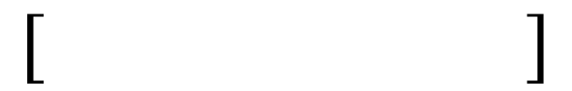


Sparse representation
Sparse code corresponding to a benign instance
Sparse code corresponding to a malicious instance
Time-Delay Embedding
Overall benign data matrix $V$
$$⋯$$
Observed instance $y$
Use the concept of reconstruction error to detect abnormality based on the sparse codes
Lightweight sparse optimization algorithm
sparsity threshold

Slide 26



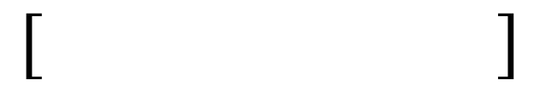
Decision threshold estimation
Sparse representation
Overall benign data matrix $V$
$$⋯$$
Observed instance $y$

Slide 27
Decision threshold estimation
Sparse representation
Critical hyper-parameter tuning: decision threshold $θ$
Fundamental assumption: we use only benign
IoT traffic data (no malicious training data)
Use proxy outliers: based on the computed sparse codes reconstruction errors

Slide 28



Decision threshold estimation
Sparse representation
Critical hyper-parameter tuning: decision threshold $θ$
Fundamental assumption: we use only benign
IoT traffic data (no malicious training data)
Use proxy outliers: based on the computed sparse codes reconstruction errors
$$\tilde{V}$$
matrix V with all
benign instances
$${\hat{c}}_{i}=\arg{\min_{c_{i}}}{\left\|y−\tilde{V}c_{i}\right\|}_{2},s.t.{\left\|c_{i}\right\|}_{0}≤τ$$
Reconstructed version
$$\hat{y}=\tilde{V}{\hat{c}}_{i}$$
RMSE error

Slide 29
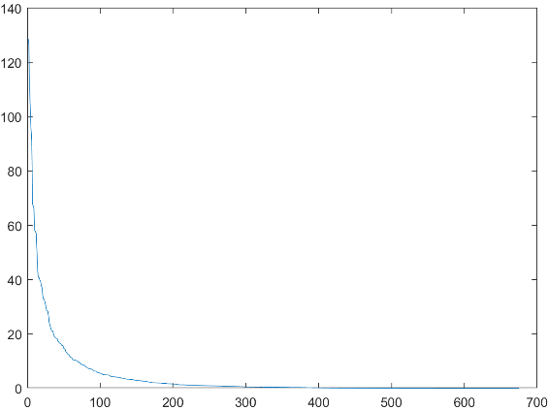
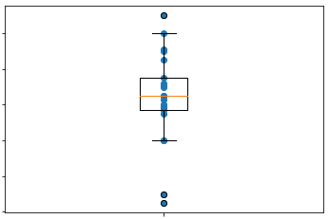

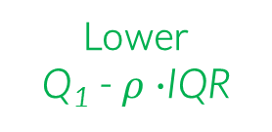
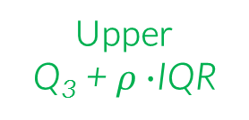
Decision threshold estimation
Sparse representation
Estimated RMS errors $\hat{e}$
Compute the lower quartile Q₁
Compute the upper quartile Q₃
Compute the inter-quartile range IQR= Q₃-Q₁
Rejection rate: percentage of instances that are within the non-extreme limits
Upper
Q₃ +$ρ∙$IQR
Interquantile range
IQR = Q₃ - Q₁
3rd Quartile
Median
1st Quartile
Lower
Q₁ -$ρ∙$IQR

Slide 30
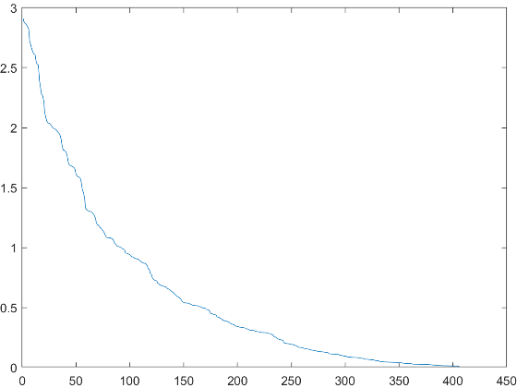



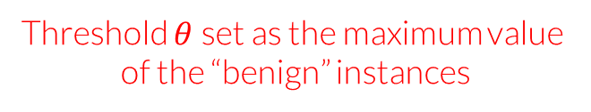
Decision threshold estimation
Sparse representation
Estimated RMS errors $\hat{e}$
Threshold $θ$set as the maximum value
of the “benign” instances
Compute the lower quartile Q₁
Compute the upper quartile Q₃
Compute the inter-quartile range IQR= Q₃-Q₁
Hyper-parameter tuning
Benign training data
$$V_{n}$$
$$V$$
All benign training data
Proxy outliers estimation
Malicious training data
$$V_{m}$$

Slide 31

Majority voting scheme
Sparse representation
Follow the sparse representation strategy for each temporal window
Use majority voting rule for the final decision
Ensemble learning scheme towards facing adverse assumed conditions
Short training/testing instances
sparse representation for each window separately
100 ms
window 1
23 instances
500 ms
window 2
23 instances
identify if each temporal window’s instance is malicious or benign
1.5 sec
window 3
23 instances
10 sec
window 4
23 instances
majority voting rule
for final decision
60 sec
window 5
23 instances

Slide 32


Evaluation
Detected
 | Malicious | Benign
Malicious | True Positive (TP) | False Negative (FN)
Benign | False Positive (FP) | True Negative (TN)
Actual
True positive rate (Sensitivity): TP/(TP+FN)
True negative rate (Specificity): TN/(TN+FP)
Positive predictive value (PPV): TP/(TP+FP)
F1-score: (2TP)/(2TP+FP+FN)
Accuracy (ACC): ((TP+TN)/(TP+TN+FP+FN))
Scan: scanning the network for vulnerable devices
Proposed sparse representation
Junk: sending spam data
COMBO: sending spam data and opening a connection to a specified IP address port
Autoencoder

Slide 33


Test case: BASHLITE botnet attack
Evaluation
Sparsity threshold
{5, 10, 15, 20, 30}
Number of autoencoder nodes
{5, 10, 15, 20, 30, 40, 50,}
3-fold cross validation
Rejection rate
{0.01, 0.5, 1, 2, 3}
Number of epochs
50
100, 300, 500 benign instances per IoT device
1600 total malicious instances from all IoT devices (200 instances per device)
Run the experiment multiple times: 10

Slide 34
Test case: BASHLITE botnet attack
Evaluation
3-fold cross validation
benign
validation
proxy/malicious instances
after IQR thresholding
benign
training
proxy/malicious
validation
benign instances after IQR thresholding
CV: iteration 1
matrix D_{t} with all
validation instances
Reconstructed version

Slide 35
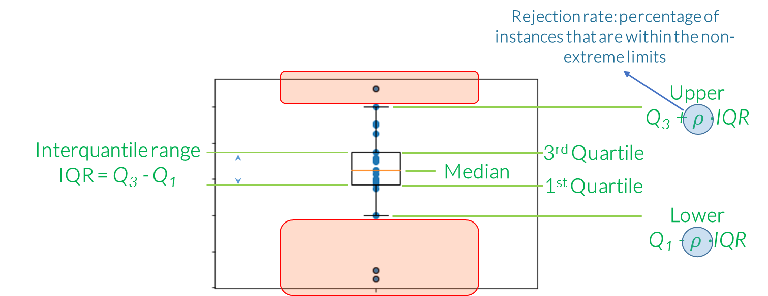
Test case: BASHLITE botnet attack
Evaluation
3-fold cross validation
CV: iteration 1
RMSE error

Slide 36
Test case: BASHLITE botnet attack
Evaluation
3-fold cross validation
benign
training
benign
validation
proxy/malicious
validation
CV: iteration 1
CV: iteration 2
CV: iteration 3

Slide 37
Test case: BASHLITE botnet attack
Evaluation
3-fold cross validation
benign
training
benign
validation
proxy/malicious
validation
CV: iteration 1
Find the combination of
hyper-parameters providing the best average geometric mean
CV: iteration 2
CV: iteration 3

Slide 38


Test case: BASHLITE botnet attack
Evaluation
Statistical significance: leave-one-out-cross-validation (LOOCV)
Select randomly 200 malicious instances from each IoT device
malicious instances
Select randomly 300 benign instances for hyper-parameter tuning from S-1 IoT devices
malicious instances
$$…$$
$$…$$
Select randomly 300 benign instances for testing from the S-th IoT device
malicious instances

Slide 39
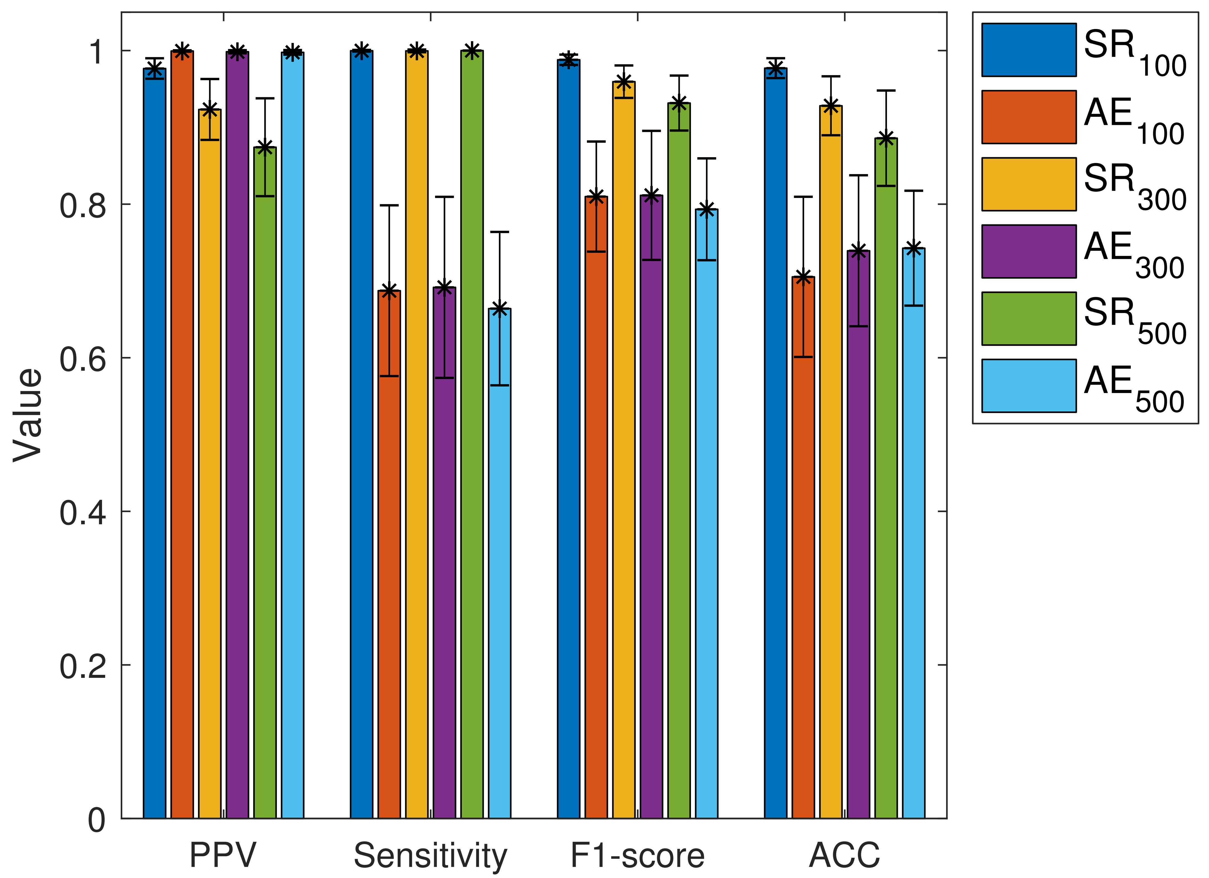
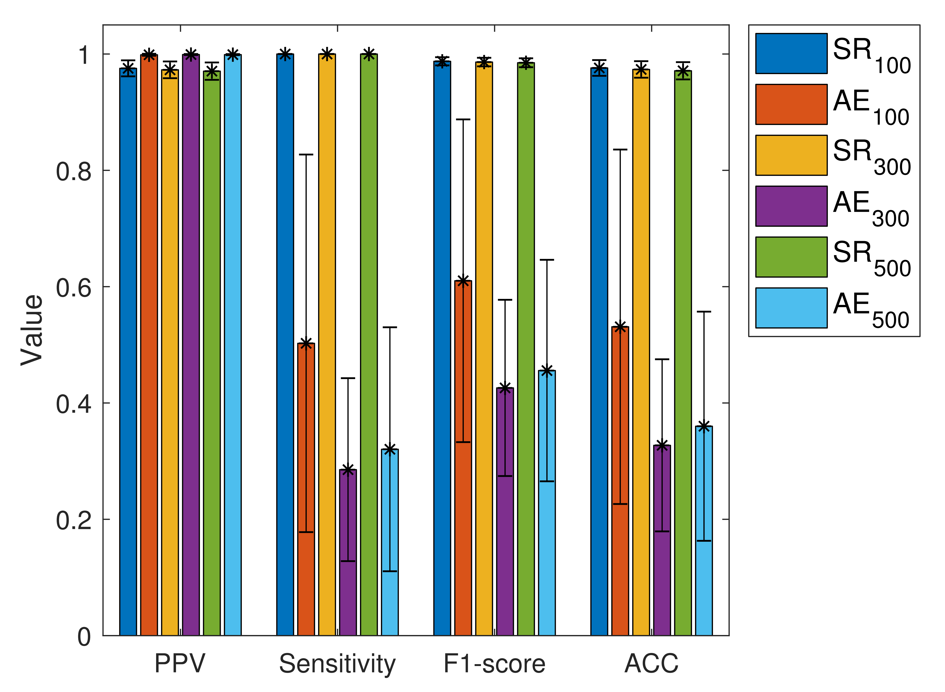
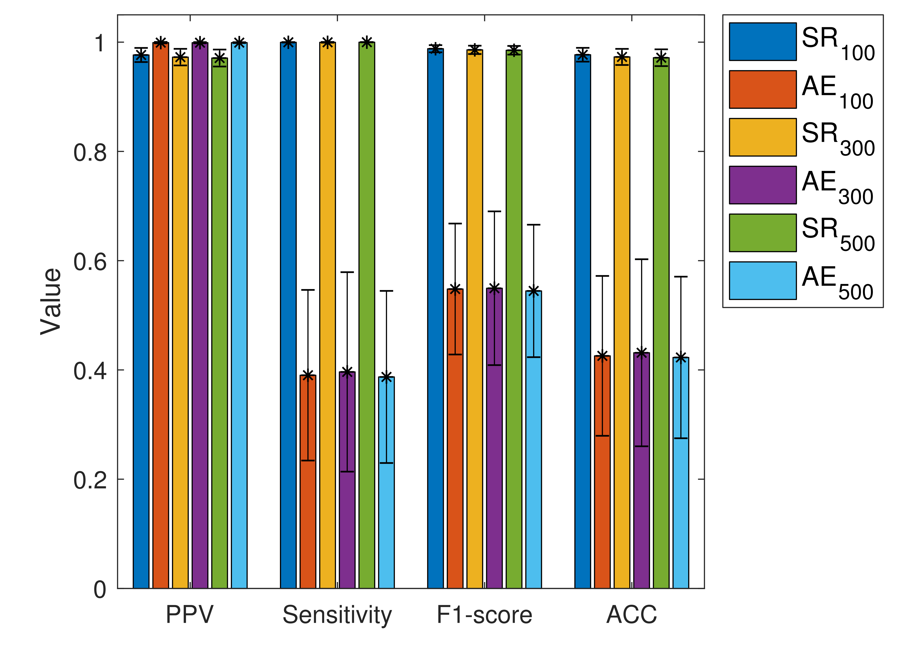
Test case: BASHLITE botnet attack
Evaluation
COMBO
Junk
Scan

Slide 40
Conclusions
Examine the efficiency of the proposed approach on more IoT botnet attack datasets and scenarios
Time series classification
Perform thorough comparisons in terms of detection accuracy and time complexity with additional lightweight IoT botnet attack detection methods
Reveal meaningful training benign instances via dictionary learning
Joint sparse representation and informative benign instances selection

Slide 41


