Slide 1

Academic Session 2026-27
ODD Semester July-Dec 2026
UNIVERSITY INSTITUTE OF ENGINEERING AND TECHNOLOGY
Department of TT
Bachelor of Engineering (B.E.) – CSE
Advanced Data Structures / Semester 3
(CS221)
Unit No. 1 Chapter No. 1.1 Lecture No. 1
Topic : Concept of Data and Information
Abhishek Thakur (E19789) Technical Trainer
Sourav Jaiswal (E19756)-MSC Technical Trainer

Slide 2
Learning Objectives
Understand the difference between data and information.
Identify real-world examples of data and information.
Explain how raw data is transformed into meaningful information.

Slide 3
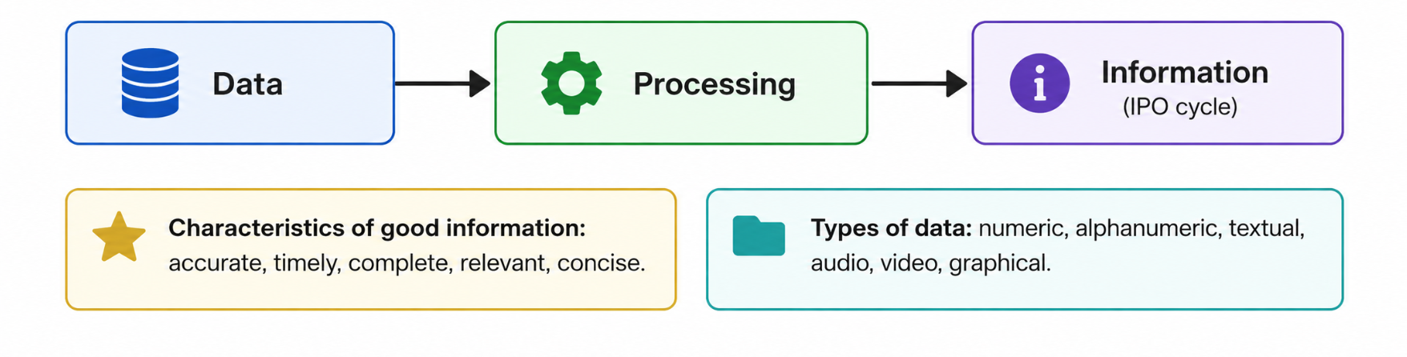
Data vs. Information
Data: Raw, unprocessed facts (numbers, characters, symbols) with no context.
Information: Processed data that is meaningful, organised, and useful for decision-making.
Example: '98', '65', '72' are data; 'Average score = 78%' is information.

Slide 4
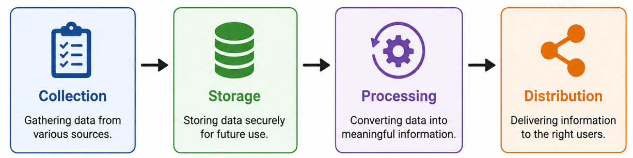
Types & Characteristics
Numeric data: integers, real numbers used in calculations.
Alphanumeric data: combinations of letters and digits (e.g., roll numbers).
Qualitative vs. Quantitative data – key distinctions.
Information quality attributes: accuracy, timeliness, completeness, relevance.

Slide 5
Qualitative vs. Quantitative data
Feature | Qualitative Data | Quantitative Data
Definition | Descriptive, non-numerical data | Numerical data that can be measured
Nature | Subjective | Objective
Type of Values | Words, labels, categories | Numbers, counts, measurements
Examples | Color, gender, opinions, feedback | Age, height, marks, salary
Data Type | Categorical | Numerical (Discrete / Continuous)
Analysis Method | Thematic analysis, grouping | Statistical analysis, calculations
Representation | Charts, graphs, text descriptions | Graphs, histograms, bar charts
Purpose | Understand qualities or characteristics | Measure quantity or amount
Collection Methods | Interviews, observations, surveys (open-ended) | Experiments, surveys (close-ended), sensors
Accuracy | Less precise | More precise

Slide 6

Applications of the Topic
Databases store raw data; DBMS converts it to useful information.
Healthcare: patient vitals (data) → medical reports (information).
E-commerce: click logs (data) → purchase recommendations (information).

Slide 7

Applications of the Topic
In stock market Investors combine quantitative data (price, volume) with qualitative data (news, sentiment).
This helps in:
Predicting stock trends.
Making Buy/Sell decisions
Risk Assessments
Portfolio Management

Slide 8
Summary of the Lecture
Data is raw, unprocessed facts; information is processed and meaningful.
The IPO cycle transforms data into information through processing.
Quality of information depends on accuracy, timeliness, and relevance.

Slide 9

Next Lecture
Introduction to Data Structures – definition, need, and classification.

Slide 10
Quiz/ FAQ’s
Q1. What is the difference between data and information? Give an example.
Q2. List any four characteristics of good information.
Q3. In which step of the IPO cycle is raw data converted to information?

Slide 11
References/ Articles/ Videos
Seymour Lipschutz, 'Data Structures', Schaum's Outlines, McGraw-Hill.
Reema Thareja, 'Data Structures Using C', Oxford University Press, 2nd Ed.
GeeksforGeeks – Data vs. Information: https://www.geeksforgeeks.org/data-vs-information/

Slide 12
Thank You
For queries
Email: abhishek.e19789@cumail.in

