Slide 1
HPSC Community Project
Ali Tariq

Slide 2
What is serverless?
Cloud service
Cloud Service providers – (business trend)
Renting out physical machines!
Virtual Machines
Containers
Resource multiplexing!
serverless!
Serverless
Write code
Deploy code
You are done!
Why serverless?
No scale-up issues
No need for over-provisioning
Pay what you use!

Slide 3
Serverless framework
Containers or VirtualMachines
Cold Starts
Stateless Functions
Can not maintain state
Can not be addressed at runtime
Limited running times
Hard limit on running-time
Industry offerings
AWS Lambda
Google Cloud Functions
IBM Cloud Functions
Azure Function Apps
Apache OpenWhisk

Slide 4

Apache OpenWhisk
Started by the folks at IBM
This project started in 2016
# of contributors: 224
Built on top of other open-source projects
Nginx
Kafka
CouchDB
Docker
Deployments
Docker-compose
Kube-deploy
Vagrant
Mac/Ubuntu Servers

Slide 5
Apache OpenWhisk
Only one release (incubating)!
Fall 2018
First stable release planned for this fall
# of commits for far: 2.6k
Want to contribute?
Sign ICLA
Introduce yourself to the community (Slack, mailing list)
Pick an issue & let the project members know you are working on it!
Issue can’t be assigned to people not part of the project
The project maintains a Confluence Wiki site
share thoughts & design proposals
Events & tech talks (mailing list)
Recent Achievements
the team behind the framework raised VC funding to ensure the project continues to grow (2017)
became an Apache Software Foundation (ASF) Top-Level-Project (July, 2019)

Slide 6
Contribution
Issue:
better error message for unsupported kind #4616
Easy first issue!
Took only 10-20 minutes to fix!
20+ hours! For merge …
Had to rewrite a test-case
Took in some proposed structural changes
looking for a more meaningful contribution after this!

Slide 7
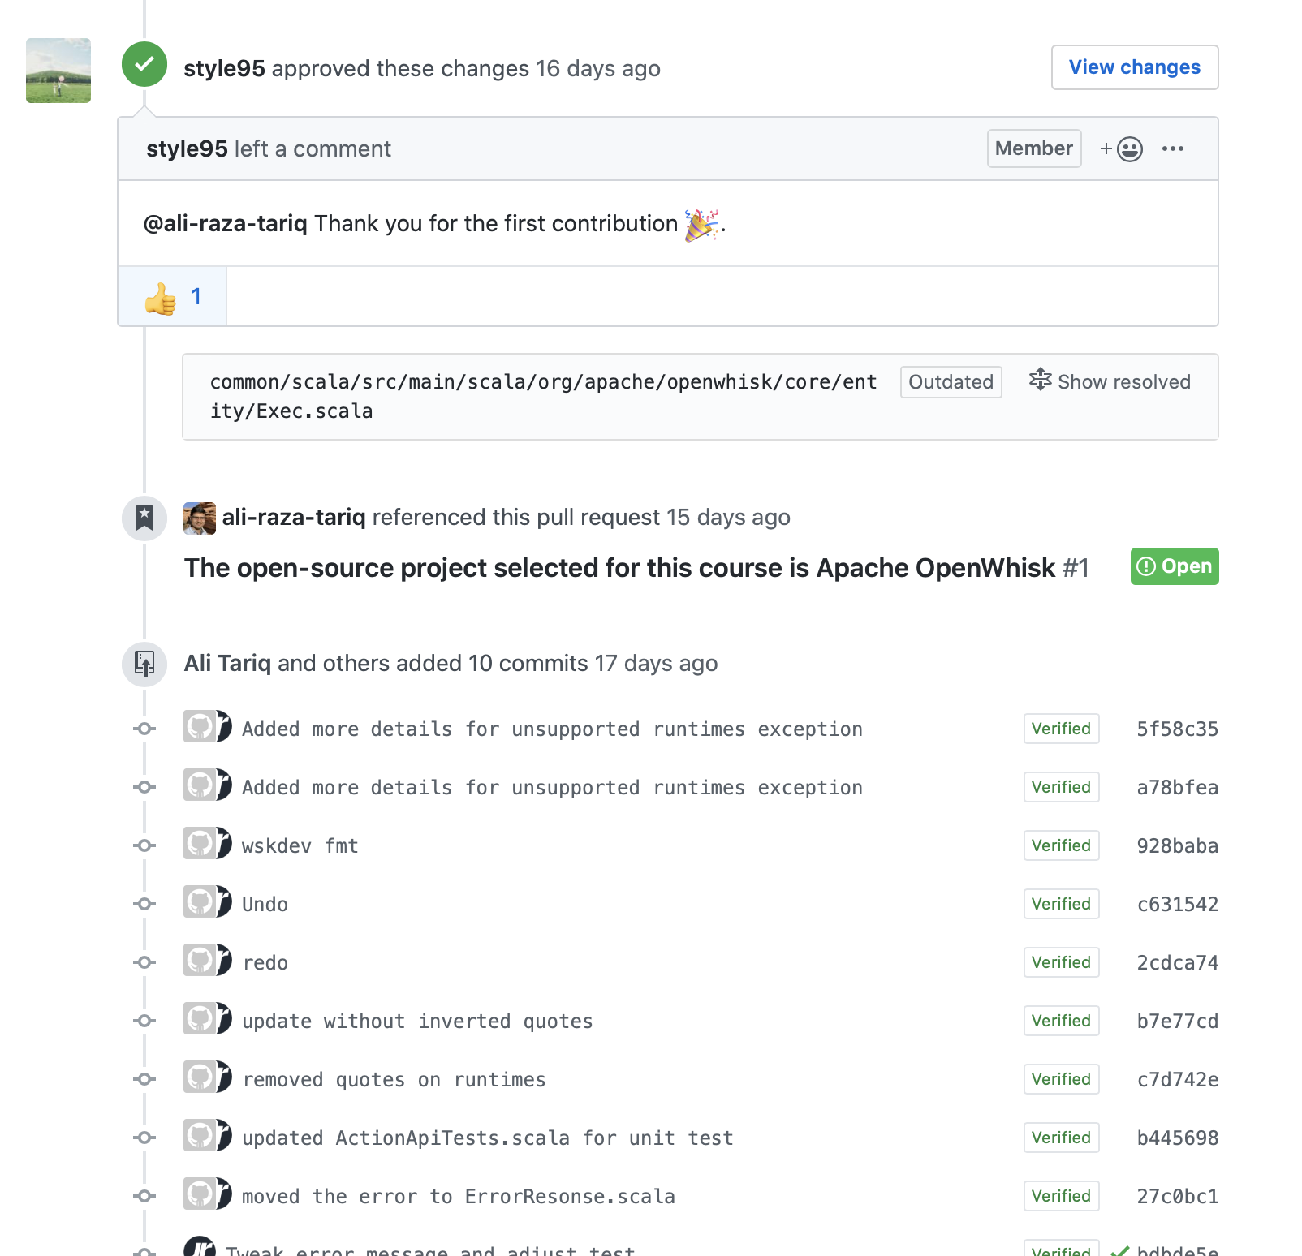
must say … felt good!

