Slide 1
Introduction to XML
2017-03-08

Slide 2
Text Encoding
“Markup”
Adds structure, commentary, and instructions to base electronic text
Delineates and names objects of interest in electronic text
Markup Languages: GML, SGML, COCOA, HTML, XML, LMNL

Slide 3
Types of Markup
Procedural vs. Descriptive
  {\rtf \li720 \fi-720 \sl480 \slmult1 \sa0 Bauman, Syd. \uc0\u8220{}Interchange Vs. Interoperability.\uc0\u8221{} \i Proceedings of Balisage: The Markup Conference 2011\i0{}. Montr\uc0\u233{}al, Canada, 2011. Web. 22 Sept 2011.\
  <reference><author>Bauman, Syd</author><title>Interchange Vs. Interoperability<title><journal>Proceedings of Balisage: The Markup Conference 2011</journal><location>Montréal, Canada</location><year>2011</year></reference>
“Indicative” vs. “Imperative”; “Proleptic” vs. “Metaleptic”; “Prospective” vs. “Retrospective”

Slide 4
XML
  E(X)tensible (M)arkup (L)anguage
  A set of rules for encoding electronic text
  Simplified SGML
  Standard
    Published and maintained by World Wide Web Consortium (W3C)
  Open
  Non-proprietary
  Platform independent
  Non-binary
  Descriptive Markup

Slide 5
Data Model
  Ordered Hierarchy of Content Objects (OHCO)
  Document
  String
  Sequence of Nodes
  Tree
  Directed Acyclic Graph
  Mixed Content

Slide 6
XML: Elements
<LINE>Now is the winter of our discontent</LINE>
  Delineates and labels segments of text
  Start-tag and end tag
  Element name
  May contain letters, numbers or other characters
  No spaces or colons
  May not start with a number
  May contain other text or other elements...
  <LINE><WORD>Now</WORD> <WORD>is</WORD> <WORD>the</WORD> <WORD>winter</WORD> <WORD>of</WORD> <WORD>our</WORD> <WORD>discontent</WORD></LINE>
  Order is significant
  ...or may be "empty“
  <SPEECH>Now is the winter of our discontent<LB/>Made glorious summer by this sun of York;...</SPEECH>

Slide 7
XML: Attributes
  <LINE n="1" trans-de="Jetzt ist der Winter unserer Unzufriedenheit">Now is the winter of our discontent</LINE>
  Additional information associated with elements
  Attribute name ("n")
  letters, numbers, or other characters
  no spaces
  must begin with a letter, underscore, or colon
  Attribute value ("1") ;in quotes (either single or double)
  Order is not significant
  May not contain elements
  <LINE n="1" trans-de="Jetzt ist der Winter unserer Unzufriedenheit”>Now is the winter of our discontent</LINE>

Slide 8
XML: Document Structure
  "Well-formedness"
  Single "tree" with one "root" element
  No "overlap"
  <name><fr>Cafe <eng>Starbucks</fr> Coffee</eng></name>
<poem>
<line n="1">so much depends</line>
<line n="2">upon a red wheel</line>
<line n="3">barrow glazed with rain</line>
<line n="4">water</line>
<line n="5">beside the white</line>
<line n="6">chickens.</line>
</poem>

Slide 9
XML: Character encoding + Entities
  Use Unicode, but if you don't...
  Character entities
    represent characters using special notation
    ampersand + name or unicode code point + semicolon
    &#160;, &nbsp;
    Predefined character entities
      &lt; (<)
      &gt; (>)
      &amp; (&)
      &apos; (')
      &quot; (")
  Entities can be defined to stand in for other stuff
  Chunks of code or text or external files

Slide 10
XML: Other stuff
  Comments
    Escaped sections of document
    <!-- ... -->
  <LINE>Now is the winter<!– should this be capitalized? --> of our discontent</LINE>
    May not contain "--"
  Processing Instructions
    Escaped sections of documents intended for processing applications
    "<?" + [PI Name] + [PI data] + "?>“
    <?xml-stylesheet type="text/xsl" href="show.xsl"?>

Slide 11
XML: Schema Languages
  Formal definition of elements, attributes, and structure of a class of document
  Enables validation
  Document Type Definition (DTD)
    Original language
    "Document oriented"
    Weak datatyping
    Wide user-base, esp. Publishing Industry, Government
<!ELEMENT poem (l)+>
<!ATTLIST poem>
<!ELEMENT line (#PCDATA)>
<!ATTLIST line
n CDATA #REQUIRED>

Slide 12
XML: Schema Languages, con't
  World Wide Web Consortium XML Schema (W3C XSD)
    XML based
    Heavy duty, complex, highly expressive
    Datatypes; "data-centric"
    Wide user base; Industry
  RelaxNG
    XML and own "compact" syntax
    Highly expressive and elegant
    Uses W3C XML schema datatypes
  Schematron
    XML-based
    Rules checking
    Extremely expressive, simple, elegant

Slide 13
XML: Namespaces
  Use elements from multiple schemas in same document
  Prevents collisions between elements from different schemas
  think of as "family names" for elements
  <mods:title xmlns:mods="http://www.loc.gov/mods/v3">Great Expectations</mods:title>
  Components:
    Namespace URI: "http://www.loc.gov/mods/v3"
    Namespace Prefix: "mods"
    Local Name: "title"
    Qualified Name: mods:title
  Useful, but complicated and difficult to manage and process

Slide 14
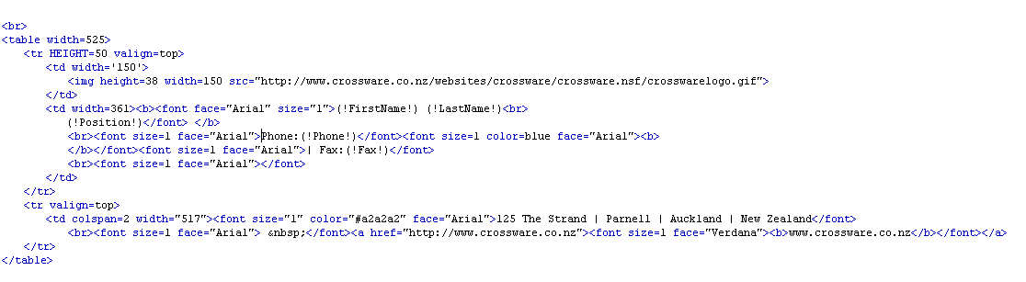
Types of XML
HTML

Slide 15
Types of XML
<?xml version="1.0" encoding="UTF-8"?>
</mods>
<mods xmlns:xlink="http://www.w3.org/1999/xlink" version="3.0"
xmlns:xsi="http://www.w3.org/2001/XMLSchema-instance" xmlns="http://www.loc.gov/mods/v3">
<titleInfo>
<nonSort>The</nonSort>
<title>Urban Question as a Scale Question</title>
<subTitle>Reflections on Henri Lefebre, Urban Theory and the Politics of Scale</subTitle>
</titleInfo>
<name type="personal">
<namePart type="given">Neil</namePart>
<namePart type="family">Brenner</namePart>
<role>
<roleTerm type="text">author</roleTerm>
</role>
</name>
<typeOfResource>text</typeOfResource>
<genre>article</genre>
<originInfo>
<issuance>monographic</issuance>
</originInfo>
<relatedItem type="host">
<titleInfo>
<title>International Journal of Urban and Regional Research</title>
</titleInfo>
<originInfo>
<issuance>continuing</issuance>
</originInfo>
<part>
<detail type="volume">
<number>24</number>
</detail>
<detail type="issue">
<number>2</number>
<caption>no.</caption>
</detail>
<extent unit="pages">
<start>361</start>
<end>378</end>
</extent>
<date>2000</date>
</part>
</relatedItem>
<identifier>BrennerN2000a</identifier>
MODS

Slide 16
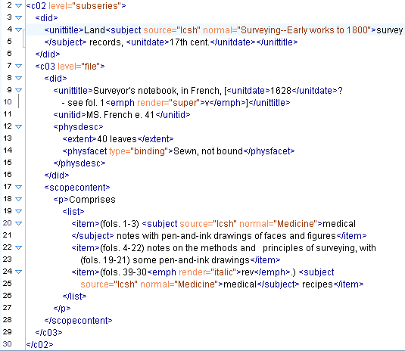
Types of XML
EAD

Slide 17
TEI
  Text Encoding Initiative
  TEI Consortium: www.tei-c.org
  Guidelines for Electronic Text Encoding and Interchange
  http://www.tei-c.org/release/doc/tei-p5-doc/en/html/index-toc.html
  Now in Proposal 5 (“P5”) 2007
  “define and document a markup language for representing the structural, renditional, and conceptual features of texts… [the] guidelines are expressed as a modular, extensible XML schema, accompanied by detailed documentation, and are published under an open-source license.”
Multiple “tagsets”; intended to be customized
  TEI-Lite
  Epidoc
Roma: tool for creating new customizations
  http://www.tei-c.org/Roma/
Tools
  OxGarage: conversions http://www.tei-c.org/oxgarage/
  Stylesheets: rendition in HTML and PDF http://www.tei-c.org/Tools/Stylesheets/

Slide 18
TEI
TEI
<div type="chapter">
<head>Chapter 1: The Manor House</head>
<p><name type="person">Charles</name> hadn’t visited the manor
house since <date when="1955-04-10">Easter, 1955</date>,
and now he remembered why.</p>
<p>“Hullo”, he called out as he walked up the drive, and
then, as if to himself, “To be or not to be?, to walk or
not to walk...oh, <emph>hang</emph> it all!” His meditation on Hamlet was interrupted as he collided with a peacock. “Sacré bleu!”
he exclaimed with irritation, his sang-froid
completely deserting him. It was going to be a long
week. His catalog of irritations included:
<list>
<item>1. The weather</item>
<item>2. The peacocks</item>
<item>3. His meagre grasp of French</item>
</list>
</p>
</div>

Slide 19
Tools for Creating XML
  Notepad
  NoteTab Pro
  oXygen
  XMLSpy
  Macros
  Export from Spreadsheets, Databases

