Slide 1
Binary Files and File Format
Varsha G. Maragi

Slide 2
ASCII vs Binary Files
ASCII files are the text files
Each character is ASCII coded
Binary files are a stream of 0’s and 1’s grouped as bytes.
ASCII files are special kinds of binary files
They are 7-bit encoding stored in a byte

Slide 3
Table of ASCII code

Slide 4
Text Editors
Provide an abstraction to the process of encoding
New line character represents the end of the line
End of file-Some editors force you to end with new line or they themselves append it.

Slide 5
Why use binary at all?
When you type in a character it is represented as an ASCII code.
Ex: 100000-consumes 6 bytes.
However binary is 4 bytes
Binary is more compact
For image,video or audio(any digital file) this is important.

Slide 6
Read and Write to binary file
Write to binary file
int x = 123;
ofstream outfile;
outfile.open(“abc.dat", ios::binary | ios::out);
outfile.write(&x, sizeof(int));
Read from binary file
int x; ifstream infile; infile.open(“xyz.dat", ios::binary | ios::in) infile.read(&x, 7);

Slide 7
File format
Various file format(JPEG,TIFF,PDF)
Determines how information is encoded.
File header-Contains metadata about the file(Ex: Image file-format,size,resolution)
TIFF-Tagged Image File Format (images)

Slide 8
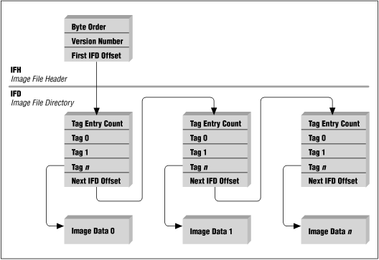
TIFF

