Slide 1
Indexing Ingredients:
Using Ingredients to Navigate Making
Jennifer Kaplan
Chris Klippenstein
Matthew Kumar
Vera Senina

Slide 2
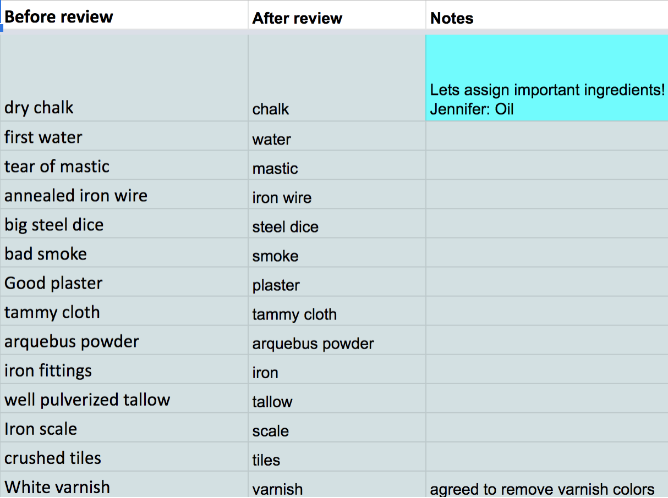
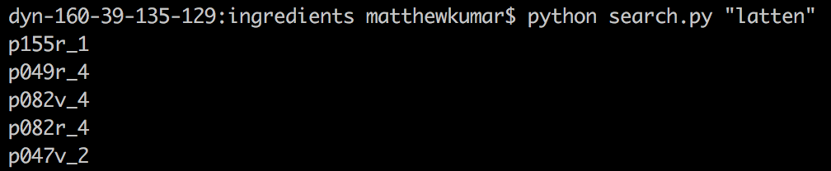
Digital Text Analysis
Locate borders between recipes
Locate the space between material tags
Organize and store data
Material Transformation List
Compiled by Chris, Vera, and Jennifer
Necessary changes for consistency in ingredients
Code automatically updates with the document
Notes:
Pretty early on we decided we wanted to investigate the ingredients, originally we wanted to find ‘material pipelines’ or (explain). This would be difficult without a computer since, the tagged recipes are all in one large barely-readable document, and some have some weird terms. This would be a lot easier if wad individual recipes in separate files, and none of the visual clutter of tags.
To do this we took the entire XML document, and separated it at each tag that marked the beginning or end of a recipe, and saved that as an individual file, still with the XML tags. From there, it was easy to remove everything except the ingredients and the title of the recipe.
In the last stage of file writing, we deal with the the problem of strange terms. Chris, Vera, and Jennifer made this list, so that whenever something appears in the left column, it gets replaced with the term in the right column. If this needs to be changed or updated, you can just change the downloaded list instead of any code.
The first algorithm we wrote is the search function, which takes in an ingredient, and returns the recipes it’s found in.

Slide 3
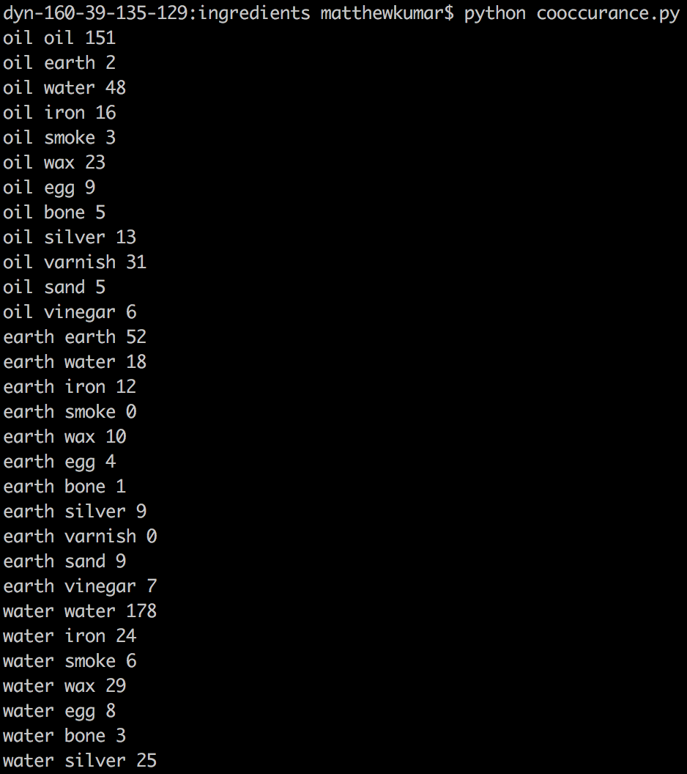
Digital Text Analysis
Search:
Read user input settings
Iterate through recipes and save the ones that contain the search term
Search through ingredients, results, or both
Open files with or without XML tags
Count the number of results
Find co-occurrences
Use same file structure as search.py
Could be implemented with search.py
Notes:
Several more settings were added to search, such as specifying whether or not you wanted ingredients or results, to open the files with or without tags, or to count the number of results.
The second step was finding co-occurrences of terms. This alg used the same files that we made for search, but instead checked for two terms. This could have been implemented by using the exact same search function, but I chose to copy and rewrite similar code.
Finally, we can choose terms, or view a list of terms that was typed in. We used the co-occurrences of terms to investigate how they interacted.

Slide 4
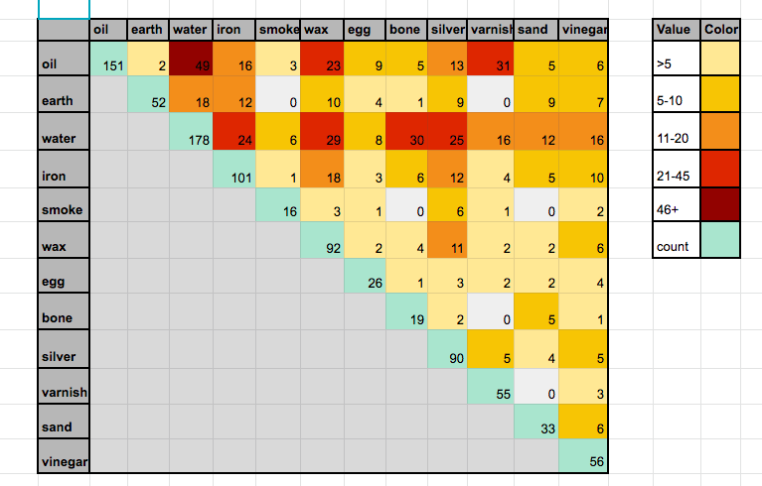
I46+ ngredient co-occurrence graph

Slide 5
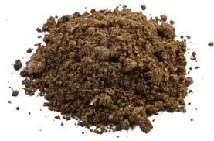

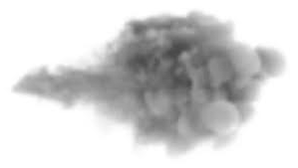
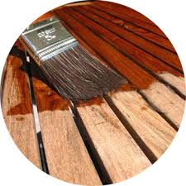
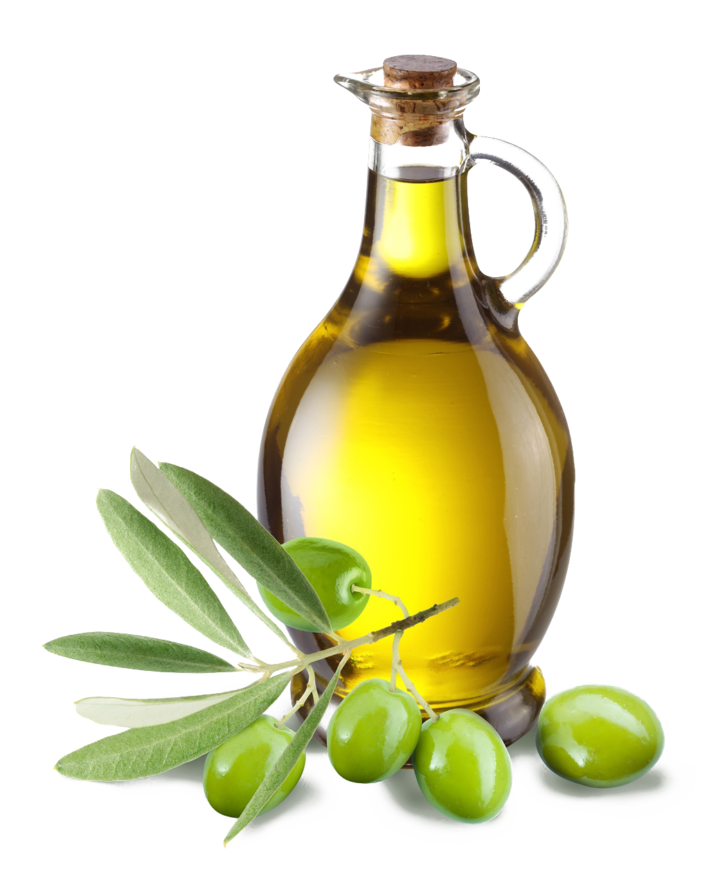
Ingredient Profiles
Frequency of Overall Ingredient
Types
Frequency of Each Type
Ingredient Research
Spotlighted Ingredients:
Earth
Egg
Oil
Smoke
Varnish

Slide 6
Ingredient Profiles
Example Profile: Oil
Frequency of Overall Ingredient
As Ingredient:168 ; As Outcome:19
Types
Oil of sulfur
Turpentine oil
Fatty oil
Oil
White turpentine oil
Walnut oil
Antimony Oil
Black oil
Common oil
Egg oil
Lavender Spike Oil
Linseed oil
Oil of Jacob
Oil panel
Oil varnish
Tartar oil
Wax oil
Wheat oil
White soporific oil
White oil
Ingredient Research
Lavender Spike Oil: Specific type of lavender that grows in Mediterranean
Oil of Jacob: Refers to Genesis 28:18, where Jacob pours oil; likely Olive Oil
Results:
Able to infer location

