Slide 1
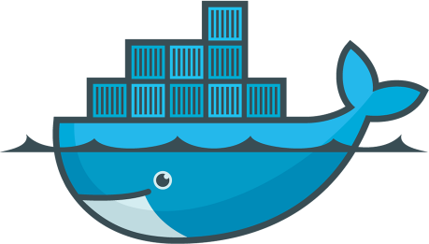
DOCKER
ADVANCES IN DATA SCIENCES
Vasanti Mahajan
Nehal Bhanushali
Pranjal Jain
Github Link: https://github.com/jainpranj/docker-datascience
Under the guidance of Professor Srikanth Krishnamurthy

Slide 2
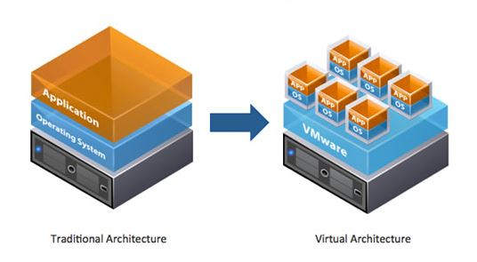
VIRTUALIZATION
Virtualization is a framework or methodology of dividing the resources of a computer into multiple execution environments
The virtual resources are created to simulate underlying physical hardware, enabling multiple applications to run concurrently in their own virtual OS
There are different types of virtualizations like Hardware Virtualization, Software Virtualization, OS Virtualization, Network Virtualization
We would be focusing on OS Virtualization

Slide 3
OS Virtualization
Operating-system-level virtualization is a server virtualization method in which the kernel of an operating system allows the existence of multiple isolated user-space instances, instead of just one
These instances are called containers, virtualized engines or jails
Examples include Windows Workstations, Solaris containers, Parallels Virtuozzo, Docker Containers
Containers have the following features:
Namespace isolation
Host’s resource sharing

Slide 4
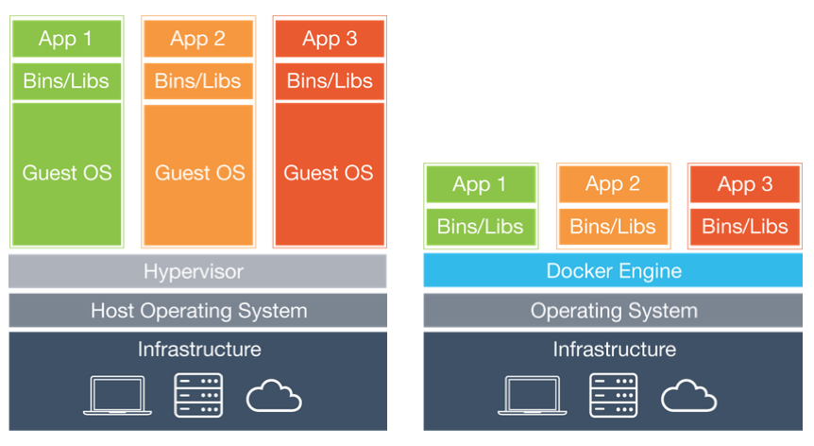
VM vs CONTAINERS
VM’s have their own copies of OS files libraries and application code along with full memory instance of an OS. Starting a new VM requires booting another instance of the OS because of which each application on the VM pays the cost of OS boot and in-memory footprint for its own private copy
Containers share the operating system including the kernel and libraries, so they do not need to boot an OS, load libraries or pay private memory cost for those files

Slide 5
DOCKER
Docker is a tool that can package any application and its dependencies in a virtual container than can run on any Linux Server (and any Microsoft Windows 10 Server), on premise, on the private or public cloud, bare metal or not, with little to no overhead
With Docker, we can download an image file that contains a set of packages and data science tools. We can then boot up a data science environment using this image within seconds, without the need to manually install packages or wait around. This environment is called a Docker container

Slide 6
DOCKER WORKFLOW
Get your code and its dependencies into Docker containers. This can be done in the following ways:
Write a Dockerfile that defines the execution environment and pulls in your code
Pull an already existing image from Docker Hub
Configure networking and storage for your solution, if needed
Upload builds to a registry or your cloud providers to collaborate with your team
Deploy to your preferred cloud providers with Docker Cloud, or use Docker Datacenter to deploy to your own on-premise hardware

Slide 7
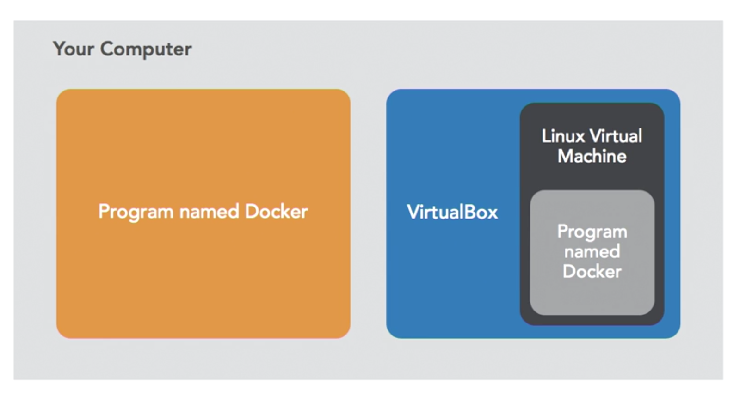
DOCKER TOOLBOX SETUP
Install Docker Toolbox from https://www.docker.com/products/docker-toolbox
Docker Toolbox will install a program called Docker and VirtualBox for managing virtual machines
It will install a program called Docker Machine, and Docker Machine manages a Linux Virtual Machine on your computer
First run Docker Quickstart Terminal to start Docker machine

Slide 8
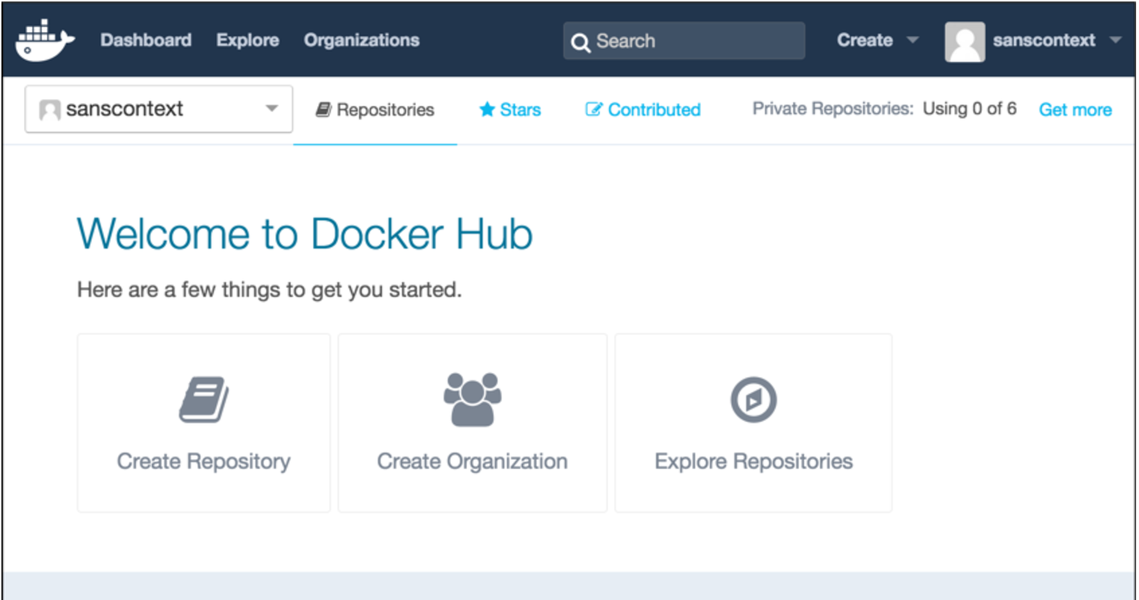
DOCKERHUB
Docker Hub is a cloud-based registry service which allows you to link to code repositories, build your images and test them, stores manually pushed images, and links to Docker Cloud so you can deploy images to your hosts. It provides a centralized resource for container image discovery, distribution and change management, user and team collaboration, and workflow automation throughout the development pipeline.

Slide 9
DOCKERHUB
Docker Hub provides the following features:
Image Repositories: Find and pull images from community and official libraries, and manage, push to, and pull from private image libraries to which you have access.
Automated Builds: Automatically create new images when you make changes to a source code repository.
Webhooks: A feature of Automated Builds, Webhooks let you trigger actions after a successful push to a repository.
Organizations: Create work groups to manage access to image repositories.
GitHub and Bitbucket Integration: Add the Hub and your Docker Images to your current workflows

Slide 10
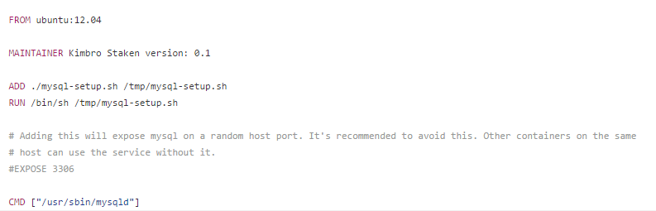
DOCKERFILE
Docker can build images automatically by reading the instruction from a Dockerfile. Dockerfile is a text document that contains all the commands a user could call on the command line to assemble an image.
Sample example of Dockerfile to build mysql server

Slide 11
ANACONDA AND DOCKER TOGETHER
Whether you’re a developer, data scientist, or devops engineer, Anaconda and Docker can provide your entire data science team with a scalable, deployable and reproducible Open Data Science platform
Steps for using Anaconda with Docker:
Download an Anaconda image from one of the following resources:
https://hub.docker.com/r/continuumio/anaconda3/
https://www.dataquest.io/blog/docker-data-science/
Pull and Run the image
Start a Jupyter Notebook server (optional) and interact with Anaconda via your browser

Slide 12
DOCKER WITH AWS
Docker is available on different operating systems like Linux, Ubuntu, Mac OSX and Windows. Using Amazon EC2 install, we can install docker and get started with it.
Steps for using Docker in AWS:
Launch an EC2 instance with Amazon Linux AMI
Connect to your instance
Install docker
Run docker commands in the AWS instance

Slide 13
CONTACT DETAILS
CONTACT US:
Vasanti Mahajan
Email Id: mahajan.v@husky.neu.edu
Ph.no: (631) 944-1700
LinkedIn: https://www.linkedin.com/in/vasantimahajan
Nehal Bhanushali
Email Id: bhanushali.n@husky.neu.edu
Ph.no: (781) 492-8810
LinkedIn: https://www.linkedin.com/in/nehalbhanushali
Pranjal Jain
Email Id: jain.pran@husky.neu.edu
Ph.no: (503) 724-3015
LinkedIn: https://www.linkedin.com/in/jainpranj

Slide 14
REFERENCES
https://en.wikipedia.org/wiki/Operating-system-level_virtualization
https://docs.docker.com/
http://docs.aws.amazon.com/AmazonECS/latest/developerguide/docker-basics.html
https://www.continuum.io/blog/developer-blog/anaconda-and-docker-better-together-reproducible-data-science
https://www.dataquest.io/blog/docker-data-science/
Cloud Computing by Professor Dino Konstantopoulos

