Slide 1
Community Presentation
Grid:Numerical Integration for Quantum Chemistry
Presented by
Tayden
Brenner

Slide 2
What does Grid do?
-creates a grid
-has matrix of coordinates
-array of weights
- allow for integration, differentiation, interpolation
-Helps provide points and use numerical methods

Slide 3
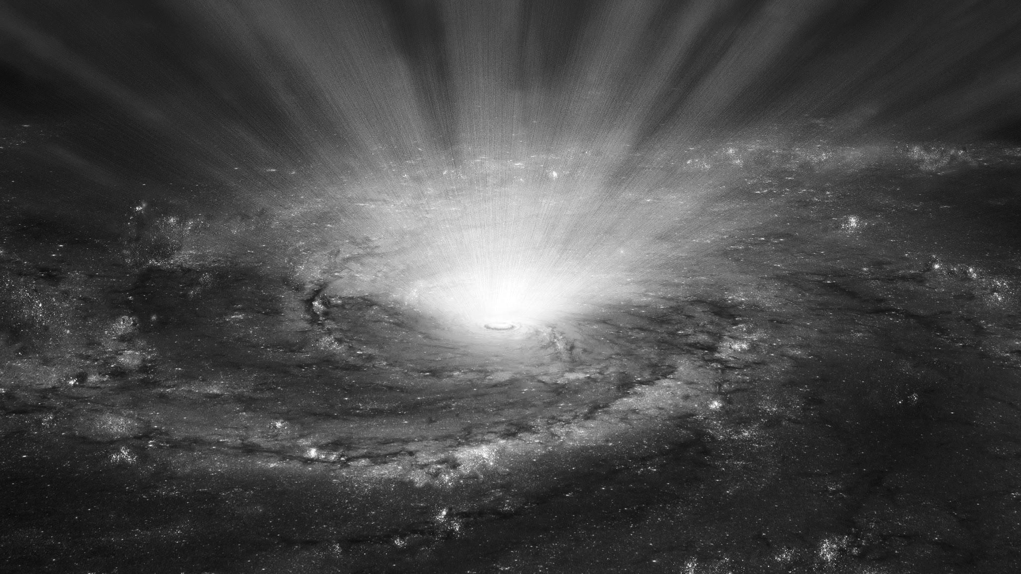
What use is this data?
-Quantum Chemistry
-Atomic interactions
-Interpolation

