Slide 1
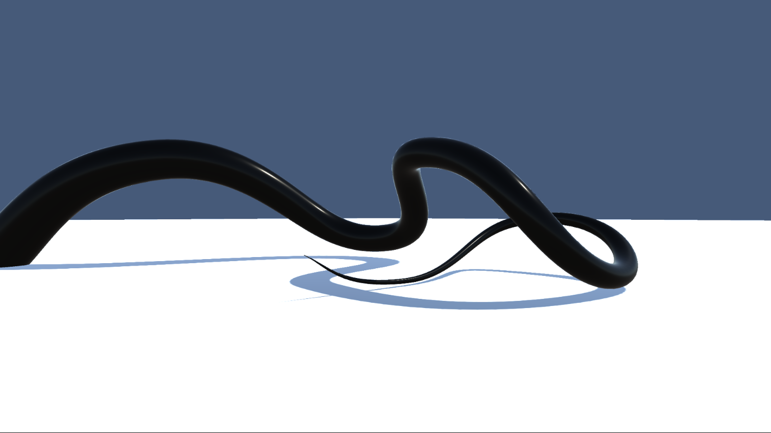
Analysis of Methusalah’s SplineMesh
Henry Whisman

Slide 2

Summary
SplineMesh is an open source addon asset for Unity that generates 3D curves using Bezier splines that can update in real time with the intention of allowing 3D modelers to construct and manipulate curved 3D models.
Base language: C#
Primary additions
Spline Gameobject script
Spline Mesh tiling script
Spline smoother script
Visual Example scripts (such as the tentacle example script which I used on the spline shown here)
Github repository:
methusalah/SplineMesh: A Unity plugin to create curved content in real-time with bézier curves (github.com)

Slide 3
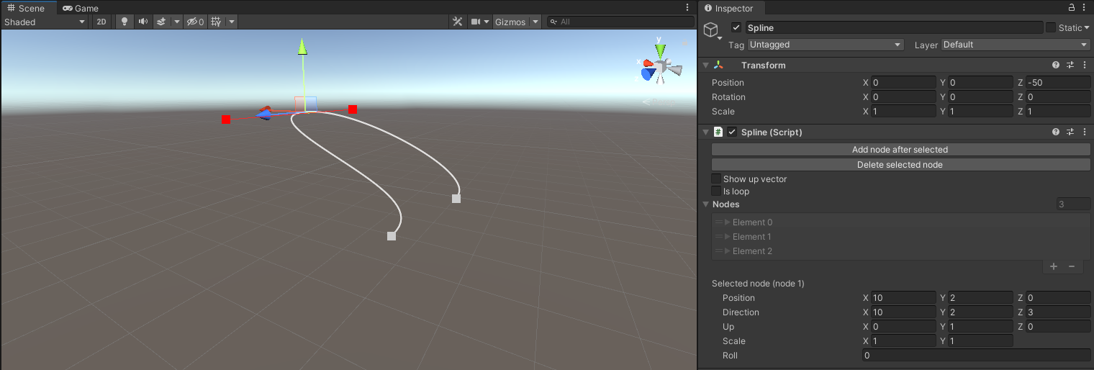
Spline game_object
Creates a series of nodes (starts at 2) each with a position vector (x,y,z) and a direction vector which the Bezier spline uses to interpolate the curve connecting them

Slide 4
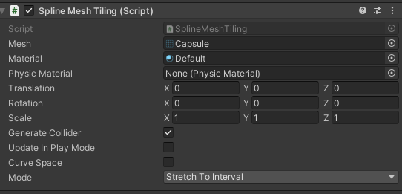
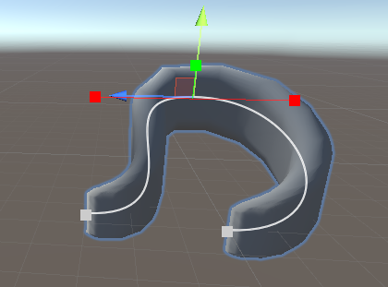
Spline mesh tiling
A script component that can be added to a spline that tiles a 3D object mesh along the spline
3 modes
repeat: repeatedly places the mesh on points along the spline
Once: creates one mesh and the spline to it
Stretch across interval: stretches the mesh across the interval
I personally found repeat to work best

Slide 5
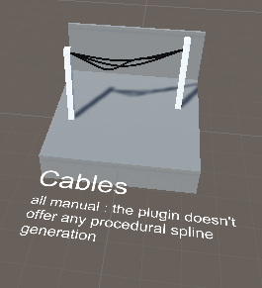
Question
In the plugin showcase, the software suggests that the plugin doesn’t offer any procedural spline generation but is the lack pf procedural spline generation a personal choice of the programmer or is it due to a fundamental impossibility with the structure of a manual spline generator)?

Slide 6
Potential investigations
Compare Splinemesh’s Bezier spline interpolation with a cubic spline interpolation found in class
Pick 2D functions and create a game_object script that feeds points into Splinemesh’s Bezier spline code (keeping the third axis constant), compare the generated curve with Julia’s cubicSplineInterpolation (comparing the condition number, and error)
Going off the question in the previous slide, can we try to create a script (using the splinemesh) that creates a procedural spline generation

