Slide 1
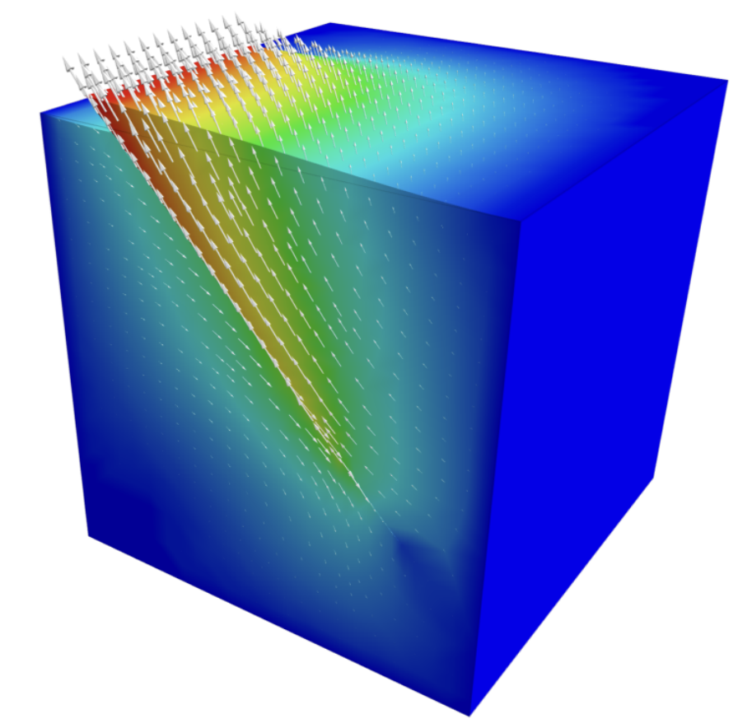

PyLith Community Analysis
Ren Stengel, Fall 2021 CSCI 5636

Slide 2
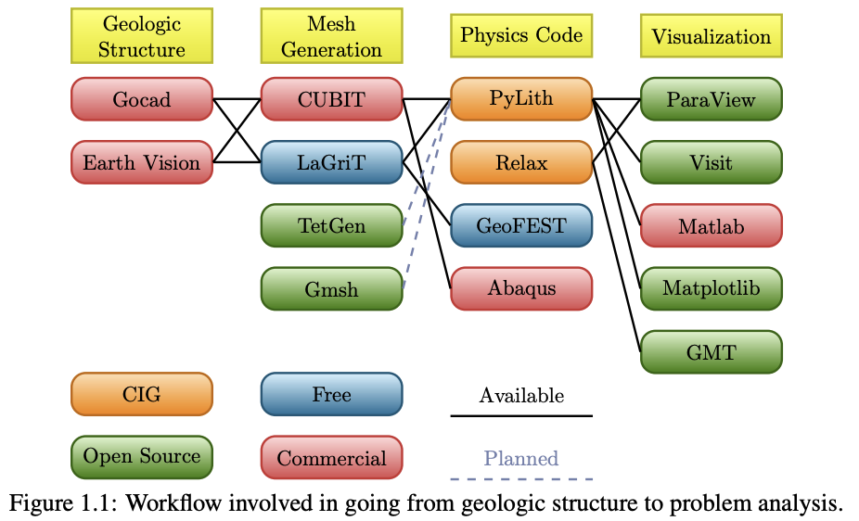
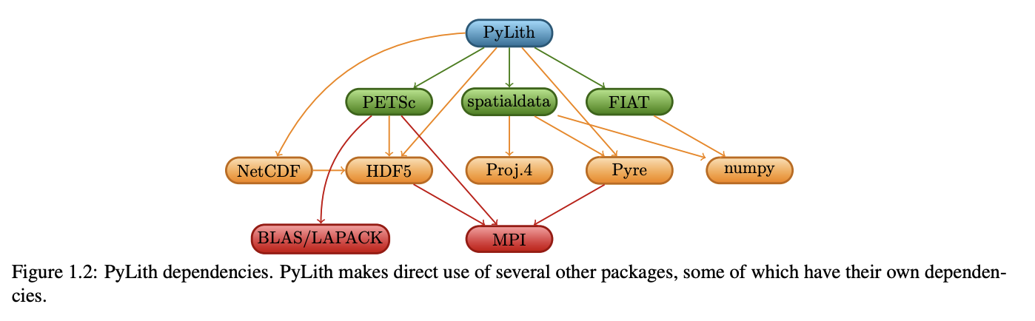
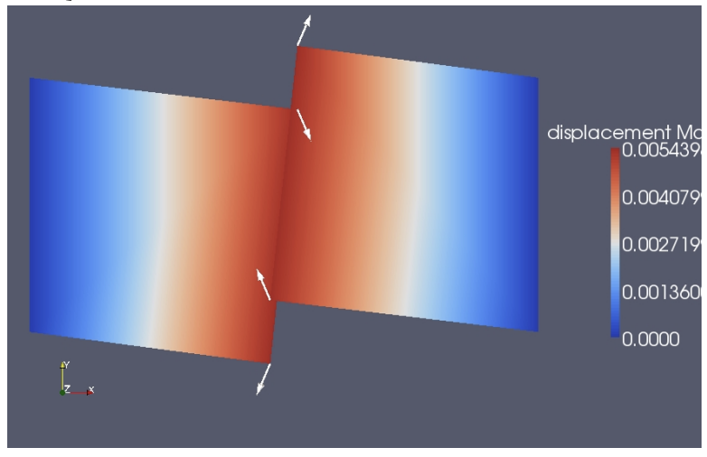
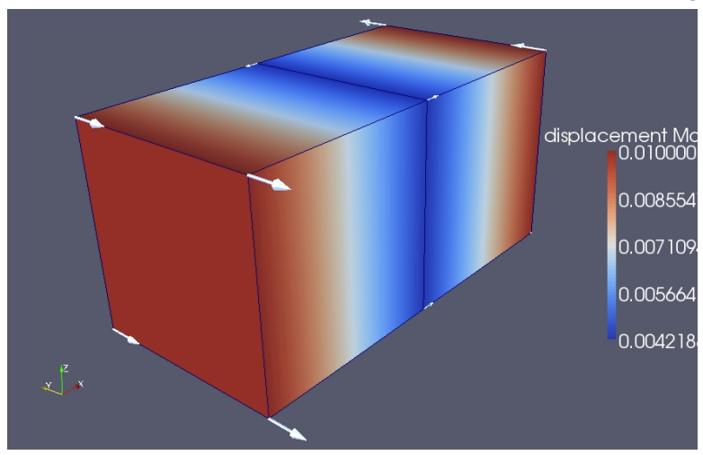
Background
PyLith is a finite-element code for dynamic and quasistatic simulations of crustal deformation, primarily earthquakes and volcanoes.
Features:
Quasi-static (implicit) and dynamic (explicit) time-stepping
Cell types include triangles, quadrilaterals, hexahedra, and tetrahedra
Linear elastic, linear and generalized Maxwell viscoelastic, power-law viscoelastic, and Drucker-Prager elastoplastic materials
Infinitesimal and small strain elasticity formulations
Time-dependent Dirichlet (displacement/velocity) boundary conditions
Time-dependent Neumann (traction) boundary conditions
Time-dependent point forces
Absorbing boundary conditions
Gravitational body force
VTK and HDF5/Xdmf output of solution, fault information, and state variables
Templates for adding your own bulk rheologies, fault constitutive models, and interfacing with a custom seismic velocity model.
User-friendly computation of static 3-D Green's functions
PyLith v2.2.2 User Manual
Kinematic Fault Example
Shear displacement example

Slide 3
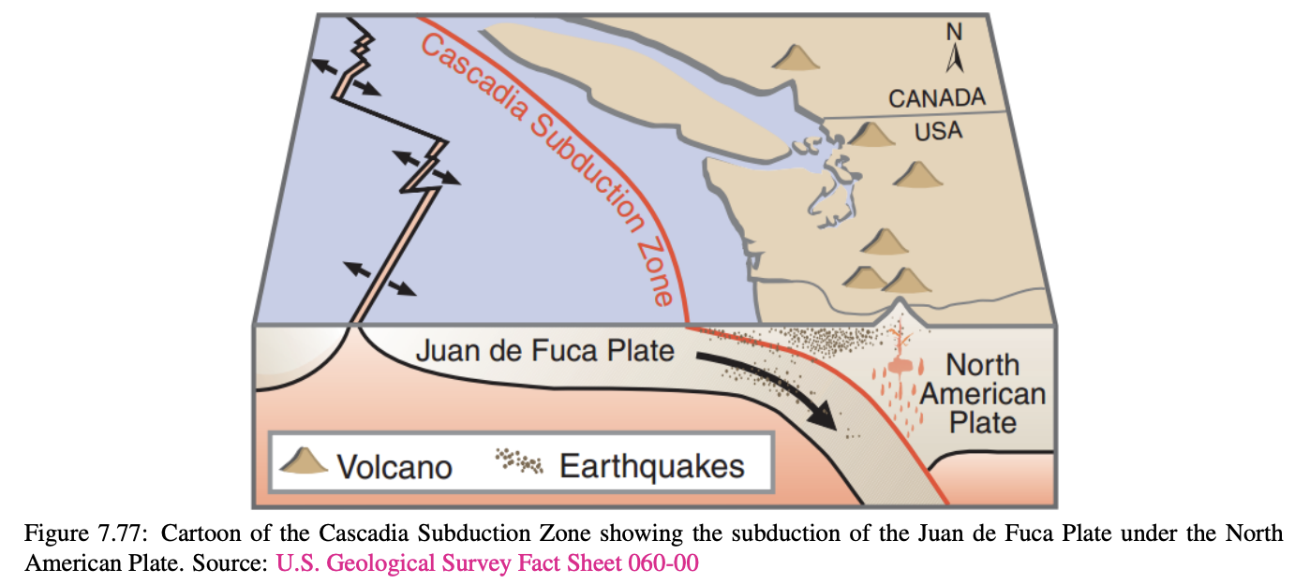
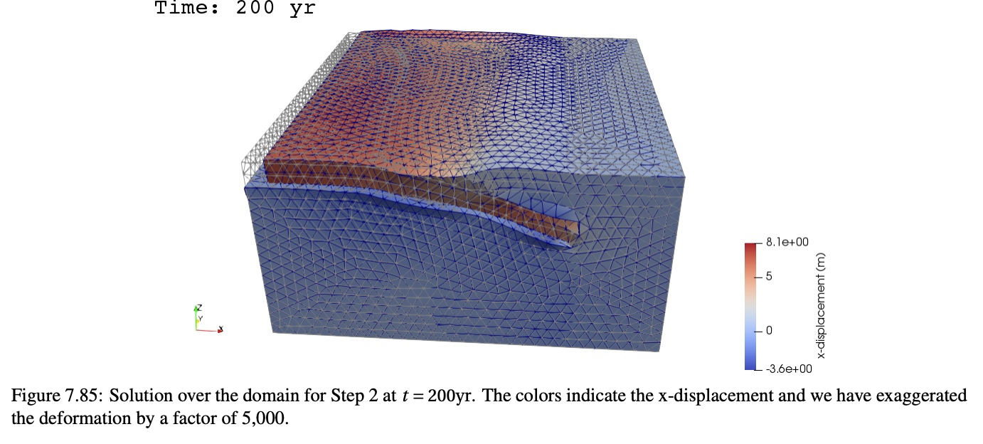
Applications
Fault interfaces using cohesive cells
Prescribed slip with multiple, potentially overlapping earthquake ruptures and aseismic creep
Spontaneous slip with slip-weakening friction and Dieterich rate- and state-friction fault constitutive models
Various seismic related problems such as subduction zones
Kinematic Fault Example
Shear displacement example
PyLith v2.2.2 User Manual

Slide 4
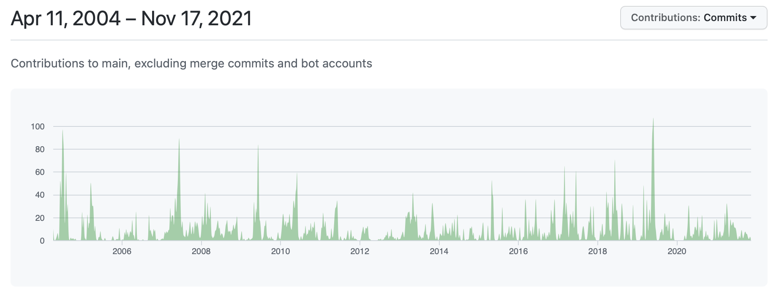
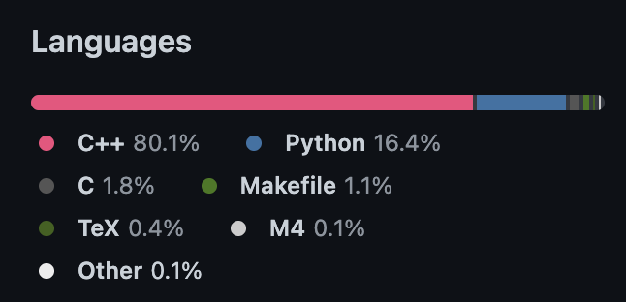
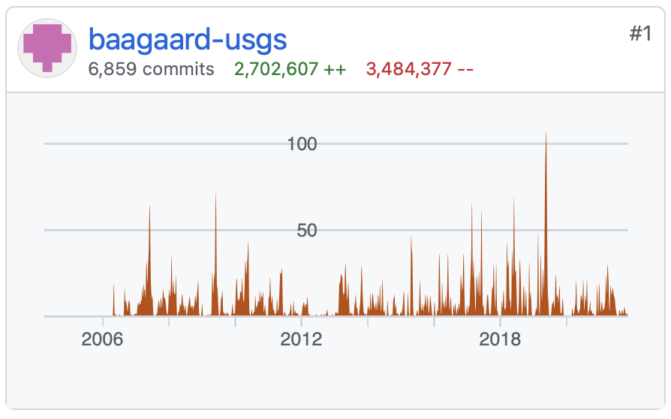
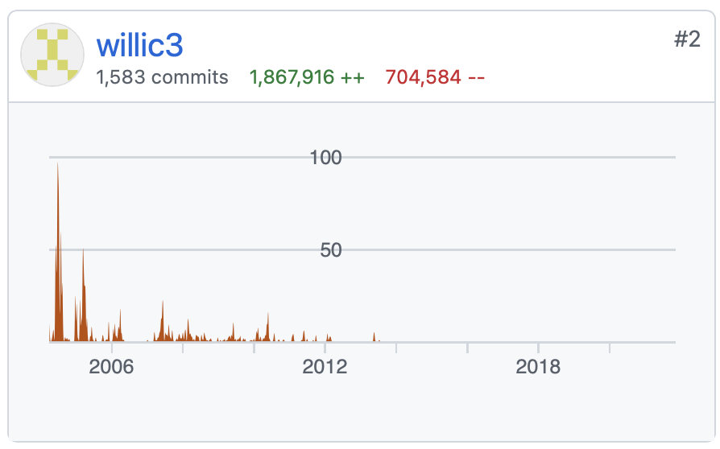
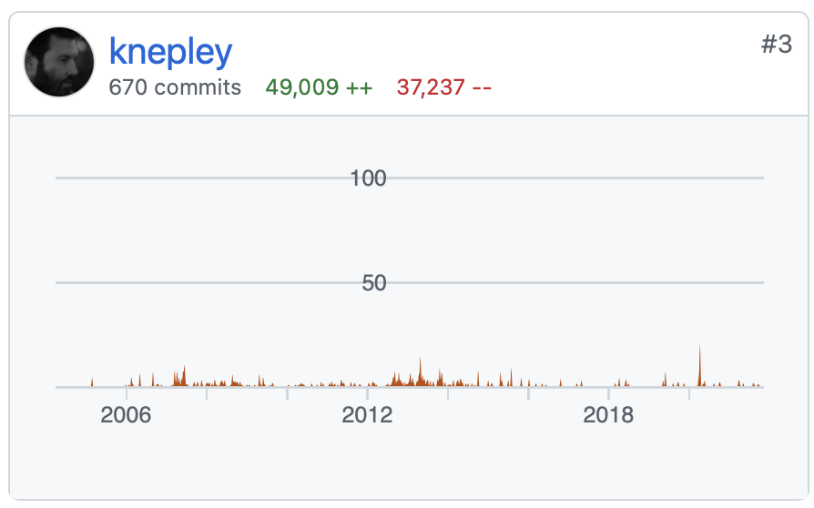
Development Community
+ 5 others
Brad Aagaard @ USGS
Charles Williams @ GNS Science
Matthew Knepley @ University at Buffalo

Slide 5
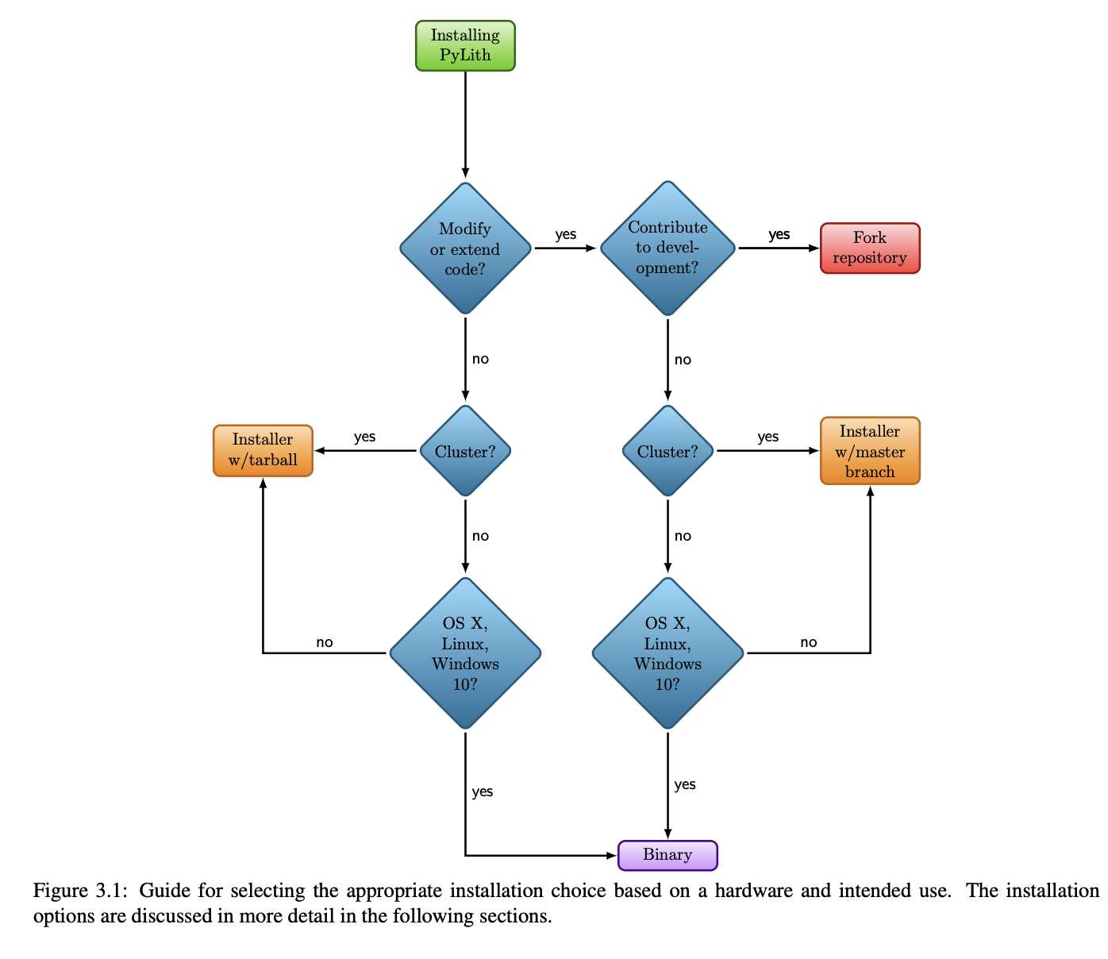
Barriers to community development
PyLith can be challenging to install and develop in
PyLith users can install via source, binary, Docker, or by the PyLith Installer package
Installing the development version can be more intensive (especially on Mac)
Development can be difficult due to intermingling of languages in the code and addressing bugs
Varying sets of instructions depending between the forum, user manual, and readthedocs pages

Slide 6
Relevant links and references
https://community.geodynamics.org/
https://wiki.geodynamics.org/software:pylith:start
https://geodynamics.org/cig/software/pylith/
Aagaard, B., Knepley, M., Williams C., (2017) PyLith v2.2.1, Computational Infrastructure for Geodynamics, doi: 10.5281/zenodo.886600, url: https://geodynamics.org.cig/software/pylith

