Slide 1
Community Analysis on PyClaw
Christina Wang

Slide 2
What is PyClaw?
A Python-based interface to the algorithms of Clawpack and SharpClaw
Clawpack: package for solving hyperbolic PDE systems in 1/2/3D; includes a number of solvers originally in Fortran
SharpClaw: higher-order wave propagation using WENO reconstruction and Runge-Kutta integration, in 1/2D

Slide 3
Some stats
Started in 2010
34 contributors in the lifetime of the project
Development discussions take place on Github, Gitter, Twitter, google group
0-4 commits every week in the past two months
Accepts contributions thru pull requests, PyClaw issue tracker
No legal/licensing steps required to contribute

Slide 4
Examples available
1-dimensional advection
1-dimensional variable-velocity advection
1-dimensional acoustics
1-dimensional Burgers’ equation
1-dimensional shallow water equation
1-dimensional nonlinear elasticity
1-dimensional Euler equations
2-dimensional advection
2-dimensional variable-coefficient advection
2-dimensional acoustics
2-dimensional variable-coefficient acoustics
2-dimensional advection-reaction
2-dimensional shallow water equations
2-dimensional shallow water on the sphere
2-dimensional Euler equations
2-dimensional KPP equation
2-dimensional p-system

Slide 5
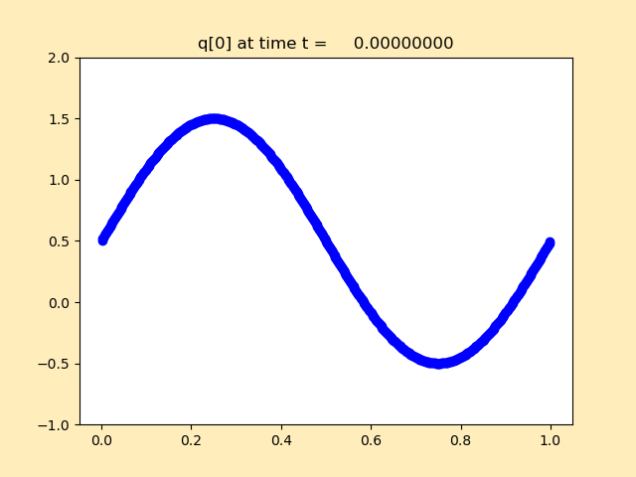
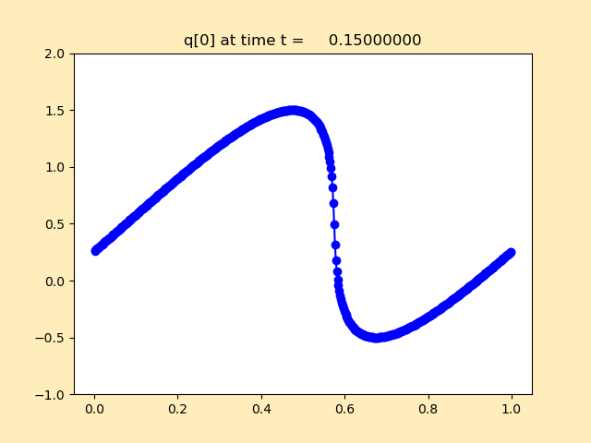
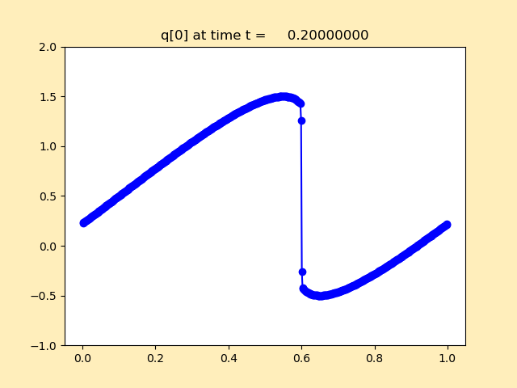
Burgers’ equation 1D

Slide 6
Possible contribution ideas
New example or tutorial
Experiment on one system with both Clawpack and SharpClaw and compare the accuracy and cost.

