Slide 1
ASPECT: Advanced Solver for Planetary Evolution, Convection, and Tectonics
Tao Yuan

Slide 2
About ASPECT
Started: 2011 (v1.0 at 2014)
widely used in geodynamics nowadays. (150+ publications)
Simulate problems in thermal convection (mantle)
Glacial isostatic adjustment (viscoelastic)
Lithospheric scale deformation (visco-elastic-plastic)
FEM
Adaptive mesh refinement
Built on deal.ii
Usability, extensibility and Community
different from “old” code in geodynamics

Slide 3
Numerical methods
Stokes equations
block triangular preconditioner utilizing an algebraic multigrid
trying to transfer to geometric multigrid
When used correctly, this can reduce the compute time spent in the solver by about a factor of 3, and decrease the memory requirements by a factor of 10.
Advection-diffusion equations
SUPG Stabilization
Entropy Viscosity Stabilization

Slide 4
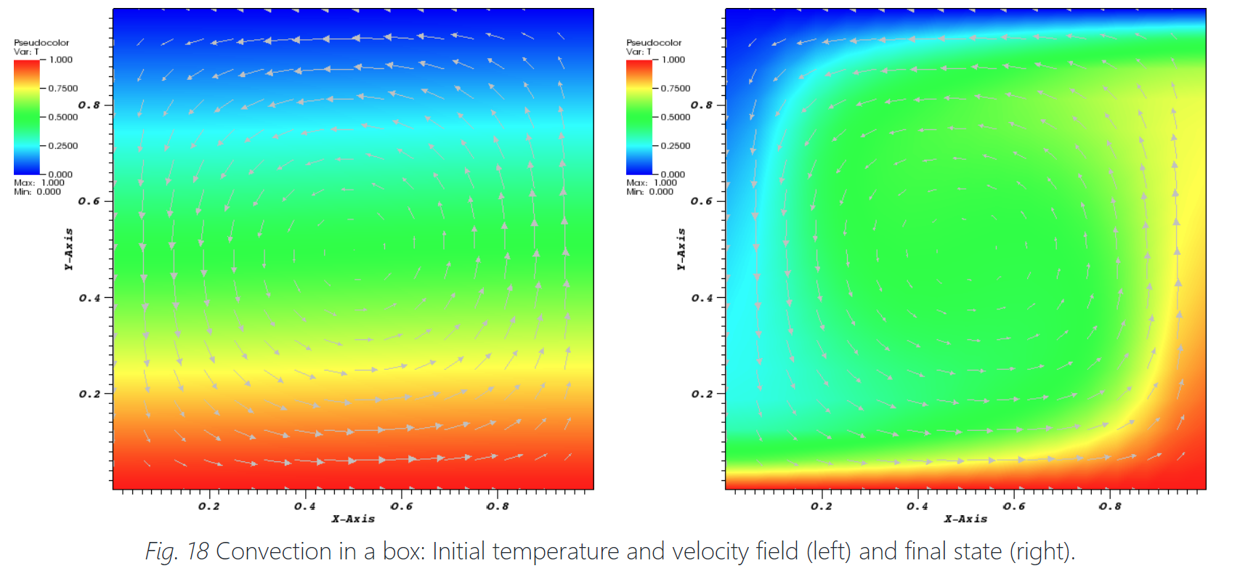

Slide 5
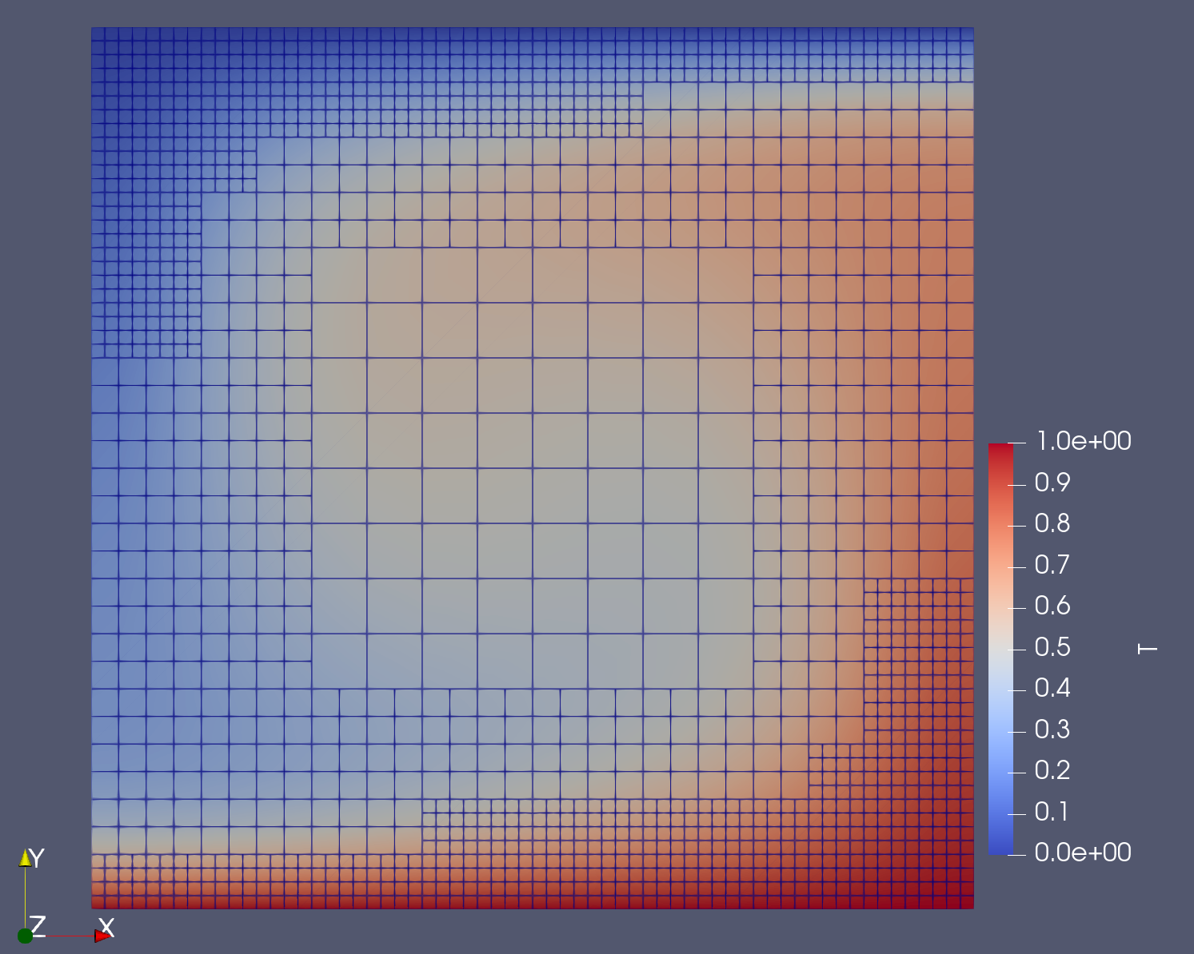
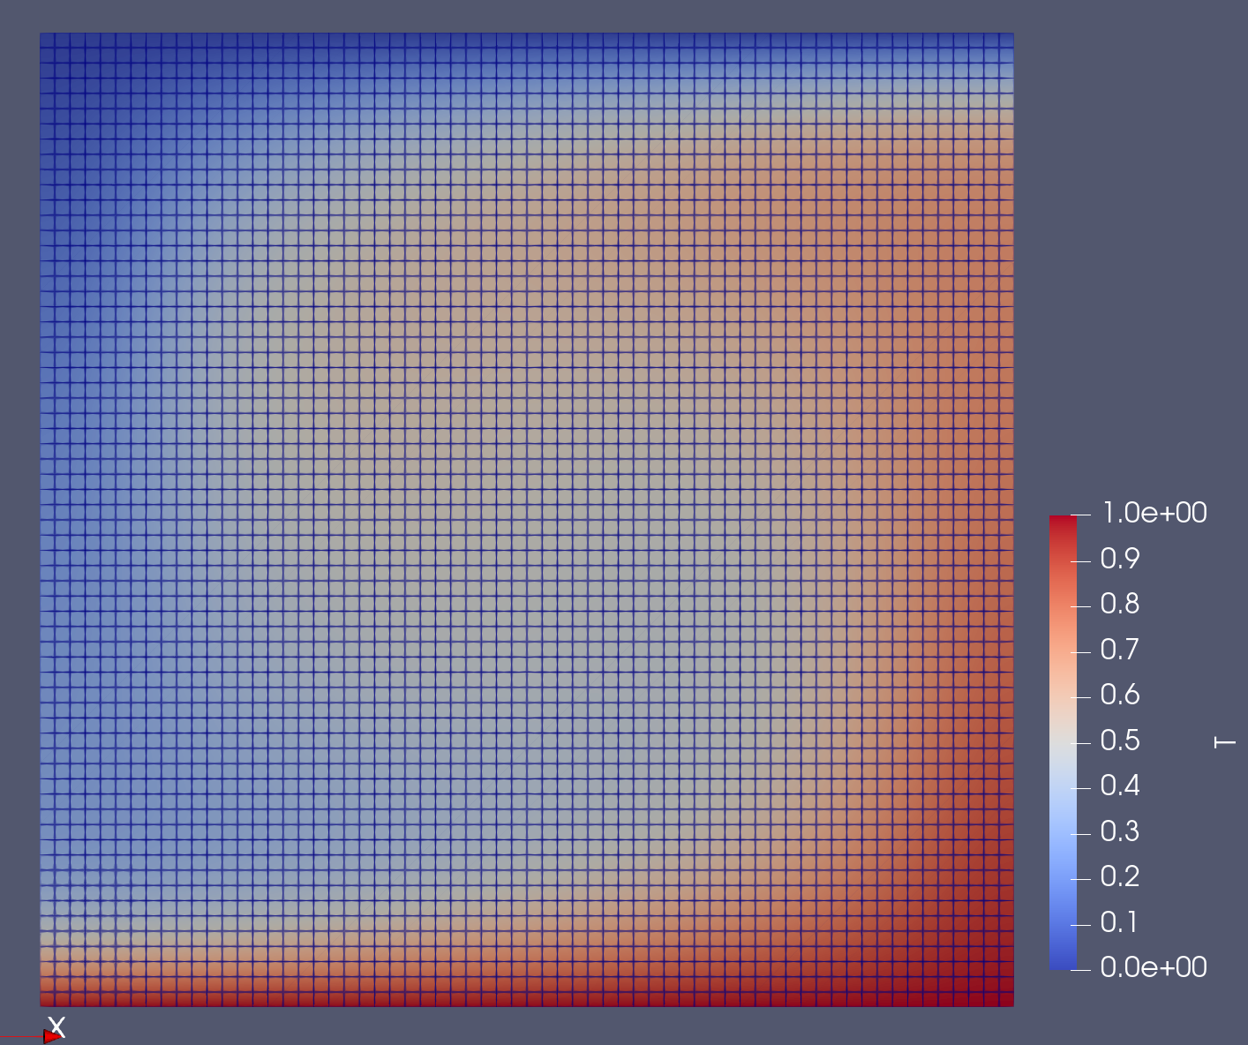
One idea about contribution
Test accuracy and efficiency of AMR
Overall accuracy
Accuracy in refined regions
is it as good as refining the whole domain
Notes:
(Use a very high-resolution model as standard to compare with)

Slide 6
Other ideas
Efficiency comparison: algebraic multigrid vs geometric multigrid
Accuracy comparison: SUPG vs Entropy Viscosity Stabilization
Finally, contribute those additional tests to user manual.

Slide 7
Suggestions?

