Slide 1
FEniCS for PDEs
May An van de Poll
11/10/2023
CS5636

Slide 2
About FeniCS
Created in 2003 as a collaboration between researchers from various universities and research institutions.
It is an open-source computing platform for automated solution of PDEs using finite elements.
The FEniCS software can be found at the FEniCS Project website, http://fenicsproject.org/.
FEniCS includes a number of powerful features, examples are:
- automated solution of variational problems
- automated error control and adaptivity
- extensive library of finite elements
- provides an interface to linear algebra solvers and data-structures, such as PETSc
- visualization via a simple interactive plotting function
- can be used with Python and C++
-extensive documentation: tutorial, handbook, demos etc.

Slide 3
Why FEniCS for PDEs?
Said to be the only framework where the code stays compact, very close to the mathematical formulation, even when complexity of math and algorithm increases and when using a high-performance compute server (cluster).

Slide 4
Getting started with FEniCS
Who is the audience?
Windows: a bit tedious, everything else more straightforward explanation
Install Docker, or do it via Linux for Windows
Install editor: my preference Visual Studio Code
Tutorials (handbook and the internet in general)

Slide 5
Example from tutorial
Poisson equation: most fundamental task to solve in FEMs for PDEs:
Poisson equation is an example of a boundary value problem:
In 2D:
Notes:
Here, u = u(x) is the unknown function, f = f(x) is a prescribed function, ∇^2 is the Laplace operator (often written as ∆), Ω is the spatial domain, and ∂Ω is the boundary of Ω. The Poisson problem, including both the PDE −∇^2 u = f and the boundary condition u = u_D on ∂Ω, is an example of a boundary-value problem which must be precisely stated before it makes sense to solve it with FEniCS.

Slide 6
Example from tutorial: Poisson equation
Applications: physics like heat conduction, electrostatics, twisting of elastic rods etc.
Steps to solve Poisson equation in FEniCS:
Identify the computational domain Ω, the PDE, its boundary conditions and source terms
Reformulate the PDE as a finite element variational problem
Write Python program defining Ω, the variational problem, boundary conditions, source terms using FEniCS
Call FEniCS to solve the boundary-value problem
Notes:
For step two: The basic recipe for turning a PDE into a variational problem is to multiply the PDE by a function v, integrate the resulting equation over the domain Ω, and perform integration by parts of terms with second-order derivatives. The function v which multiplies the PDE is called a test function. The unknown function u to be approximated is referred to as a trial function. The terms trial and test functions are used in FEniCS programs too. The trial and test functions belong to certain so-called function spaces that specify the properties of the functions.

Slide 7
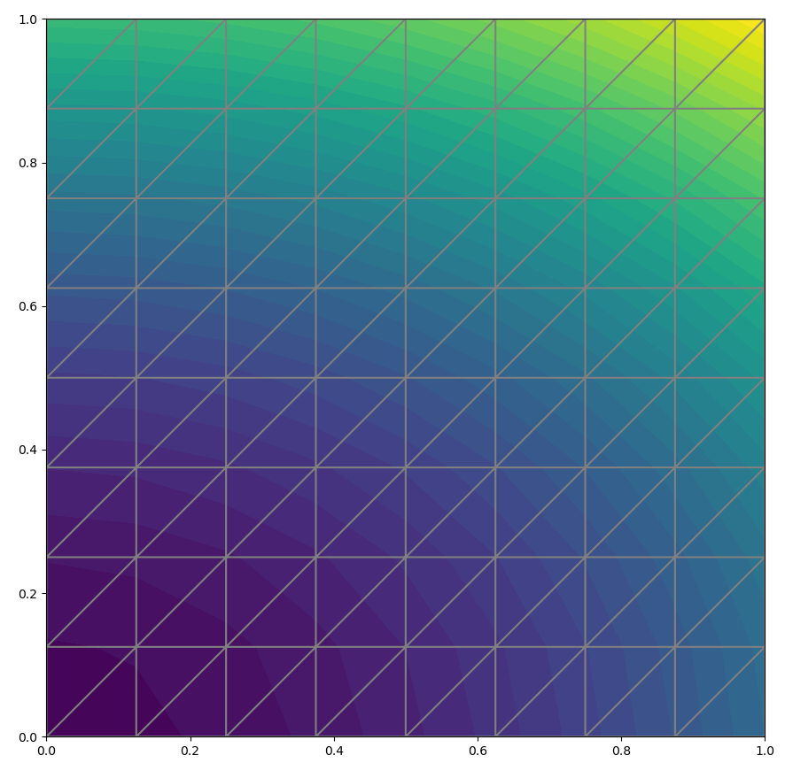
Example from tutorial: Poisson equation
Arbitrary quadratic function in 2D as the exact solution:
Substitute into the Poisson equation gives that it is a solution if:
f(x,y)= -6 and $u_{D}(x,y)=u_{E}$(x,y).
The domain is a unit square: Ω=[0,1]x[0,1]
FEniCS will compare the approximate solution u with the exact solution $u_{E}$(x,y).
The error in the $L^{2}$and maximum norms are:
error_L2 = 0.008235098073354864
error_max = 1.3322676295501878e-15
Notes:
For our first implementation we need to make specific choices for the domain Ω, the boundary condition u_D and the function f.
It will be wise to construct a problem with a known analytical solution so that we can easily check that the computed solution is correct. Solutions that are lower-order polynomials are primary candidates. Standard finite element function spaces of degree r will exactly reproduce polynomials of degree r. And piecewise linear elements (r = 1) are able to exactly reproduce a quadratic polynomial on a uniformly partitioned mesh. This important result can be used to verify our implementation. We just manufacture some quadratic function in 2D as the exact solution, say what we have on the slide.
Since we know that our approximate solution should reproduce the exact solution to within machine precision, this error should be small, something on the order of 10^−15. If plotting is enabled with matplotlib, then a window with a simple plot of the solution will appear as can be seen in the figure.
As you can see, the grid is 1x1. A mesh consisting of cells is created that are triangles in 2D. The parameters are 8x8 meaning that the square should be divided into 8x8 rectangles each divided into a pair of triangles. The total number of cells (triangles) is then 64x2=128.
Once the mesh is created, we create a finite element function space V where we can specify the type of element from the periodic table of finite elements.
In this case a P1 linear Lagrange element is used, which is a triangle with nodes at the three vertices, also known as the linear triangle. The computed solution u will be continuous across elements and linearly varying in x and y inside each element.

Slide 8
How to contribute to the FEniCS community?
Contribute to the documentation: the example discussed uses interactive() to plot but this is deprecated.
Contribute by making tutorials: e.g. variations of existing ones.
Performance comparison: FEniCS and FEniCSx (the updated version of FEniCS).
Notes:
For the comparison I got the same errors, but also the problem could be more complicated and result in a difference in error then maybe.

Slide 9
References
Langtangen, H. P., & Logg, A. (2016). Solving PDEs in Minutes – The FEniCS Tutorial Volume I. Springer.
Langtangen, H. P., & Logg, A. (2022). DOLFINx Tutorial. https://jsdokken.com/dolfinx-tutorial/chapter1/fundamentals.html
Dokken, J. S. (2022). Adapted to FEniCSx by Jørgen S. Dokken. DOLFINx Tutorial. https://jsdokken.com/dolfinx-tutorial/chapter1/fundamentals.html

