Slide 1
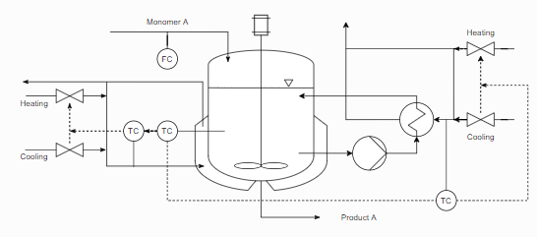
Industrial polymerization reactor
from do-mpc : https://www.do-mpc.com/en/latest/example_gallery/industrial_poly.html
The system consists of a reactor into which nonomer is fed. A schematic representation of the system is presented above;
The process is modeled by a set of 8 ODEs.
We discretized the time of the ODE to make a single transition of the MDP

Slide 2
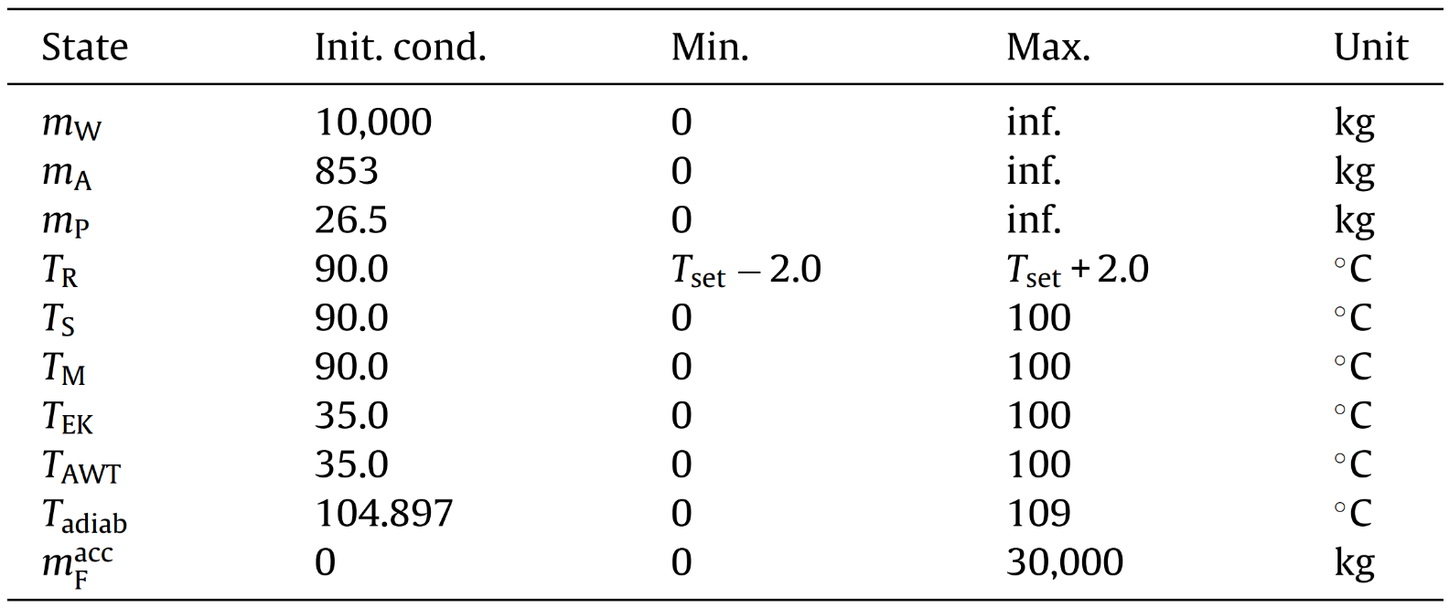

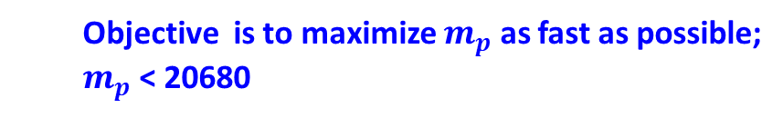
Project Description
Objective:
$${maximize}_{a_{1},…,a_{T}}\sum_{t=1}^{T−1}{R\left(s_{t},a_{t},s_{t+1}\right)}$$
$$\begin{matrix}s.t. & s_{t+1}=f\left(s_{t},a_{t}\right)\end{matrix}$$
State variable $s_{t}$:
Objective is to maximize $m_{p}$ as fast as possible;
$m_{p}$ < 20680
Safety variable

Slide 3
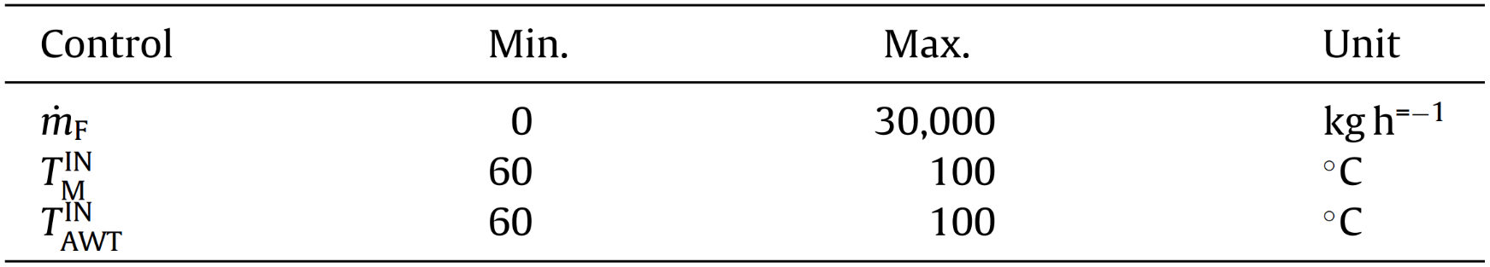

Project Description
Control variable $a_{t}$:
Check action boundary carefully!

Slide 4

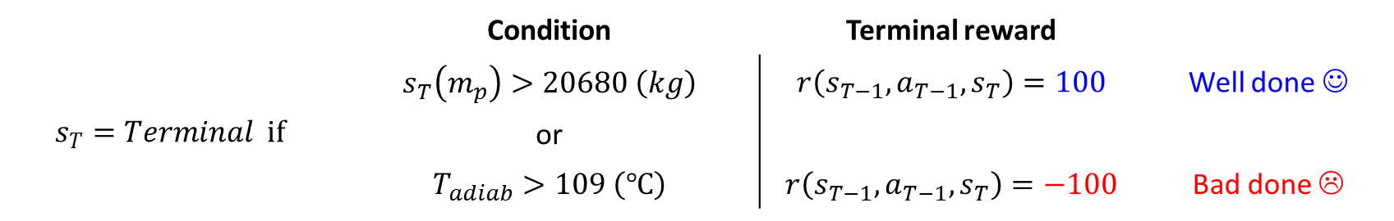
Project Description
Reward
Stage reward
$r\left(s_{t},a_{t},s_{t+1}\right)=s_{t+1}\left(m_{p}\right)−s_{t}\left(m_{p}\right)$
: The reward is the gap of $m_{p}$ in single step
Terminal reward
 | Condition | Terminal reward
$$s_{T}=Terminal if$$ | $$s_{T}\left(m_{p}\right)>20680 \left(kg\right)$$ | $$r\left(s_{T−1}, a_{T−1}, s_{T}\right)=100$$ | Well done ☺
 | or
 | $$T_{adiab}>109 \left(℃\right)$$ | $$r\left(s_{T−1}, a_{T−1}, s_{T}\right)=−100$$ | Bad done ☹

