Slide 1
Final Report
Parson’s Programming Puzzles:
Optimizing Efficiency and Investigating
the Effects of Feedback
Further research on Social Addictive Gameful Engineering (SAGE) design
and computational thinking (CT)
Spring 2021
Alexander Liebeskind

Slide 2
Overview
Related Research
Study Purpose
Methods
Results
Cognitive Load
Performance
Efficiency
Motivation
Discussion
Further Work
Notes:
Parson’s Programming Puzzles: A Fun and Effective Learning Tool for First Programming Courses
Established original Parson’s Programming Puzzles and key aims (maximize the engagement, constrain the logic, permit common errors, model good code, and provide immediate feedback)
Lessons Learned from Available Parsons Puzzles Software
Researched PPP implementations ( Hot Potatoes Implementation, JS-Parsons, Epplets, and EvoParsons) and determined ideal PPP constraints
Measuring Cognitive Load in Introductory CS: Adaptation of an Instrument
Established metrics for cognitive load and introduced cognitive load theory (working memory constraint)

Slide 3
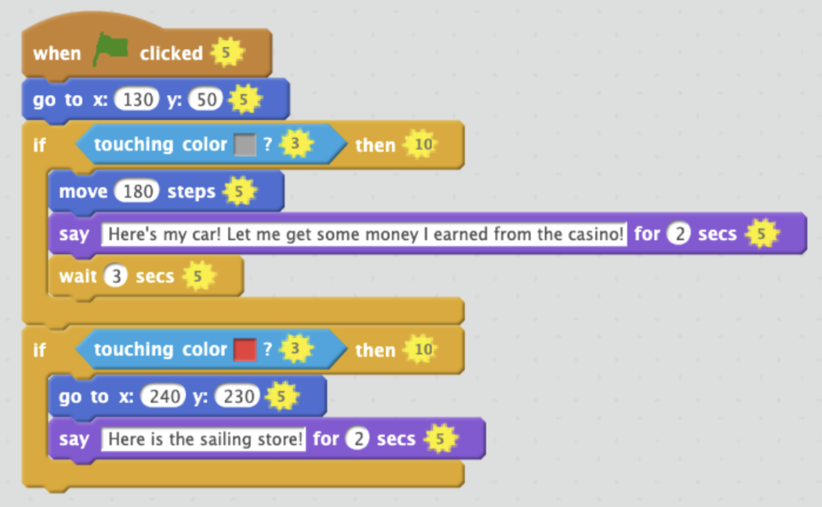
Related Research
Integrating Parsons Programming Puzzles with Scratch
Parson’s Programming Puzzles: A Fun and Effective Learning Tool for First Programming Courses
Lessons Learned from Available Parsons Puzzles Software
Measuring Cognitive Load in Introductory CS: Adaptation of an Instrument
Notes:
Background:
Field study 1 (fs1) was recently completed, written up, and submitted for publication (Integrating Parsons Programming Puzzles with Scratch), which explored cognitive load, performance, efficiency, and motivation across PPP conditions
These findings support the hypothesis that (1) PPP and PPP with distractors training increases motivation and
reduce extraneous cognitive load (as compared to limited constraint and feedback), but refute the hypothesis (2) PPP training yields the highest learning efficiency.
Research Aims:
Extend upon prior investigation of Social Addictive Gameful Engineering (SAGE) and computational thinking (CT) by completing field study 2 (fs2)
Field study 2 (fs2) is underway - data collection has just been completed
Preprocessing, analysis, and write-up have not yet begun
Stretch goal: fs3 design and execution

Slide 4
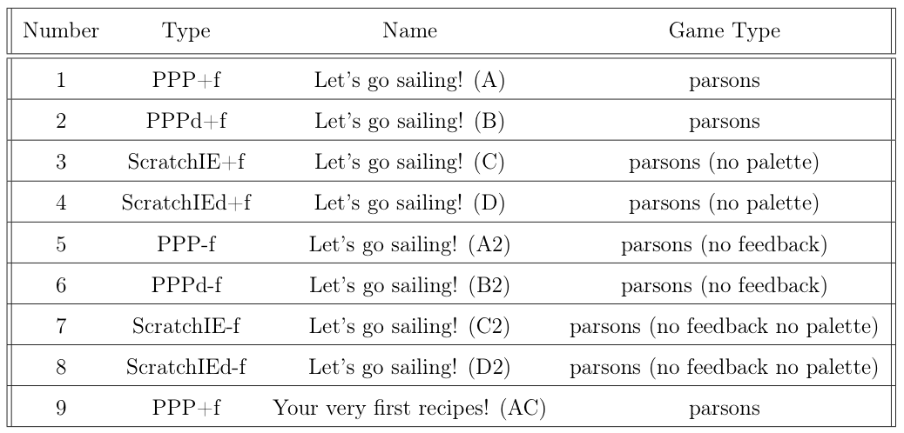
Study Purpose
1. Fs1/SAGE validation
2. Cognitive Load, Efficiency, Performance, Motivation
3. Demographics
Notes:
Background:
Field study 1 (fs1) was recently completed, written up, and submitted for publication (Integrating Parsons Programming Puzzles with Scratch), which explored cognitive load, performance, efficiency, and motivation across PPP conditions
These findings support the hypothesis that (1) PPP and PPP with distractors training increases motivation and
reduce extraneous cognitive load (as compared to limited constraint and feedback), but refute the hypothesis (2) PPP training yields the highest learning efficiency.
Research Aims:
Extend upon prior investigation of Social Addictive Gameful Engineering (SAGE) and computational thinking (CT) by completing field study 2 (fs2)
Field study 2 (fs2) is underway - data collection has just been completed
Preprocessing, analysis, and write-up have not yet begun
Stretch goal: fs3 design and execution

Slide 5
Methods
Extraction and preprocessing
Enrollment (username)
UI and CT tutorial
Pretest feedback
Training feedback
Posttest feedback
Background survey
Pretest
Condition training
Posttest
Study feedback
Analysis
Notes:
8) posttest
9) posttest feedback
10) study feedback

Slide 6
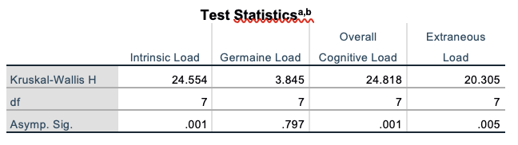
Results: Cognitive Load
After Pretest (Survey 03)
After Puzzle (Survey 04)
After Posttest (Survey 06)
Notes:
1. fs1 GDI Paper
Read referenced papers and define key terms to inform fs2 analysis approach
2. Relevant Statistics and Graphical Methods
Explore prior methodology in relevant studies
3. Data Extraction
Qualtrics results have been exported, stored, and validated for MTurk/Prolific approvals
Remaining Qualtrics work is to categorize participants by condition
Access SAGE database for quantitative findings
4. Data Timing and Correctness Preprocessing
Pre and post test data must be found across conditions to determine if there are any significant differences between groups
5. Analysis
Use SAGE data (time per puzzle per student, correctness of final submission, number of moves, explanation upon submission, and move visualizations) to compute usage data, cognitive load, efficiency, performance, and motivation and inter-condition differences
6. Writing, Editing, and Submission
Paper write-up and iterative editing cycles
7. Stretch Goals
Protocol content for looping CT concept, games across conditions, game instructions, Qualtrics study guide, etc.

Slide 7
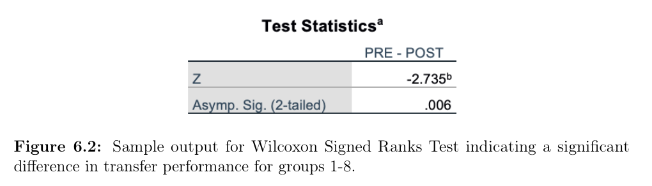
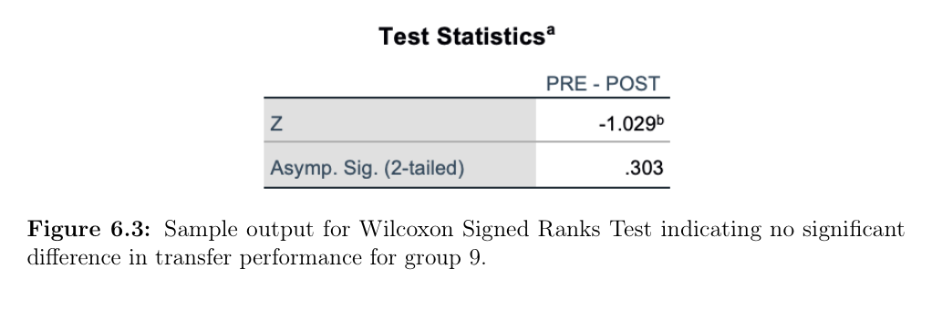
Results: Performance
Notes:
1. fs1 GDI Paper
Read referenced papers and define key terms to inform fs2 analysis approach
2. Relevant Statistics and Graphical Methods
Explore prior methodology in relevant studies
3. Data Extraction
Qualtrics results have been exported, stored, and validated for MTurk/Prolific approvals
Remaining Qualtrics work is to categorize participants by condition
Access SAGE database for quantitative findings
4. Data Timing and Correctness Preprocessing
Pre and post test data must be found across conditions to determine if there are any significant differences between groups
5. Analysis
Use SAGE data (time per puzzle per student, correctness of final submission, number of moves, explanation upon submission, and move visualizations) to compute usage data, cognitive load, efficiency, performance, and motivation and inter-condition differences
6. Writing, Editing, and Submission
Paper write-up and iterative editing cycles
7. Stretch Goals
Protocol content for looping CT concept, games across conditions, game instructions, Qualtrics study guide, etc.

Slide 8
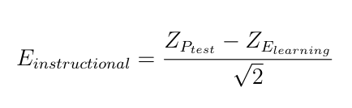
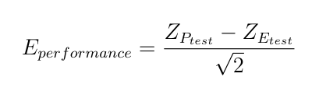
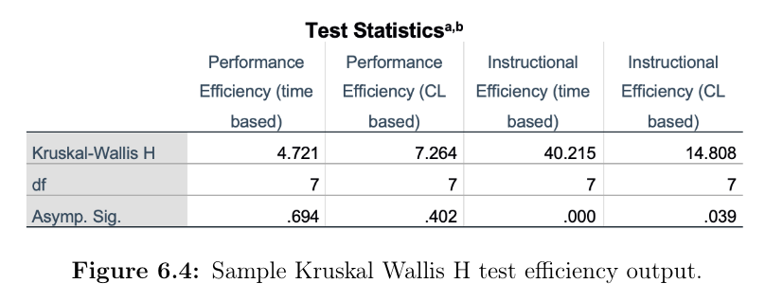
Results: Efficiency
Notes:
1. fs1 GDI Paper
Read referenced papers and define key terms to inform fs2 analysis approach
2. Relevant Statistics and Graphical Methods
Explore prior methodology in relevant studies
3. Data Extraction
Qualtrics results have been exported, stored, and validated for MTurk/Prolific approvals
Remaining Qualtrics work is to categorize participants by condition
Access SAGE database for quantitative findings
4. Data Timing and Correctness Preprocessing
Pre and post test data must be found across conditions to determine if there are any significant differences between groups
5. Analysis
Use SAGE data (time per puzzle per student, correctness of final submission, number of moves, explanation upon submission, and move visualizations) to compute usage data, cognitive load, efficiency, performance, and motivation and inter-condition differences
6. Writing, Editing, and Submission
Paper write-up and iterative editing cycles
7. Stretch Goals
Protocol content for looping CT concept, games across conditions, game instructions, Qualtrics study guide, etc.

Slide 9
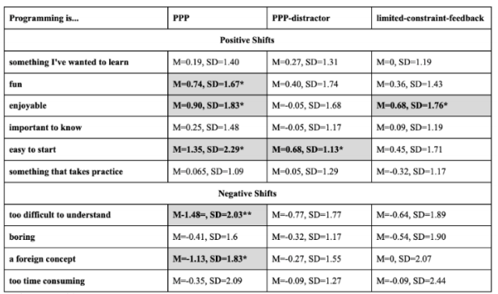
Results: Motivation
TEQ Results
Individual quantifiers
Expanding fs1 results to further conditions
Notes:
1. fs1 GDI Paper
Read referenced papers and define key terms to inform fs2 analysis approach
2. Relevant Statistics and Graphical Methods
Explore prior methodology in relevant studies
3. Data Extraction
Qualtrics results have been exported, stored, and validated for MTurk/Prolific approvals
Remaining Qualtrics work is to categorize participants by condition
Access SAGE database for quantitative findings
4. Data Timing and Correctness Preprocessing
Pre and post test data must be found across conditions to determine if there are any significant differences between groups
5. Analysis
Use SAGE data (time per puzzle per student, correctness of final submission, number of moves, explanation upon submission, and move visualizations) to compute usage data, cognitive load, efficiency, performance, and motivation and inter-condition differences
6. Writing, Editing, and Submission
Paper write-up and iterative editing cycles
7. Stretch Goals
Protocol content for looping CT concept, games across conditions, game instructions, Qualtrics study guide, etc.

Slide 10
Discussion
Significance of performance and instructional efficiency findings
Efficiency support for related work
Informing fs3 study design
Sample size, pipeline, conditions
Key points for SIGSCE submission
Notes:
1. fs1 GDI Paper
Read referenced papers and define key terms to inform fs2 analysis approach
2. Relevant Statistics and Graphical Methods
Explore prior methodology in relevant studies
3. Data Extraction
Qualtrics results have been exported, stored, and validated for MTurk/Prolific approvals
Remaining Qualtrics work is to categorize participants by condition
Access SAGE database for quantitative findings
4. Data Timing and Correctness Preprocessing
Pre and post test data must be found across conditions to determine if there are any significant differences between groups
5. Analysis
Use SAGE data (time per puzzle per student, correctness of final submission, number of moves, explanation upon submission, and move visualizations) to compute usage data, cognitive load, efficiency, performance, and motivation and inter-condition differences
6. Writing, Editing, and Submission
Paper write-up and iterative editing cycles
7. Stretch Goals
Protocol content for looping CT concept, games across conditions, game instructions, Qualtrics study guide, etc.

Slide 11
Further Work
Fs1 revisions
Fs3 design
Fs2 writeup (SIGSCE technical symposium)
Additional analysis
Demographics
Grouped comparisons (training element, puzzle type, etc.)
Notes:
1. fs1 GDI Paper
Read referenced papers and define key terms to inform fs2 analysis approach
2. Relevant Statistics and Graphical Methods
Explore prior methodology in relevant studies
3. Data Extraction
Qualtrics results have been exported, stored, and validated for MTurk/Prolific approvals
Remaining Qualtrics work is to categorize participants by condition
Access SAGE database for quantitative findings
4. Data Timing and Correctness Preprocessing
Pre and post test data must be found across conditions to determine if there are any significant differences between groups
5. Analysis
Use SAGE data (time per puzzle per student, correctness of final submission, number of moves, explanation upon submission, and move visualizations) to compute usage data, cognitive load, efficiency, performance, and motivation and inter-condition differences
6. Writing, Editing, and Submission
Paper write-up and iterative editing cycles
7. Stretch Goals
Protocol content for looping CT concept, games across conditions, game instructions, Qualtrics study guide, etc.

Slide 12
References
[1] SDT. Self-determination Theory. https://selfdeterminationtheory.org/intrinsic-motivation-inventory/.
[2] B. B. Morrison, e. a. (2014). Measuring cognitive load in introductory cs: adaptation of an instrument.
[3] Briana B. Morrison, Brian Dorn, M. G. (2014). Measuring cognitive load in introductory cs: Adaptation of an instrument. ICER ’14: Proceedings of the tenth annual conference on International computing education research.
[4] Dale Parsons, P. H. (2006). Parson’s programming puzzles: A fun and effective learning tool for first programming courses. ACE ’06: Proceedings of the 8th Australasian Conference on Computing Education - Volume 52.
[5] Dmytro Vitel, Bari A.T.M. Golam, A. G. (2019). Lessons learned from available parsons puzzles software.
[6] Fred G. W. C. Paas, J. J. G. V. M. (1993). The efficiency of instructional conditions: An approach to combine mental effort and performance measures.
[7] Jeff Bender (2021). Spring 2021 field study goals.
[8] Jeff Bender, Bingpu Zhao, L. M. G. K. (2020). Integrating parsons programming puzzles with scratch.
[9] P. Charters, e. a. (2014). Challenging stereotypes and changing attitudes: the effect of a brief programming encounter on adults’ attitudes toward programming.
[10] Tamara Van Gog, F. P. (2008). Instructional efficiency: Revisiting the original construct in educational research.
Notes:
1. fs1 GDI Paper
Read referenced papers and define key terms to inform fs2 analysis approach
2. Relevant Statistics and Graphical Methods
Explore prior methodology in relevant studies
3. Data Extraction
Qualtrics results have been exported, stored, and validated for MTurk/Prolific approvals
Remaining Qualtrics work is to categorize participants by condition
Access SAGE database for quantitative findings
4. Data Timing and Correctness Preprocessing
Pre and post test data must be found across conditions to determine if there are any significant differences between groups
5. Analysis
Use SAGE data (time per puzzle per student, correctness of final submission, number of moves, explanation upon submission, and move visualizations) to compute usage data, cognitive load, efficiency, performance, and motivation and inter-condition differences
6. Writing, Editing, and Submission
Paper write-up and iterative editing cycles
7. Stretch Goals
Protocol content for looping CT concept, games across conditions, game instructions, Qualtrics study guide, etc.

