Slide 1
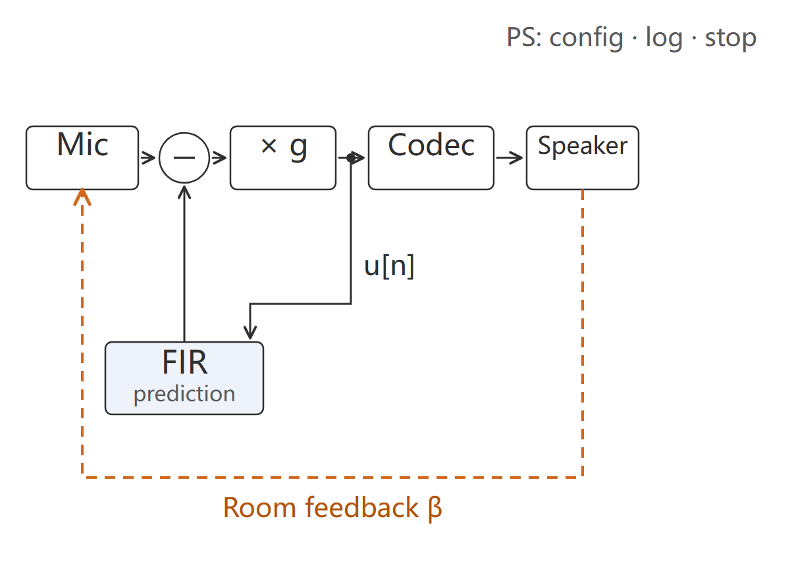




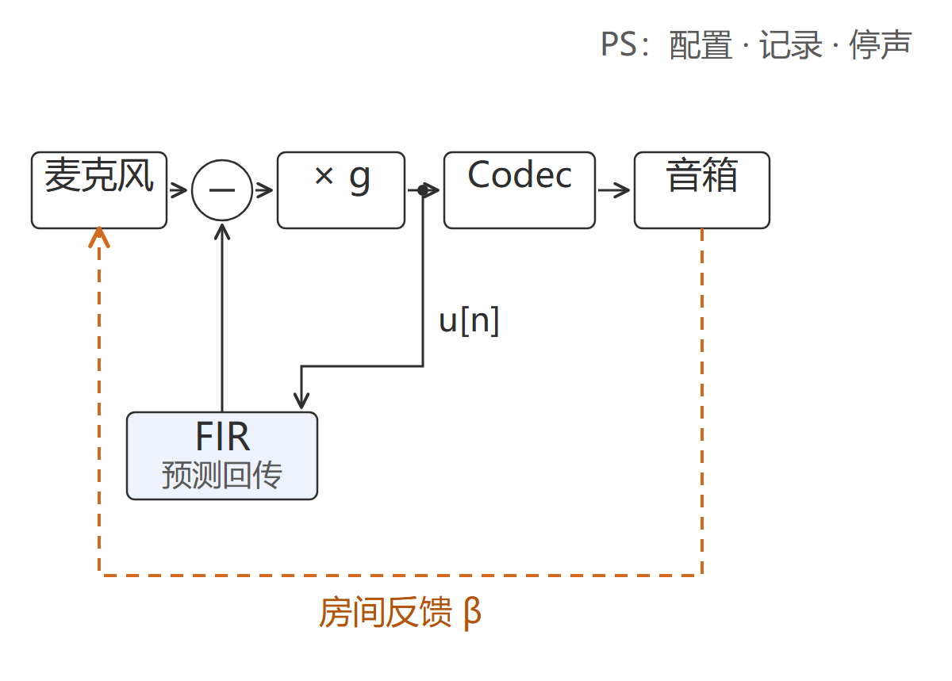


INTRODUCTION
Logo
to be supplied
Hardware photo
to be supplied
Liu Beichen, Wang Haoyu, Chen Zhiyuan
HUSH: Acoustic Feedback Suppression
with Enhanced Stability Margin
Huazhong University
of Science and Technology
Test platform
to be supplied
Real-time on Zynq-7020
Acoustic feedback is positive feedback: once the loop gain passes unity at any single frequency, howling appears within a few hundred milliseconds.
In a fixed layout such as a lectern or a meeting table the acoustic path is stable and can be identified. What is hard is that the canceller sits inside the loop: its own latency is subtracted from the stability margin before any benefit is counted, so delay is a precondition, not an optimisation.
Three issues addressed:
1. Latency inside the loop: 512 taps, 1539 of a 2048-frame budget;
2. Re-identification after the loudspeaker or microphone moves;
3. Telling cancellation apart from attenuation, not turning the volume down.
What is estimated and removed is the returning component; direct speech is never in the estimate, so it is never removed.
C
R
R
E
E
S
A
T
U
I
L
Typical application case
V
T
System Architecture
E
PL side (programmable logic):
1. 512-tap FIR, one MAC per sample;
2. Wide residual, saturation after digital gain;
3. Prediction stream aligned to lag_first = 1;
4. 1539 of the 2048-frame budget.
D
Two fixtures (enclosure, room), fixed layouts.
322 Hz three-arm, single tone, gain -8 dB: open 45.44, no cancellation 49.19, cancelling 44.43 dB -> loop boost +3.75 dB.
Room, 512 taps, per-segment residual: 150 Hz-10 kHz -11.24 dB; 8.2-8.6 kHz -23.4 dB; 300 Hz-1 kHz -4.0 dB.
XC7Z020: BRAM 80 %, DSP 3, LUT 3 588, FF 5 018, WNS +0.287 ns.
Scope: no ASG figure is claimed; reported is prediction suppression on held-out captures, not a listening result. Protection stop and cancellation benefit are stated separately.
E
S
I
N
G
PS side (processor):
1. Reads back the actual hardware identity;
2. Loads coefficients and gain, stages the model bundle;
3. Logs the run and keeps the original captures;
4. Decides the input-overload stop.

