Slide 1
LDD3 Internship
Phylogenetics and….
Emma Gairaud Hess - 20233452

Slide 2
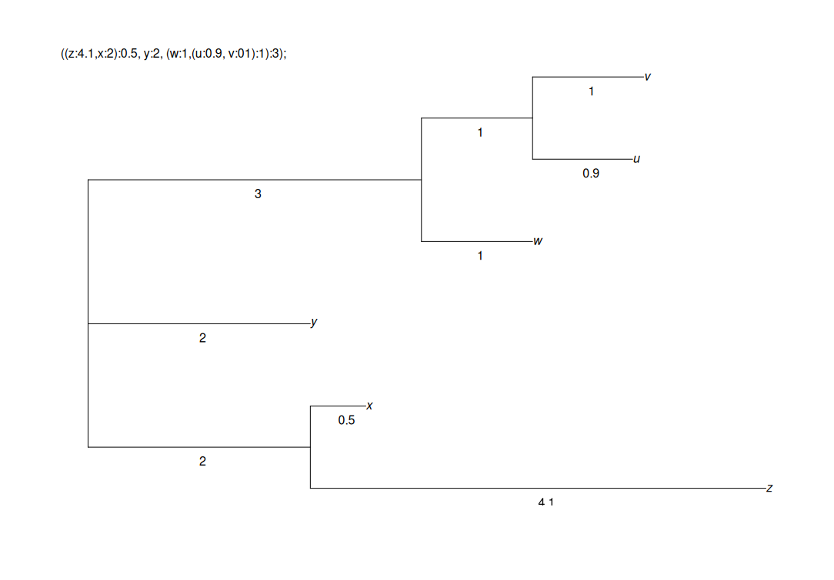
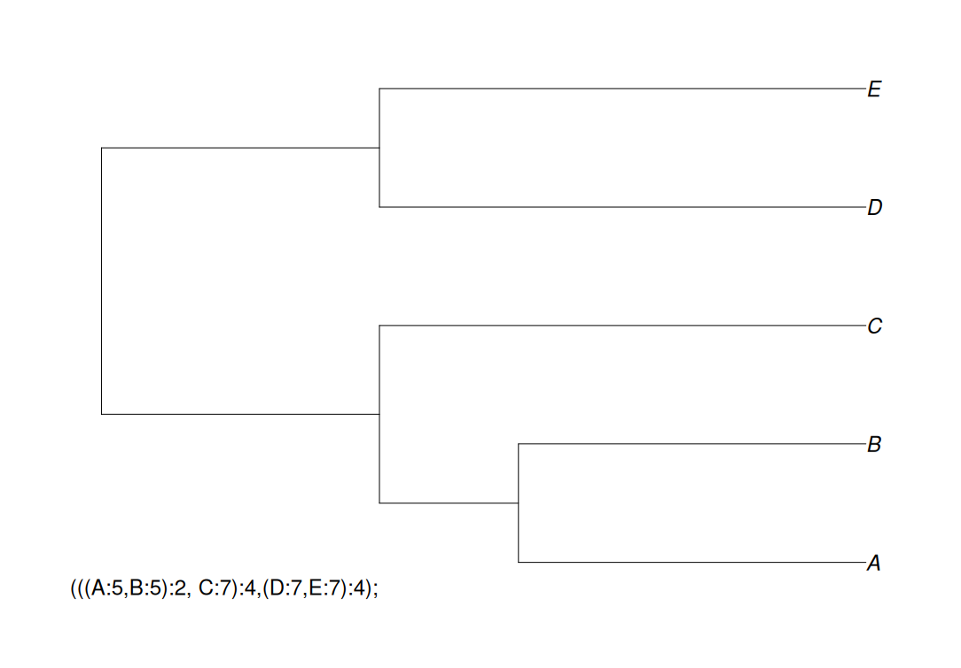
The Newick Format

Slide 3
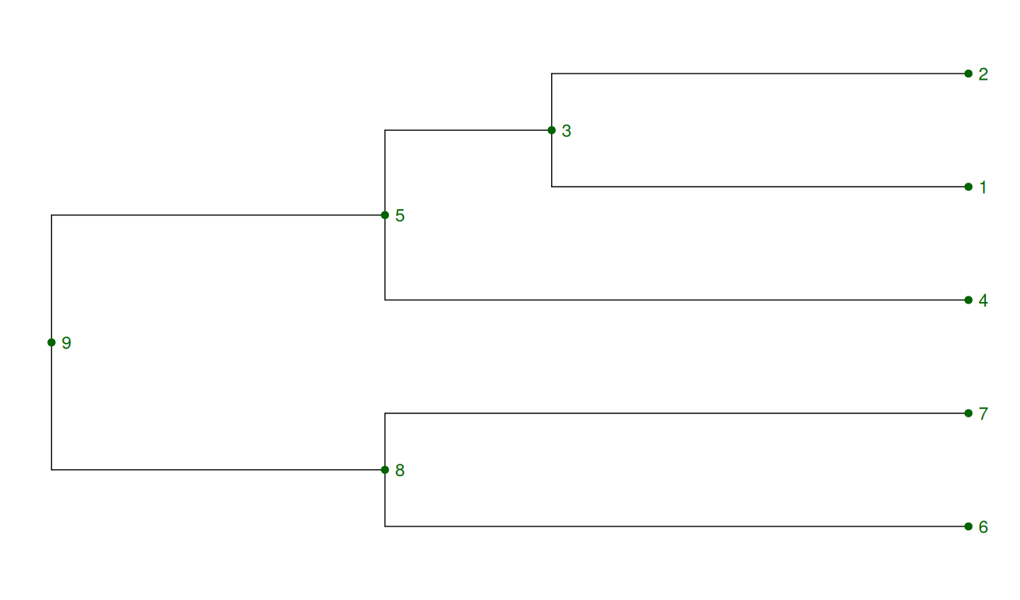
Post-order Traversal

Slide 4
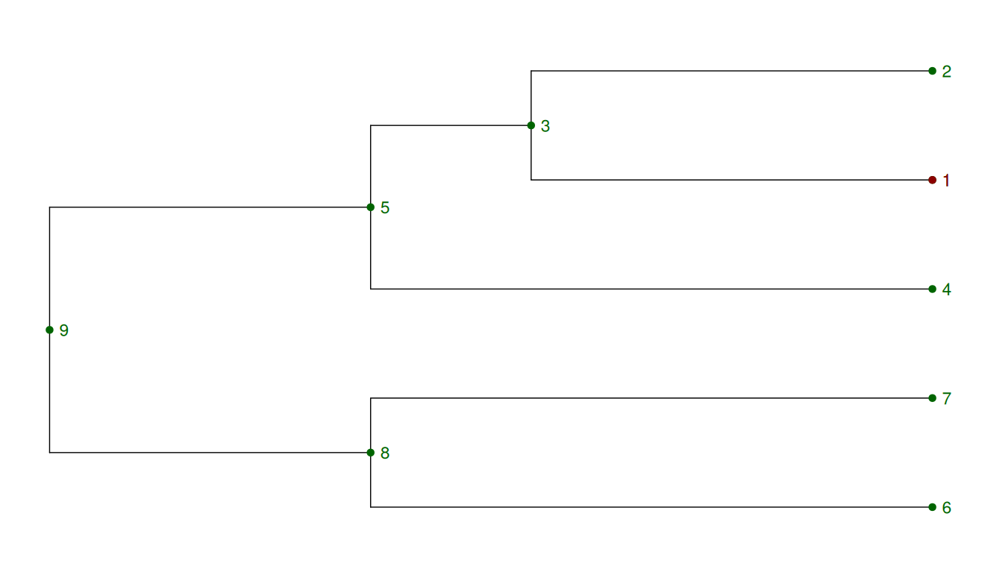
Post-order Traversal

Slide 5
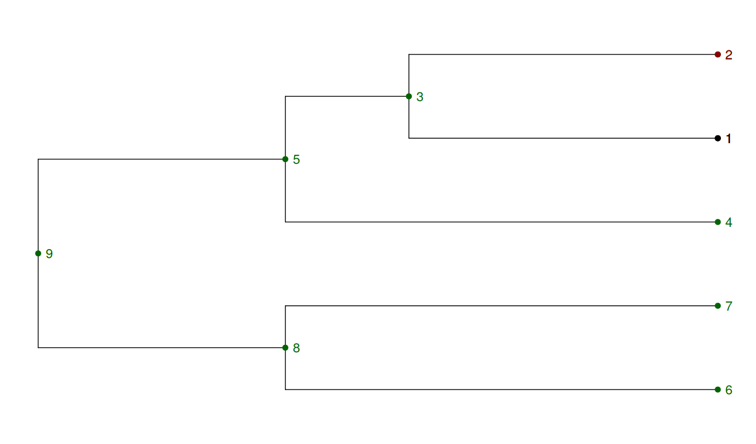
Post-order Traversal

Slide 6
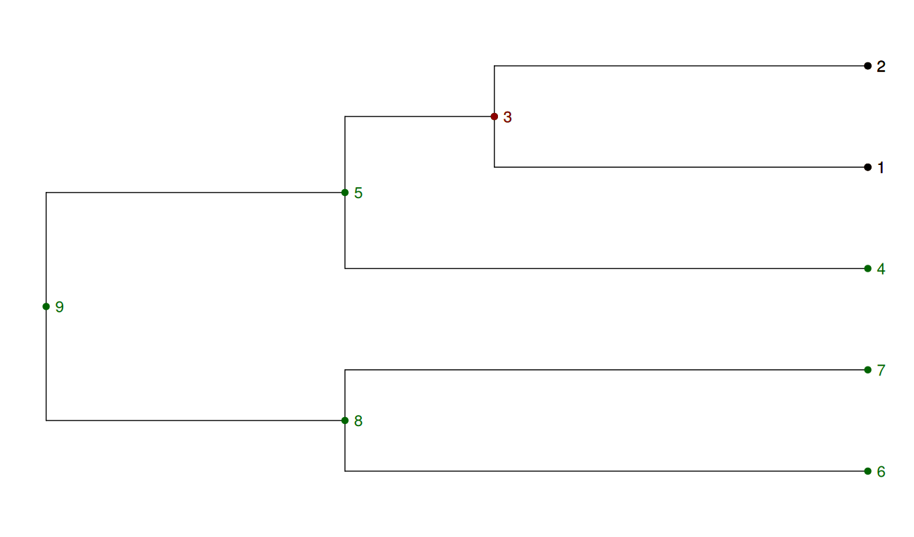
Post-order Traversal

Slide 7
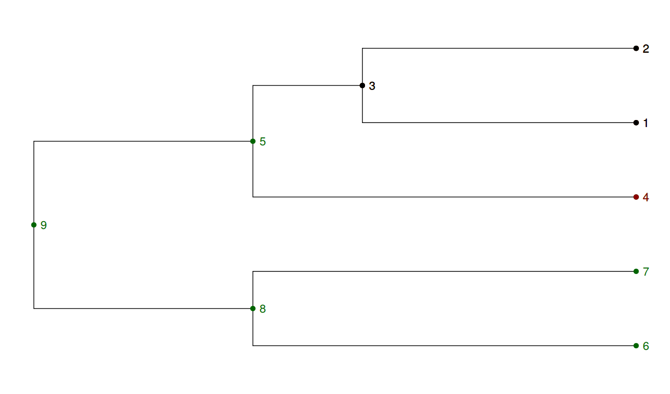
Post-order Traversal

Slide 8
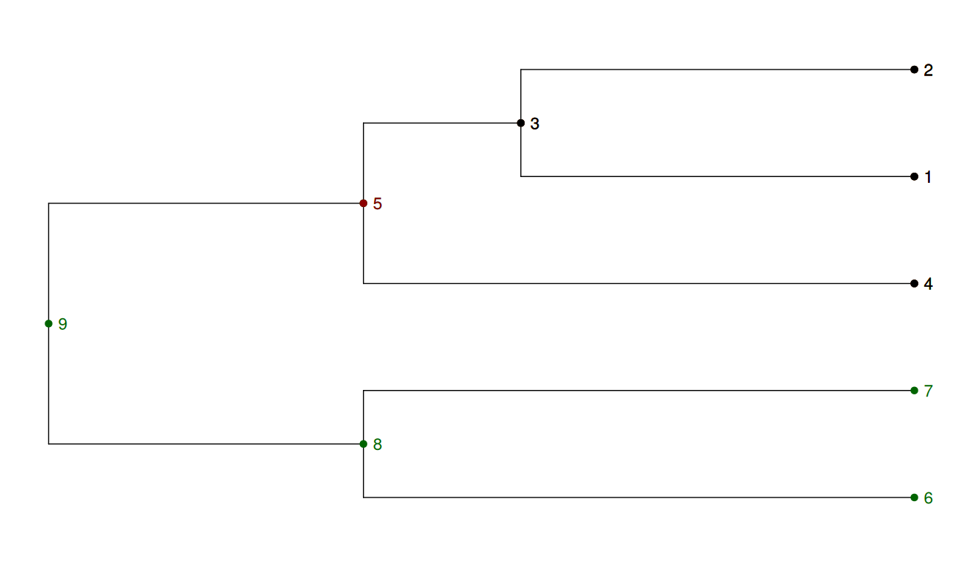
Post-order Traversal

Slide 9
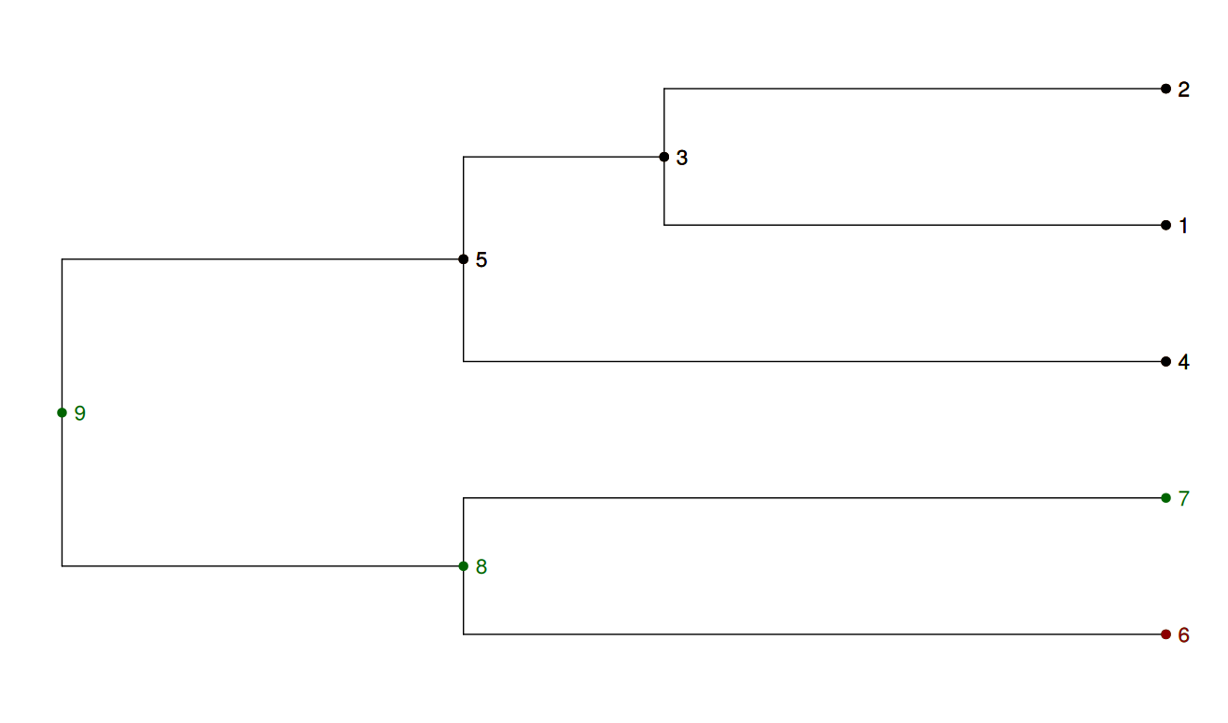
Post-order Traversal

Slide 10
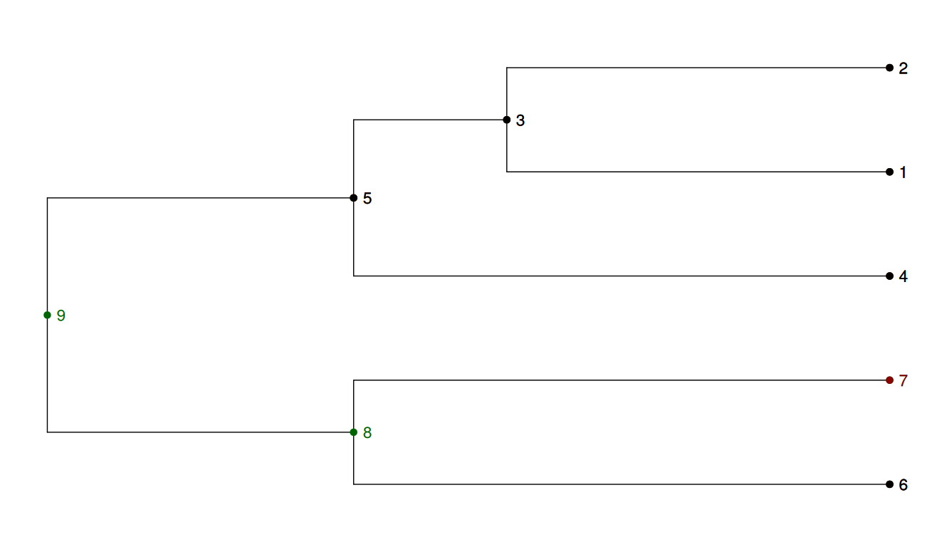
Post-order Traversal

Slide 11
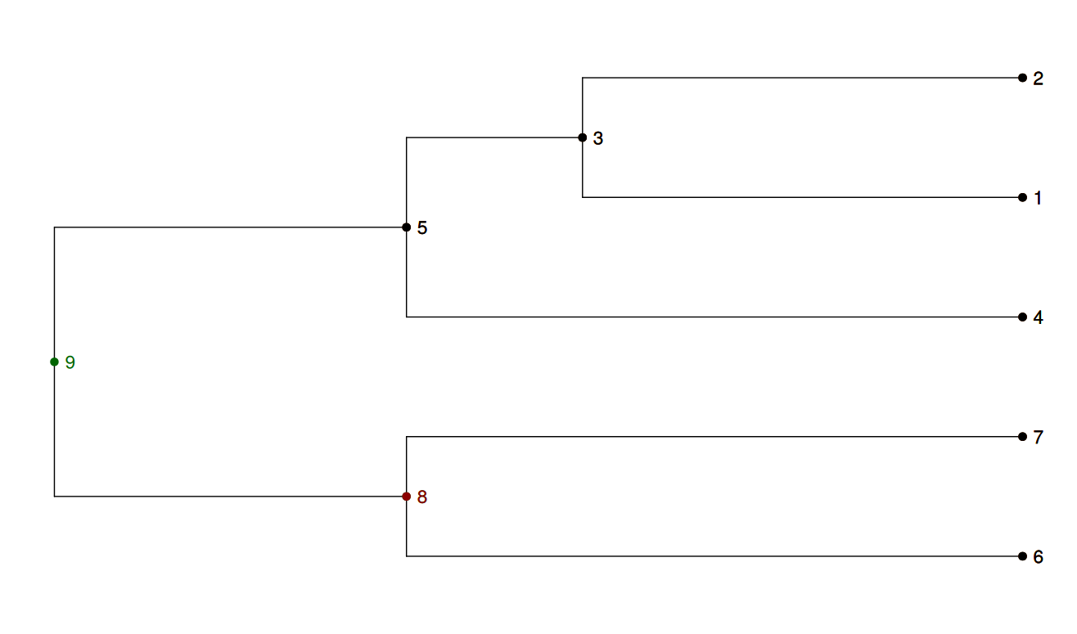
Post-order Traversal

Slide 12
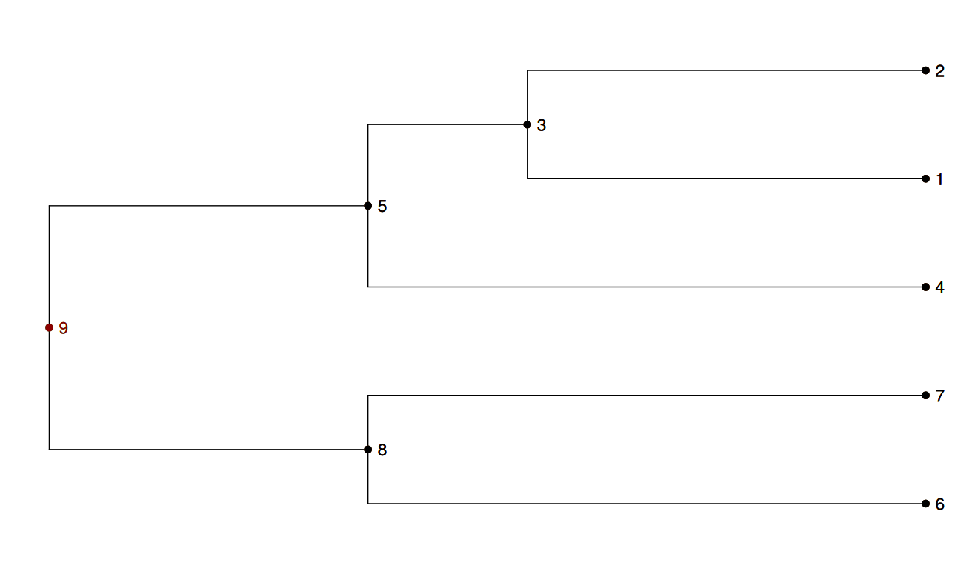
Post-order Traversal

Slide 13
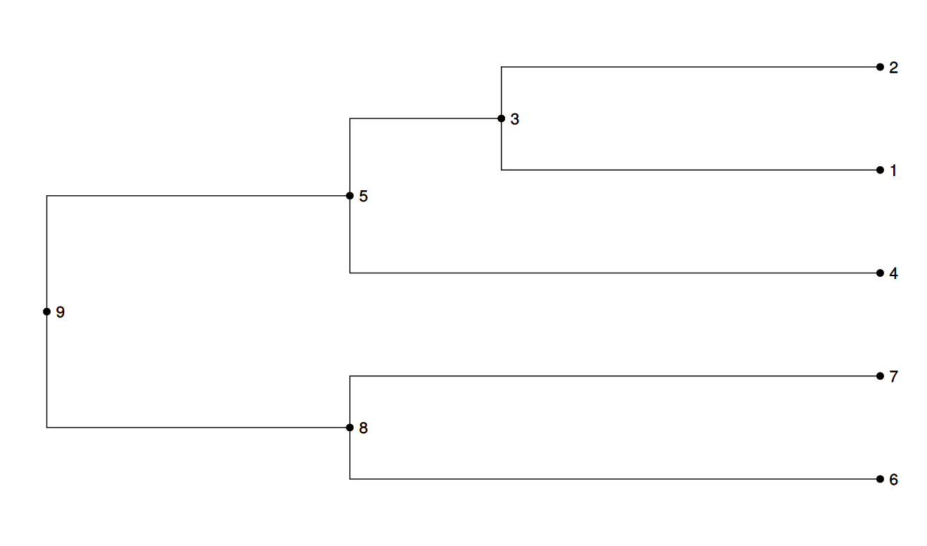
Post-order Traversal

Slide 14
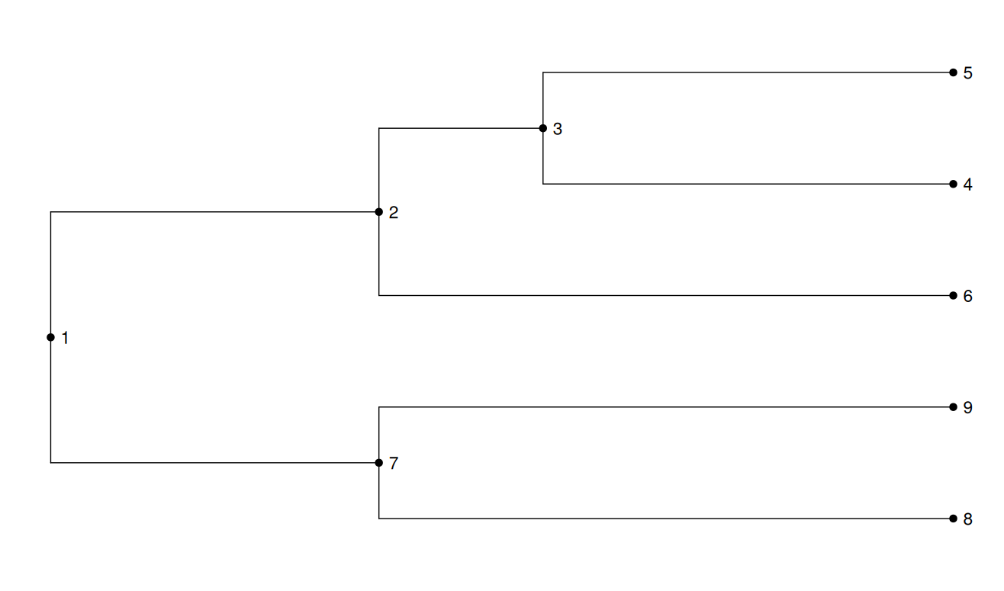
Pre-order Traversal

Slide 15
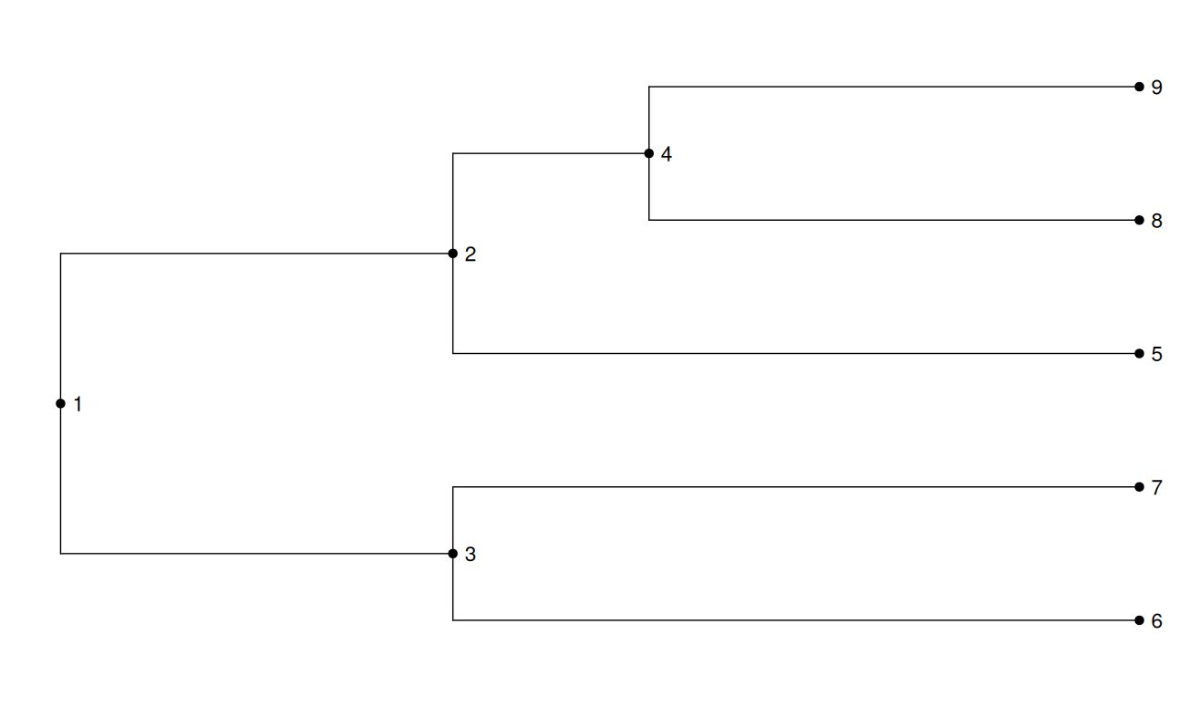
Level-order Traversal

Slide 16
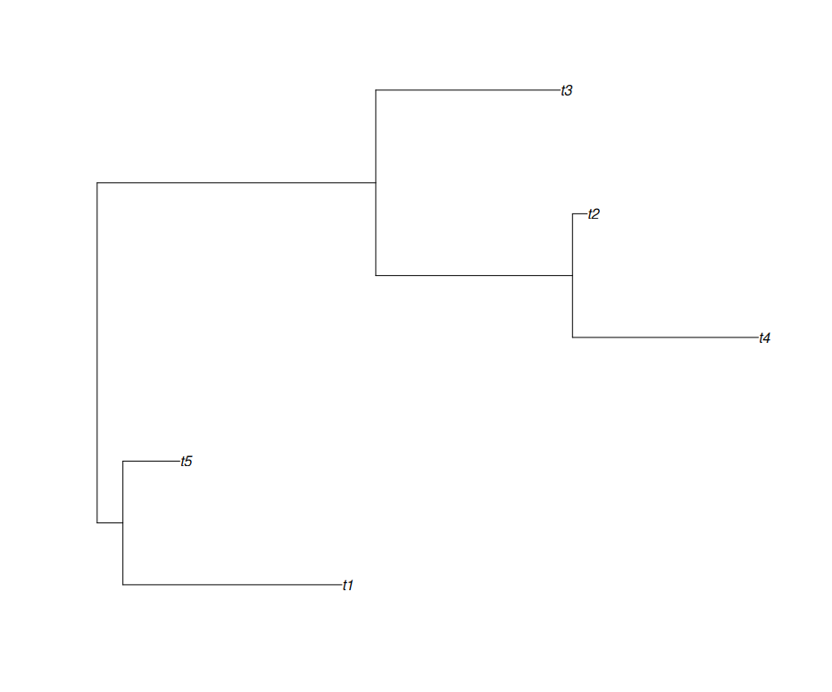
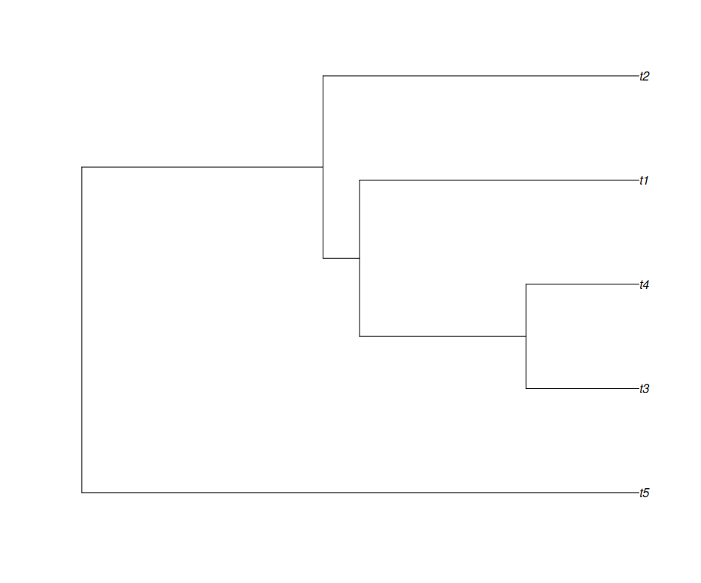
Ultrametricity

