Slide 1
Transformer models
Deep learning

Slide 2
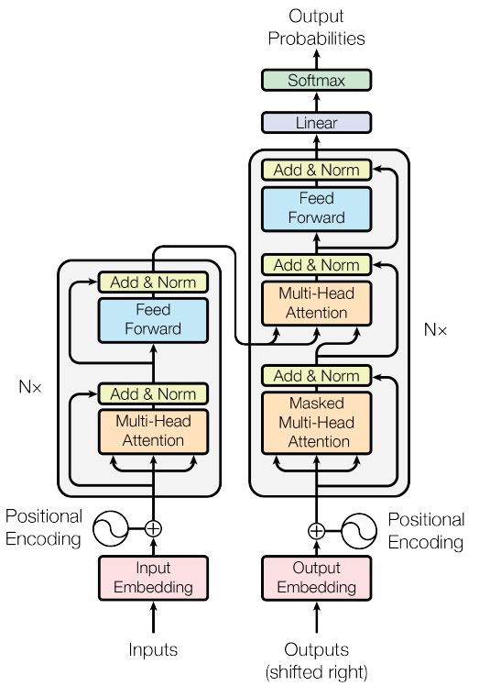
Transformer for machine translation

Slide 3
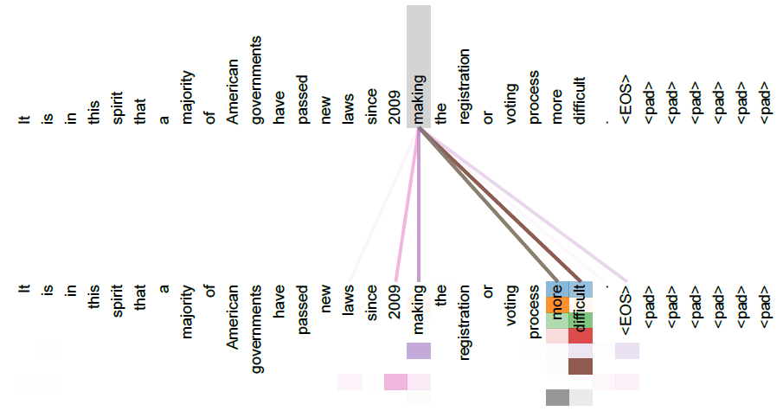
Attention visualization

Slide 4
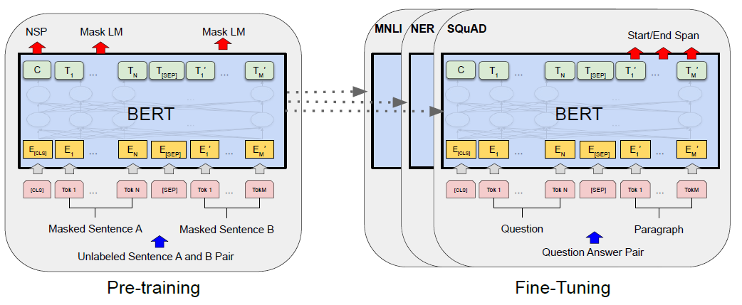
BERT (Bidirectional Encoder Representation from Transformers, 2018)
Using only Transformer encoder
Masked Language Model pretraining
Next Sentence Prediction for training CLS embedding
Fine-tuning for downstream tasks

Slide 5
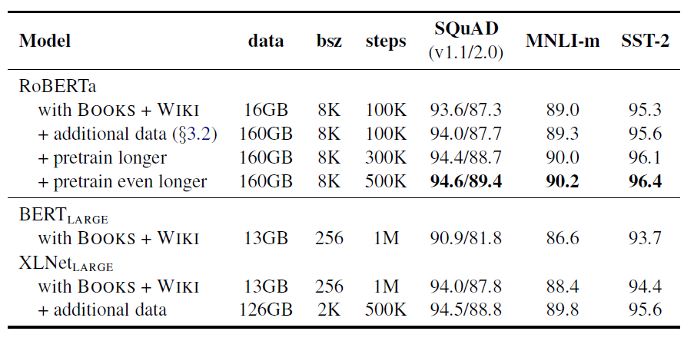
RoBERTa (2019)
Next Sentence Prediction is not used, only Masked Language Model
Randomly sampled masks
Much larger training dataset

Slide 6
ModernBERT (2024)
Modern transformer architecture: RMSNorm, Gated FFN, RoPE
Training: Masked Language Model
Local-Global interleaving self-attention: two layers with local attention (window size 128) and one layer with global attention
RoPE: for local attention theta=10000, for global attention theta=160000
Two-staged training: 1) contexts of length 1024, then 2) contexts of length 8192

Slide 7

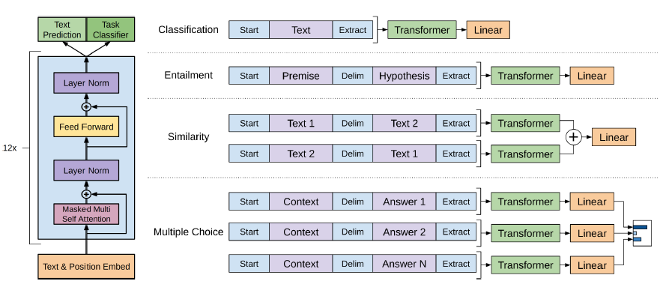
GPT-1 (Generative Pretraining from Transformers)
Using only Transformer decoder (without cross-attention parts)
Unsupervised pretraining using next token prediction
Fine-tuning for supervised tasks
Observation: fine-tuning requires only few epochs

Slide 8
GPT-like vs. BERT-like models
BERT-like models are better for token embeddings, since they look at both left and right context
GPT-like models are better for prompt answering, since they are trained in next-token-prediction fashion

Slide 9
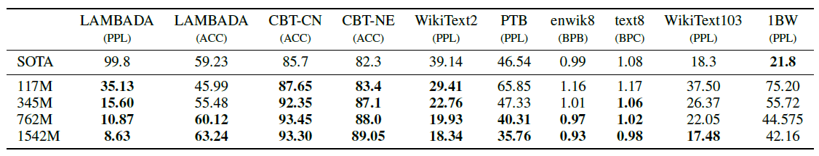
GPT-2
Increased sizes of model and dataset
Fully unsupervised training
Shows not that bad zero-shot performance

Slide 10
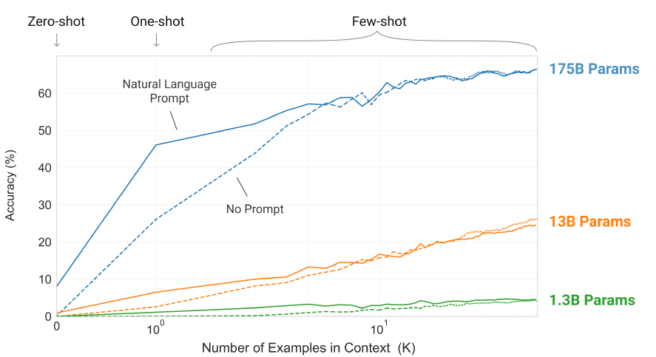
GPT-3
Significantly increased sizes of model and dataset
Fully unsupervised training
Shows much better zero-shot performance

Slide 11
LLM training pipeline
Stage 1. Pretraining using Next-token prediction
Stage 2. Learning instruction following by SFT – Supervised Fine-Tuning on golden dataset with prompts and good answers
Stage 3. Learning polite answering using DPO (Direct Policy Optimization) with preference data
Stage 4. Learning complex problem solving using RLVR (Reinforcement Learning with Verifiable Rewards)

Slide 12
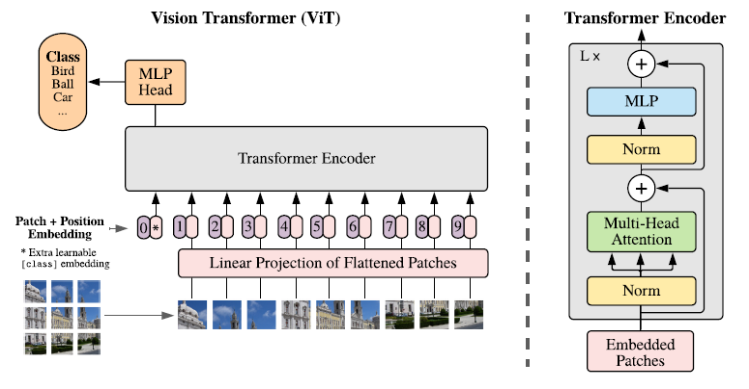
Vision Transformer
Using similar unsupervised masked pretraining mechanism for images

Slide 13
BERT/GPT models for images
Vision Transformer – an analogue of BERT/RoBERTa models, allows finding good image representation and is used as alternative to convolutional encoders
ImageGPT – an analogue of InstructGPT/ChatGPT models of image pixels, can be used for image generation, but in practice diffusion-based models like DALL-E, Stable Diffusion are usually used

