Slide 1
Semantic image segmentation

Slide 2
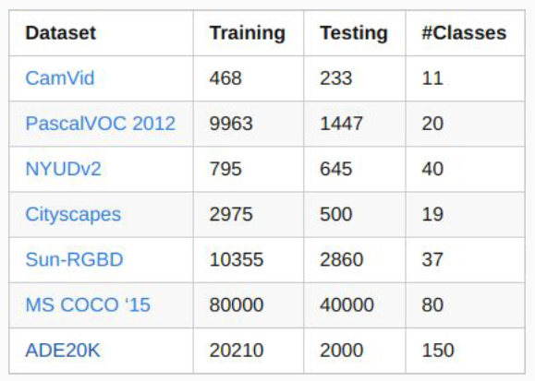
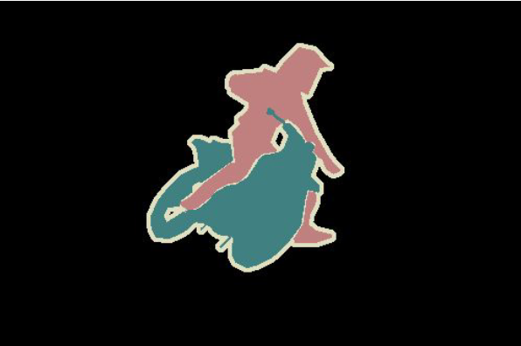
Semantic image segmentation

Slide 3
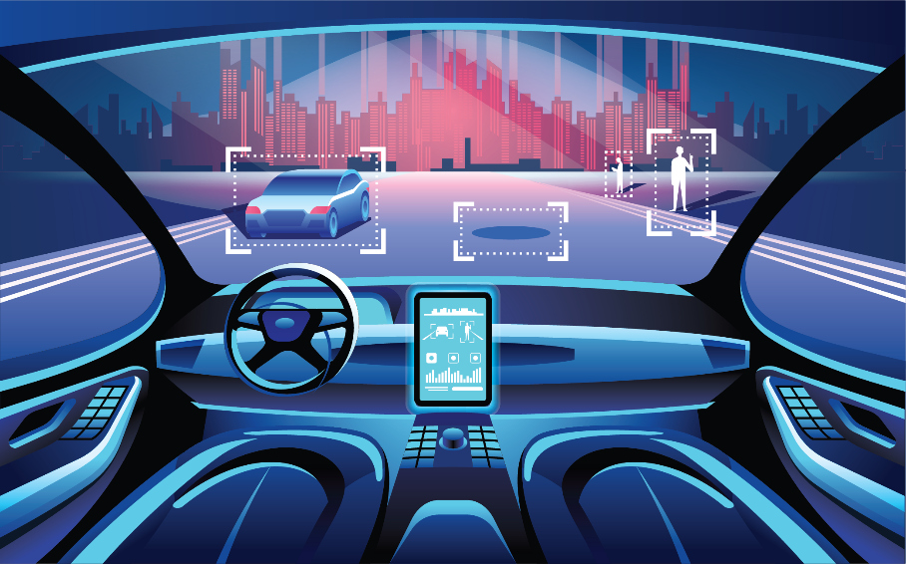
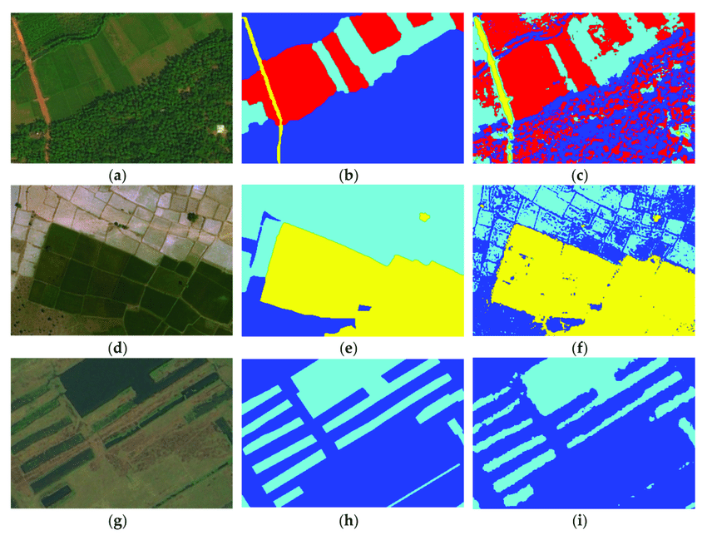
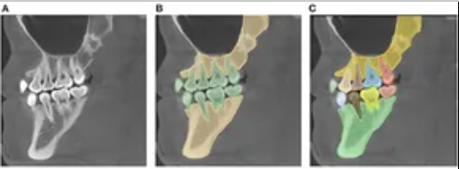
Semantic image segmentation

Slide 4
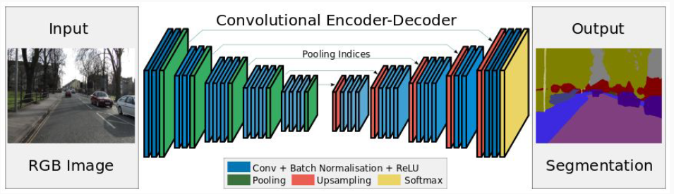
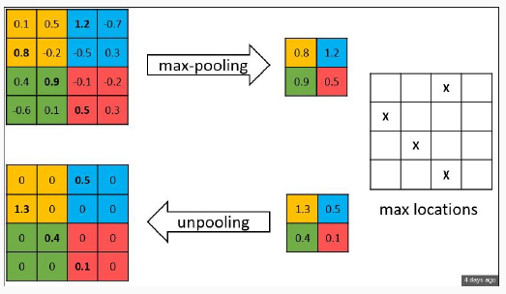
SegNet (2015)

Slide 5
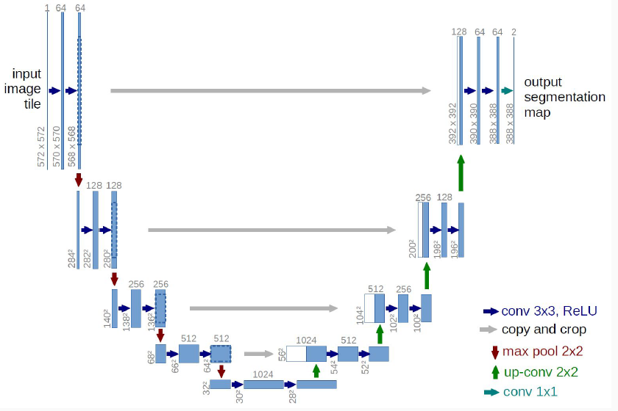
U-net (2015)

Slide 6
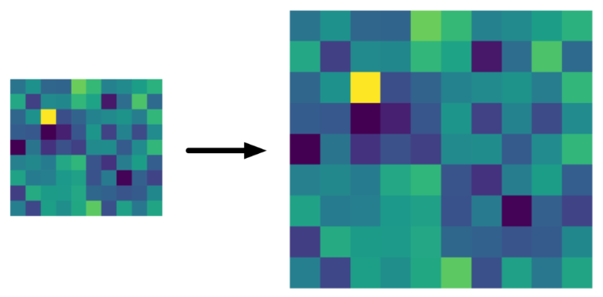
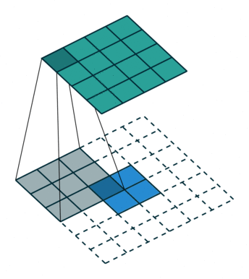
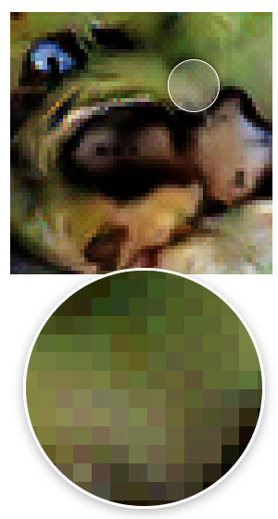
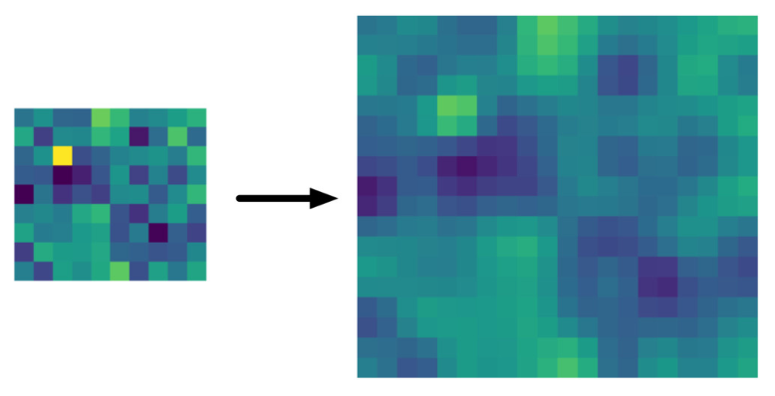
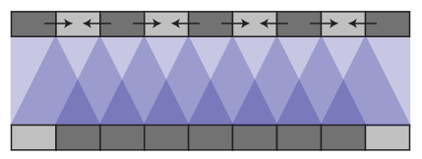
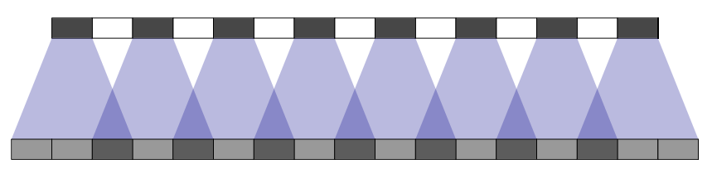
Different up-scale transforms
Nearest Neighbors upscaling:
No parameters, fast to compute
Too blocky result
Bilinear interpolation:
No parameters, fast to compute, can both upscale and downscale the result
Usually shows good results
Transposed convolutions:
has learnable parameters
may slow to compute
may lead sometimes to checkerboard patterns
An article about checkerboard effect

Slide 7
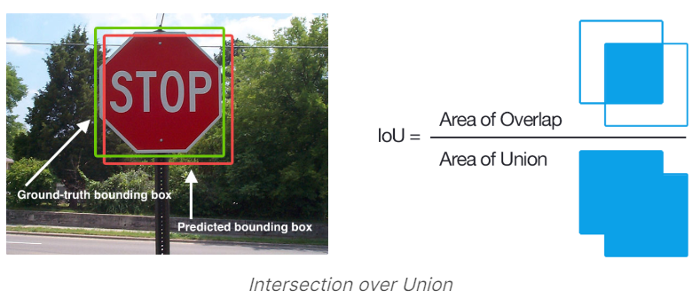
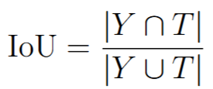
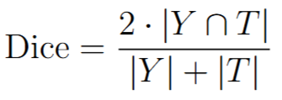
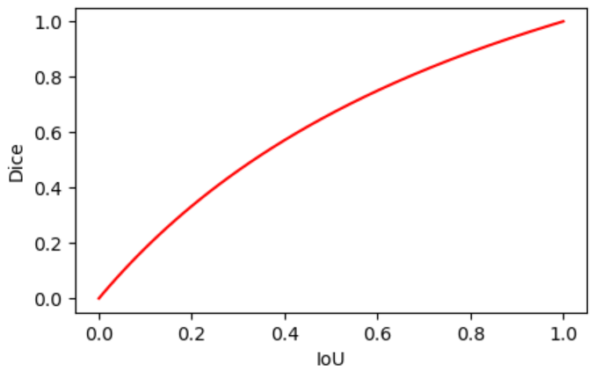
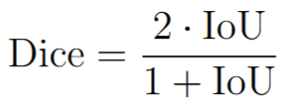
Measuring performance for semantic segmentation
Main problem: different segments may be very imbalanced in size => standard accuracy can be misleading
Dice and IoU are monotonically dependent:

Slide 8

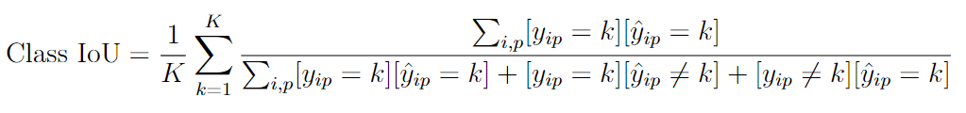
Testing performance
Main metric:
Auxiliary metric:

Slide 9
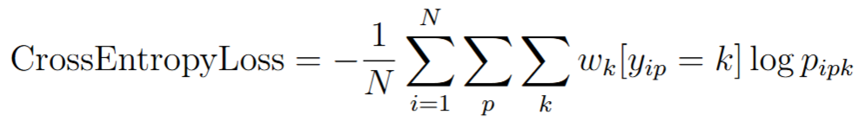
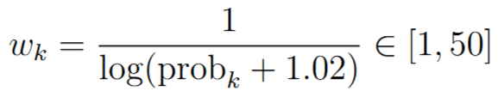
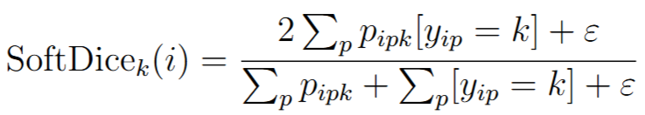
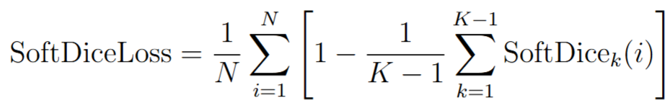
Training losses
Background class can be excluded

Slide 10
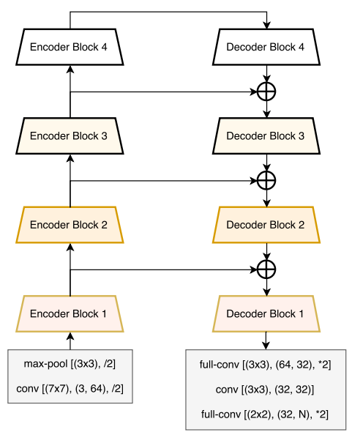
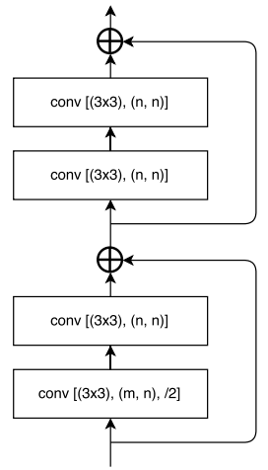
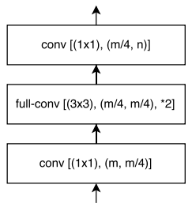
LinkNet (2017)
Decoder block
Encoder block

Slide 11
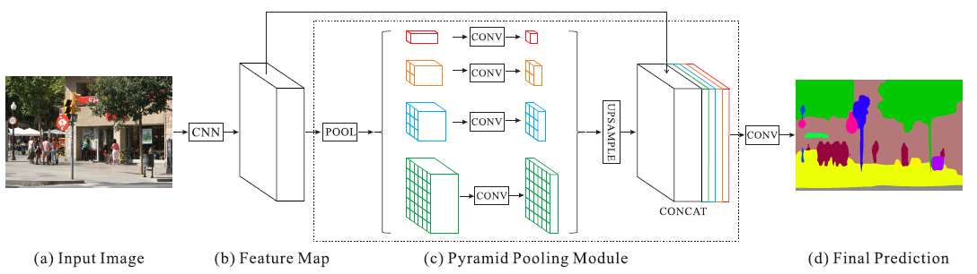
PSPNet (2016)

Slide 12
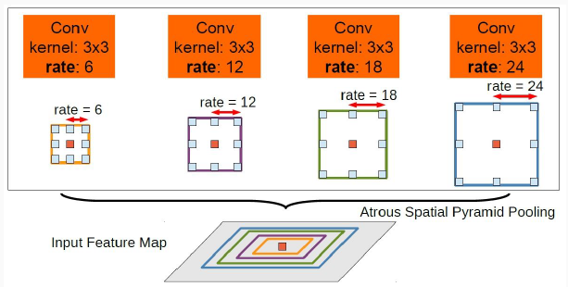
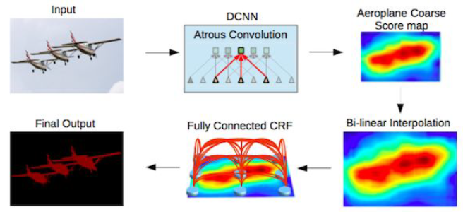
DeepLab v1, v2, …

Slide 13
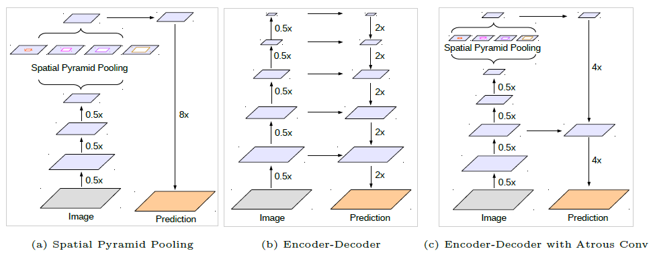
DeepLab v3+

Slide 14
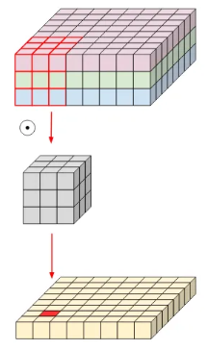
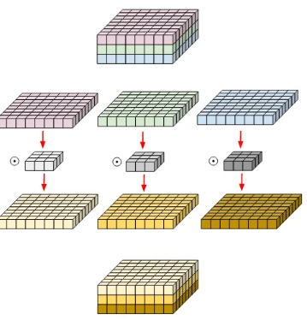
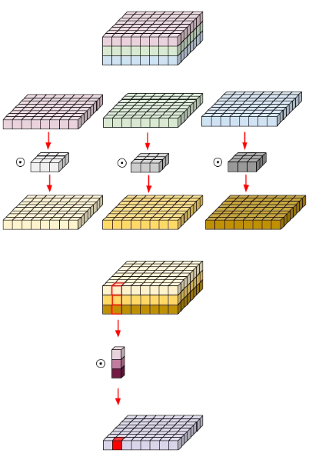
Depth-wise separable convolution
Normal convolution
Depth-wise convolution
Depth-wise separable convolution
No. of params for 3 output channels: 3*(3*3*3)
No. of params: 3*3*3
No. of params for 3 output channels: 3*3*3 + 3*(3*1)

Slide 15
Image segmentation
Main architectural ideas with convolutional NNs:
  Encoder-decoder structure with connections on different resolution levels
  Pyramid Pooling Module (PPM) or Atrous Spatial Pyramid Pooling (ASPP) for analyzing images on different scales and better consider global context
  Depth-wise separable convolutions for a smaller number of parameters and faster computations

Slide 16
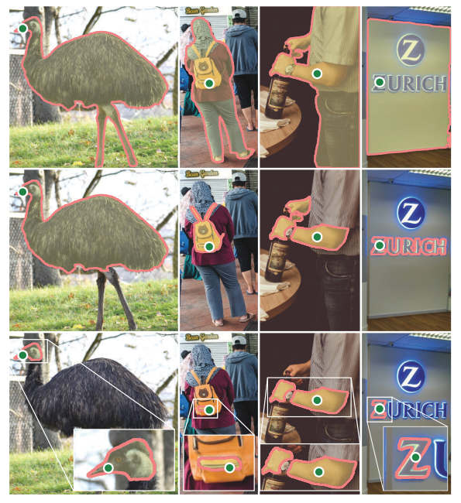
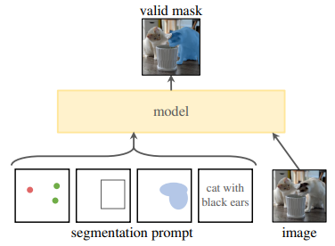
Segment Anything Model for interactive segmentation (SAM)

Slide 17
Object detection on images

Slide 18
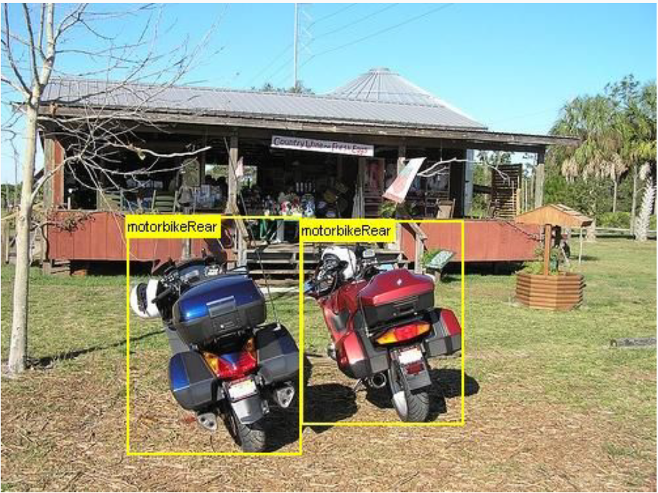
Object detection

Slide 19
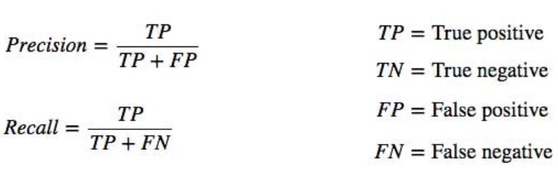
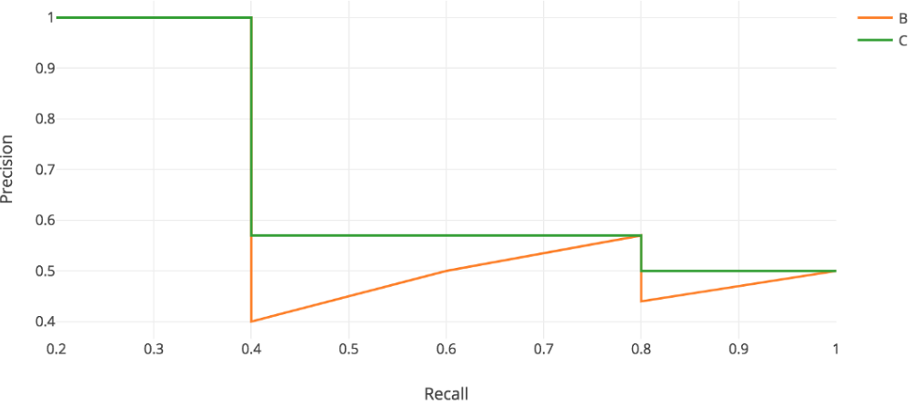
Measuring detection performance
Many sources of errors in detection: classification errors, localization errors, duplicates, non-found bounding boxes, etc.

Slide 20
Measuring detection performance
mAP computation scheme
1. For each class: for all testing images take all bounding-boxes predictions for given class with their classification scores.
2. Init: TP = 0, FP = 0, FN = #GT BBs for this class
3. Sort all BBs w.r.t. classification scores and sequentially compute:
  3.1. If BB hat IoU >= 0.5 with GT BB for this class and this GT BB is not assigned to some predicted BB, then TP+=1, assign GT BB to given BB, FN-=1
  3.2. If BB hat IoU >= 0.5 with GT BB and this GT BB is already assigned (duplicate) or IoU < 0.5, then FP+=1
  3.3. Compute Precision, Recall values
4. Compute AP = Area under PR-curve
5. Compute mAP = AP averaging w.r.t. all classes
6. Compute mAP@[0.5:0.95] by averaging mAP at different thresholds for IoU.

Slide 21
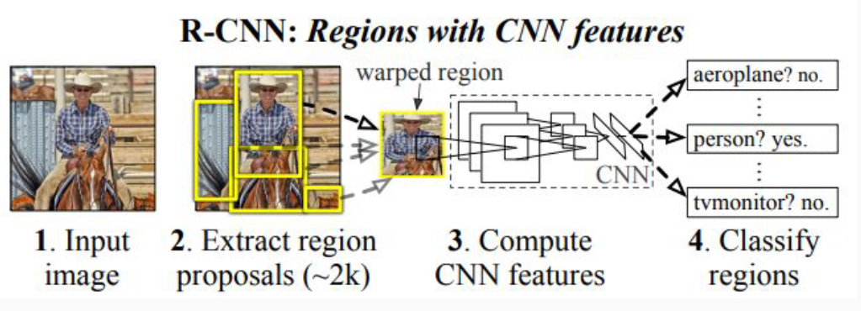
R-CNN (2013)

Slide 22
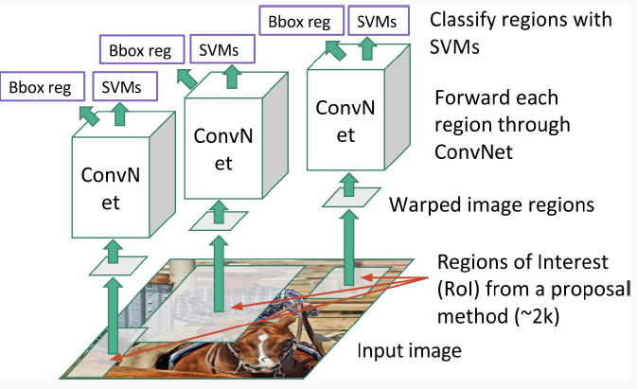
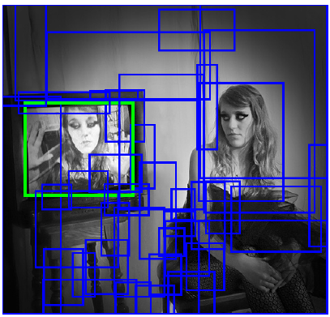
R-CNN (2013)
Training:
1) Generation of region proposals using Selective Search (classic CV algorithm = agglomerative clustering on superpixels)
2) Training classifiers and regressors

Slide 23
R-CNN (2013)
Inference:
Generate region proposals
For each region find class probabilities and regression correction coefficients
For each class make greedy non-maximum suppression

Slide 24
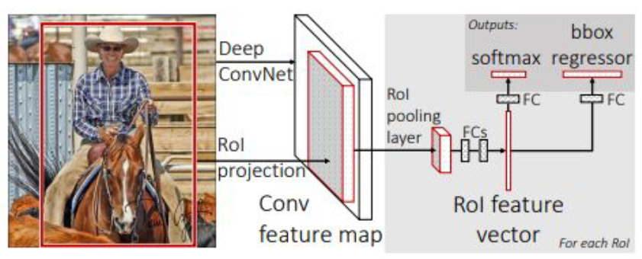
Fast R-CNN (2015)
Main idea: CNN is applied for each image only once
Training in one stage

Slide 25
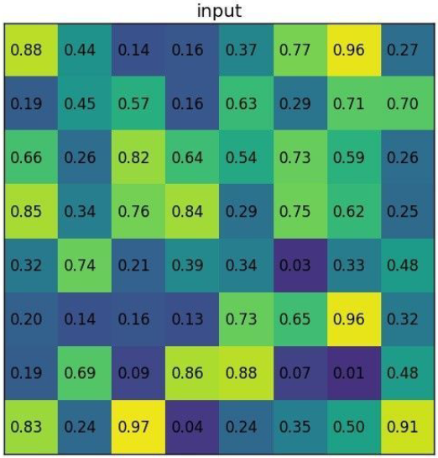
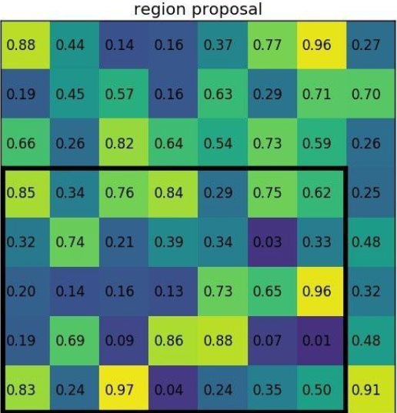
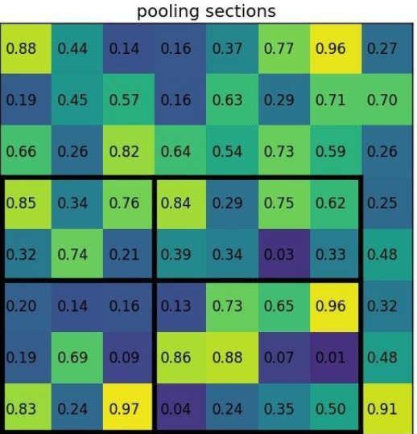
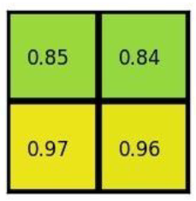
Fast R-CNN (2015)
Finding fixed-sized vector for each RoI

Slide 26
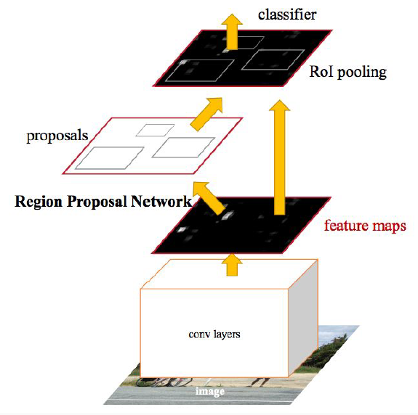
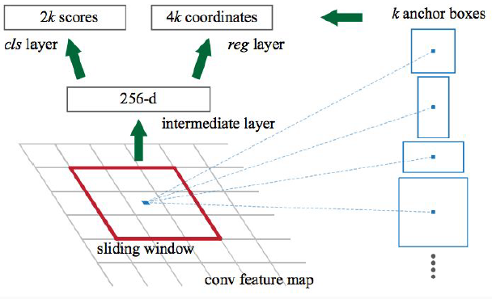
Faster R-CNN (2015)

Slide 27
Faster R-CNN (2015)
RPN training:
Find all anchors
Skip/truncate anchors intersecting image boundaries
Determine positive and negative anchors using IoU with true bounding boxes
Train object presence classifier and bbox regressor
RPN testing:
Predict regions
Apply greedy non-maximum suppression
Select top 2000/300 by object presence probability

Slide 28
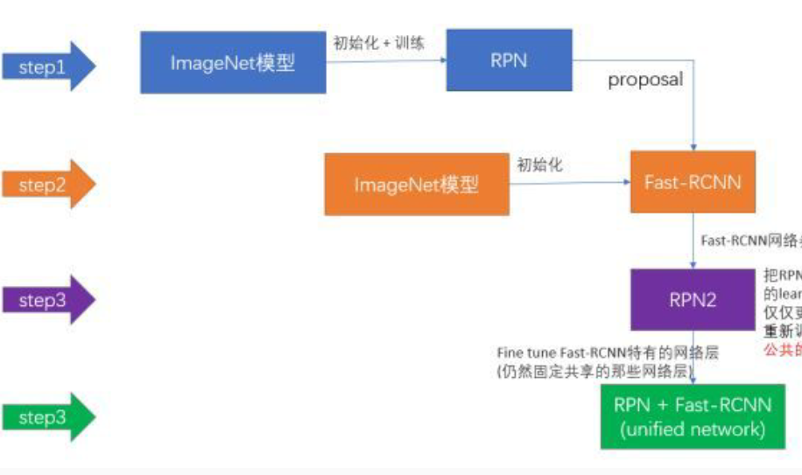
Faster R-CNN (2015)

Slide 29

Test time speed for R-CNN family

Slide 30


Adding Feature Pyramid Network (FPN) to Faster R-CNN

Slide 31


SSD (2016)
One stage object detection

Slide 32


YOLO family (v1, v2, …, v12, …)

Slide 33


RetinaNet (2017)
Focal loss

Slide 34

Instance segmentation

Slide 35


Mask R-CNN

Slide 36
Image style transfer

Slide 37

Image style transfer
Inputs: content image, style image
Output: stylized image

Slide 38
Optimization-based ST (Gatys et al., 2015)
Consider convolutional neural network (VGG)
Content is reconstructed from activations on different layers
Style is reconstructed from correlation of its activations on different layers

Slide 39

Optimization-based ST

Slide 40


Optimization-based ST

Slide 41

Optimization-based ST

Slide 42

Transformation-based ST (Johnson et al., 2016)

Slide 43

Transformation-based ST

