Slide 1
Decision Trees Feature Importance

Slide 2
Decision Trees Motivation
Gives interpretable solution from human point of view
Directly deals with categorical features and missing feature values
A building block in composition algorithms like Random Forest and Gradient Boosting

Slide 3
Introduction to Decision Trees
Example: job interview for Data Scientist position
Logistic Regression?
no
yes
Overfitting effect in ML and how to cope with it?
Dual optimization problem?
no
yes
no
yes
Reject
Further first-step interview
Further interview for Data Engineer
Can be recommended to Research Department

Slide 4
Introduction to Decision Trees
Example: loan approval in bank
Credit score > 60
no
yes
Monthly income > 3000 euro
Debt-to-Income rate < 40%
no
yes
no
yes
Reject
Approve with higher loan rate
Approve with standard conditions
Approve with VIP conditions

Slide 5




Decision Trees
Decision tree is a binary tree, where
In all internal nodes there are some logical predicates
In all leaf nodes there is some prediction
For regression:
For K-class classification:

Slide 6


Decision Tree for prediction
Predict(v, x):
If v is a leaf, then return
If :
return Predict(left(v), x)
Else:
return Predict(right(v), x)
Call Predict(v=root, x)

Slide 7



Types of predicates
Comparison of some feature value with some threshold:
Linear predicate:
Distance to given object:
In practice usually the simplest variant 1 is used, because it already allows building a universal approximator

Slide 8
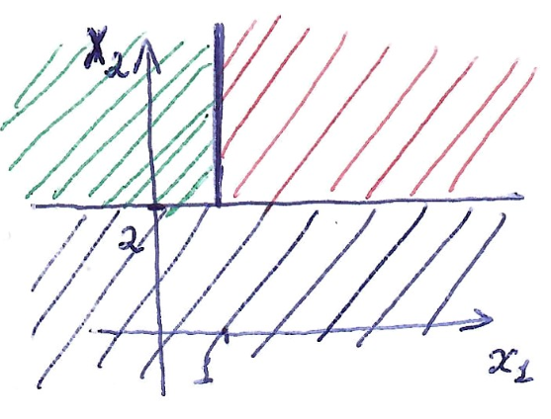


Decision Trees for simple predicates
DT builds piecewise constant prediction in feature space.
yes
no
blue region
yes
no
green region
red region

Slide 9
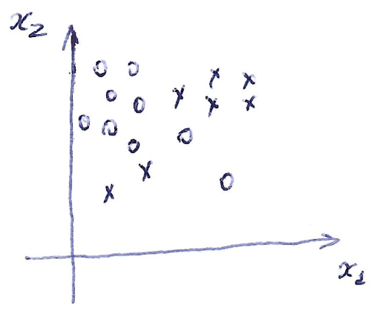
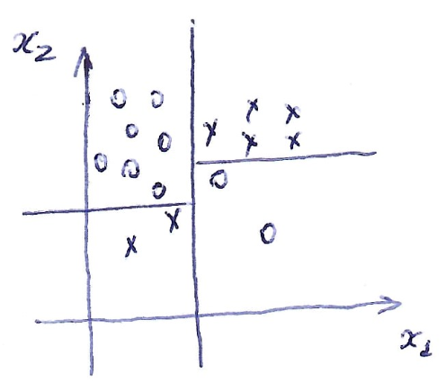
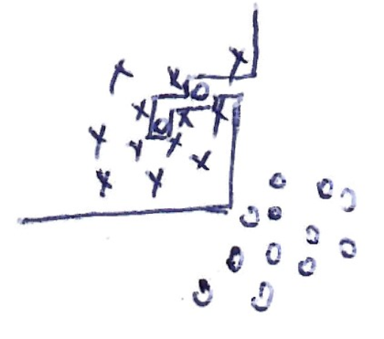
Decision Trees for simple predicates
With enough splitting steps DT with threshold predicates is able to overfit to arbitrary dataset!

Slide 10







Training Decision Trees
Procedure
If stopping criteria is satisfied:
find prediction
m = leaf
exit

Slide 11
Training Decision Trees
Choose stopping criteria
Choose constant prediction in leaves
Choose splitting criteria
Choose pruning method
Choose the way to work with missing values and categorical features
These exist many DT implementations: ID3, C4.5, CART, etc.

Slide 12

Stopping criteria
If all objects belong to one class (quality of constant prediction is below some threshold)
If maximal tree depth is reached
If
If maximal number of leaves is reached
If a splitting criteria in current node is below some threshold

Slide 13





How to find prediction in leaf?
Regression:
MSE
MAE
Classification:
Most frequent class
Class probabilities (the same as to use logistic loss in minimization)

Slide 14


How to find good predicate?
Let’s introduce some Impurity criteria
Impurity is higher if diversity of target values is higher
Criteria for finding good predicate = big reduction of impurity (Information Gain):
Note: For DT there is no necessity to make a preliminary feature normalization

Slide 15




Impurity for regression

Slide 16
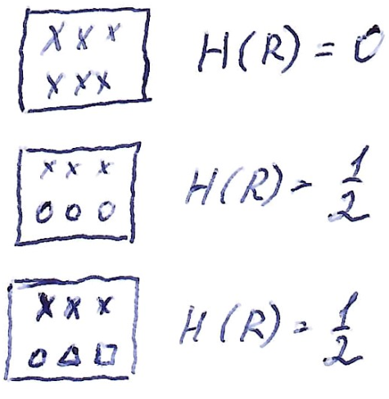
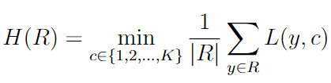

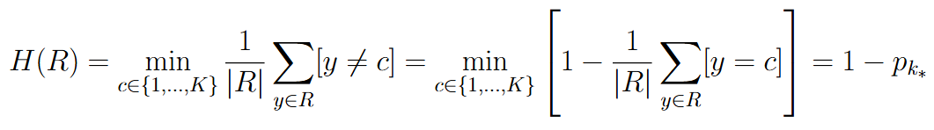
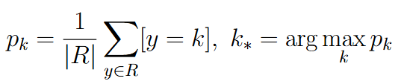
Impurity for classification

Slide 17


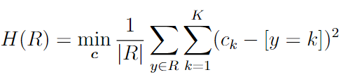



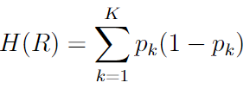
Impurity for classification: Gini index
From Logistic Regression discussion we have two loss functions that allow to learn probabilities: quadratic loss and logistic loss. Let’s try both of them.

Slide 18
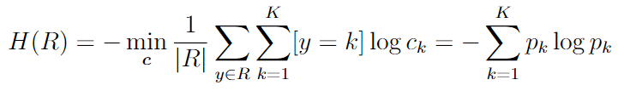
Impurity for classification: Entropy criterion
Gini index and entropy criterion show in practice similar performance

Slide 19
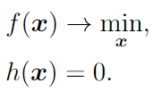



Recap: constrained minimization
Let’s consider optimization problem with some equality constraint:
Lagrange function:
If is a local constrained minimum then

Slide 20
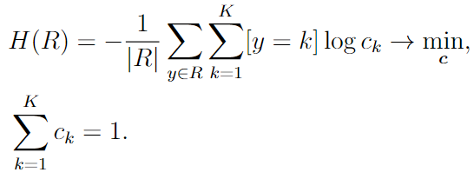
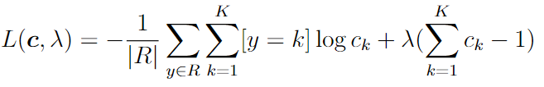
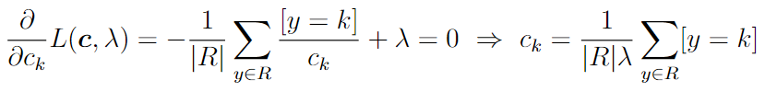
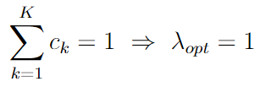

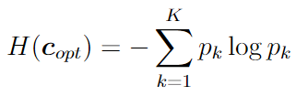
Minimizing Entropy criterion

Slide 21
Pruning for decision trees
In order to control overfitting in decision trees Pre-pruning and Post-pruning methods are used
Pre-pruning: find hyperparameters like maximal tree depth, minimal number of samples in each leaf, minimal number of samples in internal node using cross-validation, e.g. using Optuna
Post-pruning: first construct full tree and then simplify it by pruning some of its subtrees

Slide 22



Cost Complexity Pruning
Solves the problem of balancing DT quality and simplicity:
- sum of loss function values (Variance, Gini index, Entropy) for all leaf nodes
- number of tree nodes
- hyperparameter that is tuned using cross-validation

Slide 23
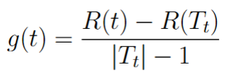

Cost Complexity Pruning
Stage 1. Find a grid of alphas.
Step 1. Build DT on training set until reaching perfect quality.
Step 2. For each internal node compute:
- DT quality, when t is collapsed to leaf.
Step 3. Find smallest g(t), collapse the corresponding leaf, recompute g(t) for all leaf predecessors, repeat the procedure until only root is left. Store g(t) for collapsed leaves as a set of alphas.

Slide 24
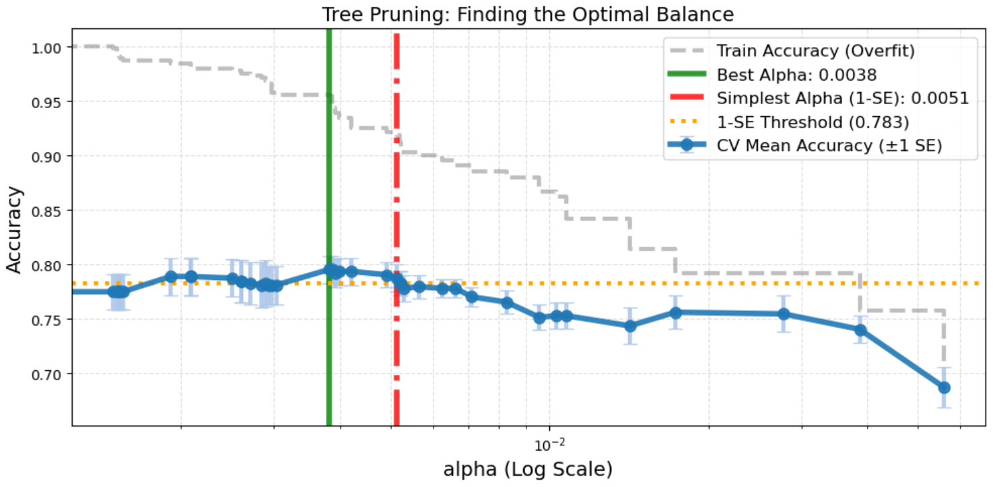
Cost Complexity Pruning

Slide 25
Cost Complexity Pruning
Stage 2. Choose best alpha
Step 1. For each alpha and for each CV split train DT on train part and validate on test part.
Step 2. Choose alpha with the best CV score. Alternative: choose the highest alpha with score >= best_score – one CV std
Step 3. Train DT on full train set using chosen alpha

Slide 26
Cost Complexity Pruning
In ML compositions with many decision trees (Random Forest, Gradient Boosting) pruning procedure is usually not used.

Slide 27
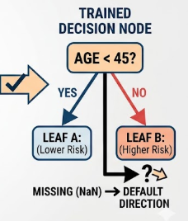
Working with missing/unknown values in decision trees
Idea: set default direction (left/right) for unknown feature value in each node
Method: on each split send all objects with unknown feature value 1) to left subtree and 2) to right subtree. For each case compute Information Gain (IG) and set default direction for higher IG.

Slide 28

Working with categorical features in decision trees
Strategy 1: Number of children = number of categories
Advantage: one-hot-encoding and binary splits requires tree depth q in order to process all possible feature value; here instead we do only one split
Disadvantage: for large q may lead to splits with many tiny sets and overfitting

Slide 29



Working with categorical features in decision trees
Strategy 2: Split all categories into two subsets
Direct implementation requires here number of splits

Slide 30




Working with categorical features in decision trees
- objects from the current set with category u
Let’s sort all categories w.r.t. target variable
Binary classification:
Regression:
Transform categorical feature into numerical one and compute Gini index or entropy criteria
For binary classification and regression this is an exact procedure

Slide 31
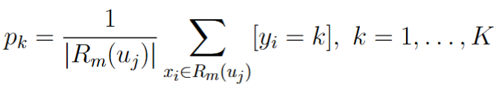
Working with categorical features in decision trees
K-class Classification: for each category u_j compute a vector of probabilities for each class k:
For a space of probability vectors make dimension reduction to 1d space using PCA and sort all vectors w.r.t. this 1d coordinate
Find best split by computing Gini index on this new numerical feature
For K-class classification this is a heuristics

Slide 32


Decision Tree as a linear classifier
DT can be interpreted as constructing a linear classifier/regressor on top of learnable features

Slide 33
Feature Importance

Slide 34
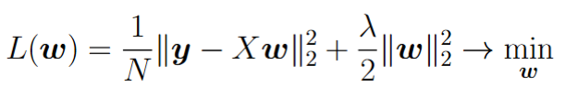

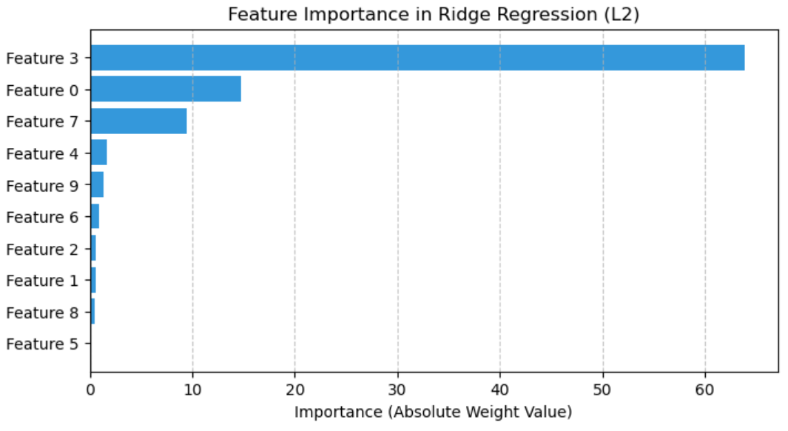
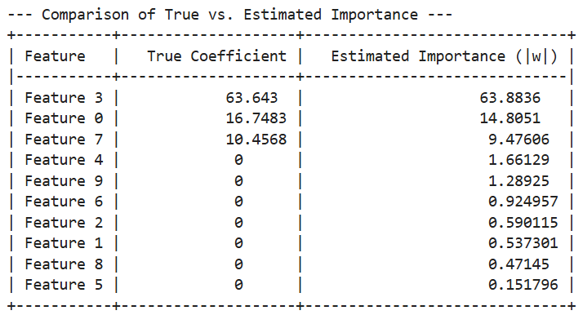
Linear Regression with L2 regularizer
Normalize features, train L2-regularized Linear Regression and use as feature importance value
Experiment: generate data from linear model and estimate feature importance

Slide 35

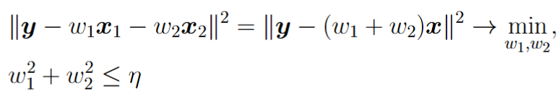
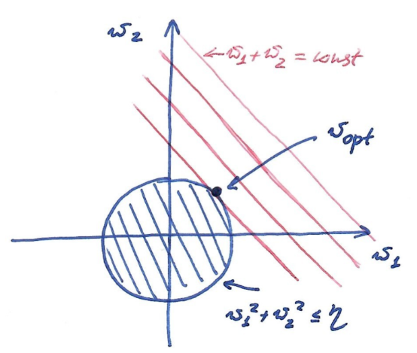

Linear Regression with L2 regularizer
Let’s consider two identical features
Regression training:
Weights after training:
Result: feature importance is spread across several correlated features

Slide 36



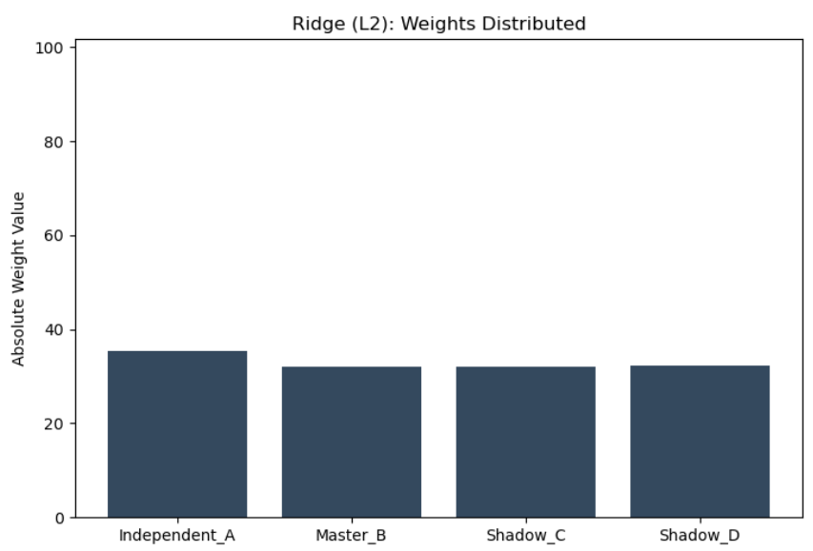
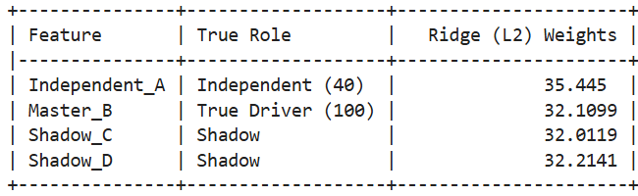
Linear Regression with L2 regularizer
Experiment:
- independent features
- correlated features
- target value

Slide 37
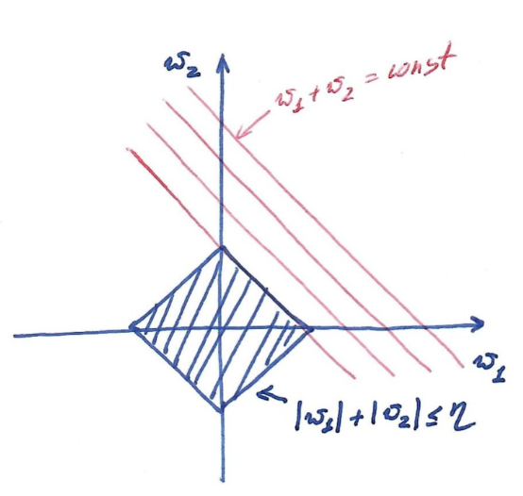
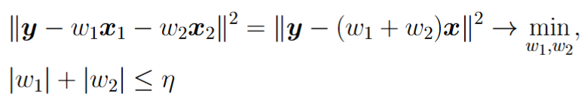

Linear Regression with L1 regularizer
Regression training for the case of two identical features:
Result:
For two highly correlated, but not identical features:

Slide 38
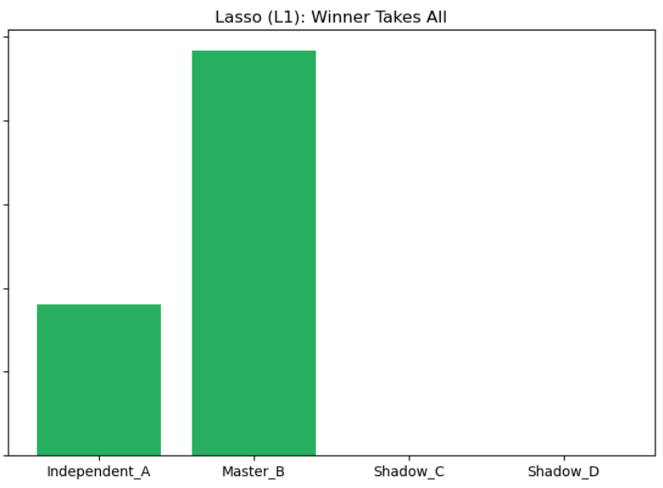
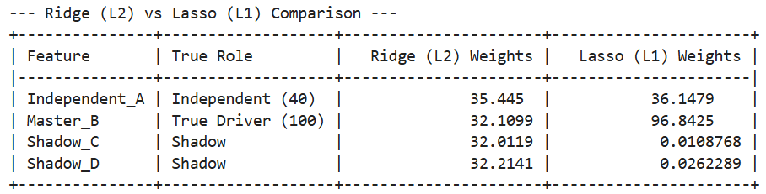
Linear Regression with L1 regularizer
Experiment:
- independent features
- correlated features
- target value

Slide 39
Linear Regression with L1 regularizer
Properties:
among several important but correlated features choose only one and zero weights for the others
when number of features exceeds number of objects, e.g. D > N, can find maximum N non-zero weights

Slide 40
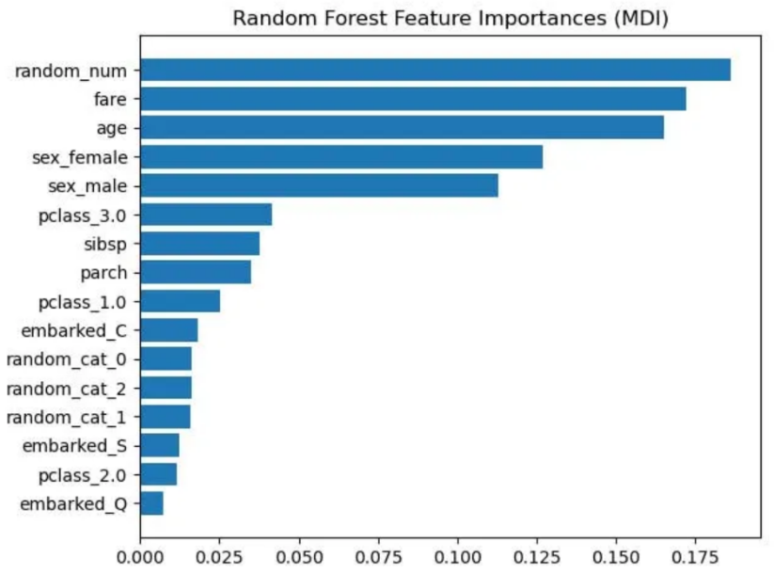
Feature Importance in Decision Trees
MDI (Mean Decrease Impurity measure)
For each node of the tree, compute the impurity decrease of the node on a specific feature.
Compute the weighted sum of the impurity decreases with weights proportional to number of objects in that node.
Advantage: MDI can be computed for free during DT training
Disadvantage: MDI can favor numerical features and categorical features with many values. Also, MDI is computed on the training set.
Alternative: Permutation Feature Importance.

Slide 41


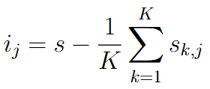
Permutation Feature Importance
Compute model’s performance s on control dataset D
For each feature j:
For each repetition k in 1,...,K:
Randomly shuffle column j of dataset D to generate a corrupted version of the data
Compute model’s performance on corrupted data
Compute feature importance:

Slide 42

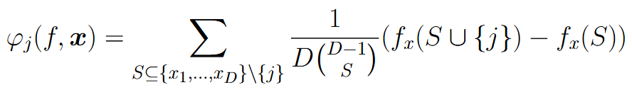

SHAP (SHapley Additive exPlanation)
- trained regression model
Importance of feature j for object x:
- coalition (some subset of features)

Slide 43
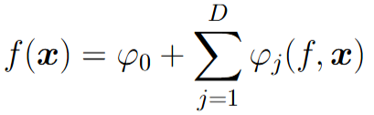

SHAP (SHapley Additive exPlanation)
SHAP properties:
1. Additivity
2. Missingness: if feature doesn’t influence performance for all coalitions, then its importance=0
3. Consistency: if feature in a new model has more impact, then its importance should increase

Slide 44
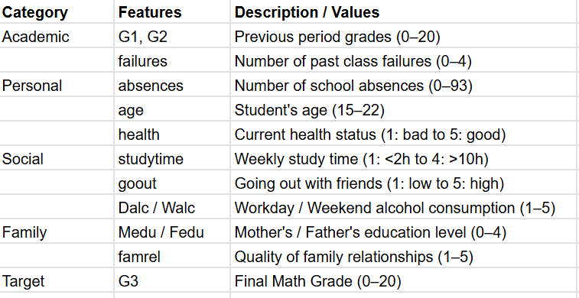
SHAP example (Student Performance Dataset)

Slide 45
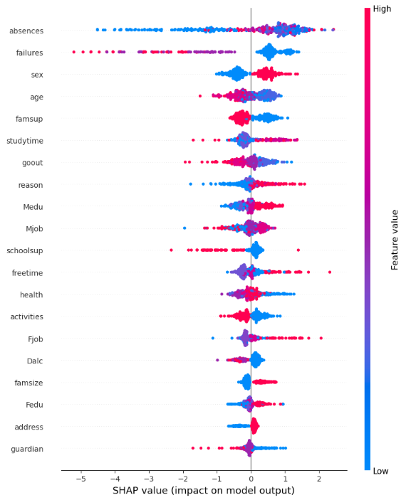

Slide 46
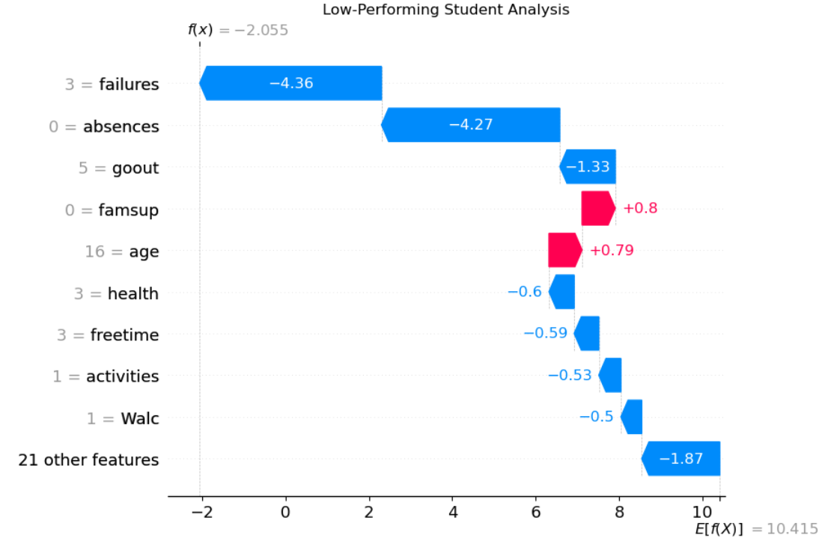

Slide 47
