Slide 1
Logistic Regression Multi-Class Classification Hyperparameter Optimization

Slide 2
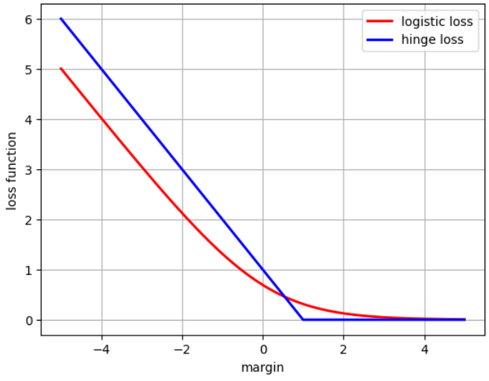



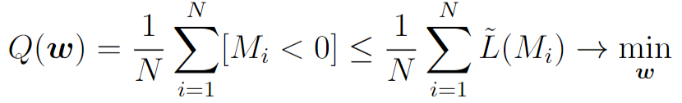


Linear classification
Let’s consider two-class classification problem
Logistic Regression
SVM

Slide 3

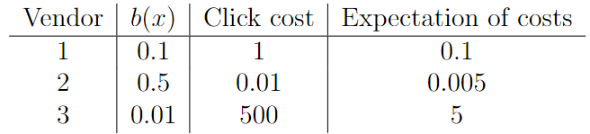
Probability prediction
Suppose we want together with class label also predict the probability / confidence of our prediction
Example: Internet advertisement sales

Slide 4


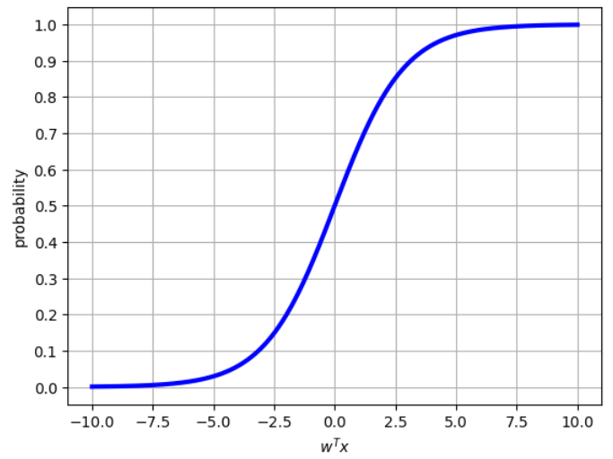
Probability prediction
To predict probability with linear models we need to define a monotonic transformation from linear score to probabilities

Slide 5

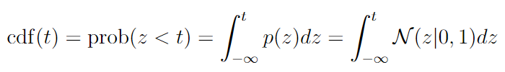

Probability prediction (Probit Regression)
Possible choice of transformation function:
cumulative density function (cdf) of a standard normal variable
Drawback: hard to deal with integral

Slide 6

Probability prediction (Logistic Regression)
Alternative: sigmoid (logistic) function

Slide 7

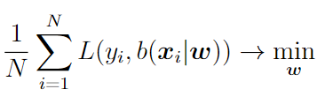
Probability prediction: Loss function view
Probability prediction:
Training procedure:
Problem: how to introduce a proper loss function that would correspond to learning correct probabilities?

Slide 8

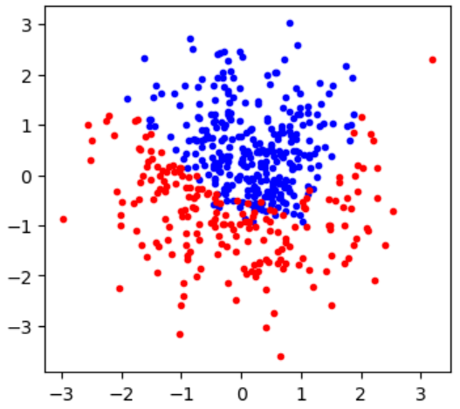


Learning probabilities
Data generative process:
Loss function on population:
Main requirement for loss function to predict probabilities:

Slide 9
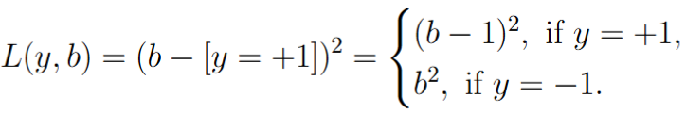



Example: quadratic loss
Desired property:
Result: quadratic loss correctly estimates probabilities

Slide 10



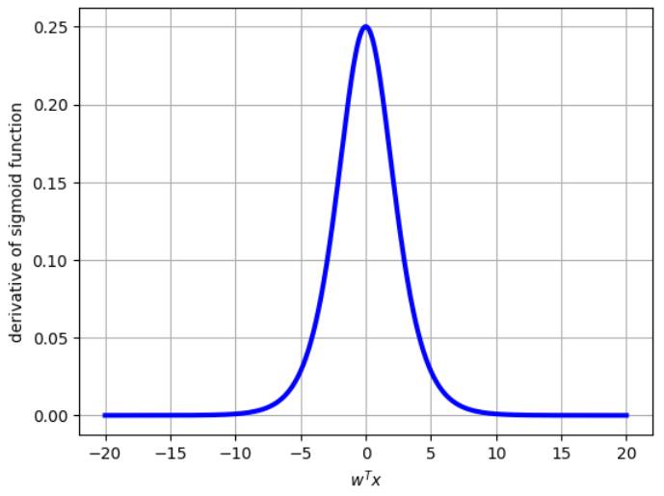
Example: quadratic loss
Sigmoid function
Training:
Derivative of sigmoid function
Here we may deal with vanishing gradient problem

Slide 11
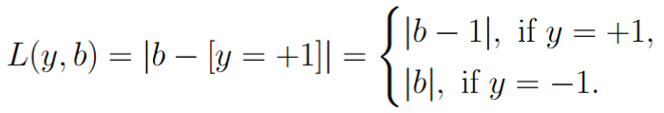
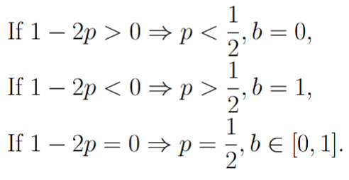
Example: L1 loss
Result: L1 loss does not correctly estimate probabilities

Slide 12



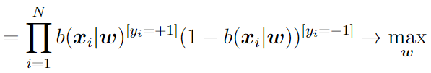
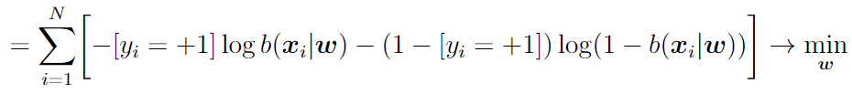
Probability prediction: probabilistic view
Dataset:
Probabilistic model:
Likelihood function:
Logistic loss (log loss):

Slide 13



Learning probabilities with logistic loss
Desired property:
Result: logistic loss correctly estimates probabilities

Slide 14




Logistic regression
Probability prediction:
Logistic loss for training:

Slide 15
Logistic Regression vs. SVM
SVM loss doesn’t penalize any margins greater than 1. This usually leads to better performance in terms of accuracy, F-measure, ROC-AUC, etc.
Logistic loss is minimized for margins tending to infinity. This usually leads to better probability calibration.
For linearly separable datasets logistic regression can’t be trained without regularizer

Slide 16


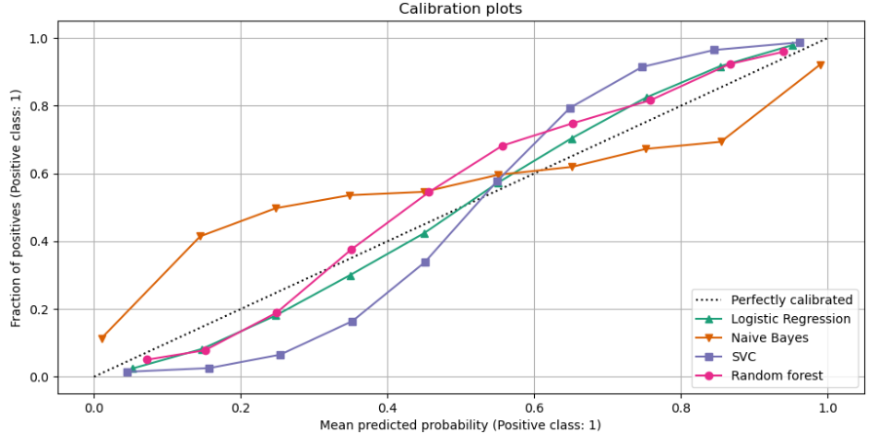

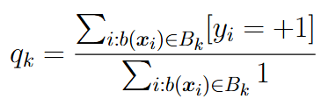
Probability calibration
Let’s take some classifier that output probabilities
For SVM we may take:
Let’s split [0,1] interval into a set of non-intersecting bins:
Compute for each bin ratio of positive class:

Slide 17
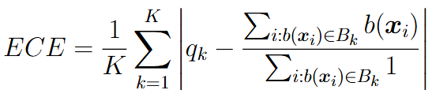
Probability calibration: estimation
For estimation of probability calibration we may use ECE criterion (Expected Calibration Error):
Here other metrics (not only sum of absolute differences) may be used

Slide 18

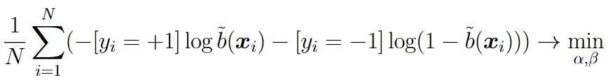
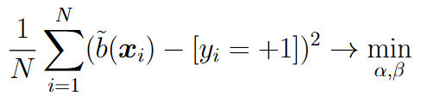
Probability calibration: Platt scaling
Let’s consider additional transformation on top of estimated probability from classifier:
Train transformation parameters using appropriate loss function:
Alternatively:
Important: calibration is made on validation set, otherwise we may have target leak

Slide 19
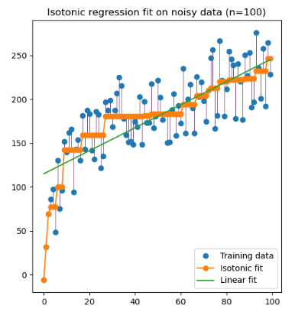
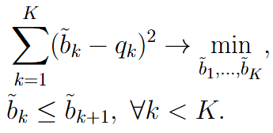
Probability calibration: Isotonic Regression
Train monotonic piecewise linear transformation from input probabilities to output probabilities:
This is QP problem of special type: for solution efficient pool-adjacent-violators algorithm (PAVA) can be used
Isotonic Regression is usually applied for big datasets and ML models like Random Forest, Gradient Boosting, etc.

Slide 20
Multi-Class Classification

Slide 21


Multi-class Classification
Two options:
Build multi-class classifier using several two-class classifiers
Directly extend two-class classification model to the general case

Slide 22
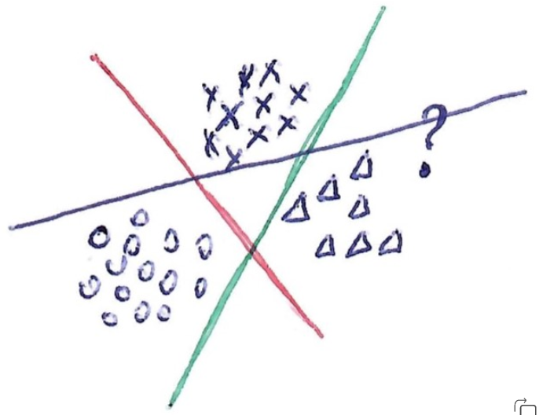



One-vs-All (One-vs-Rest)
Let’s introduce K separate two-class linear classifiers:
Each classifier is trained to separate one class from all the rest:
Final prediction:
Main drawback: each classifier is trained without any knowledge of others

Slide 23




All-vs-All (AvA)
Let’s introduce linear classifiers:
Each classifier separates one class from another one:
Final prediction:
AvA:
usually shows better performance comparing to OvA
does not depend on particular score values of separate classifiers
requires training of many classifiers and has many parameters
may be sensitive to lowly-representative classes

Slide 24




Logistic Regression for multi-class case
Logistic regression should produce probabilities for all classes:
Let’s introduce K linear scores:

Slide 25

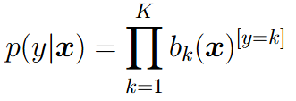

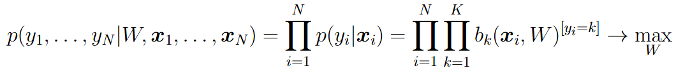
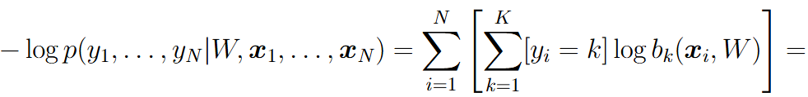
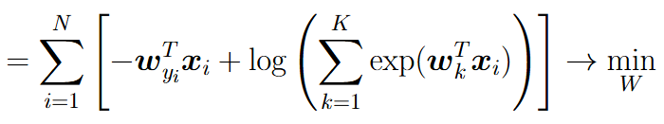

Logistic Regression for multi-class case
Probabilistic model:
Prediction:

Slide 26
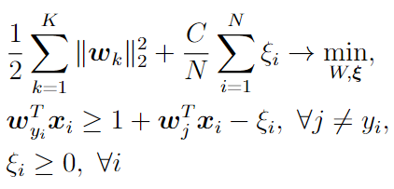
SVM for multi-class case (Crammer-Singer formulation)
Idea: score function for the right class should be higher than score values for all the other classes:
Prediction:

Slide 27
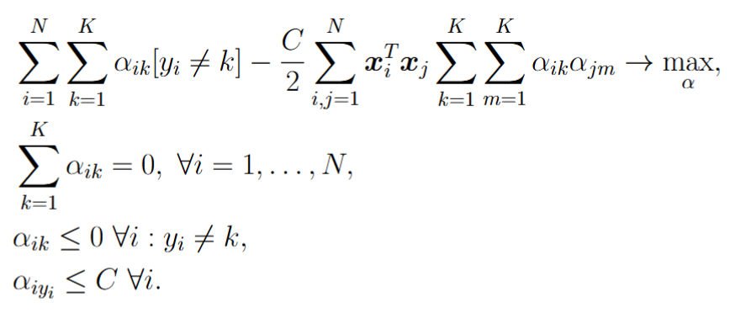
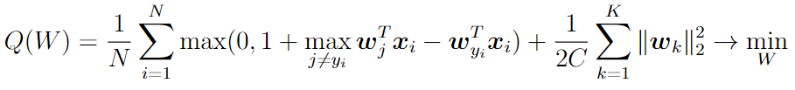
SVM for multi-class case
Primal view:
Dual view:
Unconstrained view:
Main problem: number of constraints is proportional to N*K => primal/dual view is possible only for relatively small datasets

Slide 28
Hyperparameter Optimization

Slide 29





Hyperparameters in ML models
Method | Hyperparameters
Linear Regression | Reg. coefficient for L2 or L1 regularization Reg. coefficients for ElasticNet regularization
Kernel Regression | Reg. coefficients, number of centroids M, kernel function parameters, e.g. for RBF and degree for Polynomial kernel
SVM | Penalty coefficient , kernel function parameters
Linear SVM with kernel features | Penalty coefficient , number of centroids M, kernel function parameters
Logistic Regression | Regularization parameters
Logistic Regression with kernel features | Regularization parameters, number of centroids M, kernel function parameters
Kernel features:
- clusters centers for training set (centroids)

Slide 30


Grid search
Grid of values for each hyperparameter:
For each set of hyperparameters compute cross validation (CV) accuracy / loss / ROC-AUC, etc.
Take the best set of hyperparameters and train on full trainset
Main drawback: need to train ML model from scratch M*K times, where M – a number of possible combinations of hyperparameters values, K – number of folds in CV

Slide 31
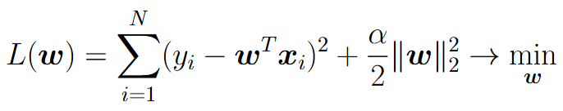

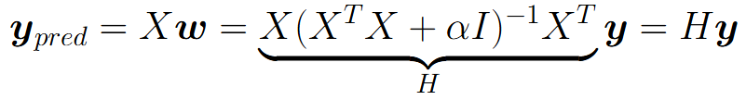
Linear Regression with L2 regularization
Optimal weights:
Prediction on training set:
Singular Value Decomposition (SVD) :

Slide 32
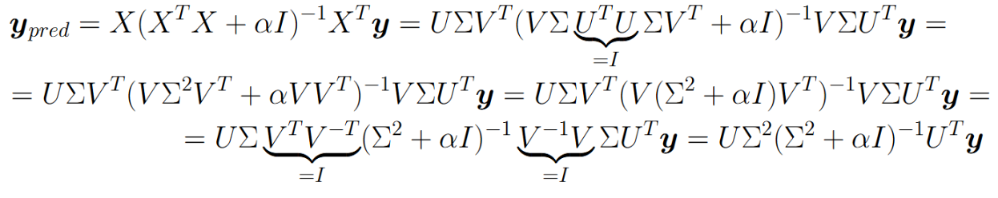



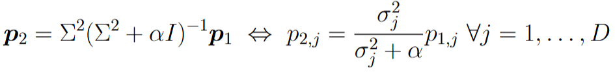


Linear Regression with L2 regularization
Training: compute SVD for X
compute
Compute for new alpha:
Result: retraining for new alpha requires O(ND) = one gradient step computation!

Slide 33

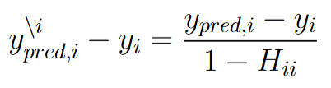

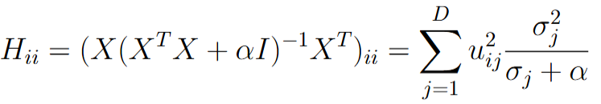
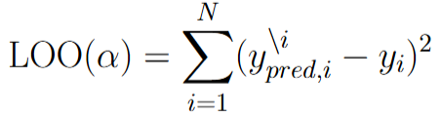
Linear Regression with L2 regularizer
- prediction for i-th object, when training on all objects except for i-th one
Leave-One-Out (LOO) estimate:
Result: compute LOO for new alpha requires just O(ND)!

Slide 34
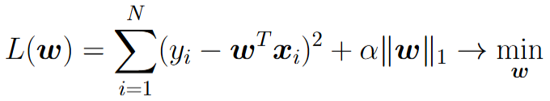
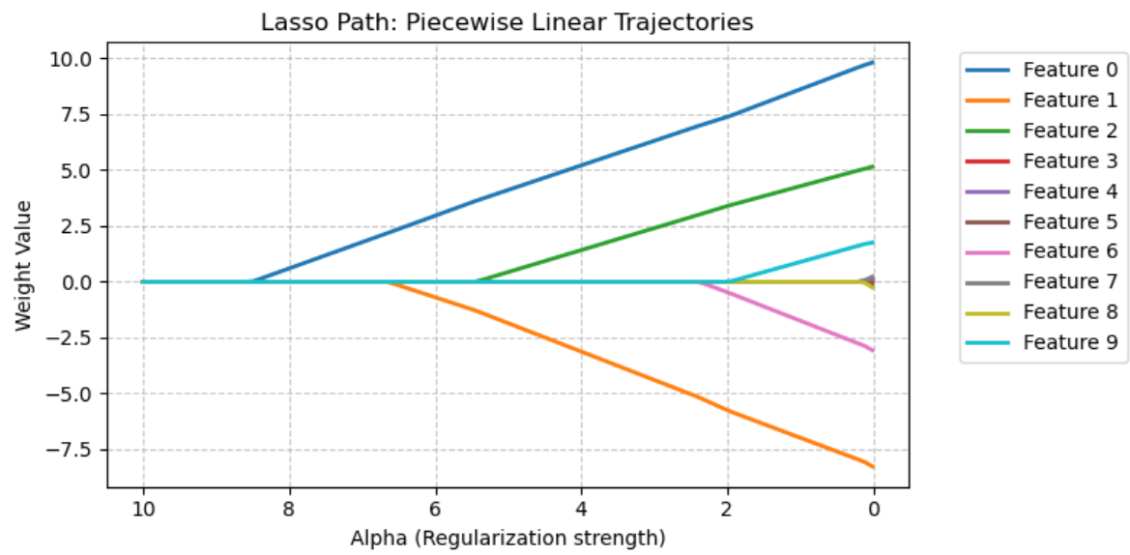
Linear Regression with L1 regularizer
Optimal weights have piecewise linear trajectory w.r.t. regularization coefficient!
This trajectory can be found by LARS (Least Angle Regression) algorithm with complexity of one training

Slide 35
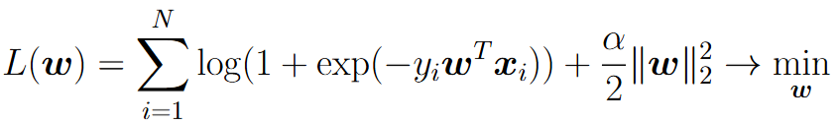
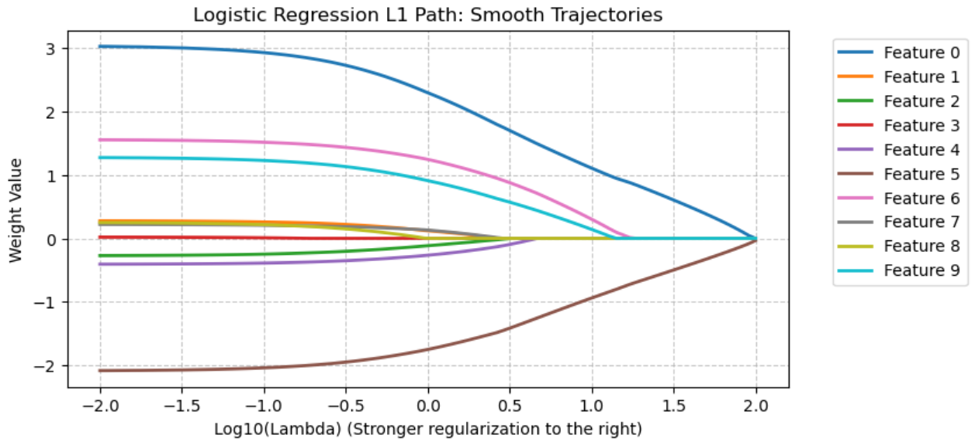
Logistic Regression with L2 regularizer
Optimal weights have smooth trajectory w.r.t. regularization coefficient!
Idea: compute weights for new alpha using weights for neighbor alpha as warm start

Slide 36
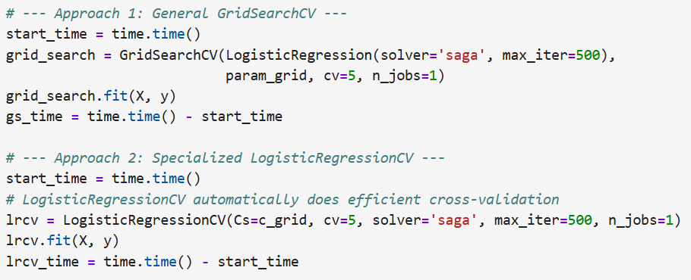

Logistic Regression with L2 regularizer

Slide 37
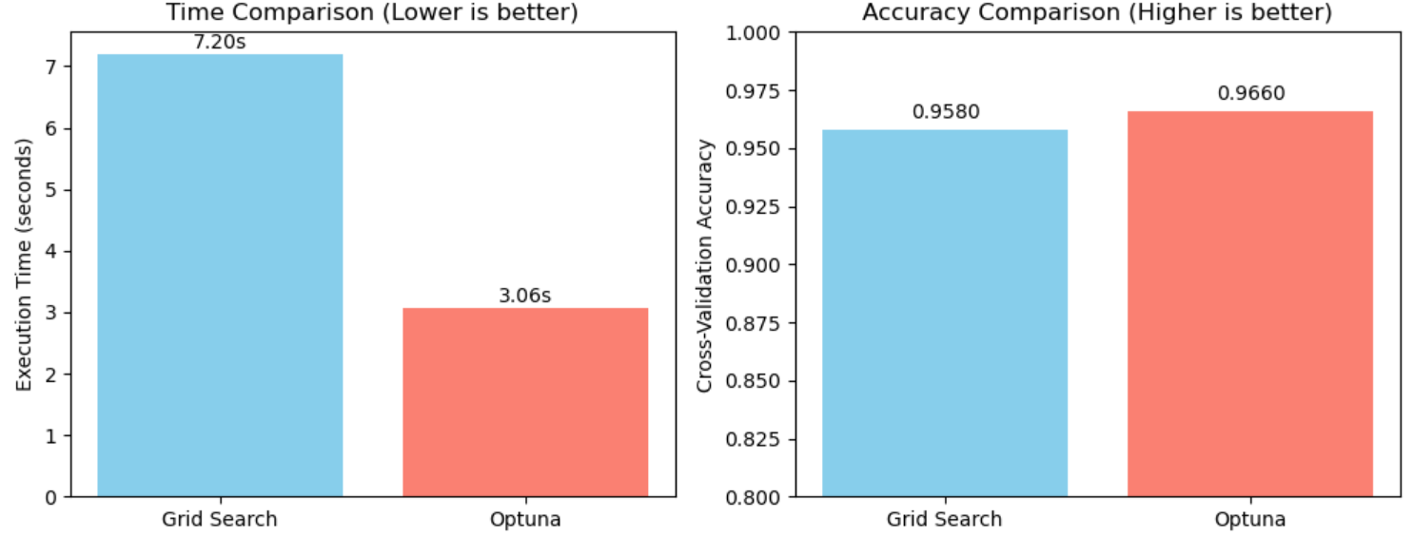
Hyperparameter optimization using Optuna
Optuna – general library for hyperparameter optimization
Example: RBF SVM, hyperparameters: C, sigma

Slide 38







Optuna optimization
Define a range for each hyperparameter:
Step 1. Sample randomly several sets of hyperparameters
and estimate CV quality of ML model for each set
Step 2. Divide all samples into two subsets: 1) high-quality samples with e.g. 25% best values and 2) low-quality samples with the rest 75% values
Step 3. Fits probability distribution for high-quality samples and f for low-quality samples using Parzen Window estimator

Slide 39
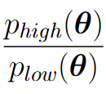

Optuna optimization
Step 4. Sample one new point by maximizing and test ML model
Step 5. Add the sampled point to high-quality or low-quality subset, update probability models and , go to step 4.
Stop sampling by reaching 1) maximum number of iterations, 2) maximum allowed computational time or 3) when best set is not improving for the last several samples.

Slide 40
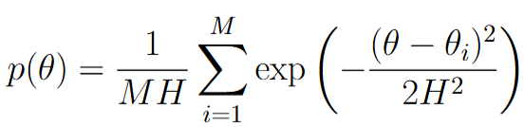

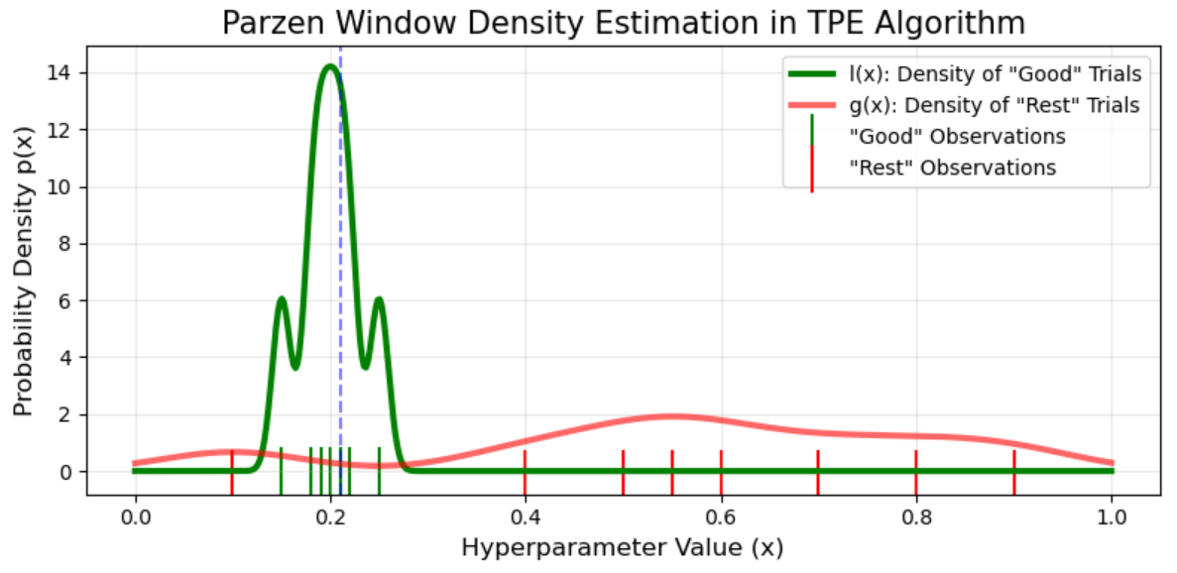
Optuna optimization
Parzen Window Estimator for real-valued scalar parameter:
- previously sampled points

