Slide 1
Gradient Boosting Implementation: XGBoost, LightGBM, CatBoost Blending, Stacking

Slide 2
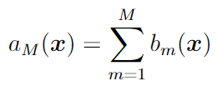
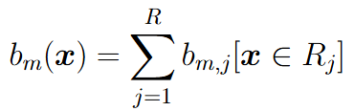

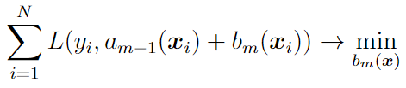
Gradient Boosting on Decision Trees
Composition of base models:
Base model = regression decision tree:
- number of leaves
The base models are trained sequentially, e.g. the next tree corrects the errors of the current composition:
Each tree is supposed to be simple (has few nodes/leaves)

Slide 3








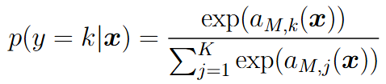
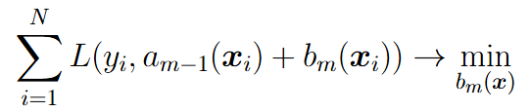
Gradient Boosting on Decision Trees
Important: the composition is happening on score values, not on targets
Regression
Prediction rule:
Probabilistic model:
Two-class classification
Prediction rule:
Probabilistic model:
K-class classification
Prediction rule:
Probabilistic model:

Slide 4




Gradient Boosting on Decision Trees
Gradient Boosting: 1) make opt. step in the space of DT outputs (e.g. with gradient descent) and 2) fit DT to the obtained step
Pseudo-residuals:
Training of the next base model:
Use shrinkage:
- step size

Slide 5

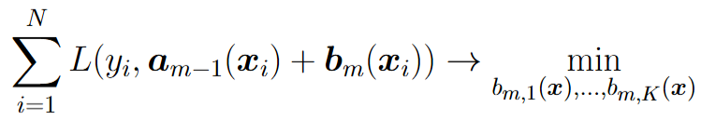
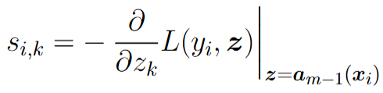
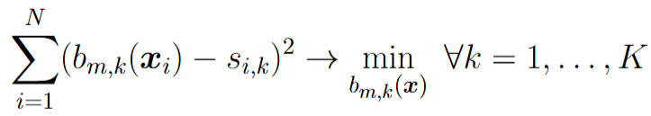

Gradient Boosting on Decision Trees
For K classes we construct a separate regression tree for each class:
Pseudo-residuals:
Training of the next K base models:
Use the same shrinkage for all classes:

Slide 6
Gradient Boosting vs Random Forest for K-class classification problems
Random Forest: independently learns classification trees (Gini/Entropy index as impurity, each leaf outputs class label or probabilities for each class)
Gradient Boosting: sequentially learns regression trees for each class separately (e.g. Variance as impurity, each leaf outputs score for given class)

Slide 7
Popular GB implementations
XGBoost (eXtreme Gradient Boosting, paper)
LightGBM (Light Gradient Boosting Machine, paper)
CatBoost (Categorical Boosting, paper)

Slide 8
XGBoost (Extreme Gradient Boosting)
Main ideas:
Using Newton optimization for loss function
Using regularization for each decision tree
Impurity criterion for splitting in decision trees depends on loss function
Using shrinkage, object and feature subsampling
Efficient procedure for finding splits in each tree
Working with missing/sparse values
Using parallel implementation and efficient memory handling

Slide 9

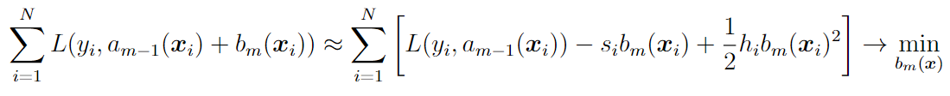

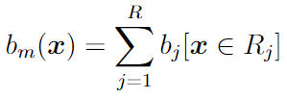



Newton optimization for loss function
Newton optimizer idea:
Base algorithm is decision tree:
Regularizations:
Number of leaves with reg. coef.
L2-regularization for values in leaves with reg. coef.

Slide 10
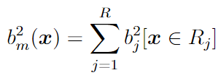
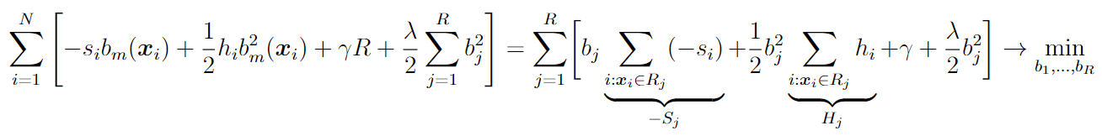
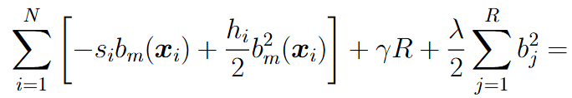



Newton optimization for loss function

Slide 11
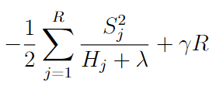

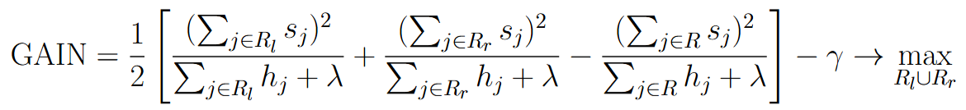
New impurity criterion for DT splits
Decision Tree quality after tuning all values in leaves:
We can use this criterion for finding the best splits in Decision Tree
Additional stopping criterion for splitting: GAIN < 0

Slide 12
Shrinkage, object and feature subsampling
Shrinkage (parameter eta):
Object subsampling (parameter subsample): random objects subsample (without repetition), default=1
Feature subsampling (parameters colsample_bytree, colsample_bylevel, colsample_bynode): random feature subsample (once per tree, once per each tree level, once for each node), default=1, 1, 1
In case of overfitting: decrease eta, increase maximal number of trees n_estimators and decrease subsample parameters

Slide 13

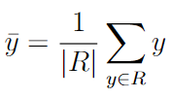
Exact Naïve Algorithm for Splits
Suppose in current node there are N objects with D features and variance is used as impurity criterion
For each feature 1..D:
Sort all objects w.r.t. current feature O(N log N)
For each threshold 1..N:
Compute mean target for left and right subtree O(N)
Compute variance for left and right subtree O(N)
Total computational cost: O(D*N*N)

Slide 14


Acceleration of Naïve Algorithm
For each feature 1..D:
Sort all objects w.r.t. current feature O(N log N)
For each threshold 1..N:
Recompute mean target when moving one object y from right to left subtree O(1)
Recompute variance for left and right subtree O(1)
Total computational cost: O(D*N*log N)

Slide 15
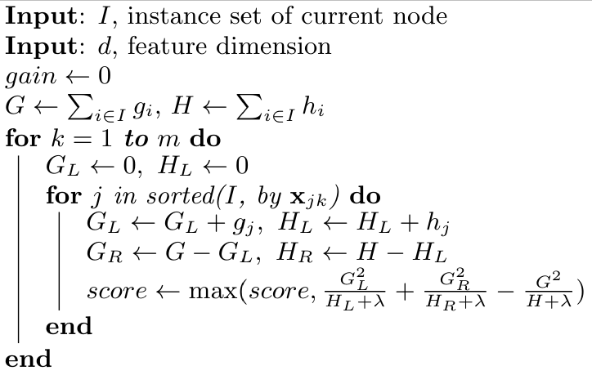
Exact algorithm for splits in XGBoost
Sorting in the beginning of training: O(D*N*log N)
In tree construction for each node: O(D*N)

Slide 16
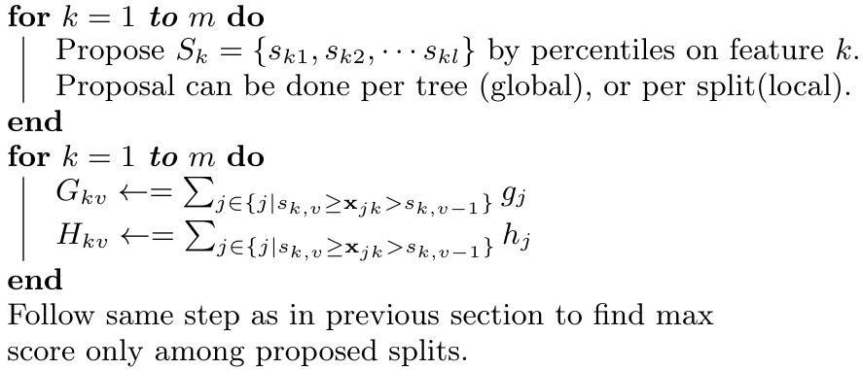
Approximate algorithms for splits
Computational cost: O(D * number of proposals)

Slide 17
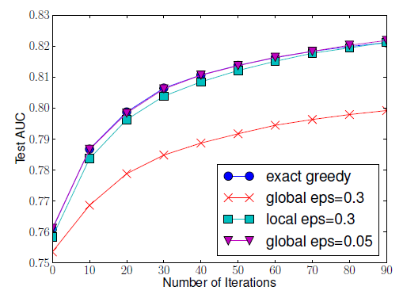
Approximate algorithms for splits
Global proposals: require more refined number of bins, but can be done only once per tree
Local proposals: we can use few bins, but need to compute them for every node a new
Result: both approaches show similar performance

Slide 18

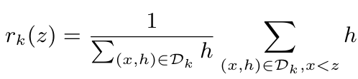

Finding good proposals
- object weight
Ranking function:
Optimal splits:
Here number of splits is approximately

Slide 19
Split strategies in xgboost
Parameter tree_method = exact: for each feature use all possible thresholds, very slow and is usually used only for small datasets
Parameter tree_method = approx, sketch_eps = 0.03: for each tree find proposals using hessian ranking function, faster than exact and more precise than hist, can be used for medium-sized datasets
Parameter tree_method = hist, max_bin = 256 (default): proposals are quantiles for each feature (ranking function = 1), are computed only once on start of training, very fast and robust

Slide 20
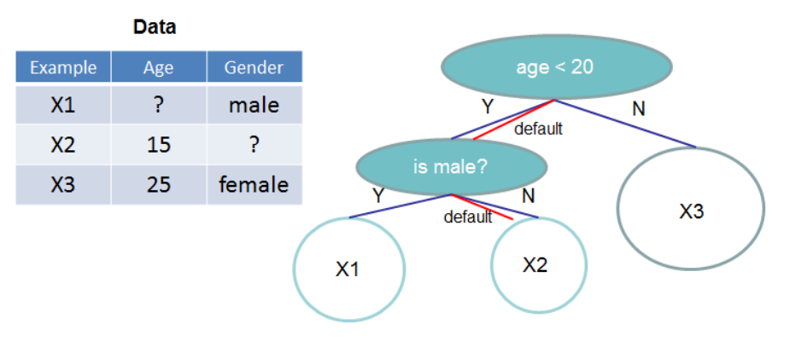
Working with missing values
Idea: introduce default subtree for missing feature value

Slide 21
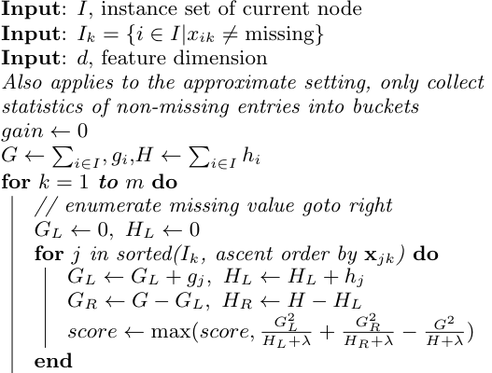
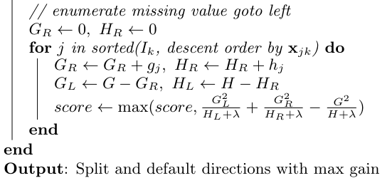
Finding default subtree
Idea: compute score value twice – 1) all missing values go to the right subtree and 2) all missing values go to the left subtree

Slide 22
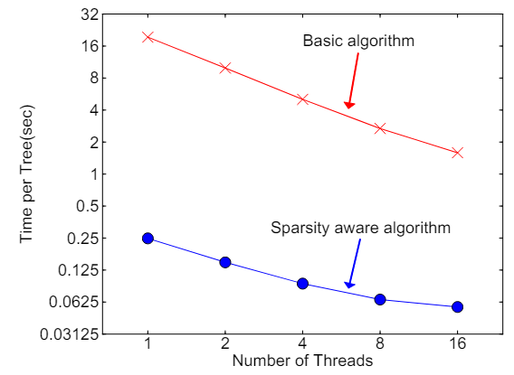
Acceleration for sparse training
Option for sparse datasets (parameter missing=0): define 0 as missing value

Slide 23
LightGBM
Main motivation: working with huge sparse datasets
Main ideas:
Using loss gradient pseudo-targets like in classic GB scheme
Using object subsampling with dramatic object reduction for construction of each tree
Using clusters of features (groups of features) with dramatic groups number reduction for construction of each tree
Using leaf-wise approach for tree construction instead of level-wise

Slide 24

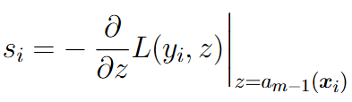
Efficient object subsampling (GOSS)
Object importance = absolute value of loss gradient (for objects with almost zero gradient the base model doesn’t need to learn anything)
GOSS (Gradient-based One-Side Sampling):
Sort all objects w.r.t. their absolute grad. values in descending order
Take the top a% objects (the objects with the highest grad. values)
Among the rest randomly sample b% of objects
Weights for dataset: =1 for objects from step 2, =(1-a)/b for objects from step 3

Slide 25


Efficient object subsampling
Considering object weights in prediction and impurity criterion:
Parameter top_rate (a), default=0.2
Parameter other_rate (b), default=0.1

Slide 26
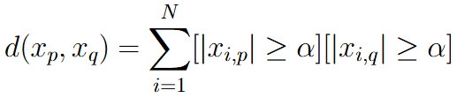

Clusters of features (Exclusive Feature Bundling)
Two features are called mutually exclusive, if they rarely take non-zero values simultaneously (e.g. features after one-hot encoding)
Distance between two features
Distance between feature and group of features
Clustering algorithm:
For each feature:
For each group:
if dist(feature, group) < threshold, then add the feature into the group
else make new group consisting of this feature

Slide 27



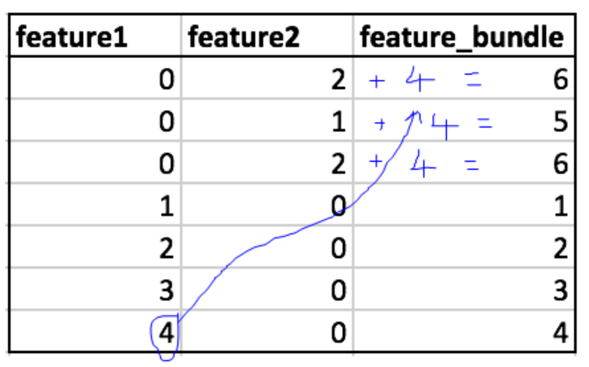
Uniting features in one group
Suppose some group consists of two features and . The first takes values between [0, 4], the second takes values between [0, 2]. Transform the second feature values to [4, 6] and create a new united feature as . Define threshold splits for this newly created feature.

Slide 28
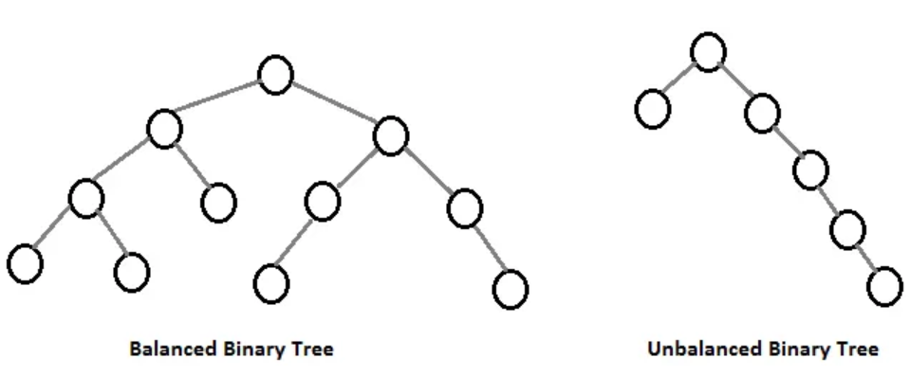
Leaf-wise tree construction
XGBoost: splits every node on current level before going to the next level (balanced decision tree), usually works slower
LightGBM: splits node with the highest impurity decrease (unbalanced decision tree), works fast, but more prone to overfitting

Slide 29
CatBoost (Categorical Boosting)
Main motivation: working with categorical variables and solving problem of prediction shift
Main ideas:
Use Ordered Target Statistics (TS) for efficient numerical encoding of categorical variables
Use Oblivious Trees for fast inference
Use Ordered Boosting for solving the problem of prediction shift

Slide 30
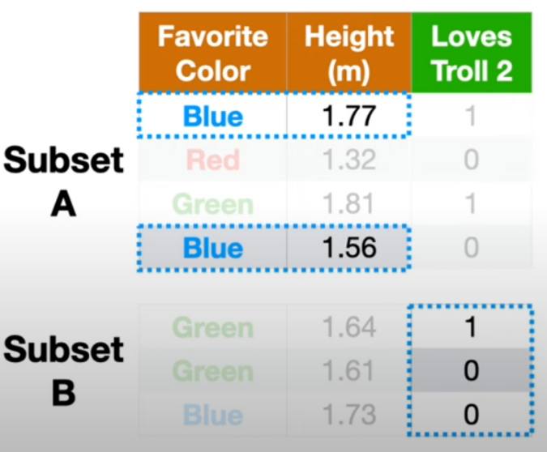
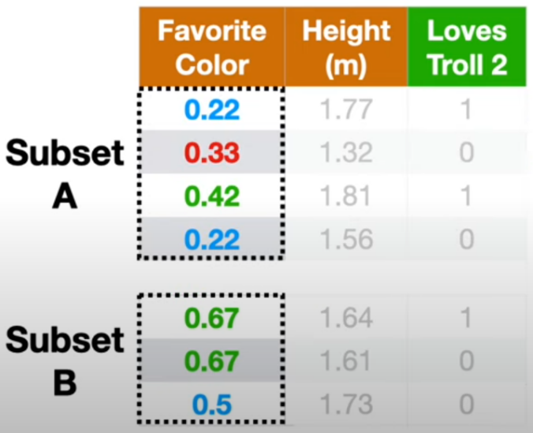
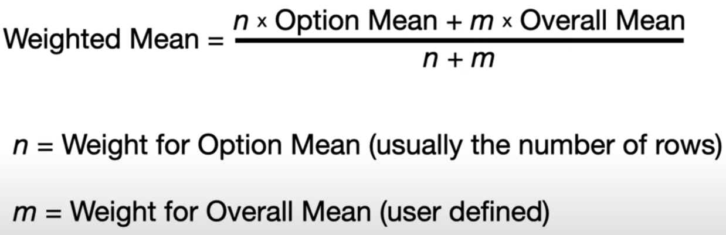
Reminder: K-Fold Target Encoding for categorical features
Idea: for each category in given fold use target averaging for this category from other folds; target averaging uses Bayesian mean
Problem: for given fold the feature is encoded with the same value, may be hard to split using DT

Slide 31



Reminder: splitting into two subsets for categorical features
Idea: split all categories into two subsets:
Direct implementation requires here number of splits
Efficient implementation: sort objects w.r.t. mean targets for all categories
Restriction: works only for the case of MSE in regression and binary classification

Slide 32


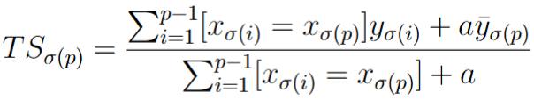
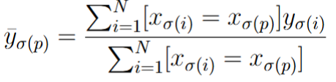
Ordered TS in CatBoost
For given feature make a random permutation of training objects:
Target encoding for object is Bayesian estimate of targets using all previous objects:
Here y is target average on full dataset:
a – regularization parameter
Permutation is generated a new for next tree

Slide 33
Ordered TS vs K-fold Target Encoding
Advantages of ordered TS:
all objects have different encodings
better works with low representative categories
better prevents target leakage

Slide 34
Working with categorical features in boosting
XGBoost: supposes OHE or Target Encoding, because splitting criteria in trees uses gradients and hessians
LightGBM: can use method with splitting categories in two subsets, because splitting criteria in trees is based on weighted MSE
CatBoost: applies Ordered TS

Slide 35
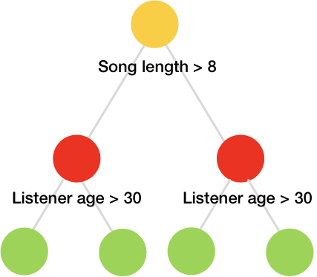
Oblivious Trees
Oblivious Tree: use the same feature and threshold for all nodes in the given tree layer
Advantages: good regularization + very fast inference

Slide 36
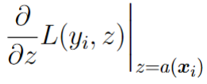
Prediction shift and Ordered Boosting
The next tree in composition is trained on pseudo-targets for current composition model, that was trained on the same object => risk of overfitting
Ordered Boosting idea: make random permutation of objects and for computing pseudo-target for current object use the composition model that was trained only on previous objects
Problem: training N composition models is too costly!
Solution: train log N composition models using idea of so called supporting models

Slide 37
Catboost vs XGBoost and LightGBM
XGBoost and LightGBM: many hyperparameters (max tree depth, max number of leaves, regularization parameters, etc) for controlling overfitting => good hyperparameter tuning is required
CatBoost: oblivious trees, ordered TS and ordered Boosting efficiently prevent overfitting => the method is less sensitive w.r.t. hyperparameters, default hyperparameters are working good

Slide 38



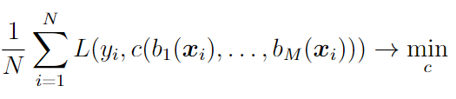
Introduction to Blending and Stacking
Random forest and GB: base models are chosen by composition procedure
Stacking: composition over arbitrary base models
Composition:
Meta-model:
Meta-model training:
Important: meta-model and base models should be trained on different datasets!

Slide 39

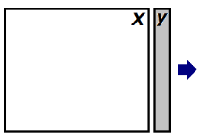
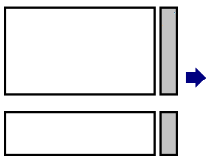
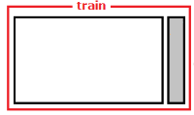


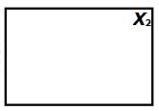
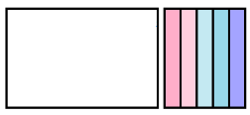
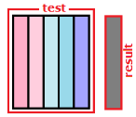
Blending
Split dataset into two parts:
Training set for base models
Train all base models
Training set
Train meta model
Training set for meta model
Answers of base models
Test set
Meta model prediction
Answers of base models for test set

Slide 40


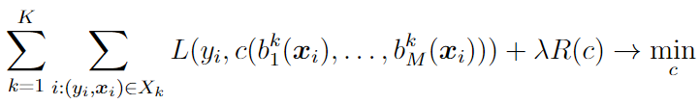

Stacking
Training:
- base model trained on all parts except of k-th part
In total MK base models
Inference:
Train all base models on full training set
Averaging of base models
Stacking on many different algorithms is a usual winner in ML competitions

Slide 41
Meta-algorithm in Blending/Stacking
Meta-algorithm is usually linear/logistic regression with L1/L2 regularization. Such algorithms are harder to overfit.
For several dozens of base algorithms meta-algorithm can use boosting, but with hard control on overfitting (very small trees, strong regularization parameters).

