Slide 1
Non-linear Conjugate Gradient Method

Slide 2
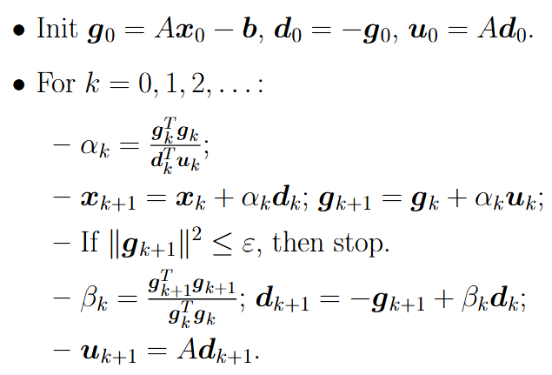
Linear CG

Slide 3
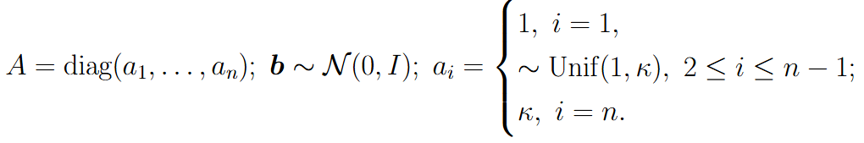

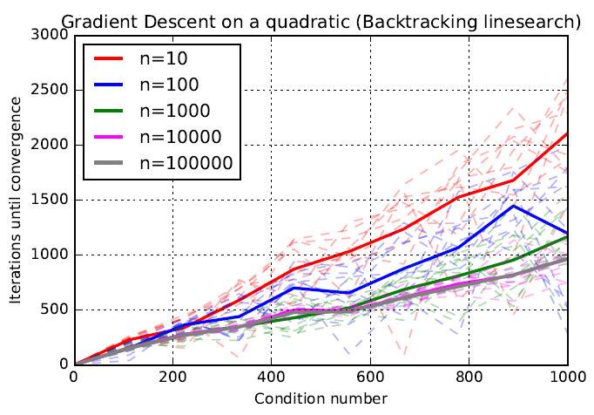
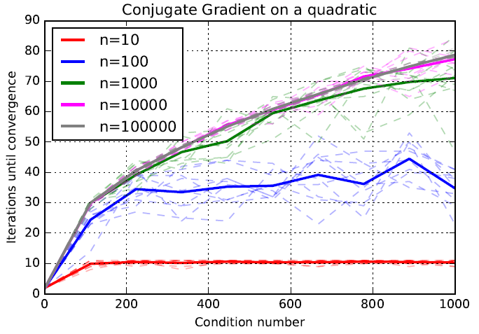
Linear CG performance

Slide 4
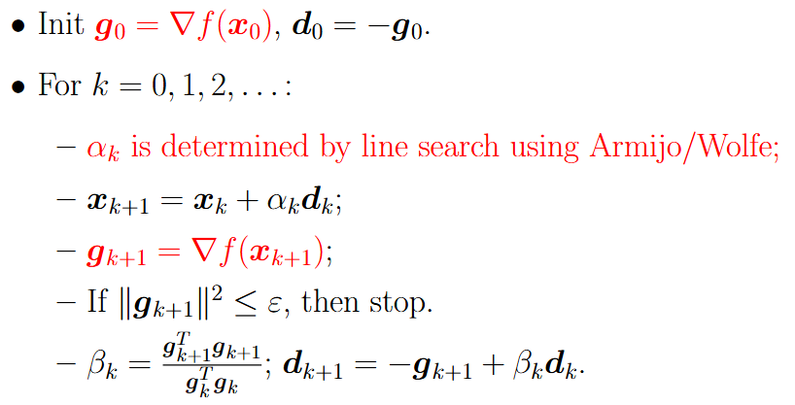
Fletcher-Reeves method
Idea: take linear CG scheme and change the corresponding parts for arbitrary function

Slide 5
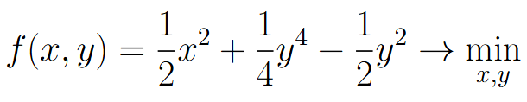
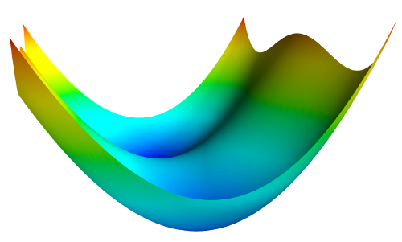
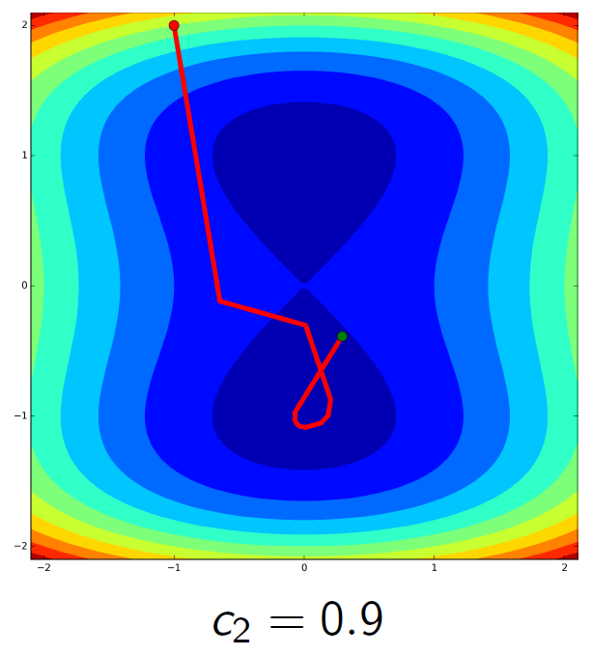
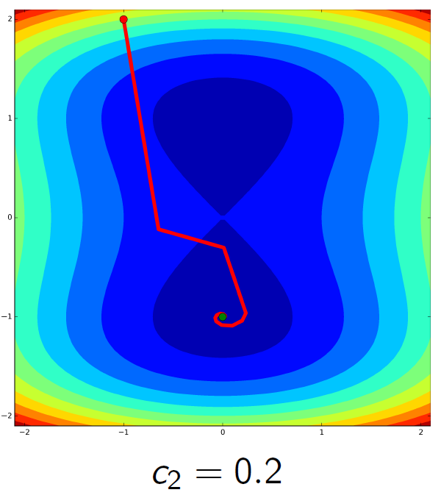
Fletcher-Reeves and descent direction
Example:
Descent direction in FR method: use Armijo/Wolfe with c2 < 0.5

Slide 6
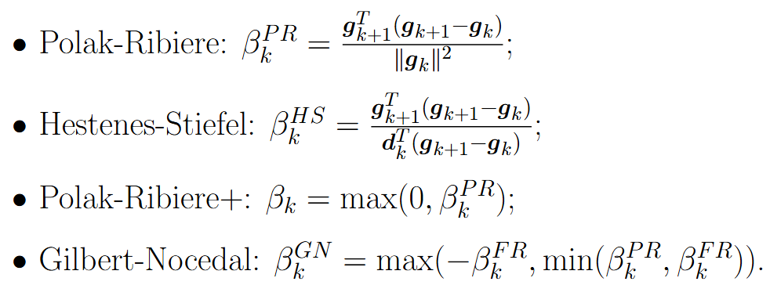
Alternative non-linear CG methods
Use FR scheme with different formula for beta:

Slide 7
Alternative non-linear CG methods
Use the idea of restarts:

Slide 8
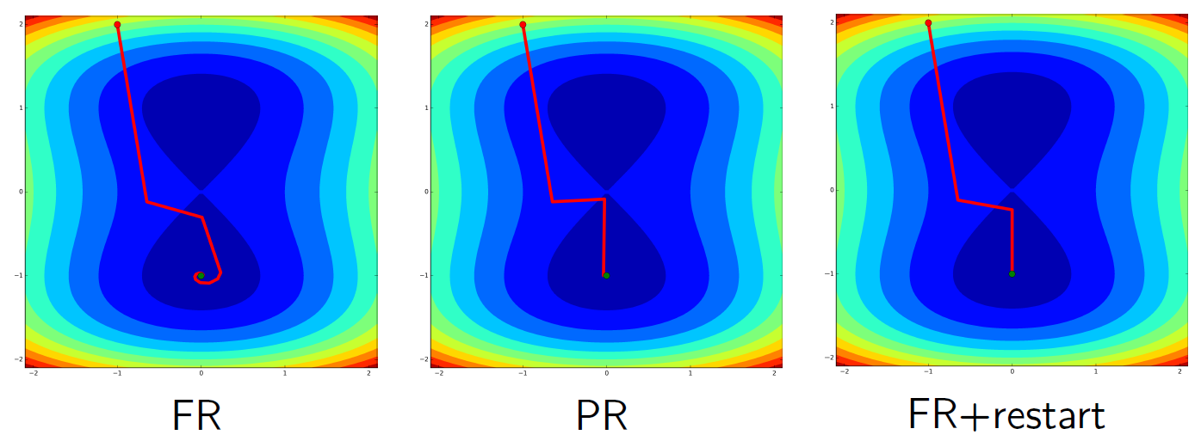
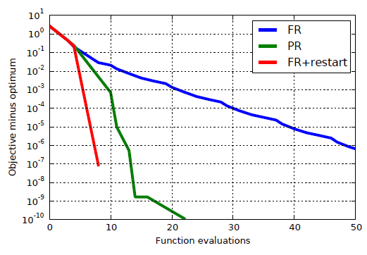
FR vs PR vs PR+restart

Slide 9

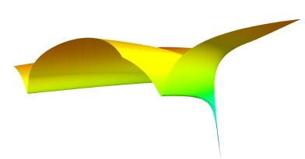
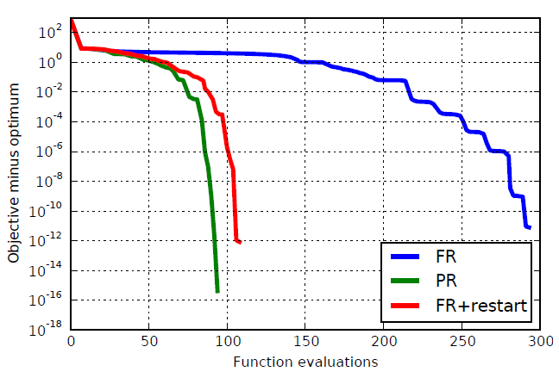
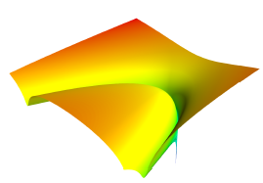
Example: Rosenbrock function

Slide 10
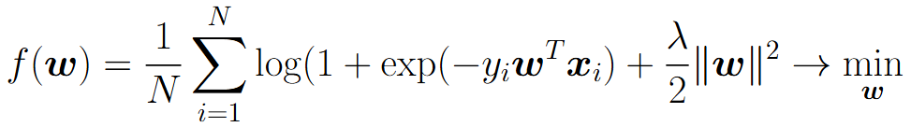
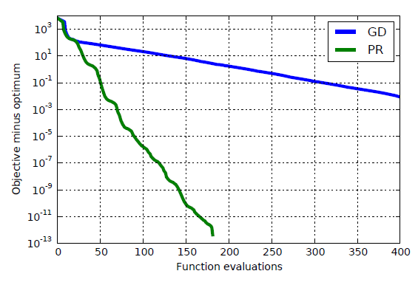
Example: logistic regression

Slide 11
CG vs GD

