Slide 1

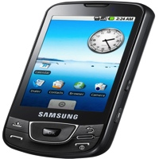

Devices
Processing Cluster
A
PC-1
B
C
D
DB
A
PC-2
A

