Slide 1
Early Detection of Alzheimer’s Disease with Blood Plasma Proteins Using Support Vector Machines

Slide 2
ABSTRACT
Alzheimer's is a type of dementia that causes problems with memory, thinking and behavior.
Symptoms usually develop slowly and get worse over time, becoming severe enough to interfere with daily tasks.
Dementia is a general term for loss of memory and other mental abilities severe enough to interfere with daily life. It is caused by physical changes in the brain.
Alzheimer's is the most common type of dementia, but there are many kinds.
The system is developed the two different machine learning algorithms for predicting the alzhimers disease.
The results shows that the performances metrics such as accuracy, sensitivity and specificity.

Slide 3
OBJECTIVES
The main objective of our project is,
To predict or detect the Alzheimer’s dementia disease.
To implement the machine learning algorithms.
To enhance the overall performance for classification algorithms.
To classify or predict the disease effectively.

Slide 4
INTRODUCTION
ALZHEIMER’s disease (AD) is the leading cause of dementia and poses a significant social and economic challenge.
It is responsible for more than half of all cases of dementia.
Alzheimer’s disease and related dementias (ADRD) have become a major public health concern in the United States.
Alzheimer’s disease research studies may suggest that early intervention and diagnosis could be crucial to the effectiveness of treatment.

Slide 5
EXISTING SYSTEM
Our method is mainly based on machine learning (ML) techniques (support vector machines in particular) because of their ability to create multivariable models by learning patterns from complex data.
Using novel feature selection and evaluation modalities, we identified 5 novel panels of non-amyloid proteins with the potential to serve as biomarkers of early AD.
Disease detection models based on the identified panels achieved sensitivity (SN) > 80%, specificity (SP) > 70%, and area under receiver operating curve (AUC) of at least 0.80 at prodromal stage (with higher performance at later stages) of the disease.

Slide 6
DISADVANTAGES
The results is low when compared with proposed
It doesn’t efficient for large volume of data’s
Theoretical limits.

Slide 7
PROPOSED SYSTEM
In this system, the Alzheimer’s dataset was taken as input. The input data was taken from the dataset repository.
Then, we have to implement the data preprocessing step.in this step, we have to handle the missing values for avoid wrong prediction. Then, we have to use label encoding.
Next, we have to implement the data splitting. In this step, we have to split the data into test and train.
Then, we have to implement the machine learning algorithms such as Support Vector Machine (SVM) and Logistic Regression (LR).
The experimental results shows that the performance metrics such as accuracy, precision, recall, sensitivity and confusion matrix.
Finally, to classify or to predict the alzhimers disease or not.

Slide 8
ADVANTAGES
It is efficient for large number of datasets.
The experimental result is high when compared with existing system.
To increase the performance metrics results.
Time consumption is low.

Slide 9
FLOW DIAGRAM

Slide 10


Handling missing values
Input data
Preprocessing
Label Encoding
Dataset
Drop unwanted columns
Test
Data Splitting
Train
Classification
SVM
LR
Accuracy, precision, recall
Performance metrics
Prediction
Disease prediction

Slide 11
MODULES
Data selection
Data preprocessing
Data splitting
Classification
Prediction
Performance analysis

Slide 12
MODULES DESCRIPTION

Slide 13
DATA SELECTION
In our process, the Alzheimer’s disease dataset is used.
This set consists of a longitudinal collection of 150 subjects aged 60 to 96.
Each subject was scanned on two or more visits, separated by at least one year for a total of 373 imaging sessions. For each subject, 3 or 4 individual T1-weighted MRI scans obtained in single scan sessions are included.
The subjects are all right-handed and include both men and women.
72 of the subjects were characterized as non-demented throughout the study.
Another 14 subjects were characterized as non-demented at the time of their initial visit and were subsequently characterized as demented at a later visit.

Slide 14
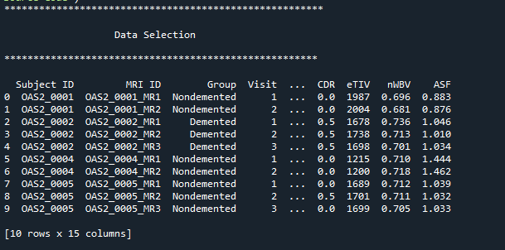
DATA SELECTION

Slide 15
DATA PREPROCESSING
Data pre-processing is the process of removing the unwanted data from the dataset.
Pre-processing data transformation operations are used to transform the dataset into a structure suitable for machine learning.
Missing data removal: In this process, the null values such as missing values and Nan values are replaced by 0.
Encoding Categorical data: That categorical data is defined as variables with a finite set of label values.

Slide 16
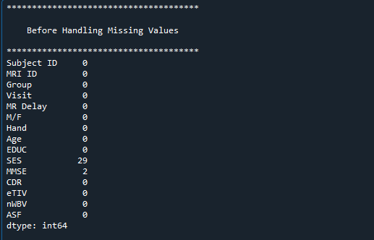
PREPROCESSING
Checking missing values

Slide 17
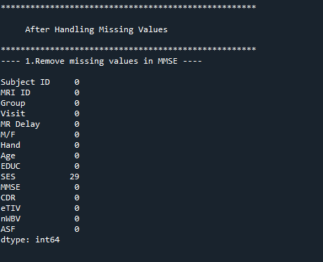
PREPROCESSING
After Checking missing values

Slide 18
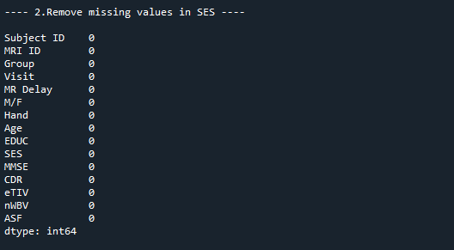
PREPROCESSING
After Checking missing values

Slide 19
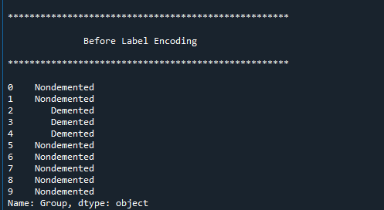
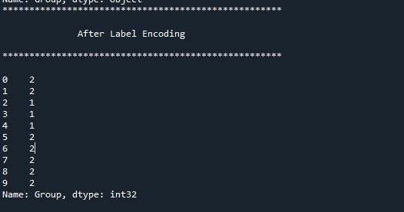
PREPROCESSING
Label Encoding

Slide 20
DATA SPLITTING
During the machine learning process, data are needed so that learning can take place.
In addition to the data required for training, test data are needed to evaluate the performance of the algorithm in order to see how well it works.
In our process, we considered 70% of the Alzheimer’s disease dataset to be the training data and the remaining 30% to be the testing data.
Data splitting is the act of partitioning available data into two portions, usually for cross-validator purposes.
One Portion of the data is used to develop a predictive model and the other to evaluate the model's performance.

Slide 21
CLASSIFICATION
In machine learning, classification refers to a predictive modelling problem where a class label is predicted for a given example of input data.
Classification is the task of predicting a discrete class label. Regression is the task of predicting a continuous quantity.
After data splitting, we have to implement the classification algorithm.
In our process, we have to use, support vector machine (SVM) and Logistic regression (LR)
SVM It is basically a representation of different classes in a hyper plane in multidimensional space.

Slide 22
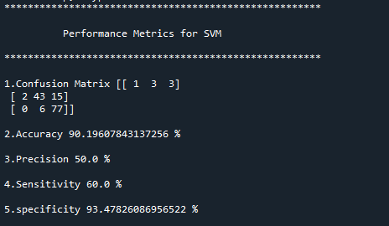
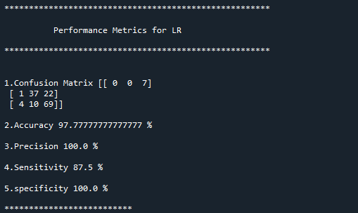
CLASSIFICATION

Slide 23
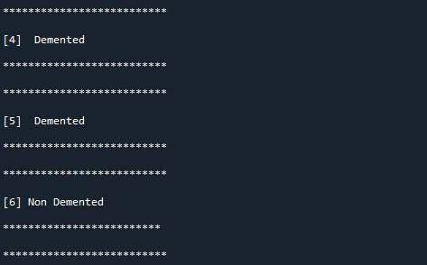
PREDICTION
In this step, we have to predict the dementia or non dementia patient by using the classification algorithms.

Slide 24
RESULT GENERATION
The Final Result will get generated based on the overall classification and prediction. The performance of this proposed approach is evaluated using some measures like,
Accuracy
Precision
Recall/specificity
Sensitivity

Slide 25
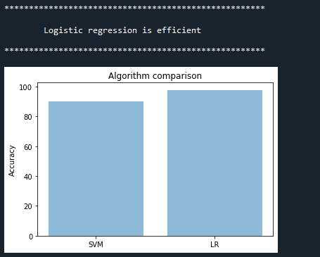
RESULT

Slide 26
SYSTEM REQUIREMENTS
SOFTWARE REQUIREMENTS:
O/S : Windows 7.
Language : Python
Front End : Anaconda Navigator – Spyder
HARDWARE REQUIREMENTS:
System : Pentium IV 2.4 GHz
Hard Disk : 200 GB
Mouse : Logitech.
Keyboard : 110 keys enhanced
Ram : 4GB

Slide 27
LITERATURE SURVEY

Slide 28
Title | Year | Author | Methology | Merits/demerits
Predicting Prodromal Dementia Using Linguistic Patterns and Deficits | 2020 | ahmed h. alkenani 1, 2, yuefeng li 1, yue xu 1 and qing zhang2 | Data was derived from the cookie theft picture corpus of Dementia Bank, from which all language samples of the identified aetiologies were used, with a random subsampling technique that handles the skewness of the classes. Our models resulted in benchmarks for differentiating all the identified classes with accuracies ranging between 95 to 98% | The advantage of n-grams features as being easily computed without requiring manual annotation, which suggests that our models could be extended to other clinically recommended pictures for the same purpose.

Slide 29
Title | Year | Author | Methology | Merits/demerits
DEMNET: A Deep Learning Model for Early Diagnosis of Alzheimer Diseases and Dementia from MR Images | 2021 | Suriya murugan 1, chandran venkatesan 2 , m. g. sumithra 2 , (senior member, ieee), xiao-zhi gao 3 , b. elakkiya 4 , m. akila 5 , and s. manoharan | Convolutional Neural Network (CNN) is utilized to create a framework that can be used to detect specific Alzheimer’s disease characteristics from MRI images. the proposed model generates high-resolution disease probability maps from the local brain structure to a multilayer perceptron and provides accurate, intuitive visualizations of individual Alzheimer’s disease risk. | The high model parameter and class imbalance in the multiclass AD classification is still an issue.

Slide 30
Title | Year | Author | Methology | Merits/demerits
Alzheimer’s Diseases Detection by Using Deep Learning Algorithms: A Mini-Review | 2020 | suhad al-shoukry 1,2, taha h. rassem 1 , (senior member, ieee), and nasrin m. makbo | we briefly review some of the important literature on AD and explore how DL can help researchers diagnose the disease at its early stages. From a computational perspective, this recent advancement has spawned the development of tools that incorporate several patient-specific observations into predictions and improve the clinical outcomes of patients suffering from such disorders. | No expertise was required, as no image segmentation was involved in preprocessing the data. This feature generally serves as the advantage of this approach over the other methods.

Slide 31
Title | Year | Author | Methology | Merits/demerits
Artificial Intelligence for Caregivers of Persons with Alzheimer’s disease and Related Dementias: Systematic Literature Review | 2020 | Bo xie,Cui Tao,JuanLi,Robin C Hilsabeck | we searched predetermined keywords in PubMed, Cumulative Index to Nursing and Allied Health Literature Plus with Full Text, PsycINFO, IEEE Xplore Digital Library, and the ACM Digital Library. | To identify and examine literature on AI that provides information to facilitate ADRD management by caregivers of individuals diagnosed with ADRD and identify gaps in the literature that suggest future directions for research.

Slide 32
Title | Year | Author | Methology | Merits/demerits
Detecting Alzheimer's Dementia Degree | 2020 | Edmond Q. Wu, Xian-Yong Peng, Sheng-Di Chen, Xiao-Yan Zhao and Zhi-Ri Tang | A warped infinite Gaussian mixture model (WiGMM) is proposed to learn the latent variables of these indicators to detect the degree of dementia. The experimental results show that HMSbased indicators are able to reflect the cognitive function of AD patients. | The warped infinite Gaussian mixture model can easily capture local information and provide higher resolution. The power of θ wave in AD group is higher in the frontal lobe than that in control group.

Slide 33
Title | Year | Author | Methology | Merits/demerits
Depression as a Risk Factor for Dementia and Alzheimer’s disease | 2020 | Vanesa Cantón-Habas, Manuel Rich-Ruiz, Manuel Romero-Saldaña | Preventing the onset of dementia and Alzheimer’s disease (AD), improving the diagnosis, and slowing the progression of these diseases remain a challenge. The aim of this study was to elucidate the association between depression and dementia/AD and to identify possible relationships between these diseases . | The difficulty in identifying all articles that are related to this study: This problem is identified and was considered to be a key problem of SLR.

Slide 34
Title | Year | Author | Methology | Merits/demerits
Automatic detection of linguistic indicators as a means of early detection of Alzheimer's disease and of related dementias: A computational linguistics analysis | 2017 | Eva Danasi, Dimitra Arfani, Katerina Fragkopoulou, Spyridoula Varlokosta | Degenerative conditions, such as Alzheimer’s disease (henceforth AD) are commonly associated with deficits across a range of subcomponents of linguistic competence. Although both AD and other types of dementia are associated with changes in spoken and written language, these changes have not been extensively examined or compared | A related index is Brunet’s W, lower values of which imply a higher number of distinct word types, and thus a richer vocabulary. The high accuracies achieved in both comparisons imply that the classifiers’ performance was high in all the 10 fold classifications tasks.

Slide 35
CONCLUSION
The results suggest that it may be feasible to detect early AD using a profile of non-amyloid proteins that identify the metabolic processes that accompany or precede the disease.
It may be therefore possible to detect the disease.
This system was proposed for efficient disease detection in IoT networks using machine learning algorithms such as SVM and logistic regression.
Experimental results analysis showed that our proposed method is efficient and can achieve better performance results on average when compared with existing.

Slide 36
FUTURE WORK
As a future work, a growing understanding of how the disease disrupts the brain has led to potential Alzheimer's treatments that short-circuit basic disease processes.
Future Alzheimer's treatments may include a combination of medications, similar to how treatments for many cancers or HIV/AIDS include more than a single drug.

Slide 37
REFERENCES
Association, “2018 Alzheimer’s disease facts and figures,” Alzheimer’s Dementia, vol. 14, no. 3, pp. 367–429, 2018.
M. Prince, A. Comas-Herrera, M. Knapp, M. Guerchet, and M. Karagiannidou, World Alzheimer Report 2016: Improving Healthcare for People Living with Dementia: Coverage, Quality and Costs now and in the Future, London, U.K.: Alzheimer’s disease International, 2016.
B. Dubois et al., “Preclinical Alzheimer’s disease: Definition, natural history, and diagnostic criteria,” Alzheimer’s Dementia, vol. 12, no. 3, pp. 292–323, 2016.

Slide 38
REFERENCES
M. S. Albert et al., “The diagnosis of mild cognitive impairment due to Alzheimer’s disease: Recommendations from the National Institute on Aging-Alzheimer’s Association workgroups on diagnostic guidelines for Alzheimer’s disease,” Alzheimer’s Dementia, vol. 7, no. 3, pp. 270–279, 2011.
G. M. McKhann et al., “The diagnosis of dementia due to Alzheimer’s disease: Recommendations from the National Institute on Aging-Alzheimer’s Association workgroups on diagnostic guidelines for Alzheimer’s disease,” Alzheimer’s Dementia, vol. 7, no. 3, pp. 263–269, 2011.

Slide 39
Thank You…

