Slide 1
Problem

Slide 2
diversly
Run Cubicle forward to explore the model evenly.
If a behavior that leads to a transition is rare then a simple random generation might not go that way enough times. The exploration is uneven.
Running example: cascading if
transition t1(i)
requires {PC[i] = A1} {PC[i] := A2}
transition t2(i)
requires {PC[i] = A2} {PC[i] := A3}
transition t(i)
requires {PC[i] = A3 && forall_other j. PC[j] = A3} { X := X+1; PC[k] := case | _ : A1}
transition t4(i j)
requires {PC[i] = A3 && PC[j] <> A3} { Y := Y + 1; PC[i] := A1 }
In this example, t has a harder to reach require than t4 and is proposed and taken less often
Final count: t is taken ~2% of the time, vs. t4, taken ~28% of the time
The goal is to get the system to run in a way where t and t4 appear an equal amount of time
In this case a solution will be : t1 is taken 40% of the time, t2: 40%, t: 10%, t4: 10%.

Slide 3
Quick overview of proposed solution

Slide 4
Method step-by-step:
Step 1: Run model exploration while maximizing entropy [Slide 12]
Step 2: Gather data from run [Slide 12]
Step 3: Run analytics on data [Slide 12]
Step 4: If analytics satisfactory then stop, else continue to Step 5 [Slide 13]
Step 5: Rerun model exploration modifying how the system is explored using one of the proposed methods [Slide 13]
(i) Bias the Proposal Distribution
(ii) Bias the Entropy
(iii) Bias both
Step 6: Gather new data and analyze it [Slide 14]
Step 7: If new analytics satisfactory, stop. Else go back to Step 5, modifying bias parameters [Slide 14]
Detailed description in following slides.

Slide 5
First idea [before generalized solution]

Slide 6
Proposition 1: Target the desired transition specifically
General idea
If you know that you want to privilege a specific transition T, you can force the system to always pick steps that bring you closer to T
You don’t always want to get closer to T, because you still want the system to have a certain degree of freedom to move. You only want to get closer to T a specific % of the time
Being brought closer to T means being brought closer to a state that satisfies T’s guard
Algorithm[vaguely]
Choose the transition T you wish to target
Pick p: the % of time you want T to be targeted [e.g. 60% of the time target T, the other 40% do whatever]
Run the execution loop:
With a probability of p: pick a transition according to weight
With a probability of 1-p: pick randomly
If I pick a transition t1 and p = 65%, then 65% of the time the system will weigh the potential states and pick the one which brings it closer to t1. 35% of the time the system will do whatever it wants.
Subtleties: you have to (1) target a specific transition (2) play around with the % to find the optimal result
The running example: forcing the system to get closer to t 71% of the time equalizes t and t4

Slide 7
Proposition 1: visual version
S1
With probability p:
The system weighs each state resulting from a possible transition. It picks the transition leading to the state with the biggest weight, i.e. the closest to chosen transition T
(if multiple states have the same weight, the system picks uniformely from those)
ps1
S2
ps2
ps3
ps4
ps1
ps2
S3
With probability 1-p:
The system randomly picks from all of the possible transitions without considering what happens after taking that transition
S4

Slide 8
Proposition 1: weights & probabilities
Weights are calculated according to the targeted state and the current state.
Approching the state: +1
Distancing from the state: -1
Neither : 0
This means that weights can be negative, if your current state matches one of the litterals of the target state, and your potential state changes that value (meaning takes you farther away)
Examples
Current: X = A && Y = B
Target: X = A && Y = C
Potenial: X = A&& Y= C
Weight: 1
Current: X = A && Y = B
Target: X = A && Y = C
Potenial: X = B && Y = B
Weight: -1
Current: X = A && Y = B
Target: X = C && Y = D
Potenial: X = B && Y = A
Weight: 0
Weighing states in this way means you always need the current state, the potential state, and the target state.
The probability is a guess- you have to try various probabilities and see what happens.
The 71% in the running example was a lucky (educated) guess.

Slide 9
Generalizing the idea

Slide 10
The idea of Proposition 1 is to target a state and force the system to go to that state with a certain probability.
A generalization of that idea is to be able to target the entire system run instead of focusing on one transition.
The weights also need to be replaced by something more neutral which can be calculated even if you’re not targeting a specific state but are generally trying to influence the system.
Proposition 1
Target one transition
Calculate weight
Weight depends on target
One probability for the transition
New Method
Target the whole system
Calculate entropy
Entropy does not depend on target
Probability distributions for the whole system
Builds transition matrix*
Calculates final stable state*
* This is not exclusive to the new method and could be implemented for proposition 1

Slide 11
Proposed solution steps

Slide 12
Steps 1-3
Step 1: Run model exploration while maximizing entropy [1][2]
This step is a test run of the model to give the user an idea of how it behaves.
Maximizing entropy is better than randomly picking transitions because it:
- guarantees a better exploration of the system by forcing the system to explore different state spaces instead of getting stuck in one place and running around in circles
- reduces sampling bias
- ensures that all outcomes have an equal chance of being generated
Steps 2 and 3: Gather data from the run & run analytics on data
The test-run spits out a bunch of information concerning the model, allowing the user to decide what to do next.
For example, it gives you a probability distribution of how often each transition is taken.
If we compare the distributions for the running example [cascading if] with a correct Dekker model:
Dekker: [req: 0.333, enter: 0.333, exit: 0.333] -> each transition is triggered equally (~33%)
Cascading if: [t: 0.026, t1: 0.35, t2: 0.35, t4: 0.272] -> t is triggered only 2% of the time
[1] Uniform Sampling for Timed Automata with Application to Language Inclusion Measurment – B. Barbot, N. Basset, M. Beunardeau, M. Kwiatkowska
[2] Information Theory and Statistical Mechanics. II. E.T. Jaynes

Slide 13
Steps 4 & 5
Step 4: : If analytics satisfactory then stop, else continue to Step 5
If the analytics seem correct to the user, like with Dekker, where the data shows that then there is no point in rerunning the system.
Step 5: Rerun the model
If the data indicates that the system is explored in a way that isn’t satisfactory, you can rerun the model changing the exploration tactics.
Tactic 1: Bias the proposal distribution
When the system decides which transition to propose it will propose transitions with a certain probability [as opposed to the test-run, which has a uniform probability]
Tactic 2: Bias the entropy
This means decide which transitions are interesting. The test-run considers each transition as equals when calculating entropy [entropy calculation detailed slide X].
Biasing entropy tells the system that certain transitions are more interesting to explore.
Tactic 3: Bias both
This mixes tactics 1 and 2, forcing the system to change everything about how the model is explored.

Slide 14
Steps 6 & 7
Step 6: Gather new data and analyze it
Rerunning the model by forcing the system to explore differently generates new data.
For example, let's say that we decide to use Tactic 1 and bias how the system proposes transitions by giving it the following distribution:
[t: 0.1, t1: 0.4, t2: 0.4; t4: 0.1], which says “propose t 10% of the time, t1 40% of the time,…”
Running the model now gives the result:
[t: 0.12, t1: 0.41, t2: 0.41, t4:0.05]
Step 7: analyze the new data and go back to Step 5 if unsatisfied
t went from 2% to 12%, and t4 went from 28% to 5%. If the goal is to force the system to explore t more often, you can stop here. If the goal is to try to get the system to explore them equally, then you can go back to Step 5 and try again.
For example if I now try a different proposal distribution:
[t: 0.135, t1: 0.35; t2: 0.35; t4: 0.165]
Running the system gives:
[t: 0.100, t1: 0.400, t2: 0.400 , t4: 0.099]
So t and t4 now appear (more or less) equally.

Slide 15
Fuzz & BRAB
Standalone [fuzz]:
The standalone version is trying to explore the system in a smarter fashion.
It either tries to cover the most interesting parts of the system, the ones which lead to more outcomes, ones which favor certain transitions, etc.
The probabilities are an easy way to compare runs and are easy to read and interpret and can signal weird behavior.
BRAB:
Plug this exploration method into BRAB. The method tries to explore a variety of states while going down. BRAB can’t go deep because it covers breadth. This tries to go deep but ~intelligently.

Slide 16
More detailed explanations

Slide 17
Markov Chain Monte Carlo (MCMC)
DEFINITION
Markov Chain: a Markov chain describes a system that transitions between different states, where transitioning to the next state depends only on the current state.
In our case this works because if you are in state S1, whether or not you can take transition t to move to S2 depends only on the state of S1 [S1 reflects the entire history]. The opposite can also be argued (that memory is needed) and is discussed in a later slide.
DEFINITION
Monte Carlo: a class of algorithms that rely on random sampling to obtain a result
DEFINITION
MCMC: Markov Chain Monte Carlo is a way to use randomness to simulate a process that you wish to study. It works by targetting a probability distribution and building a Markov chain according to that distribution.
In our case, we tell the system to maximize entropy, so we’re targetting a distribution that maximizes entropy (i.e. provides the best exploration)
﻿DEFINITION
Metropolis-Hastings: a method in MCMC used to generate a sequence of samples and bias the exploration.

Slide 18
Transition guards as states
The method treats a Cubicle model as a finite ensemble of states, represented by the transitions and their guards.
During a run, Cubicle will always cycle through the same states – states that satisfy transition guards.
These states have other values in them, but the key part is that a subset of any state has to satisfy at least one transition guard.
If a state has no way to satisfy any of the transition guards, that means the model has deadlocked.
This means that any Cubicle model can be represented as
A sort of automaton/graph [pre and post run]: you can draw which transitions come after which transitions
*Pre-run: a pre-run graph would have each transition following every other transition, since you could expect this to be true [could probably run a static analysis to see if some transitions openly contradict some guards to filter out edges without having to run Cubicle]
*Post-run: the graph after the run uses the created transition matrix and is therefore a better reflexion of the system’s actual behavior. This can be simplified to just the transitions, or detailed with transition+process couples.
A transition matrix [post run]: what transitions lead to what other transitions and with what probability

Slide 19
Transition guards as states
For example the running example would look like this:
Expectation: Reality:
1/4
1
t1
t
To be read as:
When I am in a state where I have executed t1 (or t,t2,t4), from there I can move via any of the arrows to a state where I have executed another transition. So for example when I have executed transition t, I can only move by executing transition t1
t1
t
1/4
1/4
1/4
t2
t4
t2
t4
The graph in this form is a quick visual representation of how the system can behave – which transitions can come one after the other. The edges are labelled with probabilities.
For example, in theory, there is a 25% chance that any of the transitions will follow t.
In reality, there is a 100% chance that t1 will follow t

Slide 20
Transition guards as states
So instead of the transition matrix considering state -> state, it considers transition -> transition
is replaced by
t1
t1
S1
t2
S1
S2
The transition matrix in the running example, after a test-run (1 000 000 Monte Carlo steps)
looks like this:
+----------------+-------------------+-----------------+---------------+-----------------+
| | t | t1 | t2 | t4 |
+==========+===========+==========+==========+==========+
| t | 0 | 1 | 0 | 0 |
+----------- -----+------------------+-----------------+----------------+----------------+
| t1 | 0 | 0.254844 | 0.552085. | 0.193072. |
+----------- -----+------------------+-----------------+----------------+----------------+
| t2 | 0.0744302. | 0.236885 | 0.207116 | 0.481569 |
+------------ ----+------------------+-----------------+----------------+----------------+
| t4 | 0 | 0.558558 | 0.310034 | 0.131408. |
+------------ ----+------------------+-----------------+----------------+----------------+
The rows are the source and the colums are the destination.
You can see that when you are in a state after executing t, your only possible next step is t1 (highlighted in red)
The probability of a sequence t -> t1 is 1

Slide 21
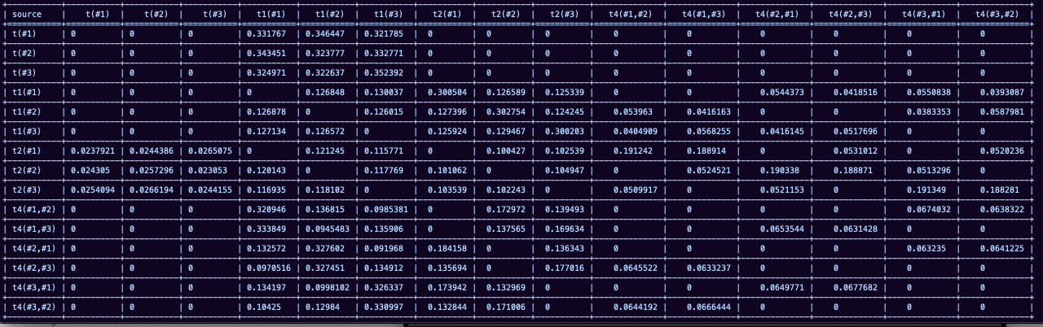
Transition guards as states
The transition matrix can also be detailed to include the actual processes (instead of being grouped together)
For the running example, the detailed matrix looks like this:
Where you can see for example that processes never do t1->t1 (highlighted in green)
[file cascading1.cub1678124754.data]

Slide 22
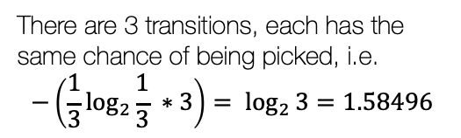
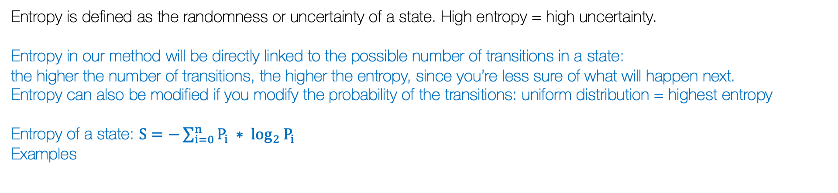

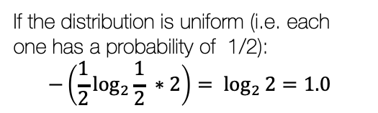
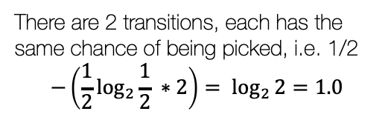
Information Entropy
Entropy is defined as the randomness or uncertainty of a state. High entropy = high uncertainty.
Entropy in our method will be directly linked to the possible number of transitions in a state:
the higher the number of transitions, the higher the entropy, since you’re less sure of what will happen next.
Entropy can also be modified if you modify the probability of the transitions: uniform distribution = highest entropy
Entropy of a state: $S=−\sum_{i=0}^{n}{P_{i} ∗ \log_{2}{P_{i}}}$
Examples
If the distribution is uniform (i.e. each one has a probability of 1/2):
$$−\left(\frac{1}{2}\log_{2}{\frac{1}{2} ∗2}\right)= \log_{2}{2}=1.0$$
There are 3 transitions, each has the same chance of being picked, i.e.
$$−\left(\frac{1}{3}\log_{2}{\frac{1}{3} ∗3}\right)= \log_{2}{3}=1.58496$$
S1
S1
If the distribution is not uniform, for example: [0.55, 0.45]
$$−\left(0.55∗\log_{2}{0.55+0.45 ∗ \log_{2}{0.45}}\right)= 0.99277$$
There are 2 transitions, each has the same chance of being picked, i.e. 1/2
$$−\left(\frac{1}{2}\log_{2}{\frac{1}{2} ∗2}\right)= \log_{2}{2}=1.0$$
S1
S2

Slide 23
Information gathered from a run
The following is a list of information that can be obtained from a run.
Steps to take and steps taken
If the ratio steps taken/steps to take is too small, that means that system may have hit a deadlock
Transition matrix
If the matrix is not stochastic that means the system hit a state it couldn’t get out of
Probabilities between transitions can be used to study the system’s behavior
Stable / Stationary state: over time, this is how the transition distribution will look like
The Markov Chain (MC)
Ergodicity
Irreducible: any state can be reached from any other (directly or indirectly)
Aperiodic: the system doesn’t end up in a loop (any state can be returned to at any time)
How often each transition, process, transition+process pair appears
How entropy evolves
Tracking the entropy of each transition will allow you to deduce whether or not the transition is succeptible to the order of execution. If the entropy is more or less stable, then the transition doesn’t depend on its history. If the entropy fluctuates, then you might need to consider Memory-Enhanced Metropolis.

Slide 24
To Do
Implement entropy tracking [in progress]
Choice between vector bias and full matrix bias + best format for user input
Have runs track both detailed and grouped matrix and either (i) create two files or (ii) choose what you want to see during the analysis
Figure out an automatic way to propose biases
Output matrix in browser – some of them are way too big for the terminal and its unreadable
Deal with floats

Slide 25
Random Notes
Transitions with more processes have a higher probability of being picked after if procs >= 3
A full transition matrix (transition+process couple) has a better chance of influencing the system
Deadlocking/livelocking systems could be expected to have weird transition matrixes
Stochastic matrix: if a transition matrix from a Markov Chain is not stochastic (meaning that the rows don’t sum up to 1
This violates one of the main properties of the Markov Chain
Indicates that there is a problem with the data or with the model itself (a missing transition or a redundant transition)

Slide 26
The method with various Cubicle models

Slide 27
Dekker.cub [test-runmaximizing entropy] [grouped transitions]
Data log file: dekker.cub1678120844.data
Transition matrix
+----------------+-----------------+----------------+----------------+
| | enter | exit | req |
+==========+==========+==========+==========+
| enter | 0 | 0.834687 | 0.165313 |
+----------------+-----------------+----------------+----------------+
| exit | 0.346006 | 0 | 0.653994 |
+----------------+-----------------+----------------+----------------+
| req | 0.653972. | 0.165305 | 0.180723. |
+----------------+-----------------+----------------+----------------+
Steady states: [0.33332976, 0.33332916, 0.33334108] -> every transition is hit more or less the same amount of times
Studying this matrix, it might seem weird that the transition exit -> enter is possible directly. We can generate a detailed matrix to the system in more detail [next slide]
The matrix describes expected behaviors, for example you can’t have two enters following each other.
Sometimes grouped transitions aren’t clear enough about the behavior, so a more detailed transition matrix can be built [see next slide]

Slide 28
Dekker.cub [test-run maximizing entropy] [detailed transitions]
Transition matrix
+-------------------+-----------------------+-----------------------+-----------------------+---------------------+----------------------+---------------------+--------------------+--------------------+--------------------+
| source | enter(#1) | enter(#2) | enter(#3) | exit(#1) | exit(#2) | exit(#3) | req(#1) | req(#2) | req(#3) |
+===========+==============+==============+==============+=============+=============+=============+============+============+============+
| enter(#1) | 0 | 0 | 0 | 0.843004 | 0 | 0 | 0 | 0.0774727 | 0.0795229 |
+-------------------+----------------------+------------------------+-----------------------+---------------------+----------------------+---------------------+--------------------+--------------------+--------------------+
| enter(#2) | 0 | 0 | 0 | 0 | 0.830604 | 0 | 0.0887046 | 0 | 0.0806912 |
+-------------------+----------------------+------------------------+-----------------------+---------------------+----------------------+---------------------+--------------------+--------------------+--------------------+
| enter(#3) | 0 | 0 | 0 | 0 | 0 | 0.831935 | 0.0865703 | 0.0814945 | 0 |
+-------------------+----------------------+------------------------+-----------------------+---------------------+----------------------+---------------------+--------------------+--------------------+--------------------+
| exit(#1) | 0 | 0.169297 | 0.169732 | 0 | 0 | 0 | 0.489066 | 0.0908921 | 0.0810139 |
+-------------------+----------------------+------------------------+-----------------------+---------------------+----------------------+---------------------+--------------------+--------------------+--------------------+
| exit(#2) | 0.189185 | 0 | 0.162985 | 0 | 0 | 0 | 0.0985297 | 0.464288 | 0.0850115 |
+-------------------+----------------------+------------------------+-----------------------+---------------------+----------------------+---------------------+--------------------+--------------------+--------------------+
| exit(#3) | 0.180754 | 0.169334 | 0 | 0 | 0 | 0 | 0.104759 | 0.0842439 | 0.460909 |
+-------------------+----------------------+------------------------+-----------------------+---------------------+----------------------+---------------------+--------------------+--------------------+--------------------+
| req(#1) | 0.447661 | 0.115177 | 0.105672 | 0 | 0.0786482 | 0.0772194 | 0 | 0.0880288 | 0.087594 |
+-------------------+----------------------+------------------------+-----------------------+---------------------+----------------------+---------------------+--------------------+--------------------+--------------------+
| req(#2) | 0.123676 | 0.406982 | 0.113434 | 0.085981 | 0 | 0.0795011 | 0.101519 | 0 | 0.0889075 |
+-------------------+----------------------+------------------------+-----------------------+---------------------+----------------------+---------------------+--------------------+--------------------+--------------------+
| req(#3) | 0.129432 | 0.10779 | 0.407825 | 0.0911526 | 0.082129 | 0 | 0.0962989 | 0.0853719 | 0 |
+-------------------+----------------------+------------------------+-----------------------+---------------------+----------------------+---------------------+--------------------+--------------------+--------------------+
Stable state: [0.12020888, 0.10717856, 0.10594082, 0.12020984, 0.10717859, 0.10593995, 0.12021135, 0.10718605, 0.10594596]
The detailed matrix shows that exit -> enter is an acceptable pair, because it is always between 2 different processes.
Data log file: dekker.cub1678123227.data

Slide 29
Buggy Dekker.cub [original deadlocking example]
Log file: buggy.cub1678220204.data
Out of 1 000 000 steps, it only took 3. No need to even try anything else, the model is clearly odd.
The transition matrix clearly shows that going 100% from req to req killed the system:
+----------------+-----------------+--------------+-------------+
| source | enter | exit | req |
+==========+==========+=========+========+
| enter | 0 | 0 | 0 |
+----------------+-----------------+--------------+-------------+
| exit | 0 | 0 | 0 |
+----------------+-----------------+--------------+-------------+
| req | 0 | 0 | 1 |
+----------------+-----------------+--------------+-------------+

Slide 30
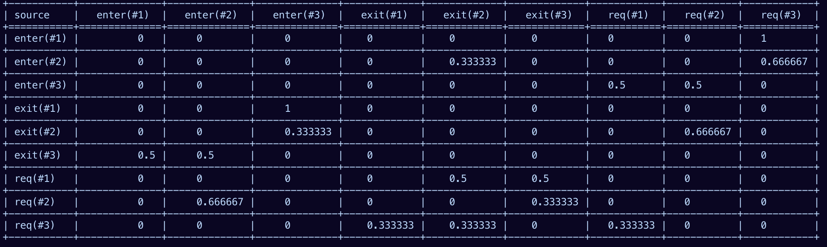
Buggy Dekker.cub [original deadlocking example]
Log file: buggy.cub1678198010.data
You can try a different run and maybe try a more detailed matrix:
Although it is also useless, since the simple information gathered from the run, i.e. how often processes/transitions appear etc is enough to deduce that something is wrong with the model.

Slide 31
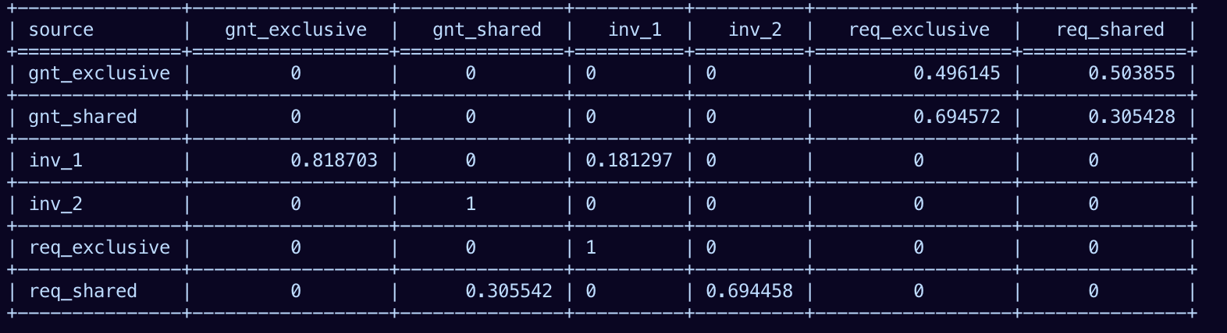
Germanish [test-run maximizing entropy]
Log file: germanish.cub1678226749.data
0.19319739, 0.14014888, 0.23597992, 0.09732752, 0.19319739, 0.14014888]
Proc 1 : 14774 times
Proc 2 : 14501 times
Proc 3 : 14367 times
Transition inv_2 : 4248 times
Transition inv_1 : 10298 times
Transition req_shared : 6117 times
Transition req_exclusive : 8431 times
Transition gnt_exclusive : 8431 times
Transition gnt_shared : 6117 times

Slide 32
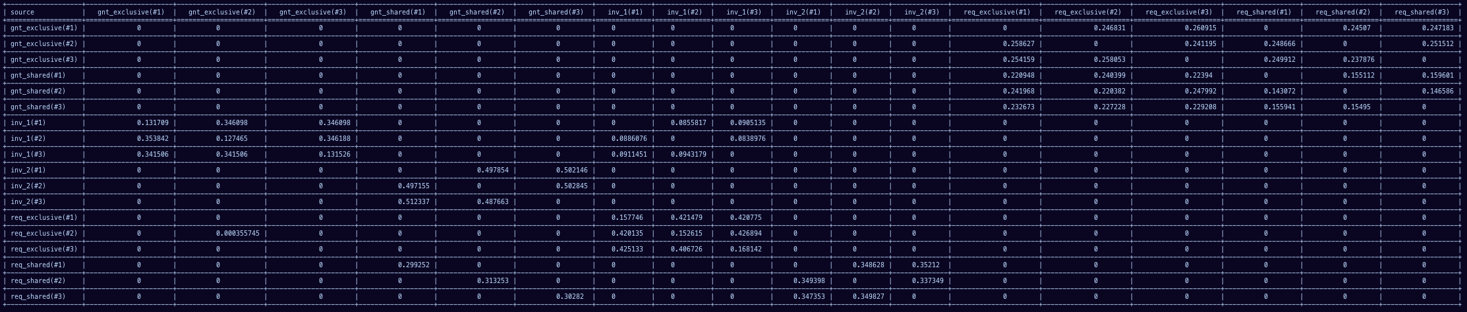
Germanish [test-run maximizing entropy]
Log file: germanish.cub1678226953.data
0.0653145 , 0.06464634, 0.0649695 , 0.04611472, 0.04581588,
0.04648112, 0.07927201, 0.07812757, 0.07973191, 0.03215312,
0.032337 , 0.03169428, 0.0653217 , 0.06463193, 0.06497671,
0.04611525, 0.04581657, 0.0464799 ]

Slide 33
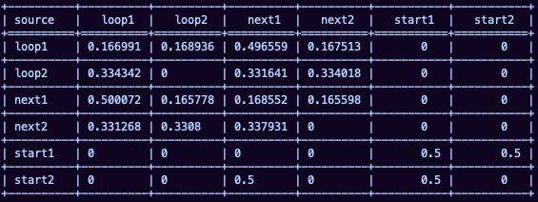

Non-ergodic [random example of a non-ergodic system]
Log file: non_ergodic2.cub1678280563.data
Irreducible: any state can be reached from any other
In this model, processes have a choice in the beginning which splits the state space in two. Once you’ve decided you can never again change spaces.

Slide 34
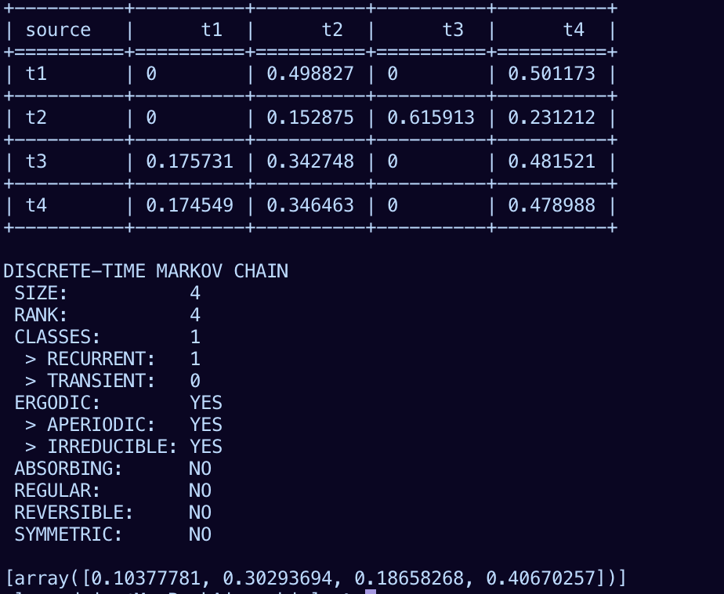
Mesi [correct protocol from Cubicle examples]
Log file: mesi.cub1678286734.data
Log file:mesi.cub1678286836.data for detailed matrix, but matrix too big to paste

Slide 35
Consensus_V9.cub [the livelock consensus algorithm from when we were looking for deadlocks]
Log file: consensus_V9.cub1678282461.data consensus_V9.cub1678282688.data
When you build an overview of the system, i.e. the grouped transitions – the matrix is fine, the Markov Chain is fine, everything looks correct.
If you build the transition matrix from the individual transition+process pairs, the matrix is not stochastic [matrix too big to copy/paste]. Somewhere something in the model goes wrong.

Slide 36
Deadlocking Germanish [germanish_bug_simple.cub]
Log file: germanish.cub1678226953.data
germanish_bug_simple.cub1678286989.data
The matrix isn’t stochastic. But also it takes like 5 steps out of the 1000000 possible, so there’s obvs something wrong with it.

Slide 37
Methods

Slide 38
Initial Exploration
Calculate how many possible initial steps there are from Init, lets call this N
For each step in N, run entropy-guided exploration for a depth of transition_depth * system_procs *system_procs (=how many transitions + proc number squared – might need to rethink this part)
Also do this multiple times? Leaning towards yes since if only like 1 init step this whole part is kinda meh
Collect data from these runs
Analyse data – maybe there’s no point in continuing
Calculate number of procs system initialized with, lets call this P
Run same depth for each proc p in P, where each step is governed by the following rule: “if a transition with p is possible, pick that transition, else pick any transition”
Collect data from that too and analyse it, again – maybe there’s no point in continuing exploration
Collected data
STATES
State : explicit state
Seen : how many times it was visited
Exit_number : how many exits at this state
Exit_transitions : which exits possible
Exit_remaining : how many left to take
Taken_transitions : which exits were taken and how often
DEADLOCKS
Deadlock State : explicit state
Dead_predecessor : who led to deadlock
Dead_path : path that led to deadlock
Dead_steps : how many steps it took
DEAD_PREDS: state -> state [states that had a deadlock follow them]
TR_COUNT: transitions that appeared [and how many times] => % of each transition overall
TR_COUPLES : how often ti -> tj appears

Slide 39
The goal is to define a sort of ‘rewards’ function that would analyze each possible step and assign a value to that step. Then the final choice would be the step that brings the biggest reward.
The potential problem with this is the look-ahead, since the function would look at S1, S2, and S3 to check if they’ve been visited.
Potential way around that:
don’t check states, only look at exits, meaning that if an exit has never been taken from the current state or has never appeared in the system ever, chances are it leads to something new
Don’t assign rewards to every step – if the first step/state checked has never been seen, stop assigning rewards and just go.
Next slide = rules rough version 1
t0
S0
t1(p)
t3
t2
S3
S2
S1

Slide 40
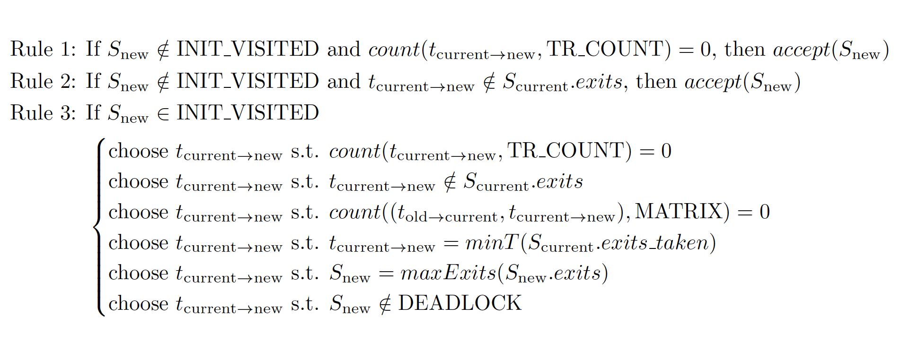
S_{current} : current state
S_{new} : potential new state
t_{current --> new} : transition from current state to potential new state
t0
INIT_VISITED : visited states
DEAD_PREDS : states that can lead to a deadlock
DEADLOCK : deadlocking states
MATRIX : transition pairs and how often they appear
TR_COUNT : transitions and how often they appear
S0
t1(p)
t3
t2
S3
S2
S1
Other:
Take into account vars -> their potential values. If there’s a value that’s not hit try to target that value (like the L9 in dekker_depth example)
If a transition never appears, set that as the target for a run?

Slide 41
FUZZ
Generate X correct seeds (X = number of initial steps) -> length is max 100, shorter if it deadlocks first [100 can be changed]
Generate 1 random seed, not necessarily correct, push to NEWCANDS
Push all seeds to NEWCANDS queue
Pop candidate from NEWCANDS
Mutate candidate
If mutation successful -> add mutated cand to NEWCANDS, candidate to OLDCANDS
If mutation unsuccessful, add candidate to OLDCANDS

Slide 42
Init
BFS stage bounded by
Time
Depth
Keeps a TODO queue of states to explore. If the TODO queue is empty before bounds are hit, then stop exploration and go back to Cubicle.
If TODO isn’t empty, then:
Take remaining nodes [blue], add them to REMAINING set
While not Empty(REMAINING) do
Pick a random node
Pick an exploration method
Apply the method to the node, get new states
Add new states to REMAINING
EXPLORATION METHODS:
Pure random: pick a depth, and then take that many steps forward [excluding deadlock]
Entropy: pick a depth, take steps according to who maximizes randomness
Smart: pick by grading potential steps:
Never visited states, never seen transitions, never taken exits
BFS from that node for a limited # of seconds
One step using a transition that’s never been taken from current node
BFS

Slide 43
Following explorations
Analyse the runs, and get the set of sets that didn’t get all of their exits visited and use those as starting states instead of going from Init
Set up a ”reward”-type function that helps the system decide where to go.
The reward will decide which states are optimal to visit
t0
What reward for S1 should taken into account:
Has S1 appeared before [++]
Has t1 appeared? What % of the time did it appear initially
How often did the couple (t0, t1) appear compared to other t0 couples (only w/ poss exits)
Has t1 been taken from S0 before [++]
How many exits does S1 have
Does S1 appear in DEAD_PRED? (only if (3) doesn’t reply deadlock)
If t1 has a proc, how did that proc behave before [maybe?]
S0
t1(p)
t3
t2
S3
S2
S1

