Slide 1
RESTful Authentication
Trusted Client
Authenticate.php
Web Service
GET [USER,md5(PASS)]
MySQL
Query Database
Untrusted Client
Exists?
GET [USER,md5(PASS)]
Result XML
Authkey
Md5(user.md5(pass).ctrlsalt)

Slide 2
RESTful query
Trusted Client
query.php
web service
GET method, saltedkey, params, hashed request
compare request vs hash
get user validate key get user privileges
Untrusted Client
Check trusted method
Check untrusted method
GET method, key, params, hashed request
Do trusted operation
Do untrusted operation
Result XML

Slide 3
Usecase: Timeblock 2
Trusted Space
add patient
Create New Appointment
SQL INSERT
Delete Patient
SQL DELETE
Delete Appointment
Edit Patient
SQL UPDATE
Trusted Client
Lock/unlock User
WebService (REST)
Untrusted Space
Login/logout
View Visit Information
Post to action log
Untrusted Client
View user information
View Patient Information

Slide 4
Pert Chart: Timeblock 2
Rest Action Log
4
Patient Edit
8
5 hrs
5 hrs
Refactor Database
REST Auth
REST Query
Screens
Dr/Nurse Edit
1
2
3
6
9
5 hrs
10 hrs
20 hrs
30 hrs
5 hrs
10 hrs
Untrusted Client
5 hrs
Admin Edit
Lock/Unlock
5
10
7
5 hrs
“The Bible”
11
10 hrs

Slide 5
“The Bible”
Wiki
A manual containing the standards for each element pertaining to the Emergency Medical Information System.
EMIS Wiki

Slide 6
Burn down Chart

Slide 7
Flow Diagram

Slide 8
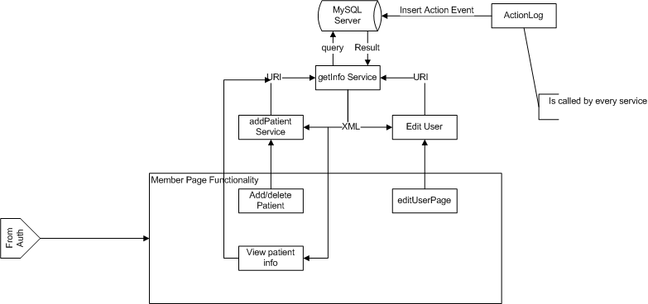
: Timeblock 2

Slide 9
: Timeblock 2

