Slide 1
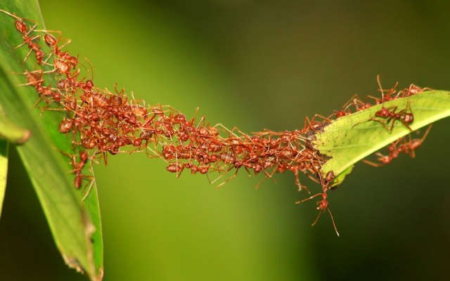
Ant Colony Algorithm
Artificial Intelligence Project - 2017

Slide 2
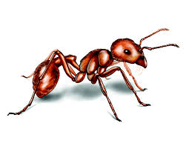
Problem : We are looking for the shortest path between two points.
Solution : We are using the same idea as ant colony works to solve this problem.

Slide 3
Ant Colony Idea :
Ants are trying to find the shortest path between the nest (starting point) and the food (stop point). First they have to start from the nest, and walk around to find some food. At the beginning they don't know where there is some food so they are walking randomly. During this walk, the ant drop some pheromones on its path to know how to go back to the nest. Then when the ant find some food, it takes some, and go back to the nest following the pheromones, and dropping some new kind of pheromones on the path, some specific pheromones informing others ant who are going to see this path that if they follow it they are going to find some food. Bigger is the path, the less is the amount of pheromones. Then when an ant is going to find a path to find some food, the ant is going to drop some pheromones also so the amount of pheromones on this path grow. The amount of pheromones on a path is proportional with its length, so the shortest path is going to be the path with the biggest amount of pheromones, and then the ant colony is going to know which path is the shortest, only regarding with the amount of pheromones.

Slide 4
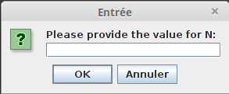
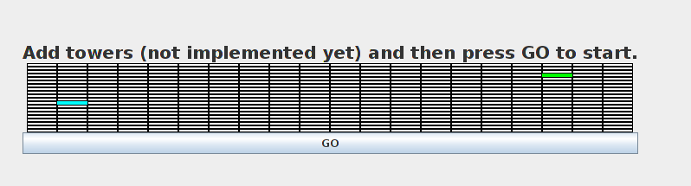
Algorithm :
At the beginning, the user have to declare dimensions of the grid (NxM), the evaporation coefficient (usually around 0.98, it's used to evaporate pheromones on the board every steps), and the alpha coefficient (used on the formula for probabilities to choose the next case for an ant). Then the user have to choose the starting point (the nest) and the stop point (the food).

Slide 5
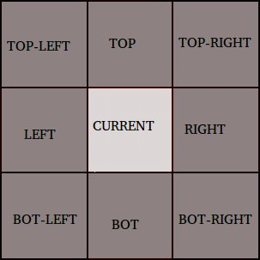
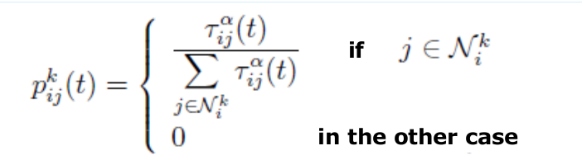
Ants are going to find the shortest path between the nest and the food and drop some pheromones on the path (regarding to the length of the path), like this next ants can find the path.
The shortest path (the one with the biggest amount of pheromones) is going to be more red.
At each step, the ant is going to choose the next case with a probability regarding the amount of pheromones on the 8 cases around. (It can not choose the previous case, to avoid loop)

Slide 6
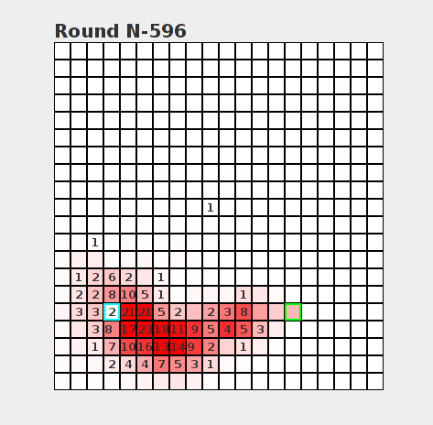

Slide 7
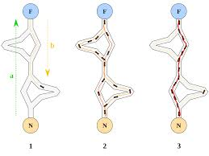
Conclusion : Our algorithm find the shortest path, so it works correctly for evaporation coefficient equal to 0.98 and alpha equal to 0.9
Also we show that an ant colony is smart as a group of ants but a single ant is not smart alone

