Slide 1
Code Graph Modernization
A trustworthy code knowledge graph for legacy modernization
Deterministic graph extraction · KDM-lite schema · GraphRAG & RAG on top
Open-source learning sandbox → TCS / MasterCraft transition
Technical review for Brajesh · June 2026

Slide 2
WHY THIS EXISTS
Modernization needs a graph you can trust
▸ Legacy estates (COBOL / JCL / copybooks) have the business logic but no reliable map: what calls what, what reads/writes which data, where the integration seams are.
▸ Modernization decisions — sequencing, risk, scope — hinge on that map. Getting it wrong is expensive.
▸ The tempting shortcut: point an LLM at raw code and ask it to describe the system.
– Plausible prose, but non-deterministic and unverifiable — you cannot stake a migration plan on it.
▸ What we actually need: a typed, evidence-backed dependency graph, with LLM techniques layered on top to explain and draft — never to invent the structure.
Design principle: structure is derived deterministically; GraphRAG/LLM sits on top; every claim cites source evidence.

Slide 3
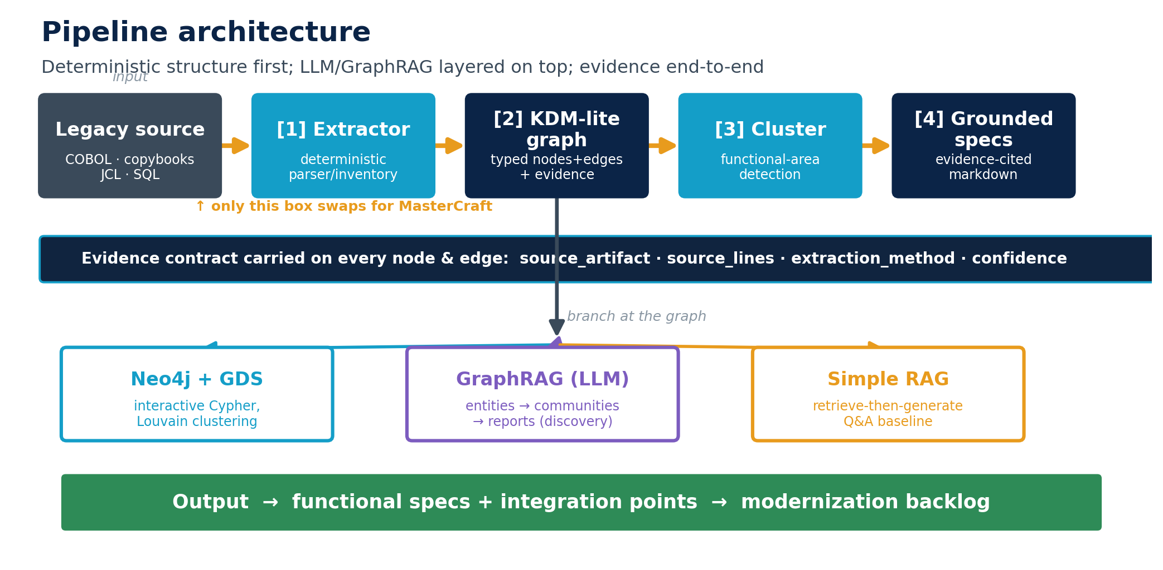
ARCHITECTURE
One pipeline, evidence end-to-end

Slide 4
SCHEMA
KDM-lite: an open stand-in for the MasterCraft inventory
A property-graph subset of OMG KDM (ISO/IEC 19506), the standard MasterCraft aligns to. Same node/edge concepts MasterCraft emits — so only the extractor swaps at the TCS boundary.
KDM-lite node | KDM origin | MasterCraft
Program | code:CompilationUnit | Program / Class
Function | code:CallableUnit | Paragraph / Method
Screen | ui:Screen | Screen / Map
DataStore | data:RelationalTable | File / Table / Queue
Job | platform:DeployedComp. | Batch Job / JCL Step
KDM-lite edge | MasterCraft
CALLS | CALLS
READS_FROM | READS_FROM
WRITES_TO | WRITES_TO
USES_COPYBOOK | USES_COPYBOOK
JOB_RUNS_PROGRAM | JOB_RUNS_PROGRAM
Evidence contract (non-negotiable): every node & edge carries source_artifact, source_lines, extraction_method, confidence.
Deterministic facts are distinguishable from inferred ones; sandbox stamps heuristic-cobol-v0 / 0.7, MasterCraft would stamp ≈1.0.

Slide 5
THE EXTRACTOR
Deterministic structure, every fact stamped
▸ Heuristic COBOL/JCL reader (stdlib only) → typed KDM-lite nodes & edges.
– Detects: program CALLS, file/table READS_FROM / WRITES_TO, USES_COPYBOOK, screen → program, JCL job → program.
▸ Every fact carries its provenance — nothing is asserted without a source line:
ACCTPOST --CALLS--> (missing)
CUSTMGMT --READS_FROM--> CUSTOMER-FILE
source_artifact: CUSTMGMT.CBL lines: 28 method: heuristic-cobol-v0 confidence: 0.7
▸ Low-confidence facts (e.g. inferred screens, 0.5) are queryable separately — reviewers audit them first.
▸ At the TCS boundary the heuristic is replaced by a MasterCraft-inventory adapter; same graph, facts stamped deterministic (~1.0).

Slide 6
PROOF ON A SAMPLE ESTATE
16 nodes · 19 edges · 3 functional areas
4
3
1
2
3
programs
copybooks
JCL job
SQL tables
functional areas
▸ Customer mgmt & daily reporting — CUSTMGMT (screen), DAILYRPT (batch via DAILYJOB) over CUSTOMER-FILE / REPORT-FILE.
▸ Account posting — ACCTPOST over ACCOUNT / TRANSACTION (DB2).
▸ Parts ordering — PARTORDR (screen) over PARTS / ORDERS.
Cross-area edges = the integration contracts that drive sequencing
CUSTMGMT CALLS ACCTPOST — customer screen reaches into account posting
DAILYRPT READS_FROM ACCOUNT — reporting depends on the posting area's data
These cross-cluster dependencies are the contracts and risks to manage when you carve the estate.

Slide 7
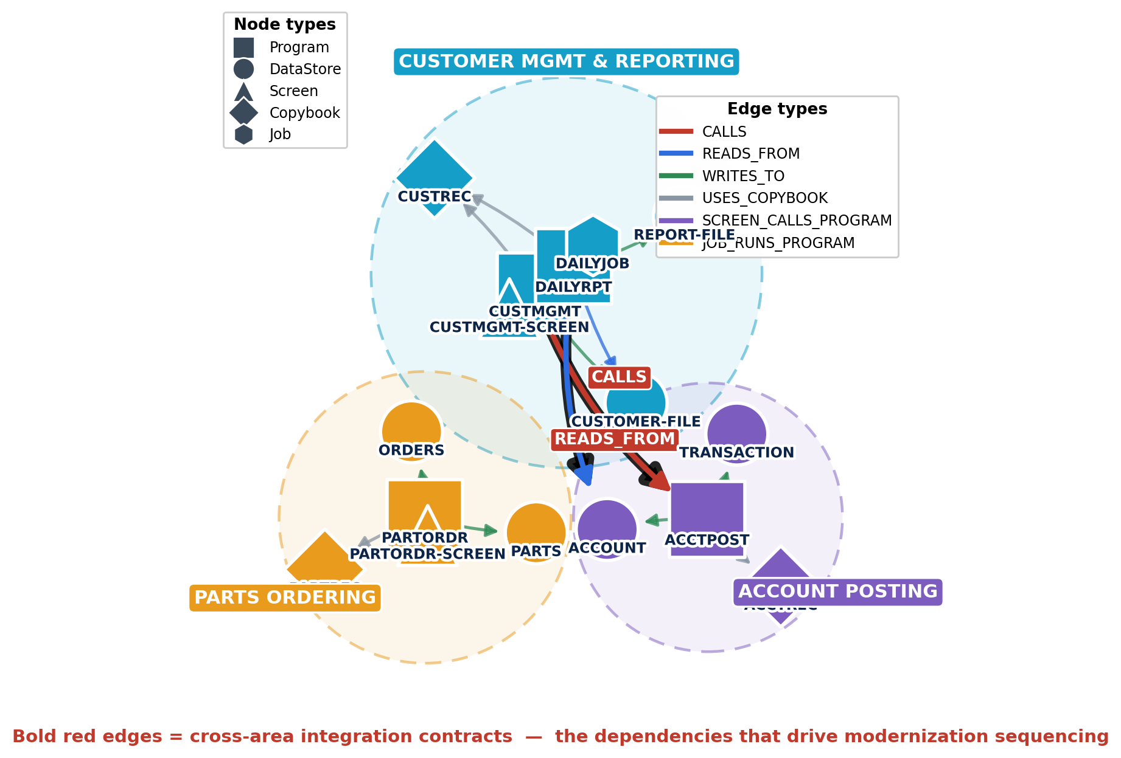
THE CODE KNOWLEDGE GRAPH
Extracted from the sample estate — graph.json
How to read it
Colour = functional area (label-propagation cluster).
Shape = KDM-lite node type — program (■), datastore (●), screen (▲), copybook (◆), job (⬣).
Thin edges = typed dependencies within an area (CALLS / READS_FROM / WRITES_TO / USES_COPYBOOK).
Bold red edges = cross-area integration contracts:
CUSTMGMT → ACCTPOST
DAILYRPT → ACCOUNT
These are the seams that drive modernization sequencing and risk.
Every node & edge links to source_artifact : lines.

Slide 8
THREE RETRIEVAL/GENERATION PATHS
Same corpus, different trust profiles
Path | How it works | Output | Trust
Graph + spec gen | Deterministic parse → typed graph → cluster → spec | Evidence-cited specs | High / auditable
GraphRAG | LLM extracts entities+rels → communities → reports | Discovery, summaries | Needs validation
Simple RAG | Chunk → retrieve top-k → stuff → LLM answer | Q&A over corpus | Baseline
▸ Primary path is the deterministic graph — structure you can stake a plan on.
▸ GraphRAG and RAG are complementary: great for discovery and natural-language exploration, validated against the graph.
▸ Reliability vs coverage: the deterministic path gives typed, stamped edges; GraphRAG gives breadth but untyped, inferred edges.

Slide 9
GRAPHRAG PATH
Microsoft GraphRAG 3.1, tuned for code
▸ Code-tuned config: entity_types set to the KDM-lite vocabulary (program, function, screen, copybook, datastore, job, handler).
▸ Extraction prompt rewritten with COBOL examples → emits CALLS / READS_FROM / WRITES_TO / USES_COPYBOOK / JOB_RUNS_PROGRAM.
▸ GraphML snapshot on → load the LLM-built graph into Neo4j alongside the deterministic one.
▸ Runs two ways:
– In Claude-on-the-web sandbox: Anthropic completion, embeddings-free workflow (extract → communities → reports → global search).
– Locally: OpenAI / Together with embeddings → full pipeline incl. local & DRIFT search.
▸ Verified end-to-end to the LLM boundary: loads docs → chunks → dispatches a Claude extraction call per document. A valid key completes the run.
Network reality: sandbox allowlists Anthropic only; OpenAI/Together hosts run locally. Config documents both paths.

Slide 10
TRANSITION TO TCS / MASTERCRAFT
One box changes — everything downstream is reused
CHANGES
CHANGES
REUSED
REUSED
MasterCraft
inventory export
▶
Adapter
(maps to KDM-lite)
▶
Same graph.json
▶
Neo4j · cluster ·
specs · GraphRAG
▸ Choosing a KDM-aligned schema for the sandbox is what makes this a remapping of sources, not a redesign.
▸ graph.json format, Neo4j loader, clustering, spec generation, GraphRAG config — all reused unchanged.
▸ De-risks the TCS engagement: the hard parts (schema, clustering, evidence, specs) are proven on open code first.

Slide 11
ROADMAP
Where we are and what's next
Schema alignment
Confirm MasterCraft export maps onto KDM-lite nodes/edges
0
Ready
This sandbox
Prove extract → graph → cluster → spec on open COBOL
1
Done
GraphRAG enrichment
Semantic retrieval + richer narratives; broaden coverage
2
In progress
Target mapping
MAPS_TO_TARGET edges, capability specs, modernization backlog
3
Planned

Slide 12
What this gives us
▸ A proven, evidence-first pipeline from legacy source to grounded functional specs.
▸ A KDM-aligned graph that transfers to TCS/MasterCraft by swapping one component.
▸ GraphRAG + RAG layered on top for discovery — validated against a deterministic spine.
▸ De-risked path: the architecture is exercised on open COBOL before touching client code.
Asks / next steps
1. Get a MasterCraft inventory export sample to validate the KDM-lite mapping (Phase 0).
2. Confirm target-state vocabulary so we can design MAPS_TO_TARGET edges (Phase 3).
3. Decide GraphRAG scope: discovery aid vs. part of the deliverable.

