Slide 1
Programmable Packet Scheduling
Akash, Cassandra, Kabir

Slide 2
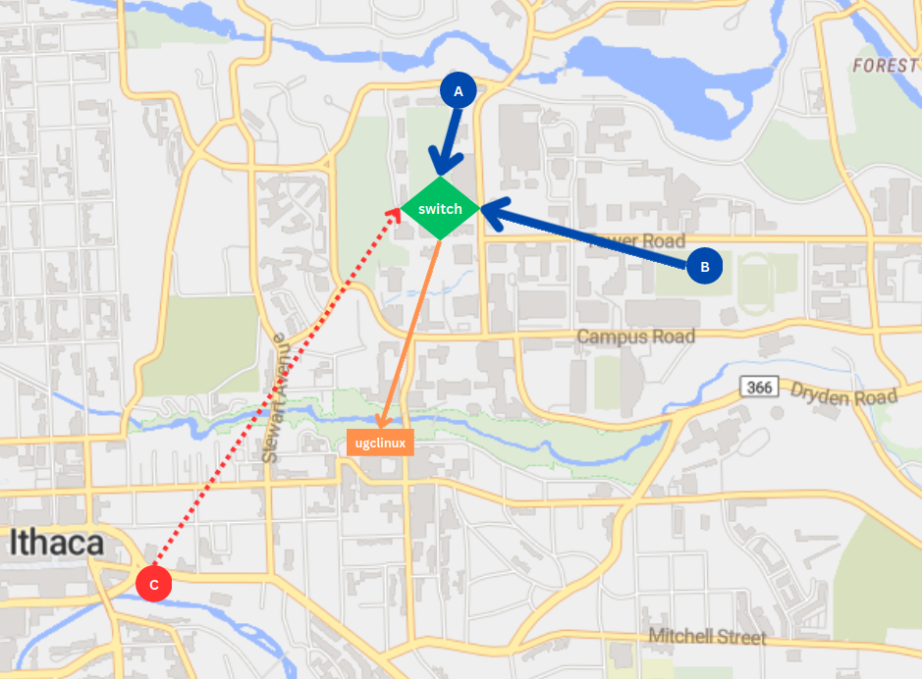
Context
WANT: Programmable
and Fast!

Slide 3
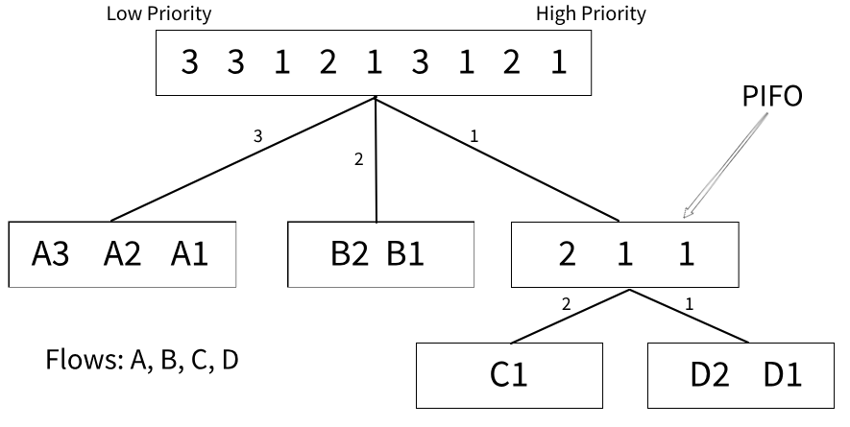
Background – PIFO Trees
Priority Queue
Sivaraman’s "Programmable Packet Scheduling at Line Rate" @ SIGCOMM’16

Slide 4
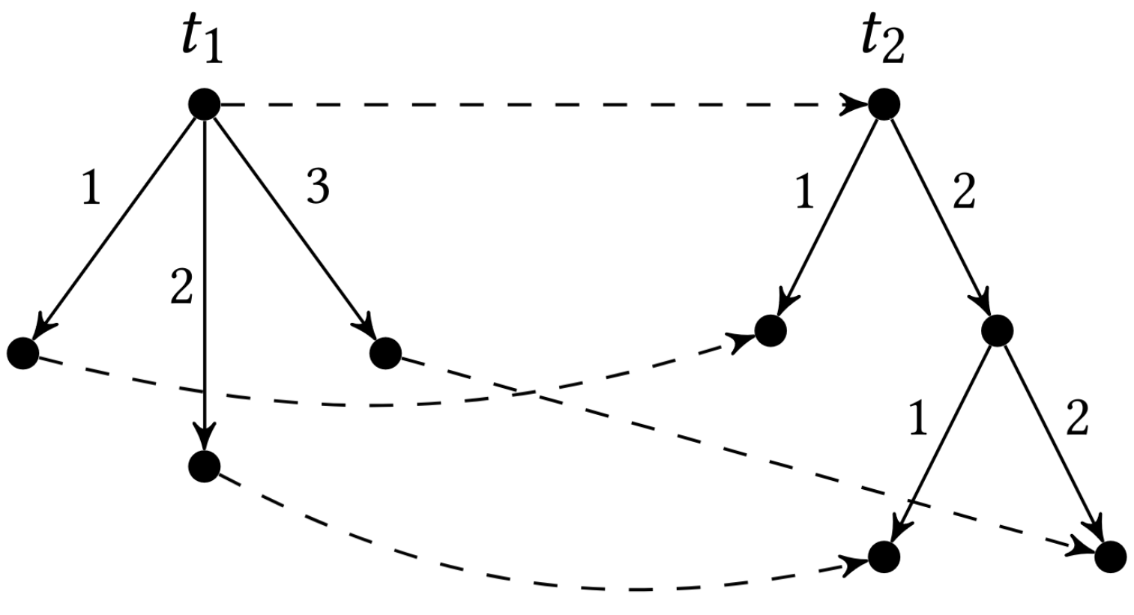
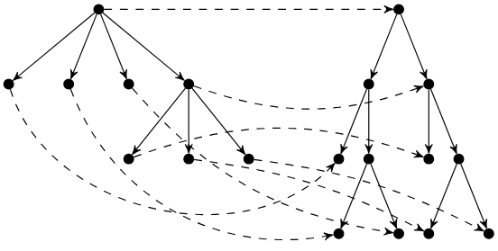
Background – Tree to Tree (T2T) Compilation
Mohan's "Formal Abstractions for Packet Scheduling" @ OOPSLA’2023

Slide 5
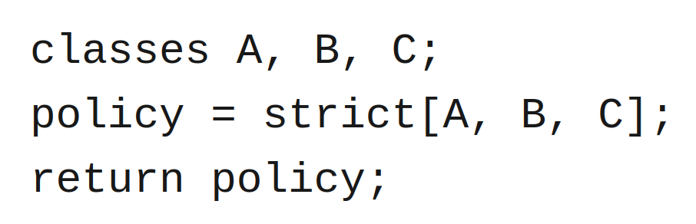
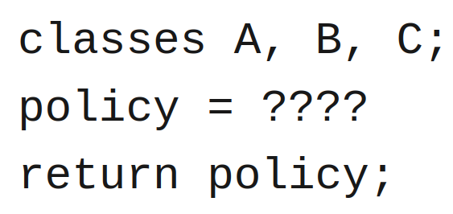
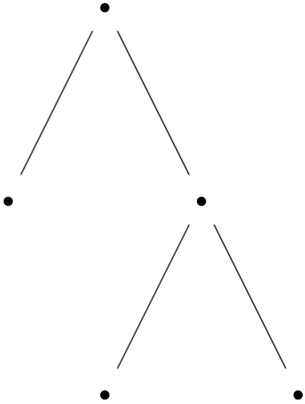
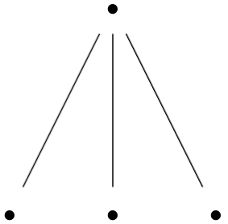
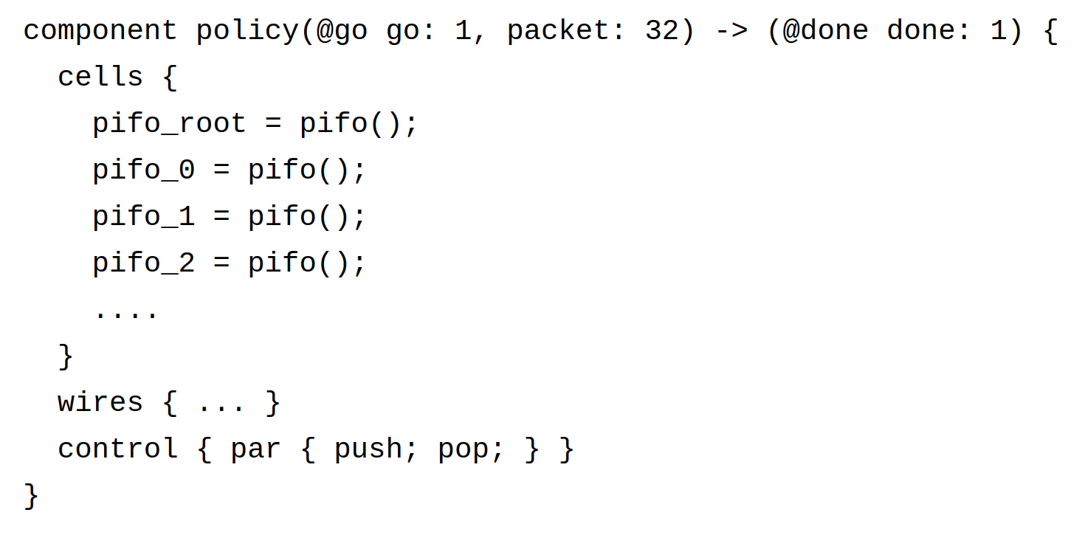
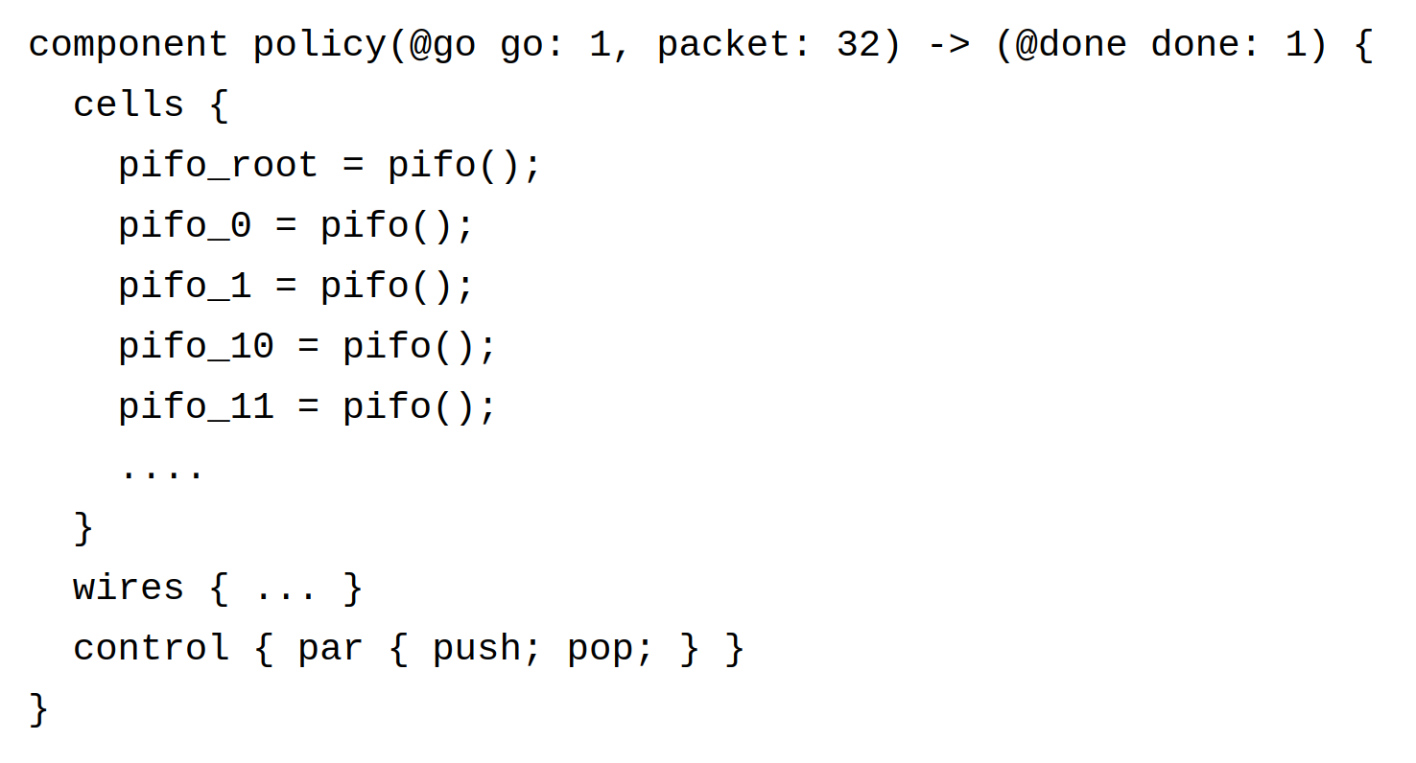


The Old Dream
T2T
Partial FPGA programming? Nope.
New bitstream = full cost, every time :(
Rio
Rio++
T2T
FPGA
FPGA

Slide 6

The New Dream – Checkpoints 1 & 2
1
FPGA
2
FPGA

Slide 7
Towards Checkpoint 1
Hierarchical policies networking folks care about
Sivaraman’s PIFO implementation
Operational semantics for Rio

Slide 8
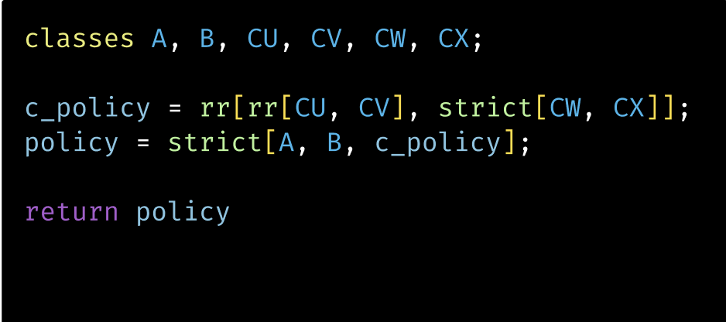
Overview
strict
rr
A
B
strict
rr
CU
CV
CW
CX
Notes:
Pifo trees allow programmable packet scheduling

Slide 9
Overview
Work conserving vs. non-work conserving policies
Work conserving - round robin, strict, weighted fair queueing (WFQ), FIFO order/FCFS, etc.
Non-work conserving - leaky bucket filter, rate controlled static priority, etc.

Slide 10
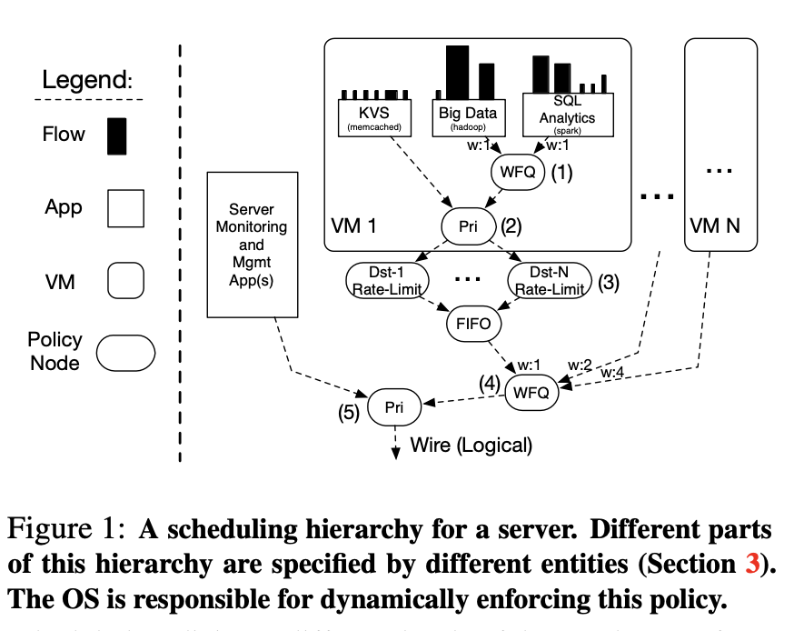
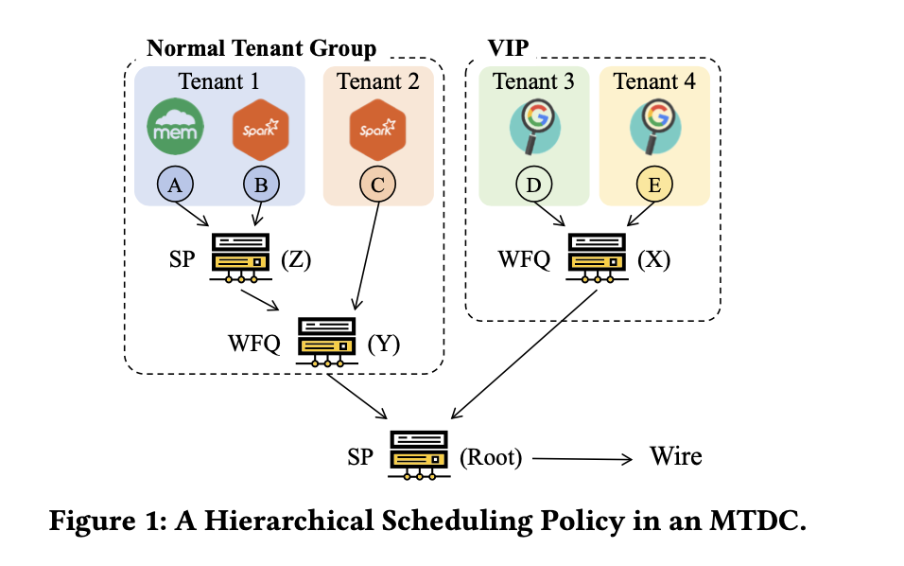
Policies people are interested in
Not all hierarchical policy compositions make sense
WFQ and Strict are popular
Zhang et. al
Loom paper (Stephens et. al)

Slide 11
Sivaraman et. al PIFOs

Slide 12
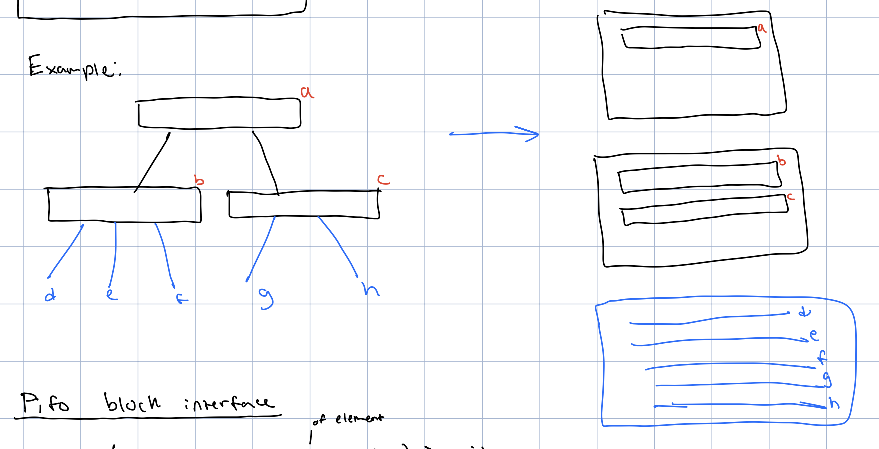
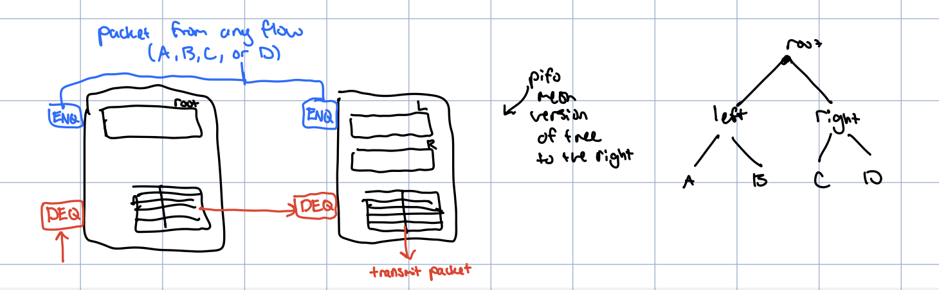
Overview of idea
Represent PIFOs as a block
Each block corresponds to a different level on the tree
Queues in a block share memory
When B gets big, C conversely gets small
Notes:
Aim to try out aspects of the pifos from sivaraman paper so we can compare against them

Slide 13
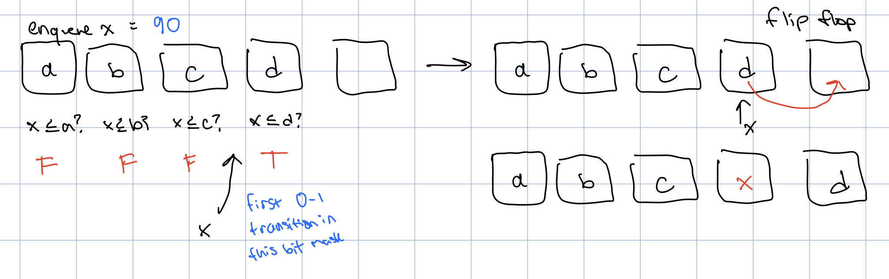
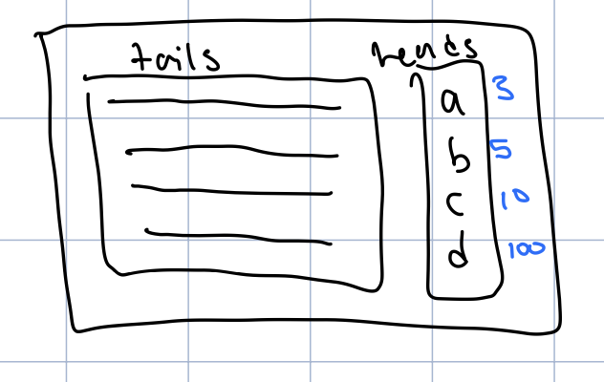
Hardware Implementation
Enqueue
Incoming element is compared against all existing elements in parallel
Flow scheduler - makes it feasible to sort based on flows rather than individual packets
Notes:
To determine its position

Slide 14
Policy Classification

Slide 15
Distinction Between Policies
Our project has looked at a variety of different policies, to determine which packet to pop next.
First-In First-Out (Which packet was enqueued first?)
Earliest-Deadline First (Which packet needs to be processed first?)
Round-Robin (Switch out between a series of different flows)
Strict (Stick one one flow until it falls silent)
And more!

Slide 16
However, there’s a key distinction:
A policy arbitrates between different classes (sources of packets). Hierarchical policies may in turn arbitrate between others.
Some policies (FIFO, EDF and others) want us to look at every packet within every class under it.
Some policies (Round Robin, Strict and others) instead want us only to consider what their immediate children say, and arbitrate between those candidates!
To get a better understanding:

Slide 17
Distinction Between Policies
RR
EDF
FIFO
FIFO
A
B
A
Set-To-Stream
Here, every single packet within A is fair game.
Stream-To-Stream
Here, we need to respect what the FIFOs say before RR can decide which packet to pop.

Slide 18
Union Operator
EDF
What happens if we want to have a set-to-stream policy look at a bunch of classes?
Union
A
B
Now, every packet in both A and B is fair game with each pop.

Slide 19
Transformers
We propose two classifications of policies:
Set-To-Stream Transformers
The policy node has exactly one child – a set (class or union of classes).
When popping, all packets within this are considered.
Stream-To-Stream Transformers
The policy node has as many children as it wants – streams (other policies).
When popping, only the pop candidates from each of its streams are considered.

Slide 20
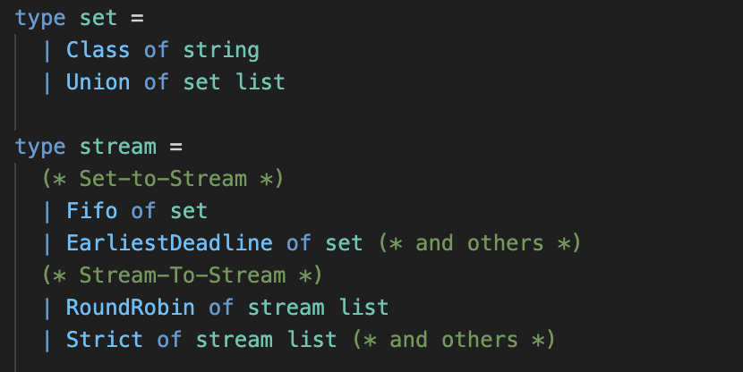
Representing Transformers As AST Nodes
Programs take on the form of streams.
Classes (and unions of classes) join the hierarchy via Set-To-Stream transformers.
We build more complex programs via Stream-To-Stream Transformers

Slide 21
Encoding These Restrictions Into Semantics
To reason about these more formally, we can define operational semantics for Rio programs based on the types of policies they contain.
We denote a concept of state – a set of PIFOs containing our packets and a program. State tuples are subject to the following operations:
push : pkt * queue * state -> state
pop : state -> pkt option * state
Pushing takes in a packet and specific queue, an existing state tuple, and accordingly updates the state.
Popping takes in a state tuple, uses the program and semantics to determine the next packet to pop, and returns it along with the updated state.

Slide 22
Compilation Pipeline – PIFO Trees vs. Rio Programs
Compiled Rio Programs (PIFO Trees)
Compile policies to PIFO Trees
The queues used in state tuples become the leaves of the resultant PIFO Tree
Packets are popped using standard logic of PIFO Trees
Semantically Evaluated Rio Programs
Packets are directly popped based on the POP and PUSH rules of our operational semantics
PIFO Trees play no role!
Next goal: Show equality between the two!

Slide 23
Current Work - Showing Equality Between The Two
A big part of our work right now circulates around showing that compiled Rio programs are equivalent to how their semantics describe them.
More formally – popping from any program should always give the same packet as popping from its corresponding PIFO Tree, once compiled.
We are working on a mechanized proof of equality for a subset of the language, using the Coq proof assistant.

