Slide 1
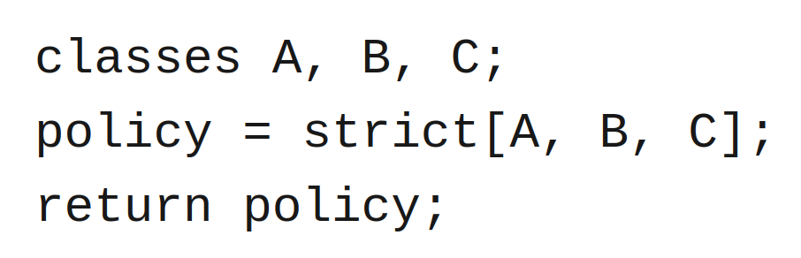


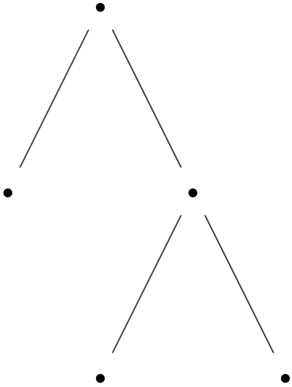
Rio: DSL for programmable packet scheduling
1
FPGA
2
FPGA

Slide 2
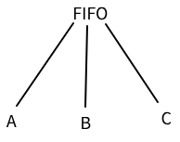
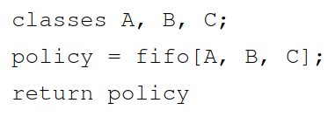
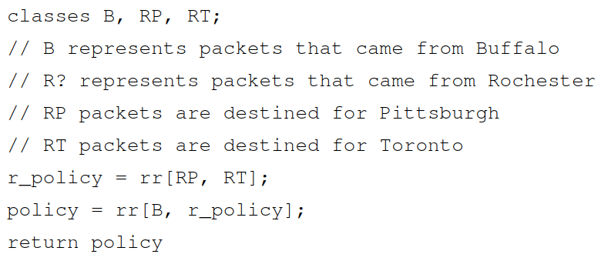
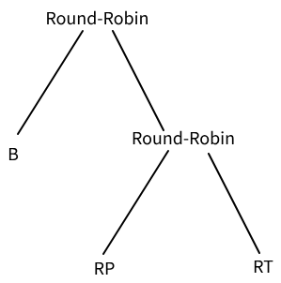
Rio Snippets

Slide 3
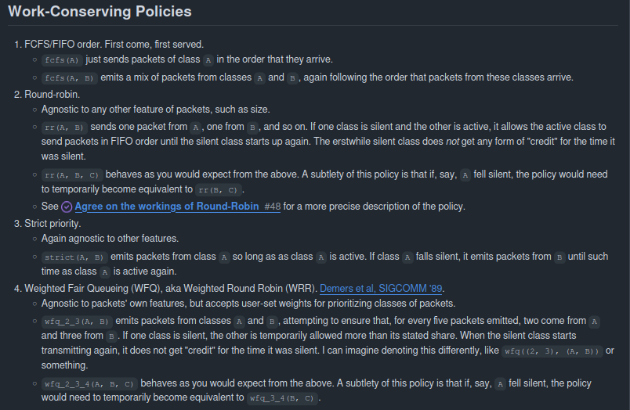
Semantics – non-hierarchical setting
glossary

Slide 4
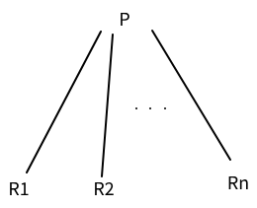
Semantics – hierarchical setting
Given a policy P and DSL programs R1, R2, … , Rn, what is this?

Slide 5
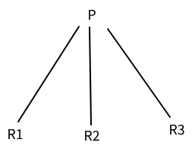
Current Strategy
Let’s consider n = 3 for instance.
Suppose we encounter a pkt, how do we push to our PIFO tree?
Flow inference
This determines which subtree pkt’s class is in. Let’s say it’s the ith subtree
Push i to the root with rank r as though each R1, R2, R3 are all classes
Recursively push to pkt to Ri

Slide 6
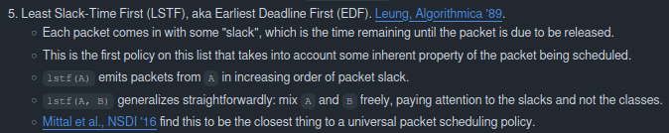
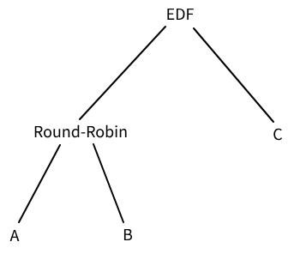
This is a bit broken
Suppose we encounter the following sequence of packets before any pops:
# Notation: (X_i, j) is the ith packet from flow X, with slack j
(A_1, 1), (A_2, 2), (A_3, 3), (B_1, 1000), (C_1, 4)
Flushing then yields
A_1, B_1, A_2, C_1, A_3

