Slide 1
Rio – Programmable Packet Scheduling
Akash & Kabir
Notes:
Presentation Split:
Kabir PS/Rio Overview
Akash Semantics
Kabir PIFO Trees
Akash Enqueue-Dequeue Equivalence

Slide 2
Scheduling Policies
A₃ A₂ A₁
Three Flow Round-Robin
B₃ B₂ B₁
A₁ B₁ C₁ A₂ B₂ C₂ A₃ B₃ C₃
C₃ C₂ C₁
Two Flow Strict
A₃ A₂ A₁
A₁ A₂ A₃ B₁ B₂ B₃
B₃ B₂ B₁

Slide 3
Types of Policies
Set-To-Stream Policies
Work with all packets and all classes.
First-In First-Out
Earliest-Deadline First
Shortest-Journey Next
Stream-To-Stream Policies
Operate over certain flows depending on the policy.
Round-Robin
Strict
Weighted-Fair Queueing

Slide 4
Trees?
Round-Robin
Strict
Round-Robin
FIFO[A]
FIFO[B]
FIFO[C]
FIFO[D∪E]

Slide 5
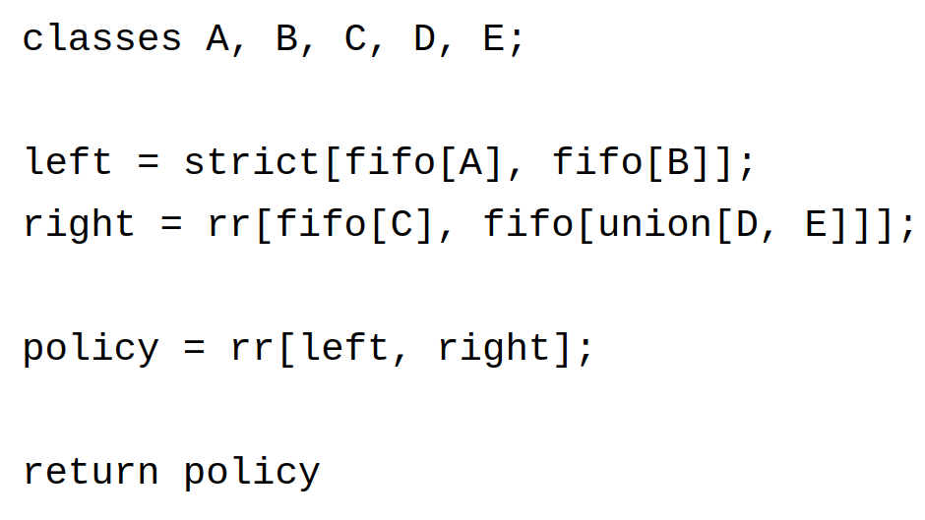
Rio Syntax
Names for collections of packets
Partitions set of all packets: i.e.
each class is disjoint
every packet belongs to some class
Classes are sets (of packets)
We can take unions of sets to build larger sets
set2stream transformer:
gives order to an unordered set (turning it into a stream)
takes one set as input
stream2stream transformer:
takes multiple streams as inputs
Must return stream at the end!

Slide 6
Rio Semantics

Slide 7
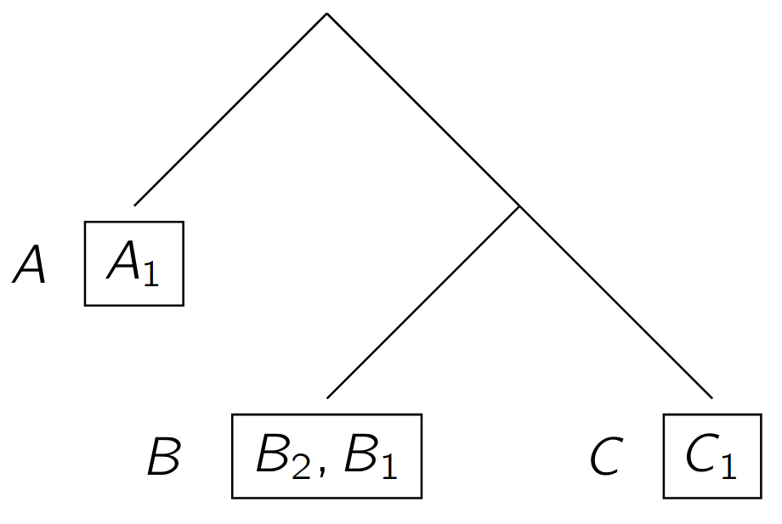
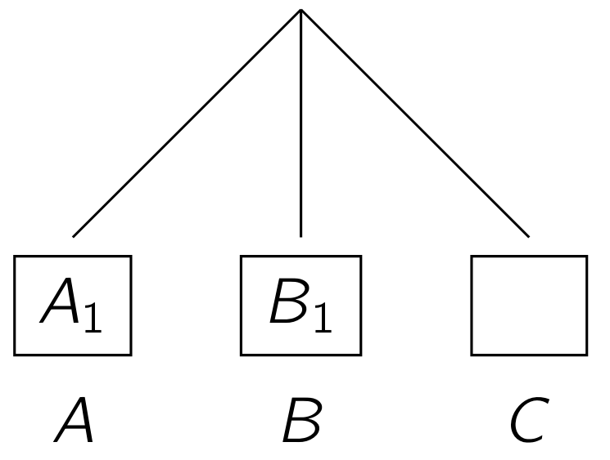
Rio Trees
PIFO holding packets
Class

Slide 8
How to Push to Rio Trees
C₂, rk
C₂, rk
C₂, rk
C₂, rk
C₂, rk
NOP!
A ≠ C
push in C₂ with rank rk
NOP!
B ≠ C

Slide 9
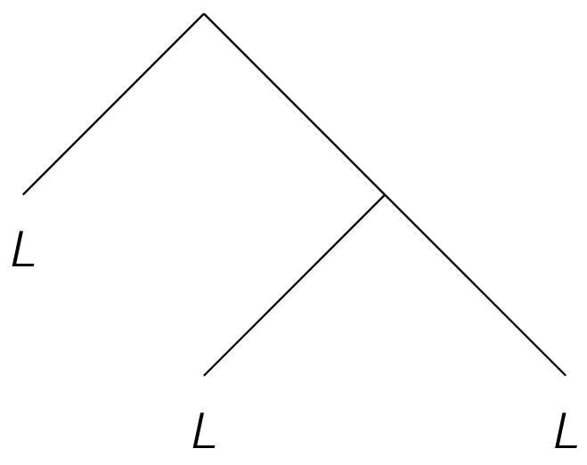
How to Pop Rio Trees
A₁
A₁
C₁
2
3
B₁
C₁
4
3

Slide 10
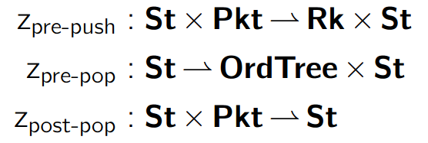
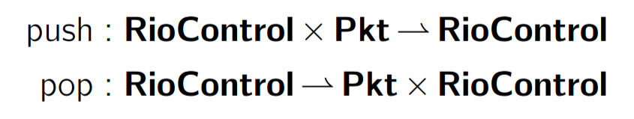
Rio Controls
+
State
+
Scheduling Transactions

Slide 11

Rio Programs to Controls
Round-Robin
Round-Robin
= S
T =
FIFO[A]
FIFO[B]
T₁
T₂
Rank children same way S would
Z_{pre-push, T} =
Z_{pre-push, T1}
Z_{pre-push, T2}

Slide 12
PIFO Trees

Slide 13
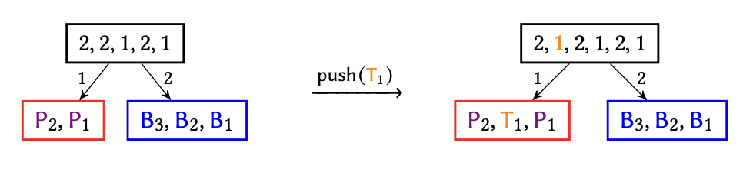
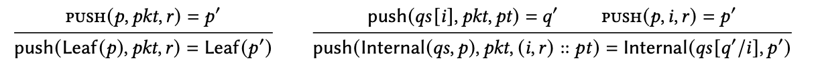
PIFO Trees Recap

Slide 14
PIFO Tree Recap

Slide 15
Implementing Policies On Hardware
Currently, we have two strategies for implementing PIFO Trees on Hardware.
Queues, which work well for policies like Round Robin, but fail on others.
Binary Heaps
We’ve made significant progress towards representing Round Robin policies on hardware!
Further work involves using our Binary Heaps to implement policies like Weighted-Fair Queueing.

Slide 16
Enqueue-Dequeue Side Equivalence

Slide 17
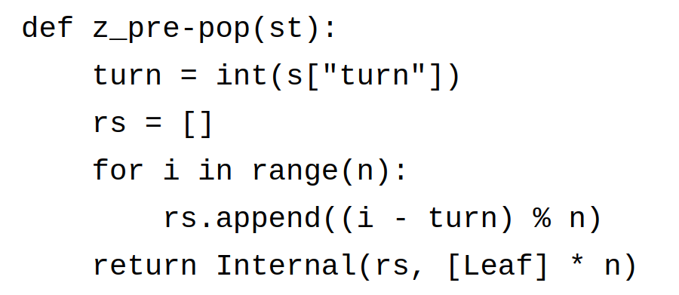
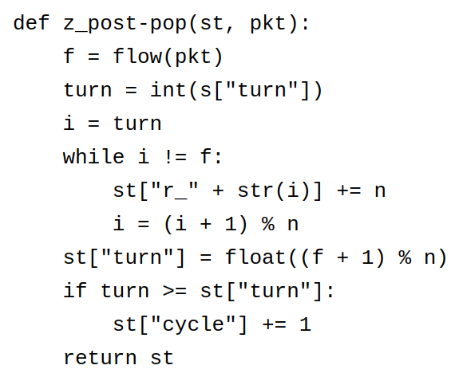
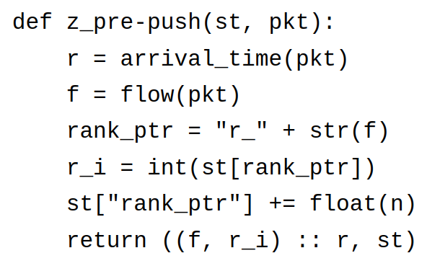
Math
PIFO Control
Rio Control
c_{init}
c_{init}
Push
Push
c₁
c₁
Push
Push
c₂
c₂
Pop
Pkt₁
=
Pkt₂
Pop
c₃
c₃

Slide 18
Simulator
DEMO time!

