Slide 1
METHODOLOGY · GERMAN REDISPATCH 2.0 · 2021–2025
Scoring Battery Locations
How the siting algorithm works — and where it breaks
Recovering the hidden nodal–zonal price wedge from redispatch, pricing every deployed battery on the congestion relief it would provide.
15-min
±500 €/MWh
ΔV / yr
end-to-end resolution
wedge clip
locational value metric

Slide 2
MOTIVATION
The price signal Germany's single bidding zone hides
Under nodal pricing, each node's price equals the marginal cost of supplying energy there — including the shadow prices of binding network constraints. A battery arbitraging that node charges when local energy is abundant and discharges when it is scarce, so its profit motive coincides with relieving congestion.
NODAL MARKET
Price varies by node → embeds congestion
Storage paid to sit where the grid needs it
Profit = congestion relief, automatically
Germany is a single bidding zone, so this locational signal is absent from the market price. Every location sees the same number. The information about where storage actually helps the grid is missing.
GERMAN ZONAL MARKET
One price for the whole country
Locational value invisible to investors
Congestion handled after the fact, by the TSO
Battery locational-siting scorer · redispatch-implied nodal price
2

Slide 3
CORE IDEA
Redispatch reveals the sign of the hidden wedge
Redispatch is the TSO's quantity-based correction of flows the grid cannot physically enable. Its direction leaks the sign of the latent nodal–zonal price wedge:
↓ DOWNWARD (curtailment)
↑ UPWARD (ramp-up)
Local surplus that cannot be exported
True local price below the zonal price
Battery should charge · sign s_g = −1
Local scarcity the grid cannot import into
True local price above the zonal price
Battery should discharge · sign s_g = +1
Key insight: a battery only relieves congestion where the local grid has headroom. A site whose only way to help is to push power across the binding constraint itself yields no relief — and earns nothing under the recovered local price.
Battery locational-siting scorer · redispatch-implied nodal price
3

Slide 4
OVERVIEW
The scoring pipeline at a glance
1
2
3
4
Load & align
Build wedge
Value profit
Rank by ΔV
→
→
→
Batteries (MaStR), redispatch events, 15-min intraday prices. Timezone-normalise each row, snap to nearest transmission bus.
For every 15-min step, bend the zonal price with a kernel-weighted, sign-carrying sum of nearby redispatch → effective local price π̂.
Daily charge/discharge heuristic against π̂ gives annual arbitrage profit V for a common 50 MW / 200 MWh reference battery.
Subtract the flat-price copperplate baseline. ΔV isolates pure locational value; rank the fleet by ΔV per year.
Scope 96 steps/day · Δt = 0.25 h · window 2021-10-01 → 2025-12-31 (harmonised Redispatch 2.0, full price & redispatch coverage) · transmission grid 220/380 kV.
Battery locational-siting scorer · redispatch-implied nodal price
4

Slide 5
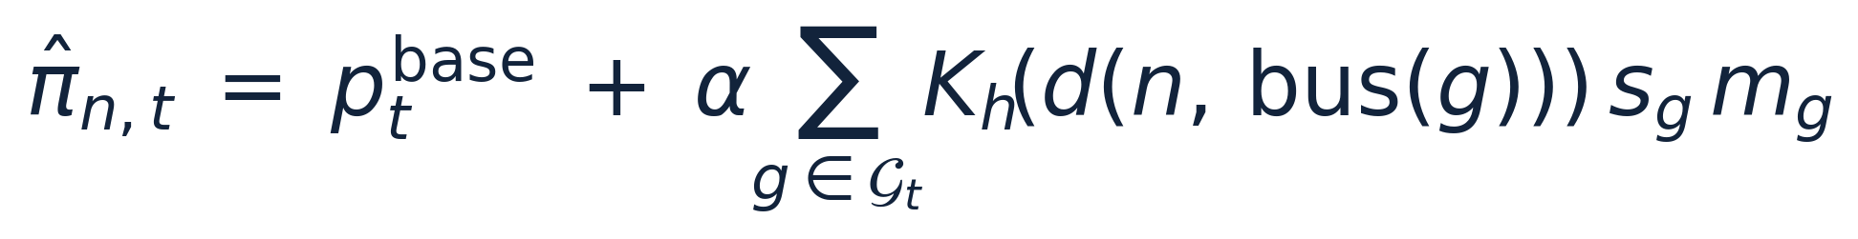
STEP 2 · CORE EQUATION
Effective local price = zonal price + congestion wedge
wedge
Symbol | Meaning
π̂ n,t | Effective local price for battery n at 15-min step t [€/MWh]
p_base t | Quarter-hourly intraday zonal price — identical for all locations
𝒢 t | Set of redispatch events active during step t
s_g ∈ {+1,−1} | Sign of event g (shortage → discharge / surplus → charge)
m_g | Mean power of event g [MW] — volume-weights the wedge
K_h(·) | Spatial kernel decaying an event's influence with distance
α | Wedge scale, calibrated to a BNetzA-anchored 100 €/MWh premium
Wedge clipped to ±500 €/MWh (~99th pct of intraday prices) so GW-scale hubs cannot fabricate an implausible scarcity premium. Positive and negative nearby events cancel within the sum.
Battery locational-siting scorer · redispatch-implied nodal price
5

Slide 6
INSIDE THE WEDGE
Sign and volume: reading each redispatch event
Sign s_g is read directly from the RICHTUNG field of the redispatch data — a mapping asserted at load time to cover 100% of rows:
RICHTUNG value | Meaning | s_g | Battery
Wirkleistungseinspeisung erhöhen | Increase feed-in → local shortage | +1 | Discharge
Wirkleistungseinspeisung reduzieren | Reduce feed-in → local surplus | −1 | Charge
Volume weight m_g
Cancellation
Each event enters the sum weighted by its mean power in MW. A GW-scale intervention bends the local price far more than a token one, so the wedge reflects how much congestion relief is actually active nearby.
Because signs enter additively, upward redispatch at one nearby site nets against downward redispatch at another. A neighbourhood pulled in both directions produces little net wedge — exactly as an ambiguous congestion picture should.
Battery locational-siting scorer · redispatch-implied nodal price
6

Slide 7
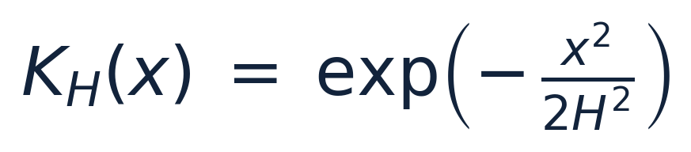
INSIDE THE WEDGE
Distance is electrical, not geographic (PTDF kernel)
The kernel decays an event's impact with distance. The default measures distance electrically: a DC power-flow model of the 220/380 kV grid (PyPSA) yields a PTDF matrix; distance between a battery bus and an event bus is the L2 norm of their PTDF-column difference.
Gaussian decay · bandwidth 0.5 (PTDF) or h = 200 km (legacy graph distance)
Why electrical distance?
Two buses with identical PTDF columns shift every line by the same amount per unit of injection — so a battery at one is a perfect electrical substitute for a redispatch action at the other. The norm measures exactly how far a site is from being that substitute. This replaces “how far apart on the map” with “how electrically interchangeable” — the property that actually determines whether a battery can stand in for the redispatch. DC PTDF column-differences are slack-invariant; disconnected sub-networks are forced to zero coupling.
Battery locational-siting scorer · redispatch-implied nodal price
7

Slide 8
INSIDE THE WEDGE
Calibrating the wedge scale α to real congestion cost
Rather than fixing α arbitrarily, it is calibrated so the mean absolute wedge over all steps with active nearby redispatch equals a target premium of 100 €/MWh.
≈ €2.8 bn
÷ ≈ 28 TWh
≈ 100 €/MWh
÷
=
BNetzA annual redispatch cost (2024)
annual redispatch energy
empirical cost of relieving congestion
Why this matters. Anchoring α to what relieving congestion actually costs the system ties the local premium to reality instead of an assumed scalar. Because α enters only through the wedge, it governs the magnitude of the premium, not the substance of the relative ranking — leaving a sensitivity sweep on α and the target as a useful robustness check.
Battery locational-siting scorer · redispatch-implied nodal price
8

Slide 9
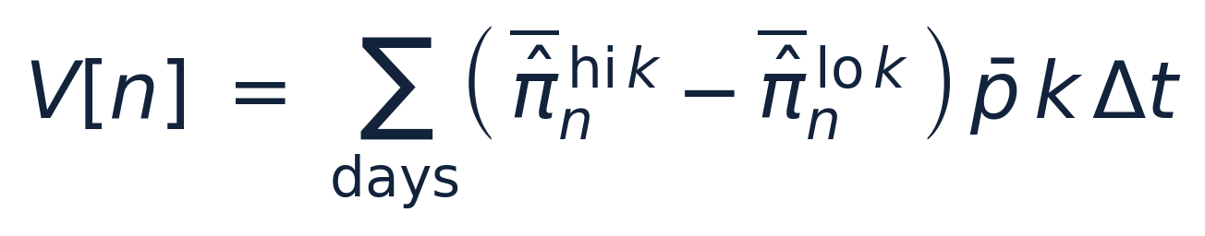
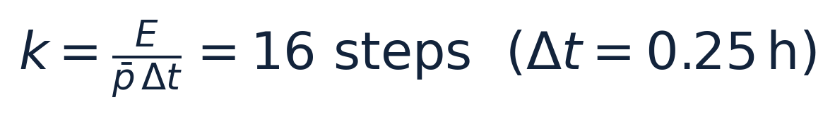
STEP 3
Profit valuation: a daily arbitrage heuristic
For each day, charge at full power during the k cheapest 15-min steps and discharge during the k most expensive. The window profit sums the daily high-minus-low price spread over the energy cycled:
A deliberately simple, lossless single-cycle model. It disregards:
Round-trip efficiency losses
Inter-day arbitrage
Ramp & degradation limits
Grid-connection constraints
Acceptable because the goal is a relative ranking: the same simplifications apply uniformly to every battery. A full cyclic state-of-charge optimisation is a natural extension.
Battery locational-siting scorer · redispatch-implied nodal price
9

Slide 10
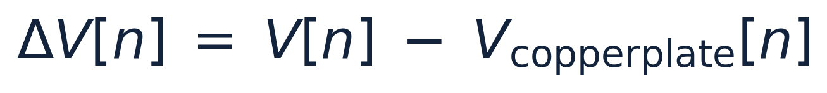
STEP 4
Normalisation and ranking: isolating ΔV
Every battery is scored at a common 50 MW / 200 MWh reference (4-hour duration), so nameplate size drops out and the comparison is purely locational. Against the flat base price we compute a spatially uniform copperplate baseline, then take the difference:
V[n]
V_copperplate
ΔV[n]
Profit under the local effective price — temporal arbitrage plus the congestion signal.
Same heuristic on the flat zonal price. Identical across the fleet, so it carries no location.
Pure locational value created by congestion. The fleet is ranked by ΔV per year.
Highest-ΔV sites are those that — if the price signal were passed through — would be most valuable for relieving grid congestion.
Battery locational-siting scorer · redispatch-implied nodal price
10

Slide 11
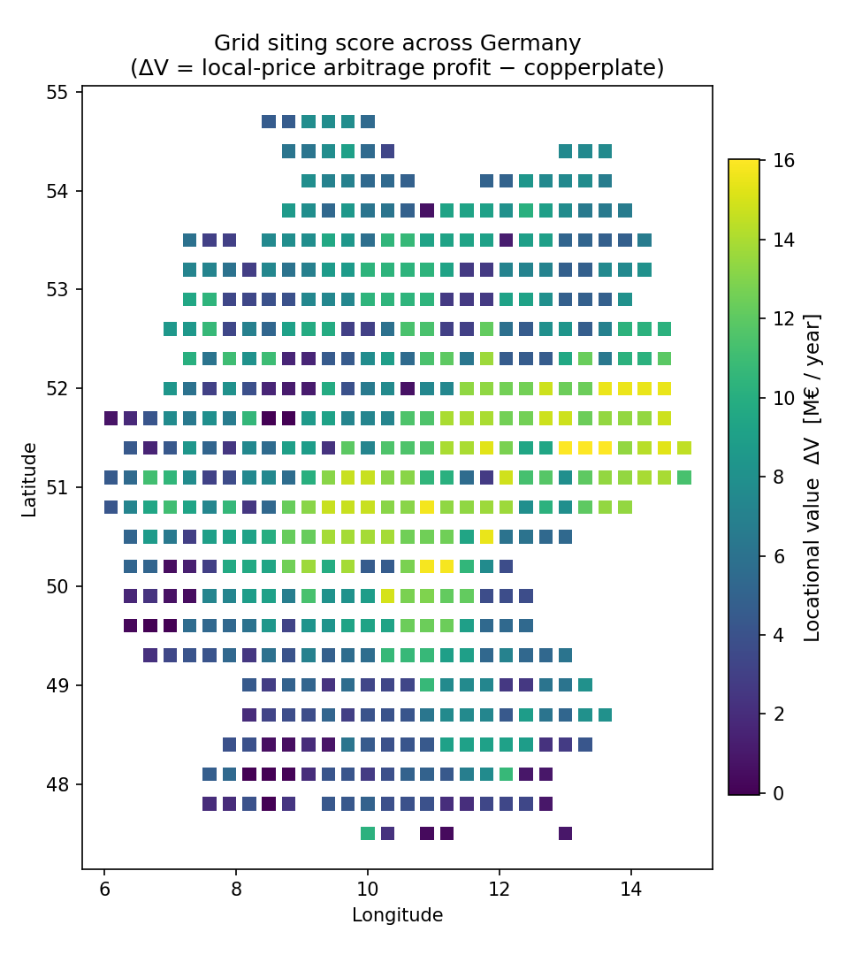
OUTPUT
The recovered locational-value surface
Scoring every grid point on the same reference battery maps where storage would earn the most from congestion if the locational signal reached it.
Bright cells mark high-ΔV hotspots — sites electrically close to persistent, one-directional redispatch.
Dark cells sit far (electrically) from congestion, or near events that cancel; their value is almost all plain temporal arbitrage.
The same ΔV logic ranks the actual deployed MaStR fleet, testing whether today's batteries sit where the grid needs them.
Battery locational-siting scorer · redispatch-implied nodal price
511 grid points · ΔV per year, reference 50 MW / 200 MWh battery
11

Slide 12
LIMITATIONS · 1 OF 2
What the score cannot see
Signal is mislocated at source
1
The wedge is anchored to the affected plant — the TSO's actuator — not the binding constraint. The PTDF kernel mitigates but cannot relocate an already-misplaced signal, so scores reward proximity to dispatch activity rather than to congestion itself.
Transmission frame only
2
Data covers just the 220/380 kV system. A battery relieving distribution-level congestion can score poorly despite being well placed; the ranking is valid only within the transmission frame.
≈30% of volume never enters
3
Mostly countertrading (identifies no congested location) plus unmatchable plants. The effective price is built on a partial view — and the missing share is not random: matchability correlates with plant type, region and vintage, so gaps are clustered in space.
Battery locational-siting scorer · redispatch-implied nodal price
12

Slide 13
LIMITATIONS · 2 OF 2
Blind spots and what the score is not
Co-location with PV / wind uncredited
4
Batteries beside solar or wind can help the grid almost by construction, soaking up local generation that would otherwise be curtailed. A pure arbitrage score does not credit this avoided curtailment and so under-ranks them.
A snapshot of today's grid
5
Redispatch reflects present-day congestion on a network actively being expanded (SuedLink, SuedOstLink…). ΔV scores today's locational value, not the congestion a battery commissioned now would face over its full operating life.
Bottom line
The scores are best read as a relative, transmission-level indication of placement against the redispatch we can observe and localise — not an absolute, node-level verdict on any individual site. Absolute profits are not forecasts; the ordering of locations is the product.
Battery locational-siting scorer · redispatch-implied nodal price
13

Slide 14
IN ONE SENTENCE
Redispatch stands in for the nodal price Germany's single bidding zone hides, and each battery is scored on the congestion relief it would be paid for.
Recover
Value
Bend the flat zonal price into a local effective price π̂ with a sign- and volume-carrying, PTDF-kernel-weighted redispatch wedge.
Score a common reference battery by a daily arbitrage heuristic against π̂ vs. a flat copperplate baseline.
Rank
Caveat
ΔV = V − V_copperplate isolates pure locational value; the fleet is ordered by ΔV per year.
Relative, transmission-level, snapshot-in-time — mislocated at the actuator and blind to ~30% of volume and to avoided curtailment.

