Slide 1


Final Presentation
Advanced Seminar in Electricity Markets
Chair for Economics of Energy Markets
Prof. Dr. Schwenen
Thirza Laws | Julian Wachsmuth
Munich, 18.06.2026

Slide 2
RECAP
TUM
Our research question is unchanged — the method has matured
How can grid-valuable battery storage sites be identified from observed redispatch data in a uniform-price market?
A methodological approach to valuing storage locations based on nodal-pricing logic
WHAT CHANGED SINCE THE MIDTERM
Network-KDE density mapping → arbitrage scoring against a local effective price : we recover the missing nodal price signal from observed redispatch and score every battery site by the locational profit it would earn with distance measured electrically (PTDF) , not geographically.
Thirza Laws & Julian Wachsmuth | Advanced Seminar Electricity Markets | Prof. Dr. Schwenen
2
Notes:
Two research questions, unchanged since the midterm. What changed is HOW we answer Q2: we moved from the network-KDE siting score to an arbitrage scoring against a redispatch-based local price proxy.

Slide 3
AGENDA
TUM
Agenda
01.
Background
Why location matters for batteries — kept brief
02.
Theory
Redispatch events, battery fleet, prices, grid topology
03.
Methodology
Plant matching pipeline · effective local price · PTDF kernel · profit scoring
04.
Results
Matching quality · descriptive patterns · scoring
05.
Discussion
Limitations · policy implications
Thirza Laws & Julian Wachsmuth | Advanced Seminar Electricity Markets | Prof. Dr. Schwenen
3
Notes:
20 minutes: short recap of the problem, then data and the matching pipeline, the scoring methodology in detail, results, and discussion. Focus today is on methodology and results.

Slide 4
Chapter 1:
Background

Slide 5
WHAT IS REDISPATCH?
Fixing the market’s blind spot costs billions
€2.8 bn ¹
spent on redispatch in 2024, 15× more than a decade ago
€0.18 /kWh ²
Forecasted increase in household grid fees until 2045
€16.3 bn ³
more forecasted for 2025-2028, and still rising
One national power price, but the grid can’t always deliver what the market trades. Redispatch is the grid operator overriding the market to keep lines within limits, compensating both sides.
¹ SMARD / ² EWI Köln / ³ BNetzA TSO (ÜNB) forecast
Thirza Laws & Julian Wachsmuth | Advanced Seminar Electricity Markets | Prof. Dr. Schwenen
6
Notes:
Germany's wind sits in the north, its demand in the south, but power is traded at one national price, as if the grid in between were infinite. When the north-south lines hit their limit, the TSO overrides the market: wind is curtailed in the north, gas ramped up in the south, and both sides are compensated. That is redispatch. It cost about 2.8 billion euros in 2024, roughly fifteen times more than a decade ago. Households pay for it through grid fees while industry is largely exempt, and TSOs expect 16.3 billion more through 2028.

Slide 6
WHY THIS PAPER, WHY NOW
Locating a battery is irreversible
15–20 yrs
a battery site is fixed once built. Network-friendly behavior can be changed later via policy, but the location cannot.
A misplaced fleet is a two-decade lock-in that no later price reform can undo.
545
requests for transmission-grid connections for larbe scale batteries have been filed in until Q3 2025 (211 GW).
25%
is all the grid-serving benefit currently counts for in the new maturity-based procedure for allocating grid connections.
Batteries could bridge the congestion gap, but their grid value depends on location. The uniform price carries no locational signal, so siting follows land, permits and grid-connection queues, not congestion.
Dvorkin et al. (2017); Figgener et al. (2024); Bundesnetzagentur (2024); Tennet (2026)
Thirza Laws & Julian Wachsmuth | Advanced Seminar Electricity Markets | Prof. Dr. Schwenen
6
Notes:
https://www.tennet.eu/de/news/uebertragungsnetzbetreiber-fuehren-reifegradverfahren-fuer-netzanschlussantraege-von-speichern-und-grossverbrauchern-ein
Other criteria are progress of approval, company KPIs: https://www.netztransparenz.de/Portals/1/Dokumente/Presse/2026/2026-02-05_Vier_Uebertragungsnetzbetreiber_Reifegradverfahren_Dokumentation_V100.pdf

Slide 7
List some other methods of estimating battery siting. Should proably alteast include Simulation (pypsa-eur applied?), possible other methods for estimating siting
01 · BACKGROUND
TUM
Existing approaches need grid models or nodal prices, ours needs neither
Normative siting models
Empirical scoring on nodal prices
Pandžić et al. 2015 · Fernández-Blanco et al. 2017 · Czock, Sitzmann & Zinke 2025
Sioshansi et al. 2009 · Salles et al. 2017 · Butler 2021
Optimisation models compute welfare-optimal storage locations from full network models. For Germany: batteries belong behind the north–south bottleneck, close to solar (Czock et al.).
Where nodal prices exist, sites can be scored directly: arbitrage value of a generic battery at 7,395 PJM nodes; congestion adds a site-specific premium.
Require a complete grid, cost and dispatch model – answer where storage should go, not where it stands.
Requires observable nodal prices – which Europe’s zonal markets do not produce.
Market design: the suppressed signal
The gap we address
Schweppe et al. 1988 · Kunz 2013 · Schmidt & Zinke 2023 · Bichler et al. 2025
Closest antecedent: Hirth et al. / Neon 2025 (€3-6 per kW·yr redispatch relief)
Uniform pricing removes the locational signal by design; siting incentives for wind, hydrogen and storage are distorted.
No method scores arbitrary sites in a zonal market from observed data. We recover the signal from redispatch: no network optimisation, no nodal prices needed.
The signal exists physically and is valuable – it is just not priced.
Observed TSO behaviour instead of model assumptions: three public data sources suffice.
Thirza Laws & Julian Wachsmuth | Advanced Seminar Electricity Markets | Prof. Dr. Schwenen
5
Notes:
Four building blocks. The redispatch data is the core: 120k events, 148 TWh, 2013-2025, all four TSOs. We keep load-induced events only and drop countertrading/exchange because they identify no location. Battery fleet from MaStR — rated power only, capacity is not public. Prices from SMARD, grid from the PyPSA open model.

Slide 8
Chapter 2:
Theory

Slide 9
02 · THEORY
TUM
Four building blocks
Redispatch events
Battery fleet
Netztransparenz.de · 50Hertz, Amprion, TenneT, TransnetBW
Marktstammdatenregister (BNetzA), via API
Per-event records 2013–2026: timing, direction, MW/MWh, reason, affected plant. 123,362 events · 182.03 TWh before cleaning.
Location, status and rated power of all active and planned battery storage units in Germany.
Filter: load-induced only; countertrading & exchange removed (no identifiable location).
Rated power (MW) used — energy capacity is not publicly reported.
Intraday prices
Grid topology
SMARD API
Open grid data (Xiong et al. 2025) · PyPSA
Quarter-hourly intraday spot prices for the DE-LU bidding zone — the zonal base price of our scoring.
DC power-flow model of the German 220/380 kV transmission grid → PTDF matrix for electrical distances.
Scoring window: Oct 2021 – Dec 2025 (Redispatch 2.0 era, full coverage).
Registries for plant matching: OPSD & PSA power-plant lists.
Thirza Laws & Julian Wachsmuth | Advanced Seminar Electricity Markets | Prof. Dr. Schwenen
5
Notes:
Four building blocks. The redispatch data is the core: 120k events, 148 TWh, 2013-2025, all four TSOs. We keep load-induced events only and drop countertrading/exchange because they identify no location. Battery fleet from MaStR — rated power only, capacity is not public. Prices from SMARD, grid from the PyPSA open model.

Slide 10
02 · THEORY
TUM
Redispatch direction reveals the missing local price signal
↓
Downward redispatch
↑
Upward redispatch
Feed-in reduced → local surplus that cannot be exported.
Feed-in increased → local scarcity behind the bottleneck.
True local price below the zonal price → a battery there should charge, absorbing energy that would be curtailed.
True local price above the zonal price → a battery there should discharge, replacing costly ramp-ups.
We bend the zonal intraday price at every battery site with a kernel-weighted sum of nearby redispatch events → an effective local price per site, at 15-minute resolution, Oct 2021 – Dec 2025. A battery arbitraging this price is automatically acting where the grid needs it.
Thirza Laws & Julian Wachsmuth | Advanced Seminar Electricity Markets | Prof. Dr. Schwenen
7
Notes:
Core idea: redispatch direction reveals the sign of the latent nodal-zonal price wedge. Downward redispatch = trapped surplus = local price below zonal. Upward = scarcity = above. We bend the zonal price accordingly at every battery location, in 15-minute steps.

Slide 11
Chapter 3:
Methodology

Slide 12
03 · METHODOLOGY
TUM
From free-text plant names to coordinates: the matching pipeline
1
Clean & classify — strip TSO codes, operator names, type abbreviations; single plant vs. grid aggregate
BASE CONFIDENCE BY SOURCE
2
Aggregates → centroids — city / region / state / DSO area (low confidence)
OPSD exact name
1.00
PSA exact name
0.95
3
Registry lookup — OPSD / PSA, exact then fuzzy, energy-type gated · c ≥ 0.85 short-circuits
Wikipedia (accepted)
0.85
4
DuckDuckGo (accepted)
0.70
Web lookup — Wikipedia (Kraftwerk / Windpark / Solarpark), DuckDuckGo fallback, gated on title, bounding box & energy type
Gazetteer place match
0.50
Nominatim geocode
0.40
5
Geographic fallbacks — OPSD city match, state / region centroids, pgeocode gazetteer
State / region centroids
0.20–0.35
6
Nominatim — single forward-geocode as last resort
7
Return best candidate — highest confidence c ∈ [0, 1] across all sources
Only matches with c > 0.5 are kept — a wrong location is worse than a blank.
Thirza Laws & Julian Wachsmuth | Advanced Seminar Electricity Markets | Prof. Dr. Schwenen
6
Notes:
Redispatch records name plants in free text. The resolve() pipeline walks through seven stages; a registry hit above 0.85 short-circuits. Everything below 0.5 confidence is discarded to avoid mismatches — a wrong location is worse than a blank.

Slide 13
03 · METHODOLOGY
TUM
The effective local price
π̂_{n,t} = p^{base}_{t} + α Σ_{g∈Gₜ} K_{h}( d(n, bus(g)) ) · s_{g} · m_{g}
pₜ^{base}
quarter-hourly intraday zonal price — identical everywhere
α
wedge scale, calibrated so mean |wedge| = 100 €/MWh (≈ BNetzA cost / energy)
Gₜ
redispatch events active in step t
Kₕ(·)
spatial kernel — decays influence with electrical distance (next slide)
sₖ
sign: +1 feed-in increased (shortage) · −1 feed-in reduced (surplus)
mₖ
mean power of the event [MW] — volume-weights the wedge
Additive wedge — a flat €/MWh shift, symmetric across the day, not biased toward peak hours.
Clipped at ±500 €/MWh — no implausible premia next to GW-scale redispatch hubs.
Signs cancel — opposing up/down events at nearby sites offset within the sum.
Do I actually clip -> check. Possibly rethink this equation
Thirza Laws & Julian Wachsmuth | Advanced Seminar Electricity Markets | Prof. Dr. Schwenen
8
Notes:
The effective price is the zonal base price plus an additive wedge: kernel-weighted, sign- and volume-weighted sum of active redispatch events. Additive so the shift is symmetric across the day. Clipped at ±500. Alpha is calibrated so the mean absolute wedge equals 100 EUR/MWh — anchored to what congestion actually costs the system.

Slide 14
03 · METHODOLOGY
TUM
Distance is electrical, not geographical
d_{elec}(n, g) = ‖ PTDF_{:,n} − PTDF_{:,g} ‖₂
SPECIFICATION
Kernel shape
Gaussian
Bandwidth (dimensionless)
0.5
DC power-flow model of the 220/380 kV grid in PyPSA → Power Transfer Distribution Factor matrix. Each column: how one bus’s injection loads every line.
Slack-invariant
yes (column differences)
Disconnected subnetworks
zero coupling
Identical columns = perfect substitutes: a battery at bus n replaces a redispatch action at bus g one-for-one. The norm measures exactly how far a site is from being such a substitute.
vs. the midterm: the graph-distance kernel (Dijkstra shortest path, h = 200 km) is retained as a robustness alternative — PTDF replaces “how far on the map” with “how electrically interchangeable” , the property that determines whether a battery can substitute a redispatch action.
Thirza Laws & Julian Wachsmuth | Advanced Seminar Electricity Markets | Prof. Dr. Schwenen
9
Notes:
Key upgrade since the midterm: distance is electrical. We build a DC power-flow model in PyPSA, compute the PTDF matrix, and define distance as the L2 norm between PTDF columns. Two buses with identical columns are perfect substitutes. Gaussian decay, dimensionless bandwidth 0.5. The old graph-distance kernel stays as a robustness check.

Slide 15
03 · METHODOLOGY
TUM
Scoring: locational profit vs. the copperplate baseline
1 · Daily arbitrage heuristic
2 · Common reference battery
3 · Locational value
Each day: charge at full power in the 16 cheapest 15-min steps, discharge in the 16 most expensive — one lossless 4-hour cycle against the effective local price.
Every site scored at 50 MW / 200 MWh (4 h). Own nameplate does not enter — the comparison is purely locational.
Same heuristic on the flat zonal price → copperplate baseline V_{copper} , identical for all sites (pure temporal arbitrage).
ΔV[n] = V[n] − V_{copperplate}
= the pure locational value of site n for congestion relief. The fleet is ranked by ΔV per year.
Deliberately abstracted: round-trip losses, inter-day arbitrage, ramp & degradation limits, grid-connection constraints, DSO-level redispatch. Identical simplifications for every site → the relative ranking stays interpretable; absolute profits are not forecasts.
Thirza Laws & Julian Wachsmuth | Advanced Seminar Electricity Markets | Prof. Dr. Schwenen
10
Notes:
Simple daily heuristic: charge the 16 cheapest quarter-hours, discharge the 16 most expensive — one lossless 4-hour cycle. Every site is scored with the same reference battery, 50 MW / 200 MWh, so nameplate doesn't enter. Delta V against the copperplate baseline isolates pure locational value; the fleet is ranked by Delta V per year.

Slide 16
03 · METHODOLOGY
TUM
Evaluation: an independent PyPSA-Eur baseline
1 · PyPSA-Eur nodal model
2 · Same valuation operator
3 · Two spatial resolutions
Open European power-flow model (Hörsch et al. 2018). A nodal solve makes the hidden locational value explicit as nodal marginal prices (LMPs) — a physics-based ground truth for what our redispatch score approximates.
The PyPSA LMPs are fed into the identical arbitrage heuristic and the same 50 MW / 4 h battery. Only the price signal differs, so any ranking gap is due to the signal, not the method.
Europe clustered to 20 and 30 nodes → 10 and 17 German nodes. Reporting both checks that agreement is stable as the benchmark is refined; cell scores are pooled to the nearest node.
Spearman ρ · Kendall τ
Rank-correlate the two node orderings; also relate both to the nodal price spread (95th–5th pct), the primary driver of arbitrage value.
Caveat: system year 2025 (capacities, costs, CO₂ budget) is combined with weather year 2013 (renewables & load). The comparison is purely ordinal — the spatial pattern of congestion matters, not calibrated price levels.
New slide^:
Comparing to baseline
Thirza Laws & Julian Wachsmuth | Advanced Seminar Electricity Markets | Prof. Dr. Schwenen
10
Notes:
Simple daily heuristic: charge the 16 cheapest quarter-hours, discharge the 16 most expensive — one lossless 4-hour cycle. Every site is scored with the same reference battery, 50 MW / 200 MWh, so nameplate doesn't enter. Delta V against the copperplate baseline isolates pure locational value; the fleet is ranked by Delta V per year.

Slide 17
Chapter 4:
Results

Slide 18
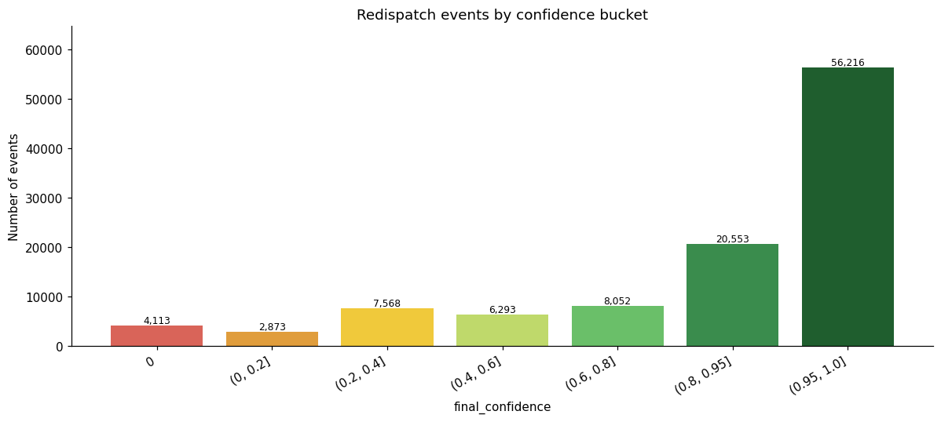
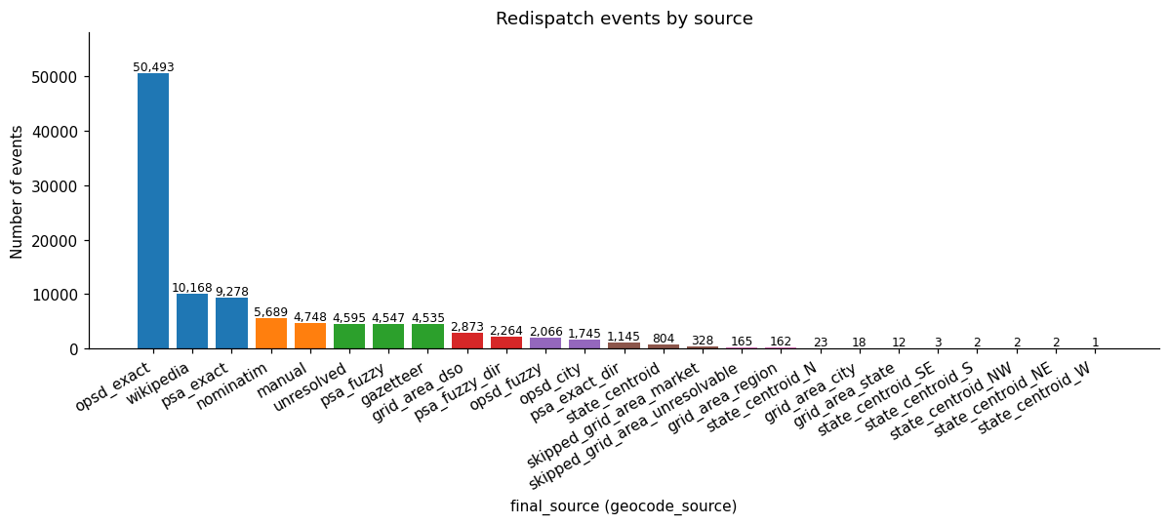
04 · RESULTS — MATCHING
TUM
Three quarters of all events matched with confidence above 0.8
Final confidence scores — 56,216 events in (0.95, 1.0], 20,553 in (0.8, 0.95]
Resolution source — opsd_exact dominates (50,493), then Wikipedia (10,168) and psa_exact (9,278)
High-precision exact-match sources carry the bulk of the volume → the matched core of the dataset is reliable.
Thirza Laws & Julian Wachsmuth | Advanced Seminar Electricity Markets | Prof. Dr. Schwenen
11
Notes:
Matching worked: 56k events in the top bucket, 20k in (0.8, 0.95] — three quarters above 0.8. The bulk comes from high-precision exact registry matches (opsd_exact 50,493), then Wikipedia and psa_exact.

Slide 19
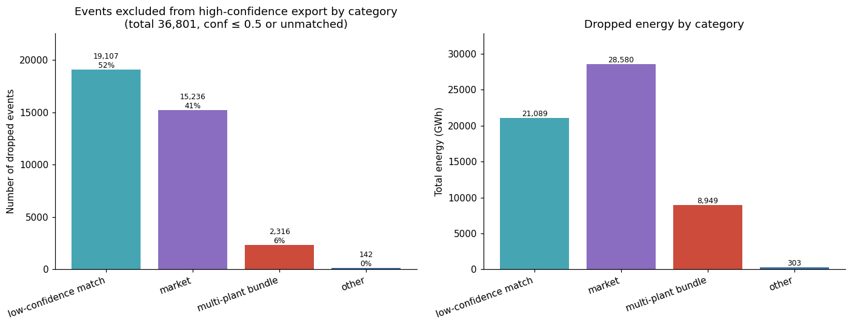
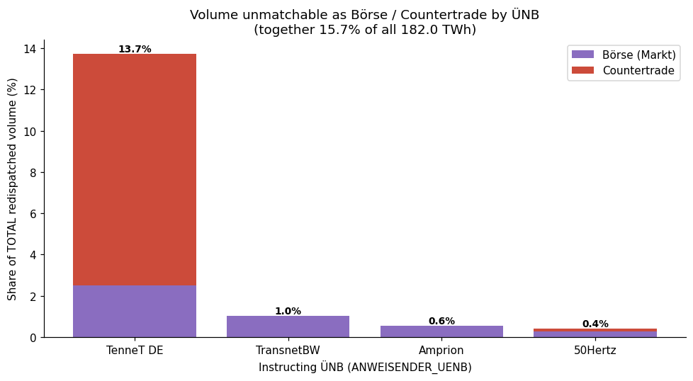
04 · RESULTS — MATCHING
TUM
Dropped volume is dominated by structurally unmatchable market measures
36,801 excluded events: by count low-confidence leads (52%); by energy, market measures (28,580 GWh)
Börse / countertrade volume is concentrated almost entirely under TenneT DE (13.7% of total)
Market measures and multi-plant bundles identify no location by construction — the genuinely addressable gap is the low-confidence category.
Thirza Laws & Julian Wachsmuth | Advanced Seminar Electricity Markets | Prof. Dr. Schwenen
12
Notes:
36,801 events excluded. By count, low-confidence dominates; by energy, market-based measures are the biggest chunk — and those are structurally unmatchable, they identify no location by construction. The genuinely addressable gap is the low-confidence category.

Slide 20
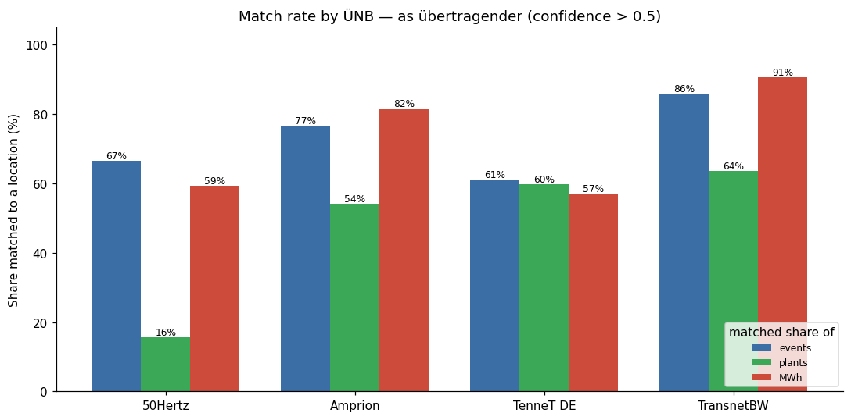
04 · RESULTS — MATCHING
TUM
Match quality differs by TSO — TenneT structural, 50Hertz a real gap
Amprion & TransnetBW
Strong across events, plants and MWh (up to 91% of volume matched).
TenneT DE
Low rates are largely an artefact of its heavy countertrade use — real but irreducible.
50Hertz
Almost no market volume → the low plant match rate is a genuine coverage limitation : the north-east is systematically underrepresented.
Share matched to a location (confidence > 0.4), per instructing TSO — events / plants / MWh
Thirza Laws & Julian Wachsmuth | Advanced Seminar Electricity Markets | Prof. Dr. Schwenen
13
Notes:
Match quality is not uniform. Amprion and TransnetBW are strong on all three dimensions. TenneT looks weak but that's largely the countertrade artefact — real but irreducible. 50Hertz has almost no market volume, so its low plant match rate is a genuine coverage limitation: the north is systematically underrepresented in any plant-level analysis.

Slide 21
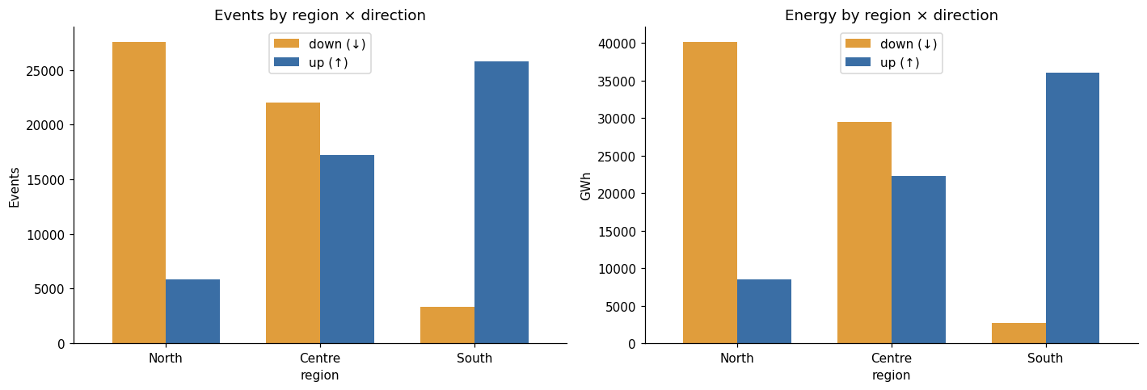
04 · RESULTS — DESCRIPTIVE
TUM
The data reproduces the north–south congestion pattern
North: curtailment
↓ ~40,000 GWh
~27,800 downward events — surplus wind that cannot be exported
South: ramp-up
↑ ~36,000 GWh
Redispatch events (left) and energy (right) by region × direction, 2013–2025
~25,900 upward events — generation behind the bottleneck
Mirror image across the dominant north–south corridors → dataset is representative.
Thirza Laws & Julian Wachsmuth | Advanced Seminar Electricity Markets | Prof. Dr. Schwenen
14
Notes:
Sanity check passed: the geolocated data reproduces the textbook pattern. North dominated by downward redispatch — wind curtailment, about 40,000 GWh down. South is the mirror image, 36,000 GWh up, behind the north-south bottleneck. Gives us confidence the dataset is representative.

Slide 22
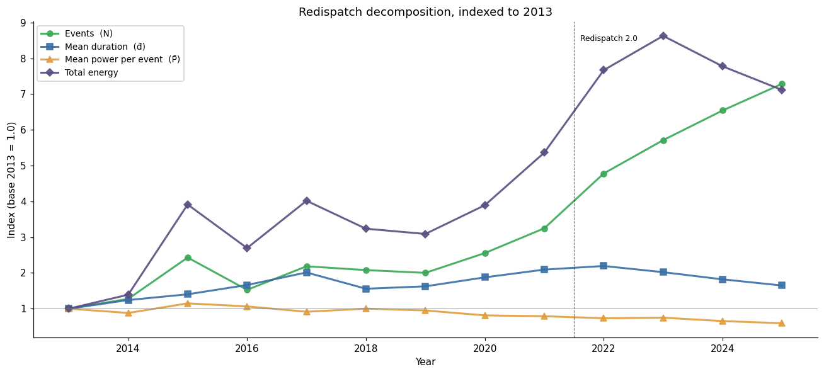
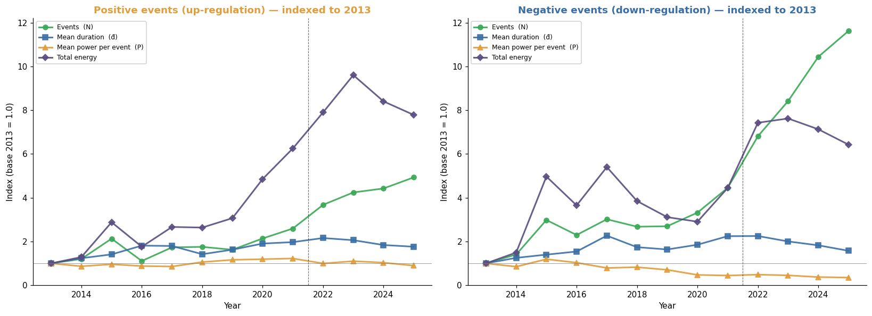
04 · RESULTS — DESCRIPTIVE
TUM
Redispatch 2.0: more, smaller, shorter events — driven by renewable curtailment
Split by direction: the post-2021 surge in event counts is concentrated on the negative (curtailment) side
Indexed to 2013: energy peaks 2023 and declines; events rise steadily while mean duration & power fall
Since renewables entered the mechanism (Redispatch 2.0, Oct 2021), many small downward events push counts up while mean duration and power per event fall.
Thirza Laws & Julian Wachsmuth | Advanced Seminar Electricity Markets | Prof. Dr. Schwenen
15
Notes:
Energy rose until 2023 then declined; event counts rise steadily. Since Redispatch 2.0 in 2021, events multiply while mean duration and power fall — the split by direction shows it's the negative side: renewables now enter curtailment, many small short events.

Slide 23
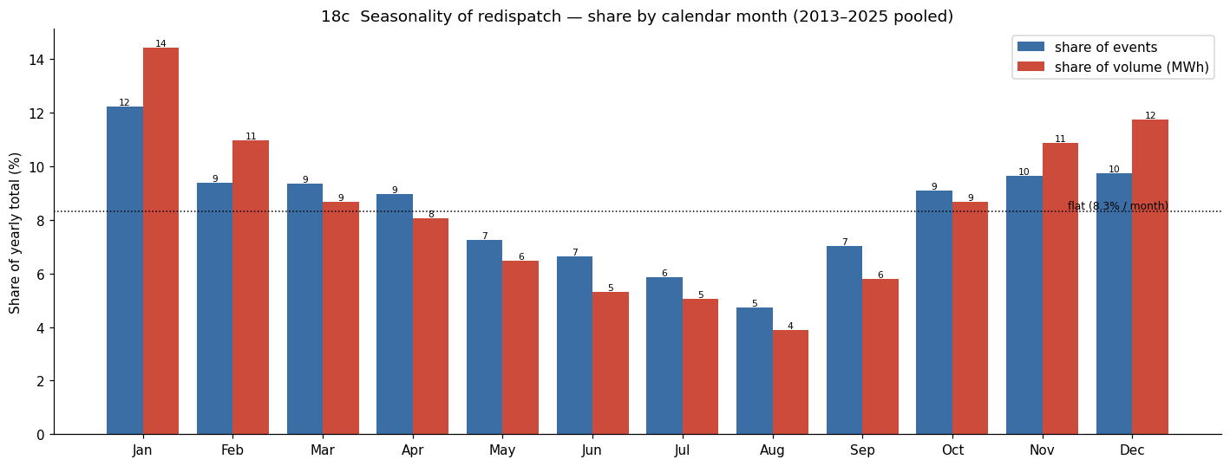
04 · RESULTS — DESCRIPTIVE
TUM
Winter wind drives the largest and longest redispatch events
Jan / Feb / Nov / Dec lead in both counts and volume — on- and offshore wind production peaks in winter.
Volume share exceeds event share in winter → winter events are larger and longer .
PV-driven summer events: shorter, smaller, more distributed and closer to demand centres.
Share of yearly total by calendar month, 2013–2025 pooled — events vs. volume
Thirza Laws & Julian Wachsmuth | Advanced Seminar Electricity Markets | Prof. Dr. Schwenen
16
Notes:
Winter dominates in both counts and volume — high wind production in the north. Winter events are also bigger and longer, consistent with wind-driven congestion; PV-driven events are shorter and more distributed.

Slide 24
04 · RESULTS — SCORING
TUM
Our score reproduces the PyPSA-Eur nodal ranking
01
02
03
Rankings agree — ρ = 0.65
Positive, but not sharp
Converges and is robust
Across the 17 German nodes of the 30-node solve, our redispatch score and the PyPSA-Eur ranking agree at Spearman ρ = 0.65 (Kendall τ = 0.43, p = 0.005). Same heuristic on both sides → the agreement is due to the price signal alone.
With only 17 nodes the estimate is noisy: a node bootstrap gives a 95% CI of [0.24, 0.85], and leave-one-out keeps ρ in 0.58–0.71 — no single node drives the result.
Refining the benchmark 10 → 17 nodes raises agreement (ρ = 0.48 → 0.65): the methods converge as resolution improves. Re-valuing with round-trip losses (η = 0.85) leaves ρ = 0.65.
04
05
A redispatch-based score with no nodal prices reproduces a physics-based nodal ranking — the locational signal really is recoverable from observed redispatch.
It is the spread, not the level
Regions yes, buses not yet
Value is driven by the intraday price spread (siting vs. spread ρ = 0.60); a naïve |congestion| proxy from mean-price deviation shows nothing (ρ = −0.17, p = 0.50). The score tracks what monetises.
Agreement holds across node regions but weakens at individual buses (ρ = 0.30) — a limit of the 17-node benchmark, which assigns one flat value per region, not of the finer within-region signal our score resolves.
Thirza Laws & Julian Wachsmuth | Advanced Seminar Electricity Markets | Prof. Dr. Schwenen
17

Slide 25
Chapter 5:
Discussion

Slide 26
05 · DISCUSSION
TUM
Limitations of the scoring
01
02
03
Signal anchored to plants, not constraints
Transmission level only
~30% of volume unobserved — and not at random
The wedge sits at the redispatched plant — the actuator — not at the binding line. PTDF mitigates, but cannot relocate a mislocated signal.
DSO-level congestion is invisible — a battery relieving distribution grids can score poorly despite being well placed.
Countertrading and unmatched plants cluster in space; the north (50Hertz, TenneT) is structurally underrepresented in the effective price.
04
05
Read the scores as a relative, transmission-level ranking against observable redispatch — not an absolute node-level verdict on any site.
Co-located batteries under-ranked
Today’s congestion, tomorrow’s grid
Batteries at PV / wind sites help the grid almost by construction, but the pure arbitrage score gives no credit for avoided curtailment.
ΔV reflects present-day congestion; SuedLink & SuedOstLink will reshape it within a battery’s lifetime.
Thirza Laws & Julian Wachsmuth | Advanced Seminar Electricity Markets | Prof. Dr. Schwenen
18
Notes:
Five limitations bound the ranking: signal anchored to the actuator plant, not the constraint; TSO-level only; 30% of volume unobserved and plausibly clustered — the north is underrepresented; co-located batteries under-ranked; and the scores reflect today's congestion on a grid that's being expanded. Read as a relative transmission-level ranking, not a node-level verdict.

Slide 27
05 · DISCUSSION
TUM
What we take away so far
Matching algorithm
Policy implication
A majority of events matched confidently → to our knowledge the first geolocated dataset of German TSO redispatch — a resource for further research, with the caveats shown.
Scoring algorithm
Under cost-based redispatch, even well-placed batteries have no incentive to behave grid-friendly — placement analysis only matters if a locational signal (grid-fee reform, local markets) reaches them.
Ranking reproduces the PyPSA-Eur benchmark (ρ = 0.65) from observed redispatch alone — no nodal prices, no network optimisation. Validated at the node-region level; within-region siting awaits a finer benchmark.
Thirza Laws & Julian Wachsmuth | Advanced Seminar Electricity Markets | Prof. Dr. Schwenen
19
Notes:
Matching: solid, and to our knowledge the first geolocated TSO redispatch dataset — useful beyond this paper. Scoring discussion still open. Policy angle: under cost-based redispatch, even perfectly placed batteries have no reason to behave grid-friendly — connects to the BNetzA grid-fee reform debate.

Slide 28
TUM
Thank you for your attention!
Thirza Laws & Julian Wachsmuth
München, [Date of final presentation]
Notes:
Thank the audience, open for questions.

