Slide 1
Stylegan

Slide 2
01
Abstract
&
Introduction
The new architecture leads to an Automatically learned, unsupervised separation of high-level attributes(e.g. pose, identity..) and stochastic variation (e.g. freckles, hair)
Better interpolation properties, better disentangles the latent factors of variation
Two new: generator architecture, dataset
Difficulties!
the understanding of various aspects of the image synthesis process,
e.g. the origin of stochastic features, is still lacking
The properties of the latent space are also poorly understood,
and the commonly demonstrated latent space interpolations provide no quantitative way to compare different generators against each other.
Suggests!
Embeds the input latent code into an inter-mediate latent space: how the factors of variation are represented in the network
Input latent space는 training data의 데이터 분포를 따라야 하기 때문에 필연적으로 entanglement 가 존재한다.
하지만 논문에서 제시한 intermediate latent space는 이러한 제약에서 자유롭고 disentagled 될 수 있다.
+ metrics 제시(perceptual path length, linear separability)

Slide 3
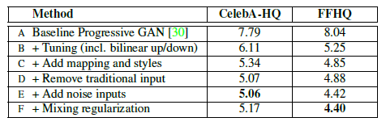
02
Method
Fr´echet inception distance (FID) for various generator designs
(lower is better)
PGGAN
Tuning: bilinear up/downsampling operations, longer training, and tuned hyperparameters.
adding the mapping network and AdaIN operations
removing the traditional input layer and starting the image synthesis from a learned 4x4x512 constant tensor
Noise inputs
Mixing regularization : decorrelates neighboring styles and enables more finegrained
control over the generated imagery
loss functions
CELEBA-HQ: WGAN-GP
FFHQ:
WGAN-GP for configuration A
Nonsaturating loss with R1 regularization for configurations B–F.
synthesis network is able to produce meaningful results even though it receives input only through the styles(y) that control the AdaIN operations.

Slide 4
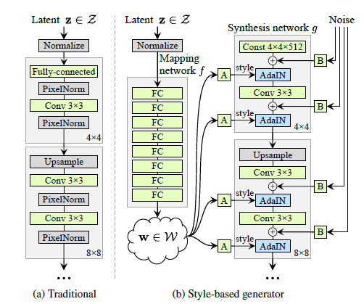
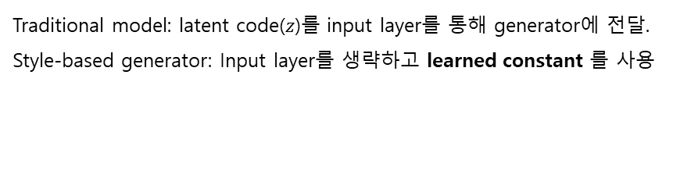
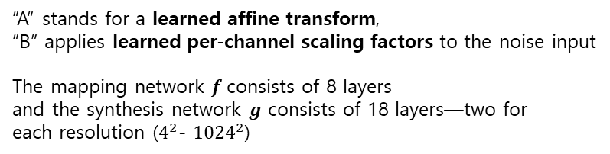
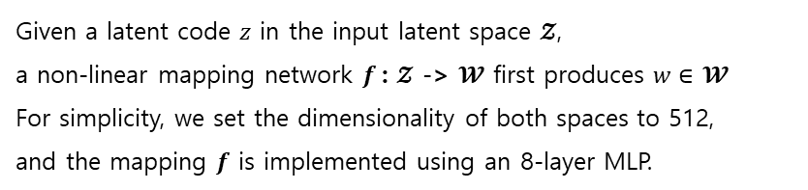
02
Style-based
generator
Traditional model: latent code($z$)를 input layer를 통해 generator에 전달.
Style-based generator: Input layer를 생략하고 learned constant 를 사용
Given a latent code $z$ in the input latent space $𝓩$,
a non-linear mapping network $f$: $𝓩$ -> $𝓦$ first produces $w∈$ $𝓦$
For simplicity, we set the dimensionality of both spaces to 512,
and the mapping $f$ is implemented using an 8-layer MLP.
“A” stands for a learned affine transform,
“B” applies learned per-channel scaling factors to the noise input
The mapping network $f$consists of 8 layers
and the synthesis network $g$ consists of 18 layers—two for
each resolution ($4^{2}$- ${1024}^{2}$)

Slide 5

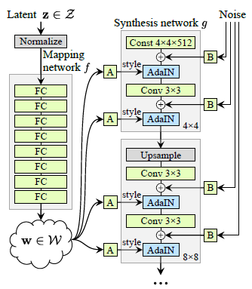
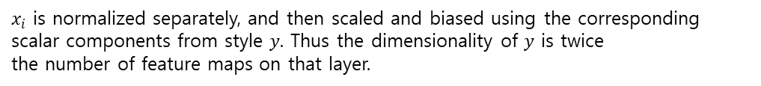

02
AdaIN
Learned affine transformations(A) then specialize $w$ to styles $y$ = ($y_{s}, y_{b}$)
that control adaptive instance normalization (AdaIN)
$x_{i}: \text{each} \text{feature}$map
$x_{i}$ is normalized separately, and then scaled and biased using the corresponding scalar components from style $y$. Thus the dimensionality of $y$ is twice
the number of feature maps on that layer.
Comparing our approach to style transfer, we compute the
spatially invariant style $y$ from vector $w$ instead of an example image
Const 4x4x512 ??

Slide 6
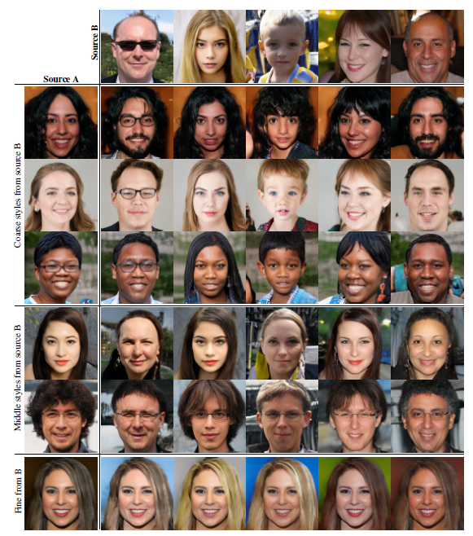
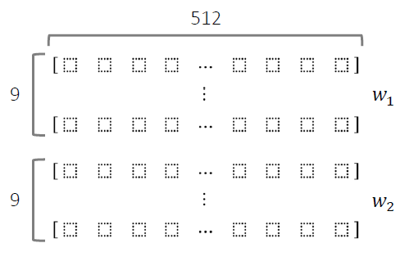
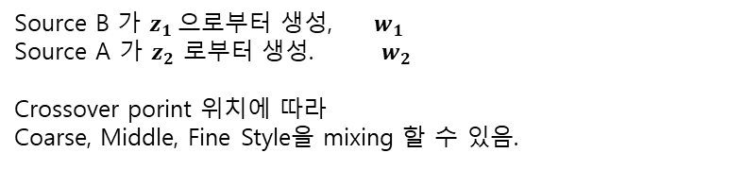
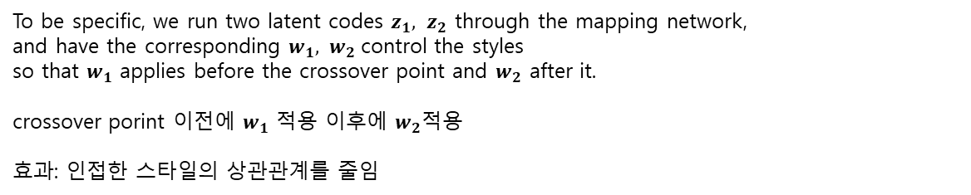
03
Style
mixing
mixing regularization to encourage the Styles to localize
given percentage of images are generated using two random latent codes during training.
To be specific, we run two latent codes $z_{1}, z_{2}$ through the mapping network,
and have the corresponding $w_{1}, w_{2}$control the styles
so that $w_{1}$ applies before the crossover point and $w_{2}$ after it.
crossover porint 이전에 $w_{1}$ 적용 이후에 $w_{2}\text{적용}$
효과: 인접한 스타일의 상관관계를 줄임
Source B 가 $z_{1}$으로부터 생성, $w_{1}$
Source A 가 $z_{2}$ 로부터 생성. $w_{2}$
Crossover porint 위치에 따라
Coarse, Middle, Fine Style을 mixing 할 수 있음.
Notes:
Resoultion (4^2 – 8^2) 까지는 w1 사용, 그이후에 w2를 사용하면 coarse style 적용?

Slide 7
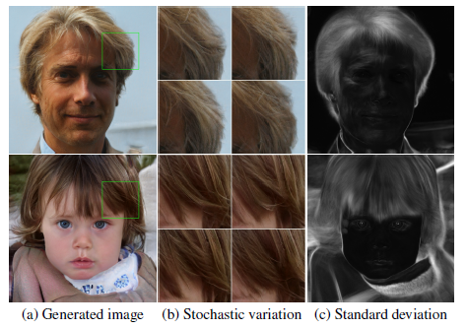
03
Stochastic
Variation
exact placement of hairs, stubble, freckles, or skin pores can be regarded as stochastic
이러한 것들은 정확한 분포(w?)를 따르는 한 이미지에 대한 인식에 영향을 미치지 않고 무작위로 추출할 수 있다.
adding per-pixel noise after each convolution.

Slide 8
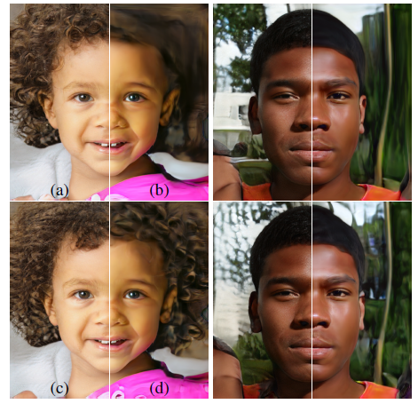
03
Stochastic
Variation
•Style: high-level global attributes
•얼굴형,포즈,안경의 유무등
•Noise: stochastic variation
•주근깨(freckle),피부모공(skinpore)
•Coarse noise:큰 크기의 머리곱슬거림,배경 등
•Fine noise:세밀한 머리 곱슬거림,배경
(a) 모든 레이어에 노이즈 적용
(b) 노이즈 적용하지 않음
(c) Fine layer 에 적용
(d) Coarse layer 에 적용

Slide 9
03
Separation of global effects from stochasticity
while changes to the style have global effects (changing pose, identity, etc.),
the noise affects only inconsequential stochastic variation (differently combed hair, beard, etc.).
the style affects the entire image because complete feature maps are scaled and biased with the same values.
Therefore, global effects such as pose, lighting, or background style can be controlled coherently.
Meanwhile, the noise is added independently to each pixel and is thus ideally suited for controlling stochastic
variation.
spatially invariant statistics (Gram matrix, channel-wise mean, variance, etc.) reliably encode the style of an image
while spatially varying features encode a specific instance.

Slide 10
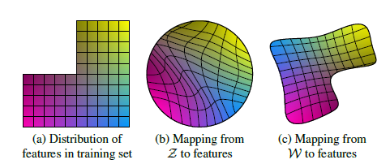
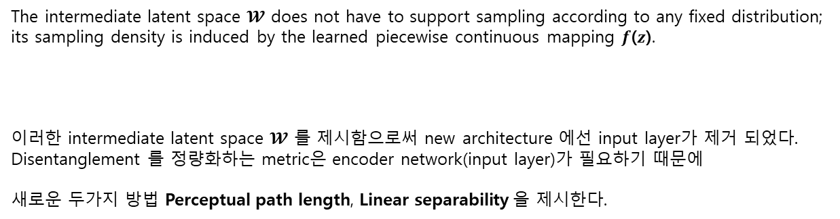
04
Disentanglement
common goal of disentanglement is a latent space that consists of linear subspaces,
each of which controls one factor of variation
unwarp
The intermediate latent space $𝓦$ does not have to support sampling according to any fixed distribution; its sampling density is induced by the learned piecewise continuous mapping $f$($z$).
이러한 intermediate latent space $𝓦$ 를 제시함으로써 new architecture 에선 input layer가 제거 되었다.
Disentanglement 를 정량화하는 metric은 encoder network(input layer)가 필요하기 때문에
새로운 두가지 방법 Perceptual path length, Linear separability 을 제시한다.
1. Path Length : 두 벡터를 보간(interpolation)할 때 얼마나 급격하게 이미지 특징이 바뀌는지
2. Separability : latent space 에서 attributes 가 얼마나 선형적으로 분류 될 수 있는지 평가
Notes:
Linear subspaces(선형 부분공간)
Figure 6. Illustrative example with two factors of variation (image features, e.g., masculinity and hair length).
An example training set where some combination (e.g., long haired males) is missing.
This forces the mapping from Z to image features to become curved so that the forbidden combination disappears in Z to prevent the sampling of invalid combinations.
(c) The learned mapping from Z to W is able to “undo” much of the warping.

Slide 11
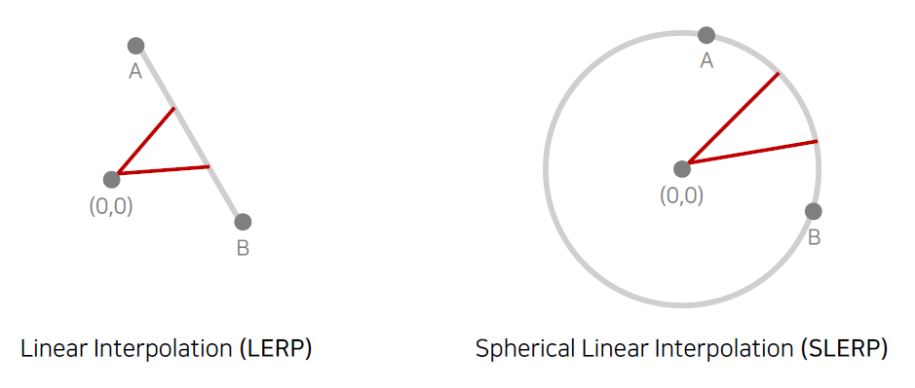
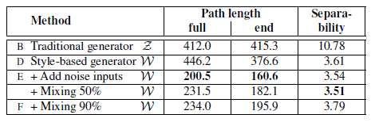
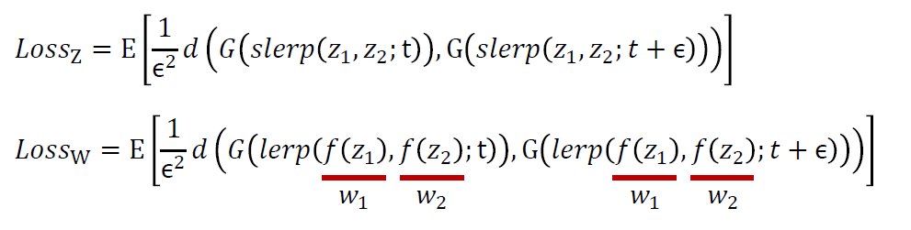

04
Perceptual
Path length
두 개의 latent codes 를 interploation 하는 방법
Official code of ppl

Slide 12
04
Linear
separability
Want to find: direction vectors that consistently correspond to individual factors of variation
metric that quantifies this effect by measuring how well the latent-space points can be separated into two distinct sets
via a linear hyperplane, so that each set corresponds to a specific binary attribute of the image.
conditional entropy H(Y|X)
X are the classes predicted by the SVM
Y are the classes determined by the pre-trained classifier.
Notes:
we train auxiliary classification networks for a number of binary attributes, e.g., to distinguish male and female faces.
To measure the separability of one attribute, we generate 200,000 images with z~P(z) and classify them using the auxiliary classification network. (CELEBA-HQ dataset that retains the 40 attributes)

Slide 13
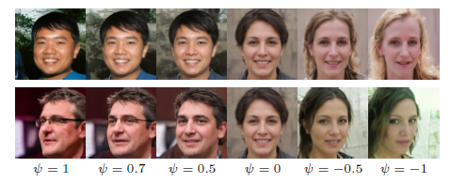
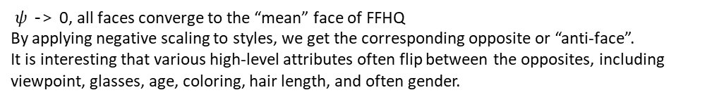
appendix
Truncation trick in $𝒲$
$ψ$ -> 0, all faces converge to the “mean” face of FFHQ
By applying negative scaling to styles, we get the corresponding opposite or “anti-face”.
It is interesting that various high-level attributes often flip between the opposites, including viewpoint, glasses, age, coloring, hair length, and often gender.
We compute the center of mass of $𝒲$ as
We can then scale the deviation of a given w from the center as where $ψ$ < 1.
Hyperparameters and training details…

