Slide 1
Analyzing Complex Survey Data Using Python Introduction to the samplics Package
PyData, Cambridge Meetup
28 April 2021

Slide 2
About me
Statistician at UNICEF
Previously worked at Westat and Statistics Canada
Hold Ph.D. in Statistics
Social media handle
Twitter / GitHub / LinkedIn: @MamadouSDiallo

Slide 3
Plan of the Presentation
Introduction
A short tour of samplics
Sample size calculation
Sample selection
Sample weighting
Population parameter estimation
T-test

Slide 4
Introduction
Why samplics?
Python is missing a comprehensive survey sampling package
Allow Python users to stay in the Python ecosystem when analysing survey data
Help reduce the gap between official statistics and machine learning / data science
Disclaimer: current version of samplics is a beta stage and the APIs are not stable yet. While the code base has extensive testing, users should expect bugs and improvements that may break their code. Many features are being developed and may influence the design of existing APIs.
Samplics documentation: https://samplics.readthedocs.io/en/latest/index.html

Slide 5
Introduction
What is Survey Sampling?
Random selection of a subset from a finite population
Known probabilities of selection
The sampling strategy or sampling design is often complex for operational, cost, or efficiency reasons
Stratification
Clustering, Stage selection
Phase selection
Calibration
Etc.
Survey sampling techniques are the set of statistical methods for estimating population parameters (e.g., mean, total, regression coefficients, etc.) under the sampling design.

Slide 6
Introduction
Research questions
what is the household poverty rate in the USA?
is poverty rate the same between households headed by women vs men?
To answer the research questions, let’s consider a subset of the ACS 2019 as our target population.
Note
American Community Survey (ACS) 2019 from IPUMS (https://usa.ipums.org/usa).
Only a subset of the ACS 2019 data was used. Hence, the numbers do not represent the full ACS2019.
All the analysis in this presentation are just for illustration purpose, not a proper statistical analysis of the 2019 ACS.

Slide 7
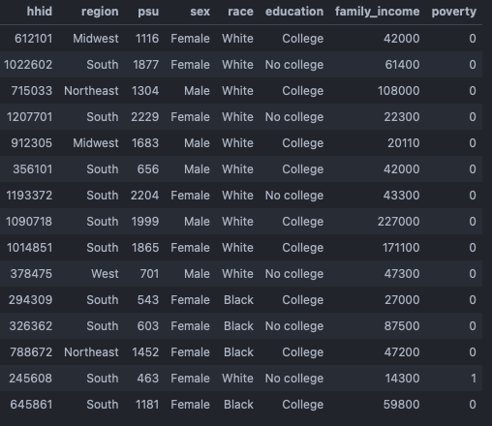
Introduction
As mentioned before, we use a subset of the ACS 2019 as our universe / frame / census
We cluster the households in the frame into 2,351 primary sampling units (PSUs)
Each cluster is a geographic area composed of a few hundred of households

Slide 8
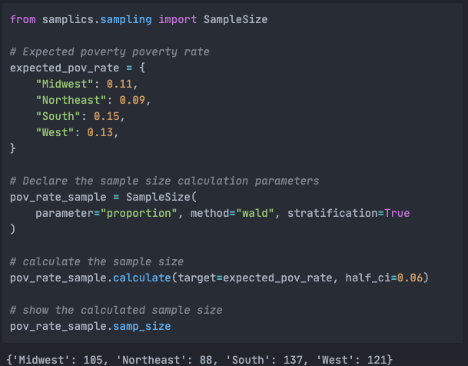
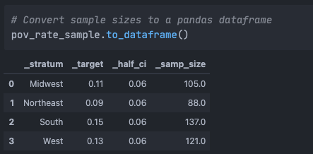
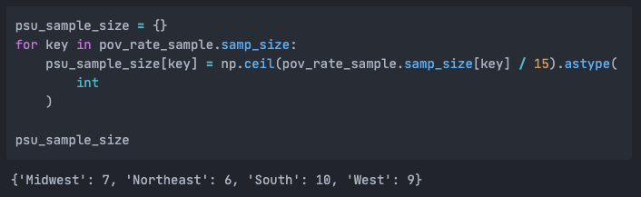
Sample Size
Determine the number of clusters needed
Total: 32 PSUs

Slide 9
Selection
The selection module in samplics provides
Simple random selection (SRS)
Systematic selection
Probability proportional to size (PPS)
Systematic (method=“pps-sys”) – with and without replacement
Brewer (method= “pps-brewer”)
Hanurav-Vijayan (method= “pps-hv”)
Murphy (method= “pps-murphy”)
Rao-Sampford (method= “pps-sampford”)

Slide 10
Selection
Two step selection
Step 1: select the PSUs (clusters of households)
Step 2: Select the households from the selected PSUs
Note
For this presentation, we artificially constructed the PSUs.
Often, data collection is needed after step 1 to create the sampling frame for the stage 2 selection.

Slide 11
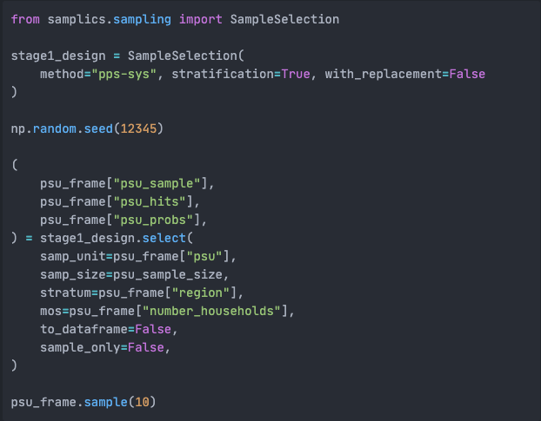
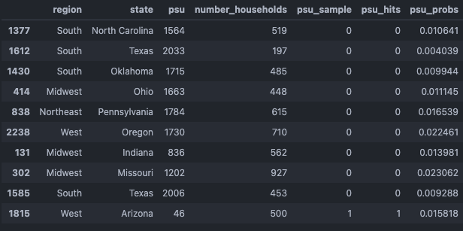
Selection
select() returns a tuple of three numpy arrays
Sample indicator
Number of hits
Selection probabilities
to_dataframe flag will return a pandas data frame when set to True

Slide 12
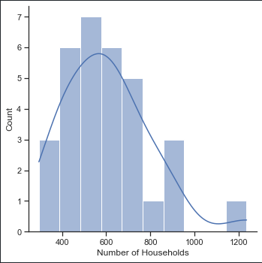
Selection
19,303 households listed in the 32 selected PSUs
In each PSU, we will select 15 households using SRS

Slide 13
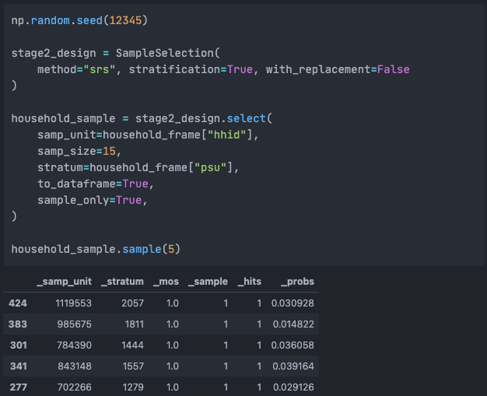
Selection
Select 15 households from each PSU in the sample
We use simple random selection (srs)
All households have the same probability of selection within a stratum
The output is of type a pandas dataframe because to_dataframe=True.

Slide 14
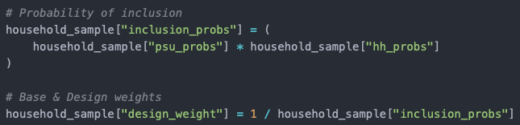
Weighting
Overall inclusion probabilities are the product of the probabilities of selection of each stage
Design weights are the inverse of the inclusion probabilities

Slide 15
Weighting
The weighing module in samplics provides
Non-response adjustment
Calibration including post-stratification
Normalization
Replicate weights
Balanced Repeated Replication (BRR)
Bootstrap
Jackknife

Slide 16
Weighting
Non-response weight adjustment consists of distributing the weight of non-respondents to respondents
Samplics uses a pre-codified scheme to distinguish the response status
“in” for ineligible
“rr” for respondent
“nr” for non-respondent
“uk” for unknown
If the response variable is not codified in the default scheme. (i.e., “in”, “rr”, “nr”, “uk”), then the user must provide a mapping between the default codes and the user-defined codes.

Slide 17
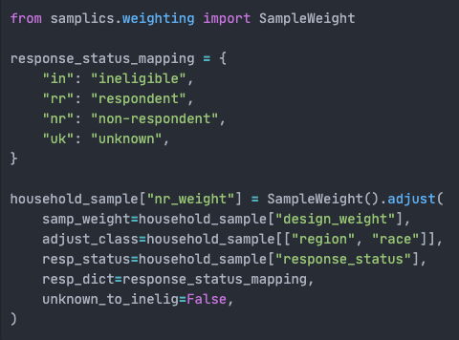
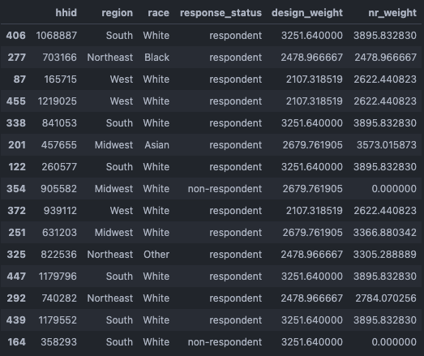
Weighting

Slide 18
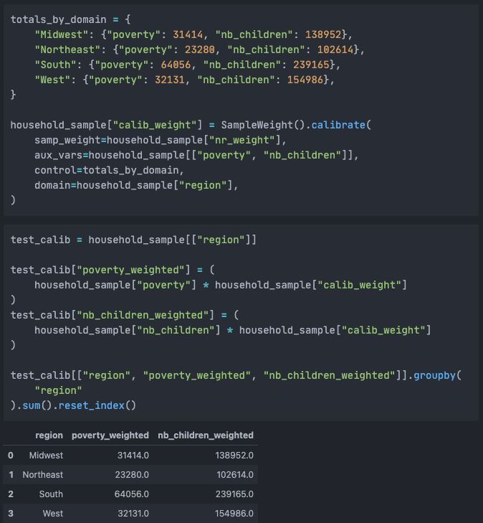
Weighting
Samplics implements the generalized regression (GREG) class for calibration
It requires known auxiliary variables control values at the population level
After the calibration adjustment, the weighted estimates of the auxiliary variables sum to the control values

Slide 19
Estimation
The estimation module in samplics provides
Taylor-based estimates (class TaylorEstimator)
Replicate-based estimates (class ReplicateEstimator)

Slide 20
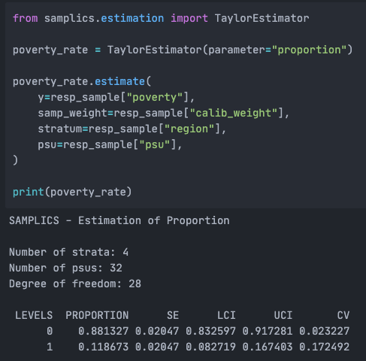
Estimation
TaylorEstimator can estimate
Proportions
Means
Totals
Ratios
Quantiles (under development)
For domain estimation, use function arguments domain.
Finite population correction (fpc) also possible
The APIs for ReplicateEstimator is similar with the use of rep_weight instead of samp_weight

Slide 21
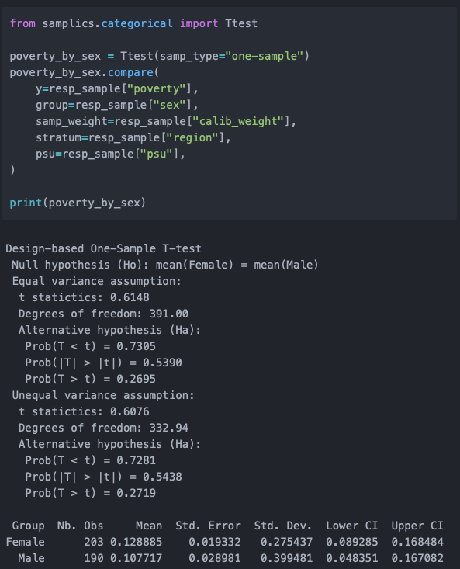
Tabulation and T-test
samplics provide APIs to produce survey-based tabulations and t-tests.
Tabulation() and CrossTabulation() classes are the main interfaces for producing one-way and two-way tables.
Rao-Scott adjustment implemented for both Pearson and Likelihood ration tests
Ttest() class is the main interface for comparison of group means.

Slide 22
Next steps
Develop more examples and training material
Add more features
Expansion of the sample size module
Addition of estimation for quantiles
Next modules to be added
Survey-based regression modelling
Imputation methods

Slide 23
Thank you @MamadouSDiallo msdiallo@sampling.org

