Slide 1


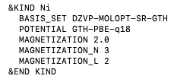
https://github.com/chrisahart/cp2k/tree/nelectron-specify_outer-scf
CP2K code changes
Major:
New keywords (float) for number of electrons NELEC_ALPHA, NELEC_BETA
New keyword (float) EPS_SCF_ARRAY to decrease EPS_SCF through OUTER_SCF
Minor:
New keyword (logical) MUST_CONVERGE aborts CP2K if inner SCF does not converge
New keyword (float) EPS_SCF_MULTIPLIER as an alternative to EPS_SCF_ARRAY
New keywords (integer) MAGNETIZATION_N and MAGNETIZATION_L
&BS section NEL integer is now a float
Bug fixes:
OUTER_SCF now works for BROYDEN_MIXING (buffer reset each OUTER_SCF)
OUTER_SCF now works for DIRECT_P_MIXING (RMS gradient is now calculated correctly)

Slide 2
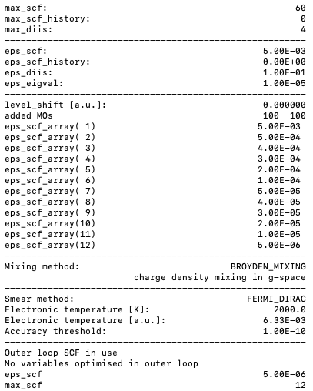

https://github.com/chrisahart/cp2k/tree/nelectron-specify_outer-scf
Decreasing EPS_SCF through OUTER_SCF
EPS_SCF_ARRAY is used to specify EPS_SCF for each OUTER_SCF

Slide 3
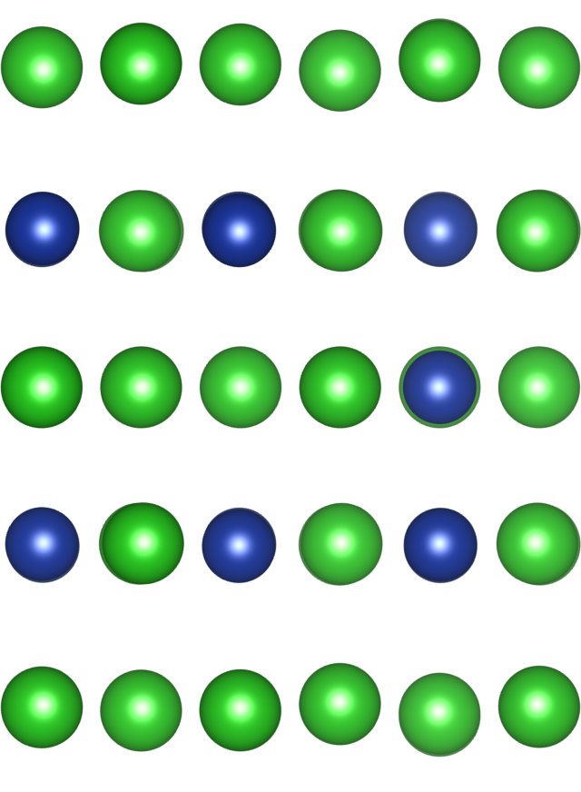
Pt₃Ni(111) Yike structure ENERGY
/rds/general/user/cahart/projects/archive/live/CX1/YIKE/ORR/water/Pt3Ni/water_bilayer
Pt-segregated Pt₃Ni(111) structure with 45 Pt atoms, 15 Ni atoms (water removed)
~ 20A total vacuum (cell size: 9.378 0.0 0.0, -4.689 8.122 0.0, 0.0 0.0 29.0618991852)
Folder | Kpoints | Multiplicity | Energy / Ha | IASD | EPS_SCF | SCF steps | SCF loops *
(1) | 1x1x1 | (0*15)+1=1 | -7948.9024 | 0.00 | 5e-6 | 44 | 1
(2) | 1x1x1 | (2*15)+1=31 | -7948.9273 | 22.4 | 1e-2 -> 5e-6 | 176 | 16
(3) | 8x8x1 | (1*15)+1=16 | -7949.3226 | 19.8 | 5e-3 -> 5e-6 | 130 | 12
(4) | 8x8x1 | (1*15)+1=16 | -7949.3226 | 19.8 | 5e-3 -> 5e-6 | 128 | 8
* Equal to 1 for no OUTER_SCF, else equal to len(EPS_SCF_ARRAY)
(1) Gitlab pt3ni/slab_yike/scarf/convergence/testing/Ni-0_Pt-0_yike_4e-2_4e-3_16_100_2000_1-1-1_pbe-d3_dzvp_eps-5e-6
(2) Gitlab pt3ni/slab_yike/scarf/convergence/testing/Ni-2_Pt-0_yike_4e-2_4e-3_16_100_2000_1-1-1_pbe-d3_dzvp_eps-1e-2-5e-6-16
(3) Gitlab pt3ni/slab_yike/scarf/convergence/outer_scf/eps_scf_array/Ni-1_Pt-0_yike_4e-2_4e-3_16_100_2000_8-8-1_pbe-d3_tzvp/MUST_CONVERGE_eps-5E-3_1E-3_5E-4_3E-4_2E-4_1E-4_5E-5_4E-5_3E-5_2E-5_1E-5_5E-6
(4) Gitlab pt3ni/slab_yike/scarf/convergence/outer_scf/eps_scf_array/Ni-1_Pt-0_yike_4e-2_4e-3_16_100_2000_8-8-1_pbe-d3_tzvp/MUST_CONVERGE_eps-5E-3_5E-4_4E-4_3E-4_2E-4_1E-4_5E-5_5E-6

Slide 4
Pt₃Ni(111) Yike structure GEO_OPT
Geometry optimisation can be run using OUTER_SCF and EPS_ARRAY
SCF_GUESS ATOMIC
12 SCF loops is more reliable than 8 and adds negligible additional SCF steps
Step | Energy / Ha | IASD | EPS_SCF | SCF steps | SCF loops *
0 | -7949.3226 | 19.8 | 5e-3 -> 5e-6 | 134 | 12
1 | -7949.3287 | 20.04 | 5e-3 -> 5e-6 | 105 | 12
2 | -7949.3301 | 20.07 | 5e-3 -> 5e-6 | 95 | 12
3 | -7949.3303 | 20.08 | 5e-3 -> 5e-6 | 87 | 12
10 | -7949.3306 | 20.14 | 5e-3 -> 5e-6 | 71 | 12
* Equal to 1 for no OUTER_SCF, else equal to len(EPS_SCF_ARRAY)
(1) Gitlab pt3ni/slab_yike/scarf/geo_opt/guess/Ni-1_Pt-0_yike_4e-2_4e-3_16_100_2000_8-8-1_pbe-d3_tzvp/MUST_CONVERGE_eps-5E-3_5E-4_4E-4_3E-4_2E-4_1E-4_5E-5_4E-5_3E-5_2E-5_1E-5_5E-6

Slide 5
Pt₃Ni(111) Yike structure GEO_OPT constrained
Geometry optimisation can be run using OUTER_SCF and EPS_ARRAY
SCF_GUESS RESTART
GEO_OPT with geometry constraints (surface reconstruction only)
Step | Energy / Ha | IASD | EPS_SCF | SCF steps | SCF loops *
0 | -7949.3226 | 19.8 | (5e-3 -> 5e-6) | (128) | (8)
1 | -7949.3260 | 19.8 | 5e-3 -> 5e-6 | 83 | 8
2 | -7949.3263 | 19.8 | 5e-3 -> 5e-6 | 79 | 8
3 | -7949.3263 | 19.8 | 5e-3 -> 5e-6 | 83 | 8
8 | -7949.3263 | 19.9 | 5e-3 -> 5e-6 | 53 | 8
* Equal to 1 for no OUTER_SCF, else equal to len(EPS_SCF_ARRAY)
(1) Gitlab pt3ni/slab_yike/scarf/geo_opt_constrained/restart/Ni-1_Pt-0_yike_4e-2_4e-3_16_100_2000_8-8-1_pbe-d3_tzvp/MUST_CONVERGE_eps-5E-3_5E-4_4E-4_3E-4_2E-4_1E-4_5E-5_5E-6

Slide 6
Supporting Information

Slide 7
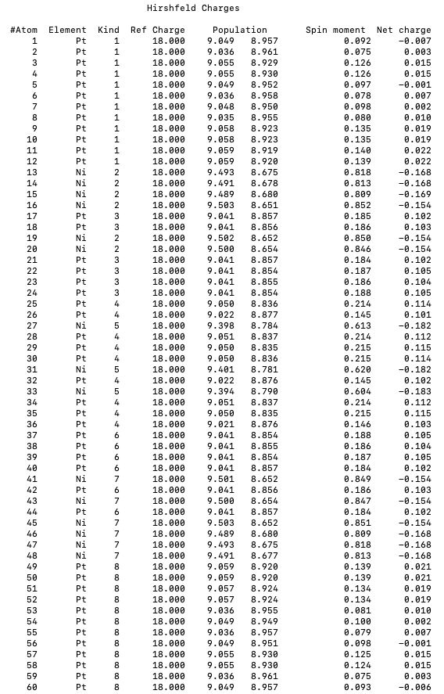
Spin moments
Source | Bulk spin moment Ni, Pt
This work | 0.61, 0.20
[1] VASP PBE | 0.67, 0.16
[2] DFTB | 0.65, 0.16
[3] DFTB | 0.58, 0.10
8 Pt
7 Ni
6 Pt
5 Ni
4 Pt
2 Ni
3 Pt
1 Pt
Numbering corresponds to CP2K atomic kind
[1] Sharma, B. K., Kwon, O., Odkhuu, D. & Hong, S. C.. Journal of Magnetism and Magnetic Materials 339, 89–93 (2013).
[2] Paudyal, D., Saha-Dasgupta, T. & Mookerjee, A. J. Phys.: Condens. Matter 16, 2317–2334 (2004).
[3] Singh, P. P. Journal of Magnetism and Magnetic Materials 261, 347–352 (2003).

Slide 8
Spin moments
Source | Bulk spin moment Ni, Pt
This work | 0.61, 0.20
[1] VASP PBE | 0.67, 0.16
[2] DFTB | 0.65, 0.16
[3] DFTB | 0.58, 0.10
8 Pt
7 Ni
6 Pt
5 Ni
4 Pt
2 Ni
3 Pt
1 Pt
Numbering corresponds to CP2K atomic kind
[1] Sharma, B. K., Kwon, O., Odkhuu, D. & Hong, S. C.. Journal of Magnetism and Magnetic Materials 339, 89–93 (2013).
[2] Paudyal, D., Saha-Dasgupta, T. & Mookerjee, A. J. Phys.: Condens. Matter 16, 2317–2334 (2004).
[3] Singh, P. P. Journal of Magnetism and Magnetic Materials 261, 347–352 (2003).

Slide 9
Methodology
Initial settings:
Ni MAGNETIZATION (2.0), Pt MAGNETIZATION (0.0) from Hund’s rule
PBE, DZVP-MOLOPT, 1x1x1, ADDED_MOS (100), ELECTRONIC_TEMPERATURE (2000), ALPHA (4e-2), CUTOFF (600)
Using multiple restarts/OUTER_SCF: initial validation of lower energy ferromagnetic structure
Using multiple restarts/OUTER_SCF: initial screening for all parameters
Using coarse EPS_SCF 5e-4 and MAX_SCF 300: perform convergence grid searches for all parameters
Optimised settings:
Ni MAGNETIZATION (1.0), Pt MAGNETIZATION (0.0)
PBE, TZVP-MOLOPT, 8x8x1, ADDED_MOS (100), ELECTRONIC_TEMPERATURE (2000), ALPHA (4e-2), CUTOFF (500)

