Slide 1
CP2K changes

Slide 2
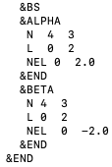
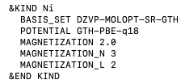

https://github.com/chrisahart/cp2k/tree/nelectron-specify
CP2K code changes
&BS section NEL integer is now a float
New keywords (integer) MAGNETIZATION_N and MAGNETIZATION_L
New keywords (float) for number of electrons NELEC_ALPHA, NELEC_BETA
55 files modified, most features likely will not support non-integer number of electrons
Known incompatibilities:
OT: number of orbitals must be equal to the number of electrons

Slide 3
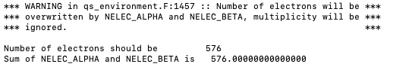
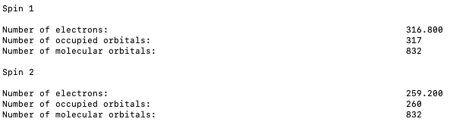
https://github.com/chrisahart/cp2k/tree/nelectron-specify
Manual allocation of electrons
Number of alpha electrons NELEC_ALPHA - CHARGE and beta electrons NELEC_BETA
Sum of NELEC_ALPHA and NELEC_BETA must be an integer
Number of alpha, beta molecular orbitals = CEILING(number of alpha, beta electrons) + ADDED_MOS

Slide 4
Ni

Slide 5
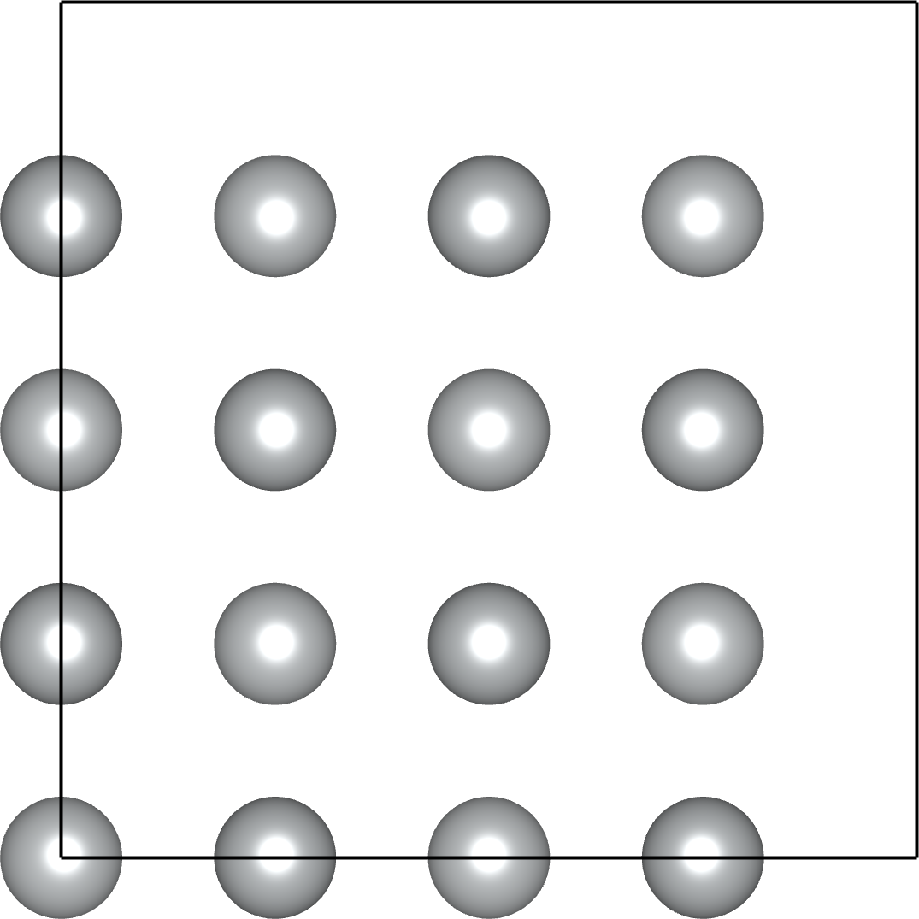
Manual allocation of electrons: bulk Ni
Ferromagnetic bulk Ni 2x2x2 supercell. Converged spin moment 0.687. Kpoints 1x1x1
SCF shown for EPS_SCF 5E-7. IASD, spin and energy shown for MAX_SCF 1 and DIRECT_P_MIXING
Right hand side table for ADDED_MOS=0 and T=0, as smearing changes guess density
Ni | Multiplicity | Electrons | IASD/32 | Spin | Energy | SCF
2 | (32*2*)+1=65 |  | 0.961 | 0.957 | -5430.5035 | 29
1.8 |  | 316.8, 259.2 | 0.796 | 0.772 | -5430.2732 | 43
1.5 | (32*1.5)+1=49 |  | 0.684 | 0.680 | -5429.9727 | 39
1 | (32*1)+1=33 |  | 0.544 | 0.446 | -5429.5932 | 28
0.5 | (32*0.5)+1=17 |  | 0.480 | 0.437 | -5429.3654
Spin | IASD/32
2 | 2.000
1.8 | 1.800
1.5 | 1.500
1 | 1.000
0.5 | 0.500

Slide 6
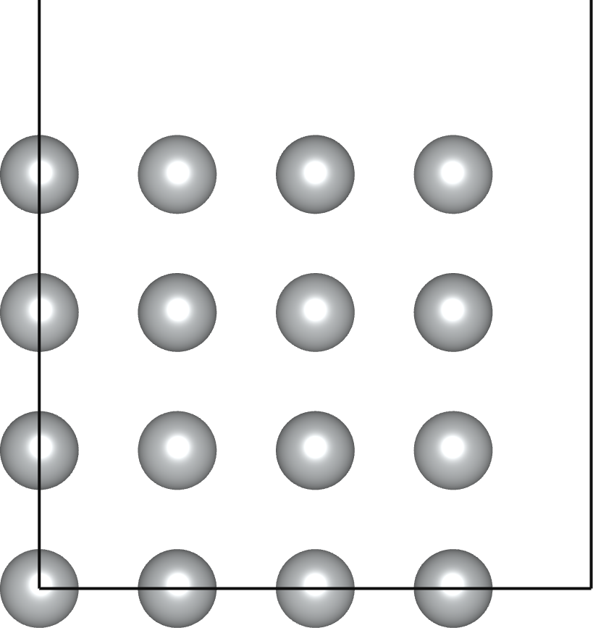
Manual allocation of electrons: Ni slab
Ni_i
Ni_b
Ni_b
Ni_i
Ferromagnetic Ni 2x2x2 slab. Converged spin moment 0.70, 0.61. Kpoints 4x4x1
SCF shown for EPS_SCF 1E-3. IASD, spin and energy shown for MAX_SCF 1 and DIRECT_P_MIXING
Right hand side table for ADDED_MOS=0, no smearing. IASD and total Mulliken spin
Ni | Multiplicity | Electrons | IASD/32 | Spin | Energy | SCF
1 | (32*1)+1=33 |  | 0.660 | 0.642, 0.560 | -5426.6352 | 95
0.75 | (32*0.75)+1=25 |  | 0.579 | 0.578, 0.500 | -5426.5023 | 17
0.7, 0.8 | (16*0.7+16*0.8)+1=25 |  | 0.580 | 0.614, 0.466 | -5426.5031 | 13
0.625 | (32*0.625)+1=21 |  | 0.526 | 0.530, 0.457 | -5426.4501 | 11
0.5, 0.7 |  | 297.6, 278.4 | 0.516 | 0.591, 0.391 | -5426.4438 | 9
Mulliken | IASD
32.00 | 32.00
24.00 | 24.13
24.00 | 24.12
20.00 | 20.56
19.20 | 19.76

Slide 7
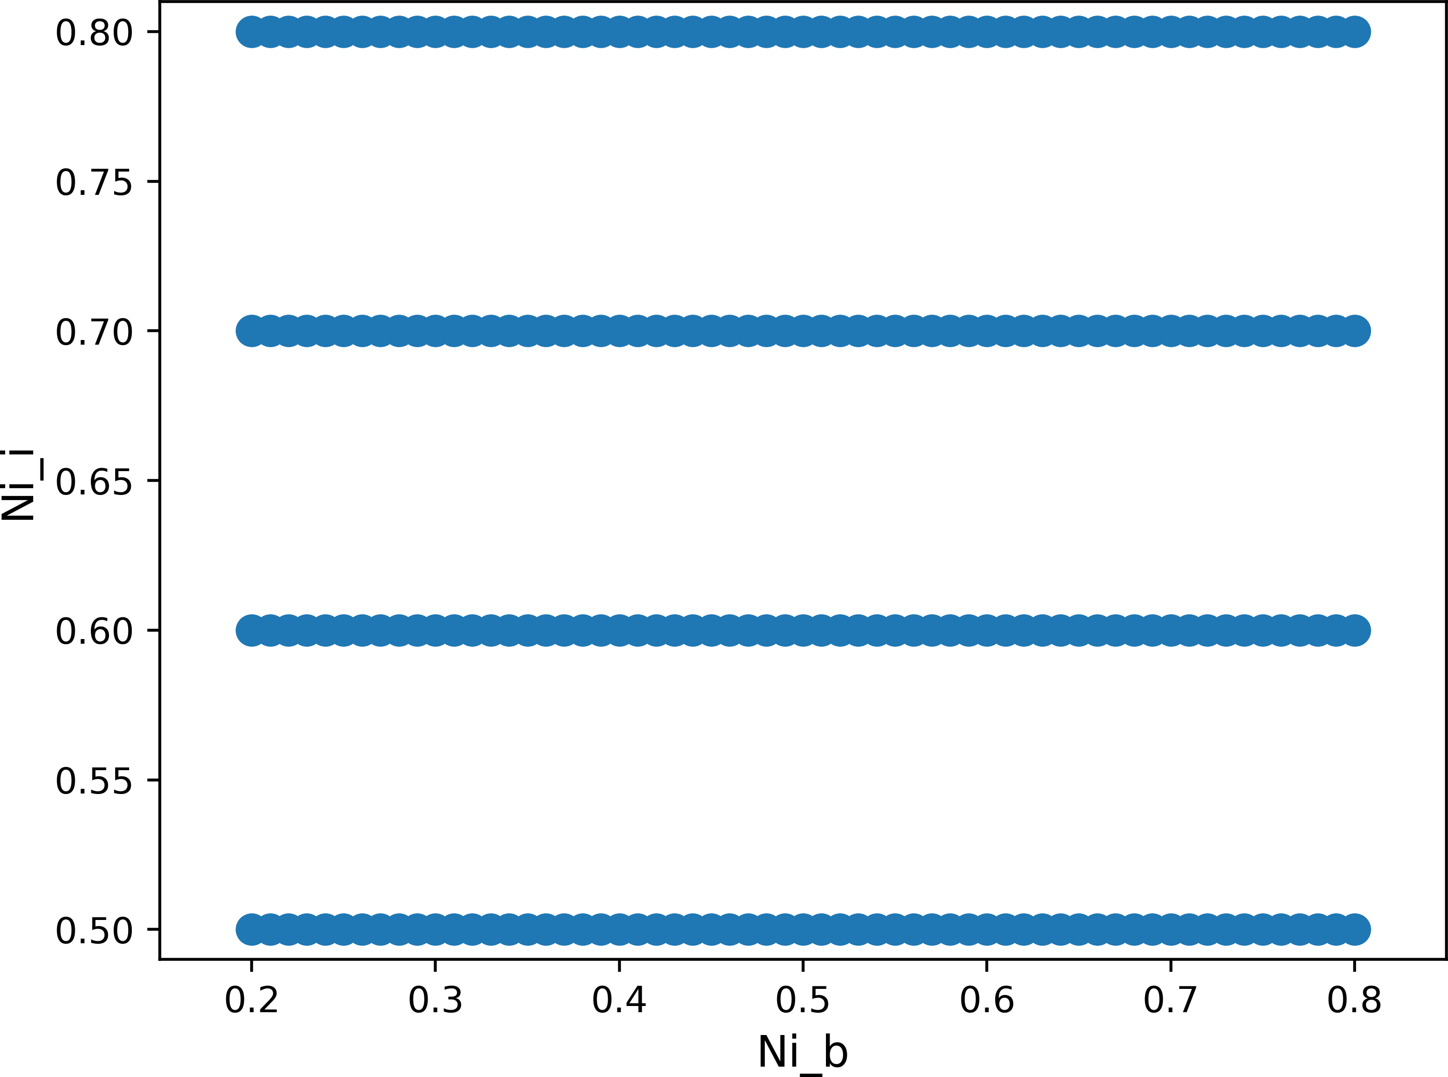
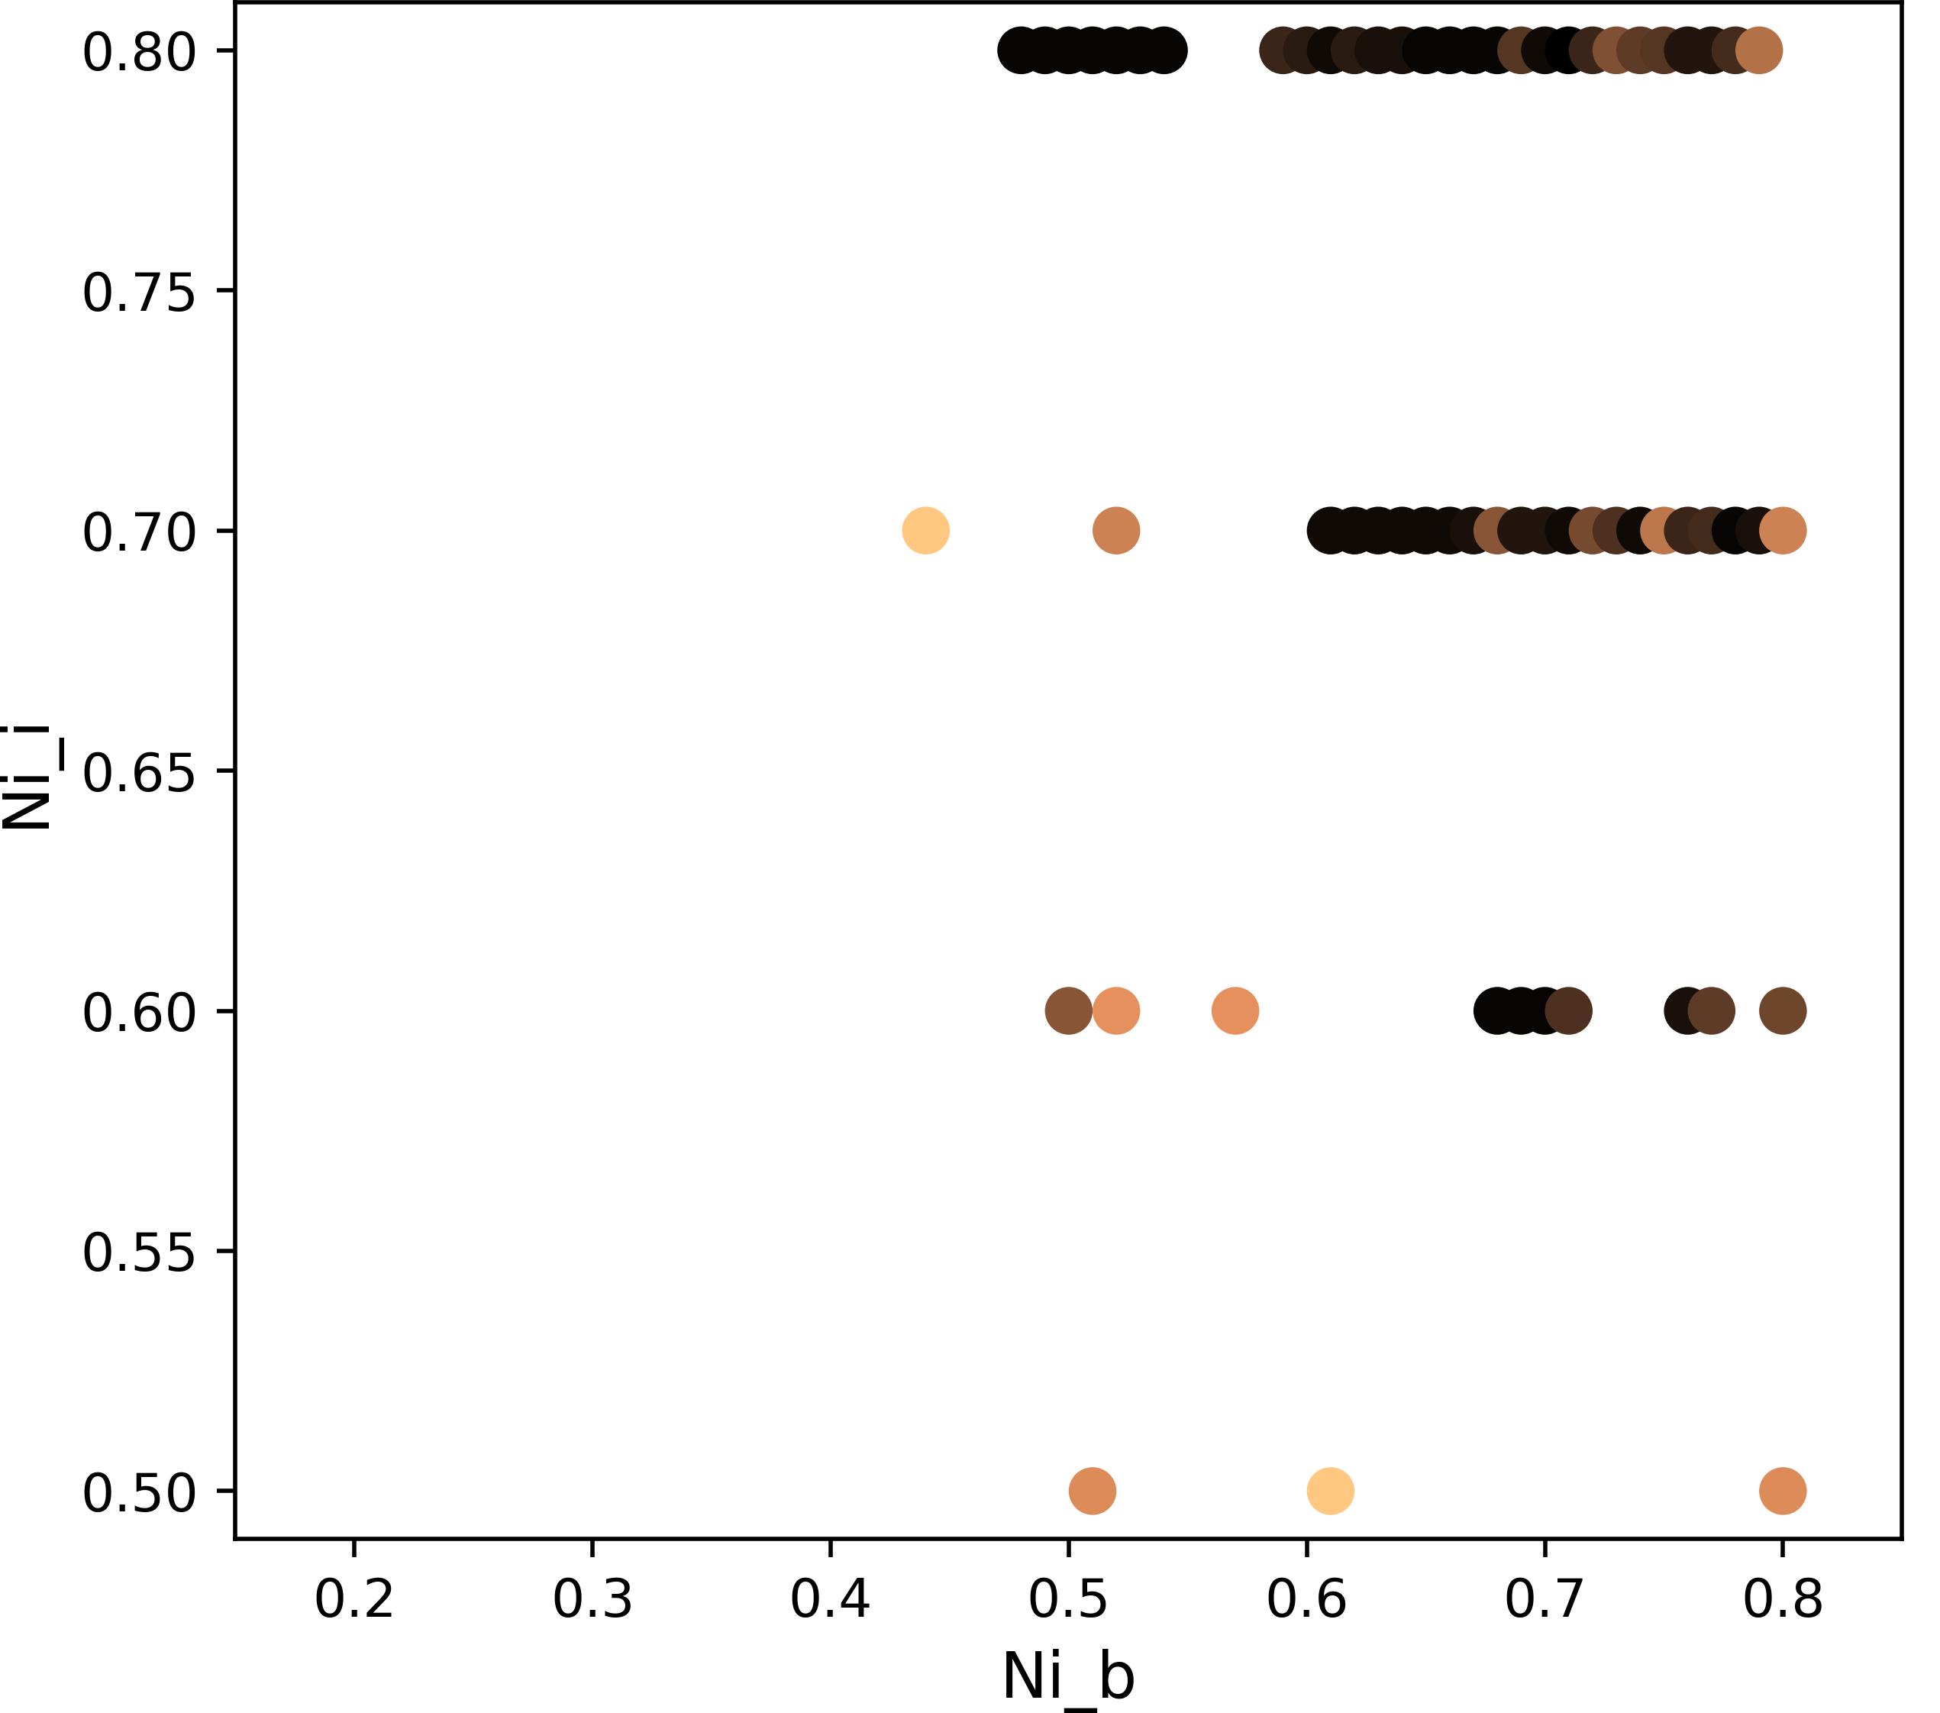
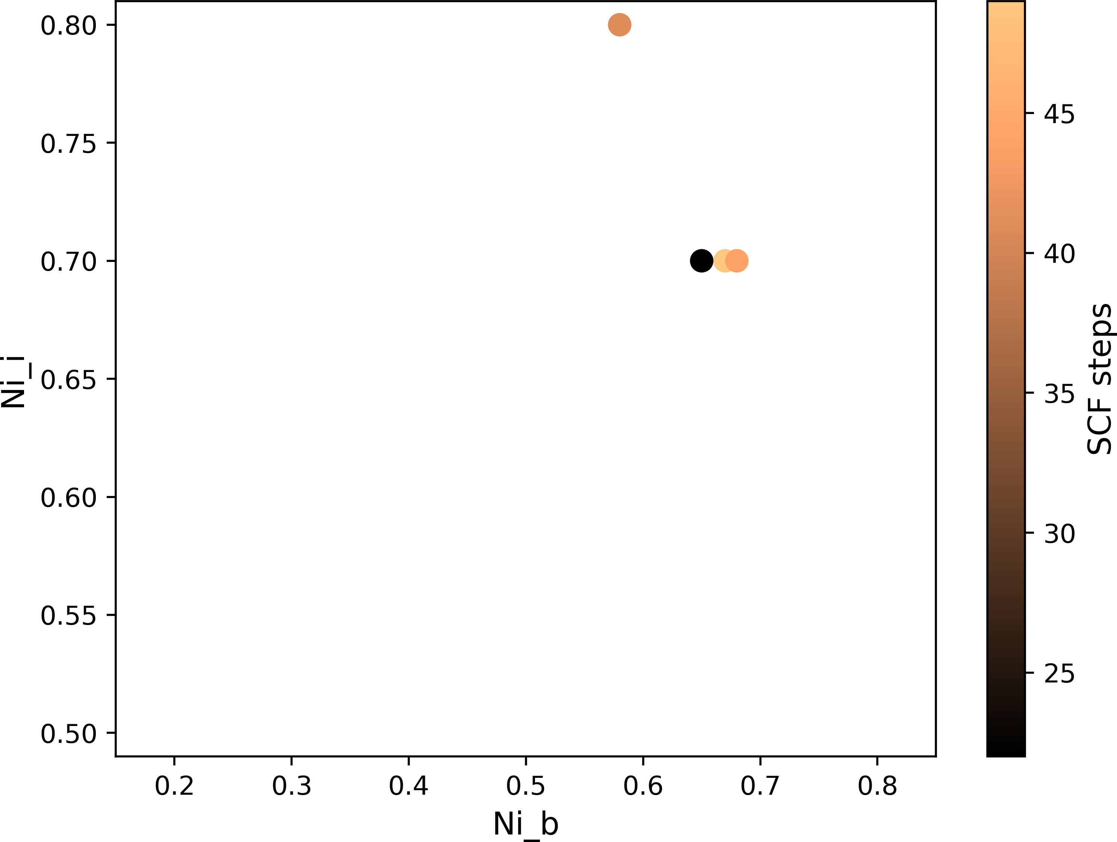
Manual allocation of electrons: Ni slab
Ni_i
Ni_b
Ni_b
Ni_i
Ferromagnetic Ni 2x2x2 slab. Converged spin moment Ni_b=0.61, Ni_i=0.70. IASD 23.65
1D grid search for KPOINTS (4x4x1), ADDED_MOS (-1), ELECTRONIC_TEMPERATURE (2000)
8x8=64 2D grid search for ALPHA (0.08), BETA (1.5)
4x60=240 2D grid search for Ni_b, Ni_i MAGNETIZATION shown for SCF < 50 and IASD > 20
Ni_b (0.65), Ni_i (0.70) converges in 63 steps for EPS_SCF 1E-5 with 1 restart, with further refinement should be faster
EPS_SCF 1E-3
EPS_SCF 1E-4

Slide 8
Supporting Information

Slide 9
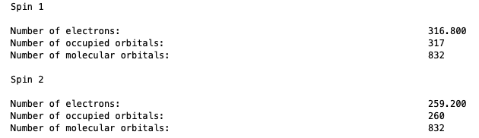
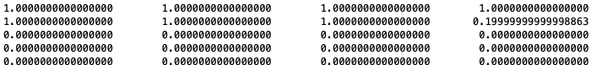


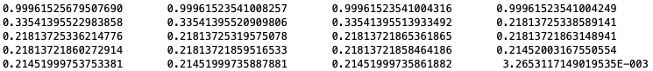


Smearing

