Slide 1


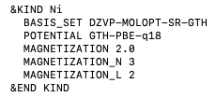
https://github.com/chrisahart/cp2k/tree/nelectron-specify_outer-scf
CP2K code changes
Major:
New keywords (float) for number of electrons NELEC_ALPHA, NELEC_BETA
New keyword (float) EPS_SCF_ARRAY to decrease EPS_SCF through OUTER_SCF
Minor:
New keyword (logical) MUST_CONVERGE aborts CP2K if inner SCF does not converge
New keyword (float) EPS_SCF_MULTIPLIER as an alternative to EPS_SCF_ARRAY
New keywords (integer) MAGNETIZATION_N and MAGNETIZATION_L
&BS section NEL integer is now a float
Bug fixes:
OUTER_SCF now works for BROYDEN_MIXING (buffer reset each OUTER_SCF)
OUTER_SCF now works for DIRECT_P_MIXING (RMS gradient is now calculated correctly)

Slide 2
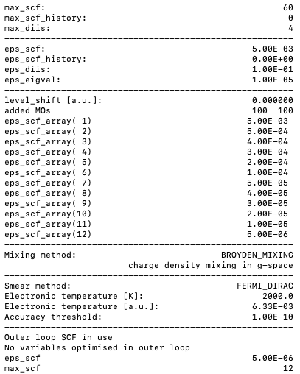

https://github.com/chrisahart/cp2k/tree/nelectron-specify_outer-scf
Decreasing EPS_SCF through OUTER_SCF
EPS_SCF_ARRAY is used to specify EPS_SCF for each OUTER_SCF

Slide 3
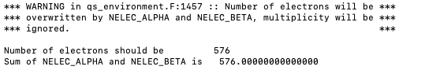
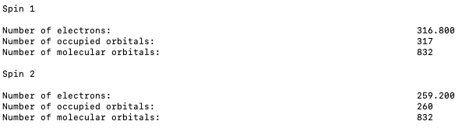
https://github.com/chrisahart/cp2k/tree/nelectron-specify_outer-scf
Manual allocation of electrons
Number of alpha electrons NELEC_ALPHA - CHARGE and beta electrons NELEC_BETA
Sum of NELEC_ALPHA and NELEC_BETA must be an integer
Number of alpha, beta molecular orbitals = CEILING(number of alpha, beta electrons) + ADDED_MOS

Slide 4
Supporting Information

Slide 5
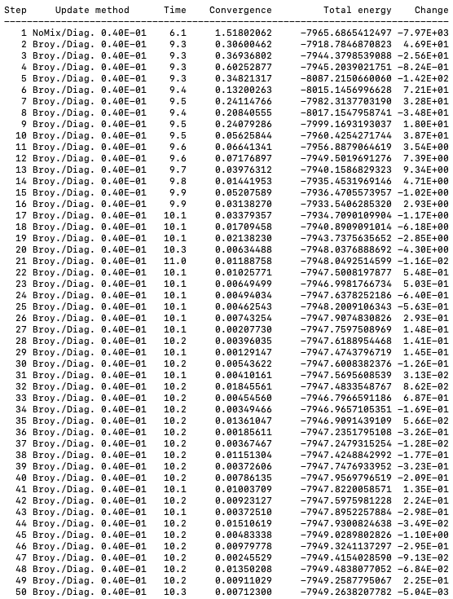
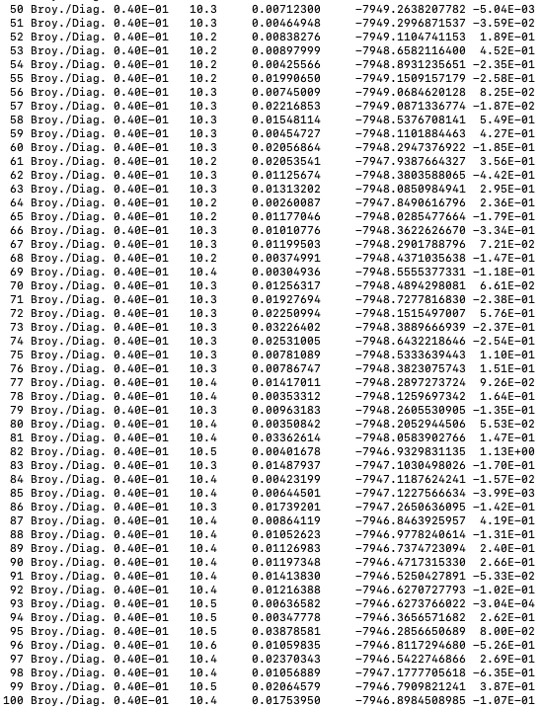
https://github.com/chrisahart/cp2k
Decreasing EPS_SCF through OUTER_SCF

Slide 6
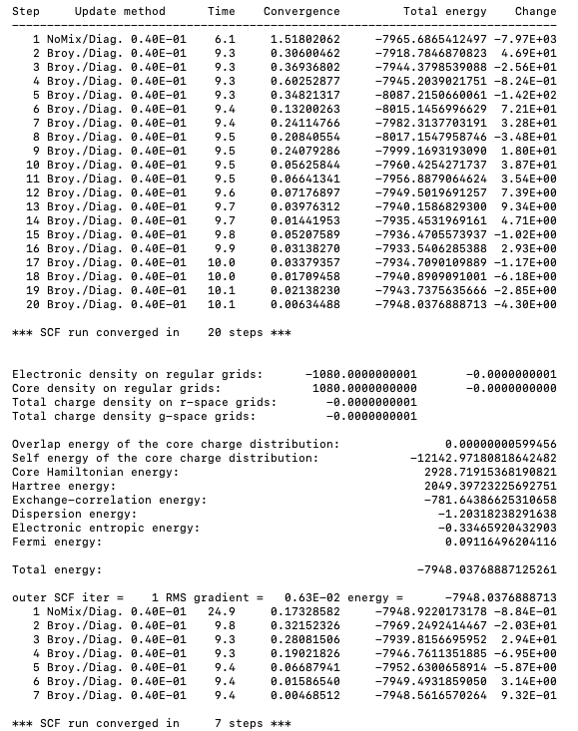
https://github.com/chrisahart/cp2k
Decreasing EPS_SCF through OUTER_SCF

Slide 7
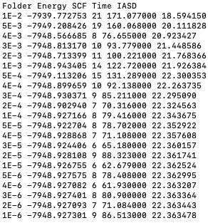
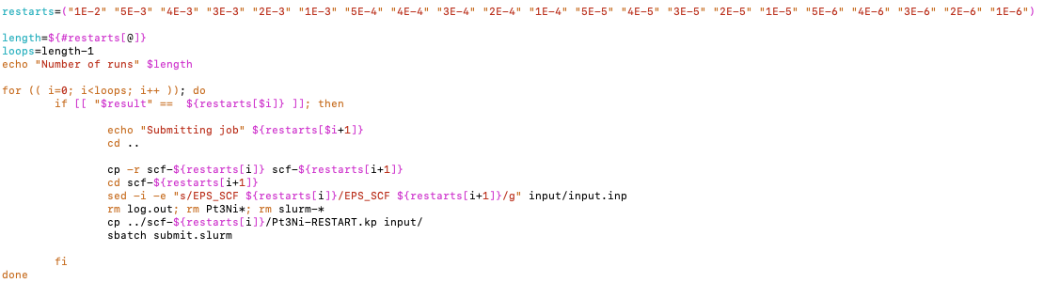
Manual restarts

Slide 8

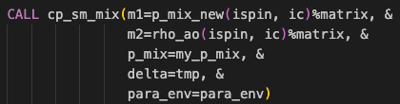
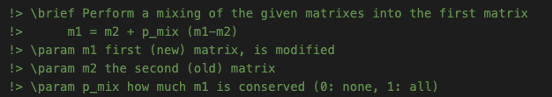
Mixing: DIRECT_P_MIXING
src/qs_scf_methods.F SUBROUTINE scf_env_density_mixing
As a mixing scheme will likely never converge
First SCF step does not perform any mixing, evaluates energy of input density only
Second step performs standard density mixing (ALPHA)

Slide 9


Mixing: BROYDEN_MIXING
src/qs_gspace_mixing.F SUBROUTINE broyden_mixing
Appears to be the most common mixing scheme
First SCF step does not perform any mixing, evaluates energy of input density only
Second step onwards performs Broyden mixing with Kerker preconditioning of the density (ALPHA, BETA, NBUFFER)

Slide 10
Mixing: other schemes
BROYDEN_MIXING_NEW, PULAY_MIXING, MULTISECANT_MIXING and KERKER_MIXING are also implemented
BROYDEN_MIXING_NEW immediately crashes with segmentation fault, as reported on Google group in 2021 [1]
PULAY_MIXING does not appear to ever converge
MULTISECANT_MIXING does not appear to ever converge
KERKER_MIXING does not appear to ever converge
[1] https://groups.google.com/g/cp2k/c/LgIHVLeReck/m/vebZVnpuBgAJ

Slide 11
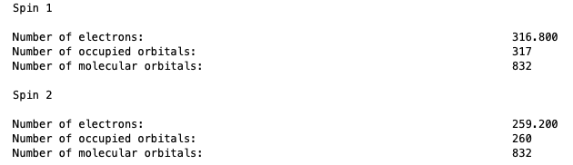
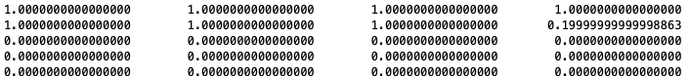


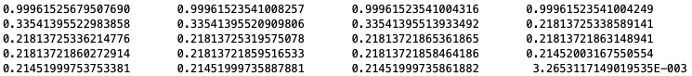


Smearing

