Slide 1
Pt₃Ni

Slide 2
Source | Spin moment Ni, Pt
This work | 0.61, 0.20
[1] VASP PBE | 0.67, 0.16
[2] DFTB | 0.65, 0.16
[3] DFTB | 0.58, 0.10
Pt₃Ni bulk
Pt₃Ni 2x2x2 bulk: 24 Pt atoms, 8 Ni atoms. EPS_SCF=1.0E-6
Multiple minima exist with different Pt spin moments
1D grid search performed for CUTOFF (600), KPOINTS (1x1x1), ADDED_MOS (30), ELECTRONIC_TEMPERATURE (300)
K-points seem to improve interface SCF convergence but decrease bulk convergence
Multiplicity | Magnetization Ni, Pt | Energy / Ha | Spin moment Ni, Pt
1 |  | -4239.1402 | 0.00, 0.00
17 |  | -4239.1402 | 0.00, 0.00
17 | 2.00, 0.00 | -4239.1707 | 0.63, 0.00
17 | 2.00, 0.00 | -4239.1712 | 0.63, 0.10
17 | 2.00, 0.00 | -4239.1743 | 0.61, 0.21
[1] Sharma, B. K., Kwon, O., Odkhuu, D. & Hong, S. C. Electronic structure and magnetism of various surfaces of the catalytic material Pt3Ni: Density-functional study. Journal of Magnetism and Magnetic Materials 339, 89–93 (2013).
[2] Paudyal, D., Saha-Dasgupta, T. & Mookerjee, A. Magnetic properties of X–Pt (X = Fe,Co,Ni) alloy systems. J. Phys.: Condens. Matter 16, 2317–2334 (2004).
[3] Singh, P. P. Relativity and magnetism in Ni–Pd and Ni–Pt alloys. Journal of Magnetism and Magnetic Materials 261, 347–352 (2003).

Slide 3
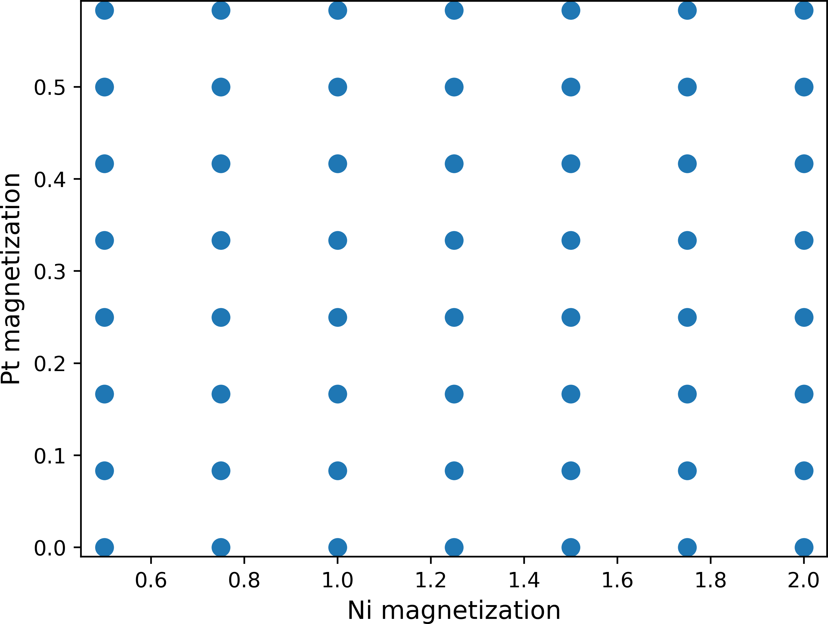
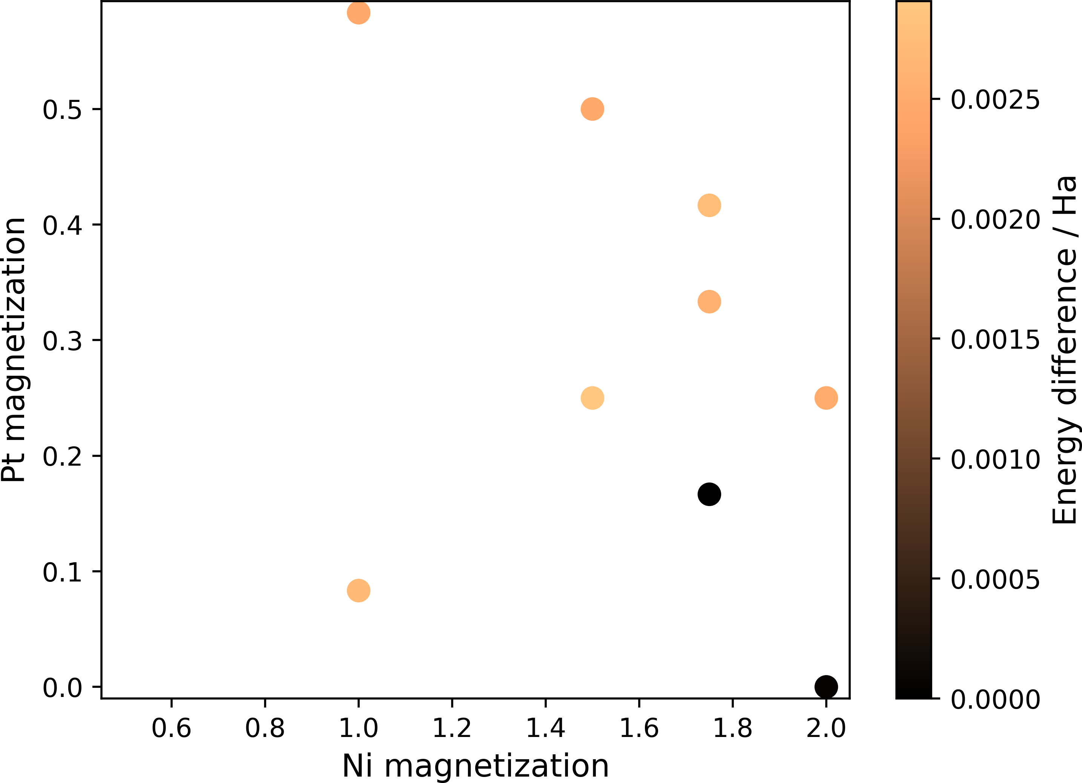
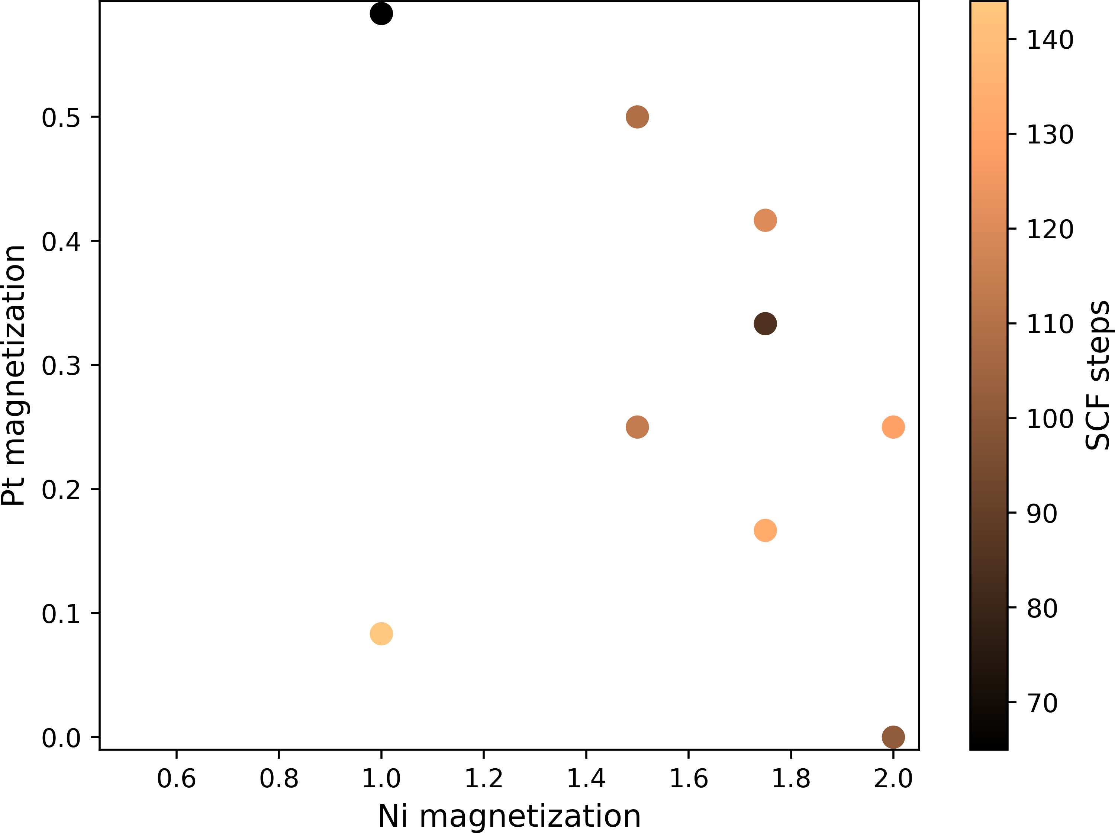
Pt₃Ni bulk optimization
Pt₃Ni 2x2x2 bulk: 24 Pt atoms, 8 Ni atoms. EPS_SCF=5.0E-7
8x8 2D grid search for Pt, Ni magnetisations which sum to odd integer multiplicity
Minimum at Ni=2.0, Pt=0.0. Finite Pt magnetisation does not improve convergence

Slide 4
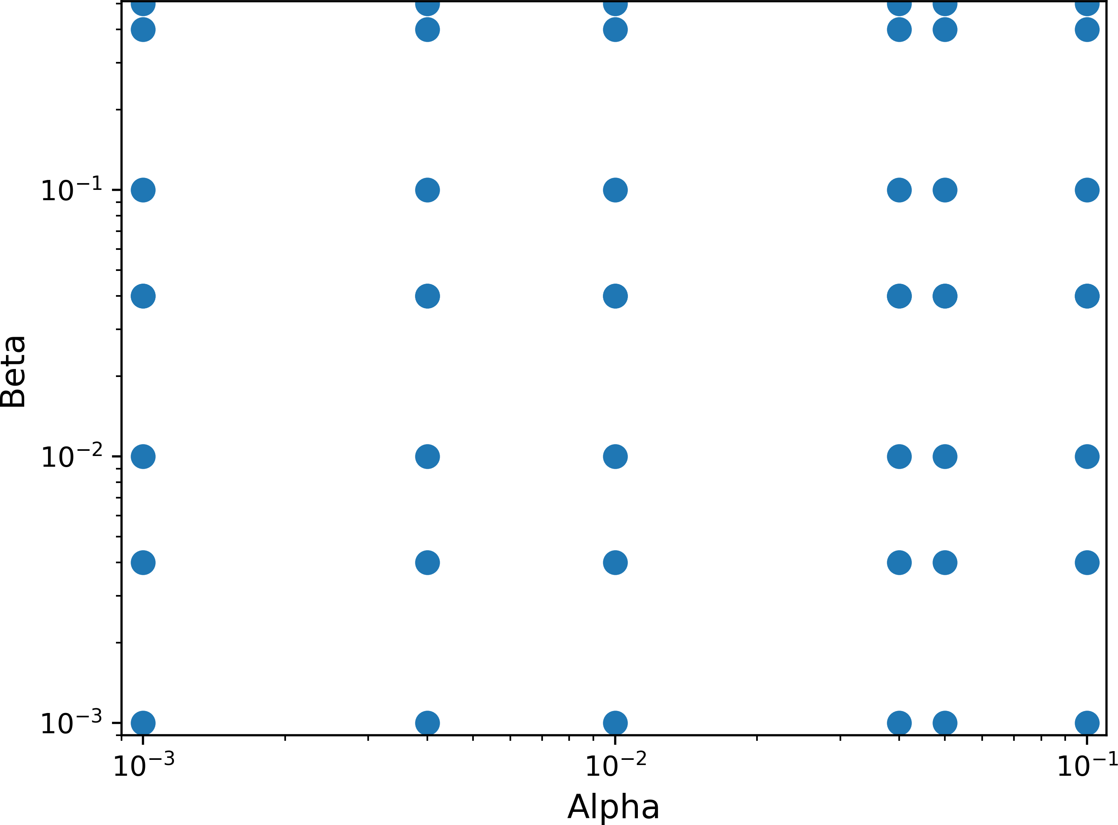
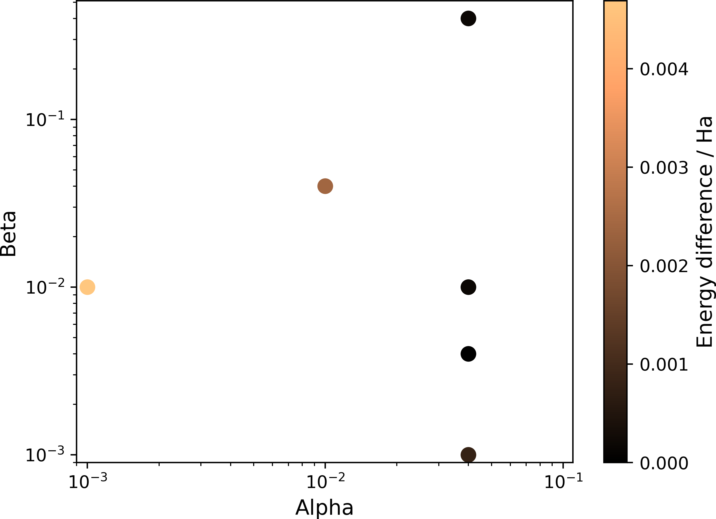
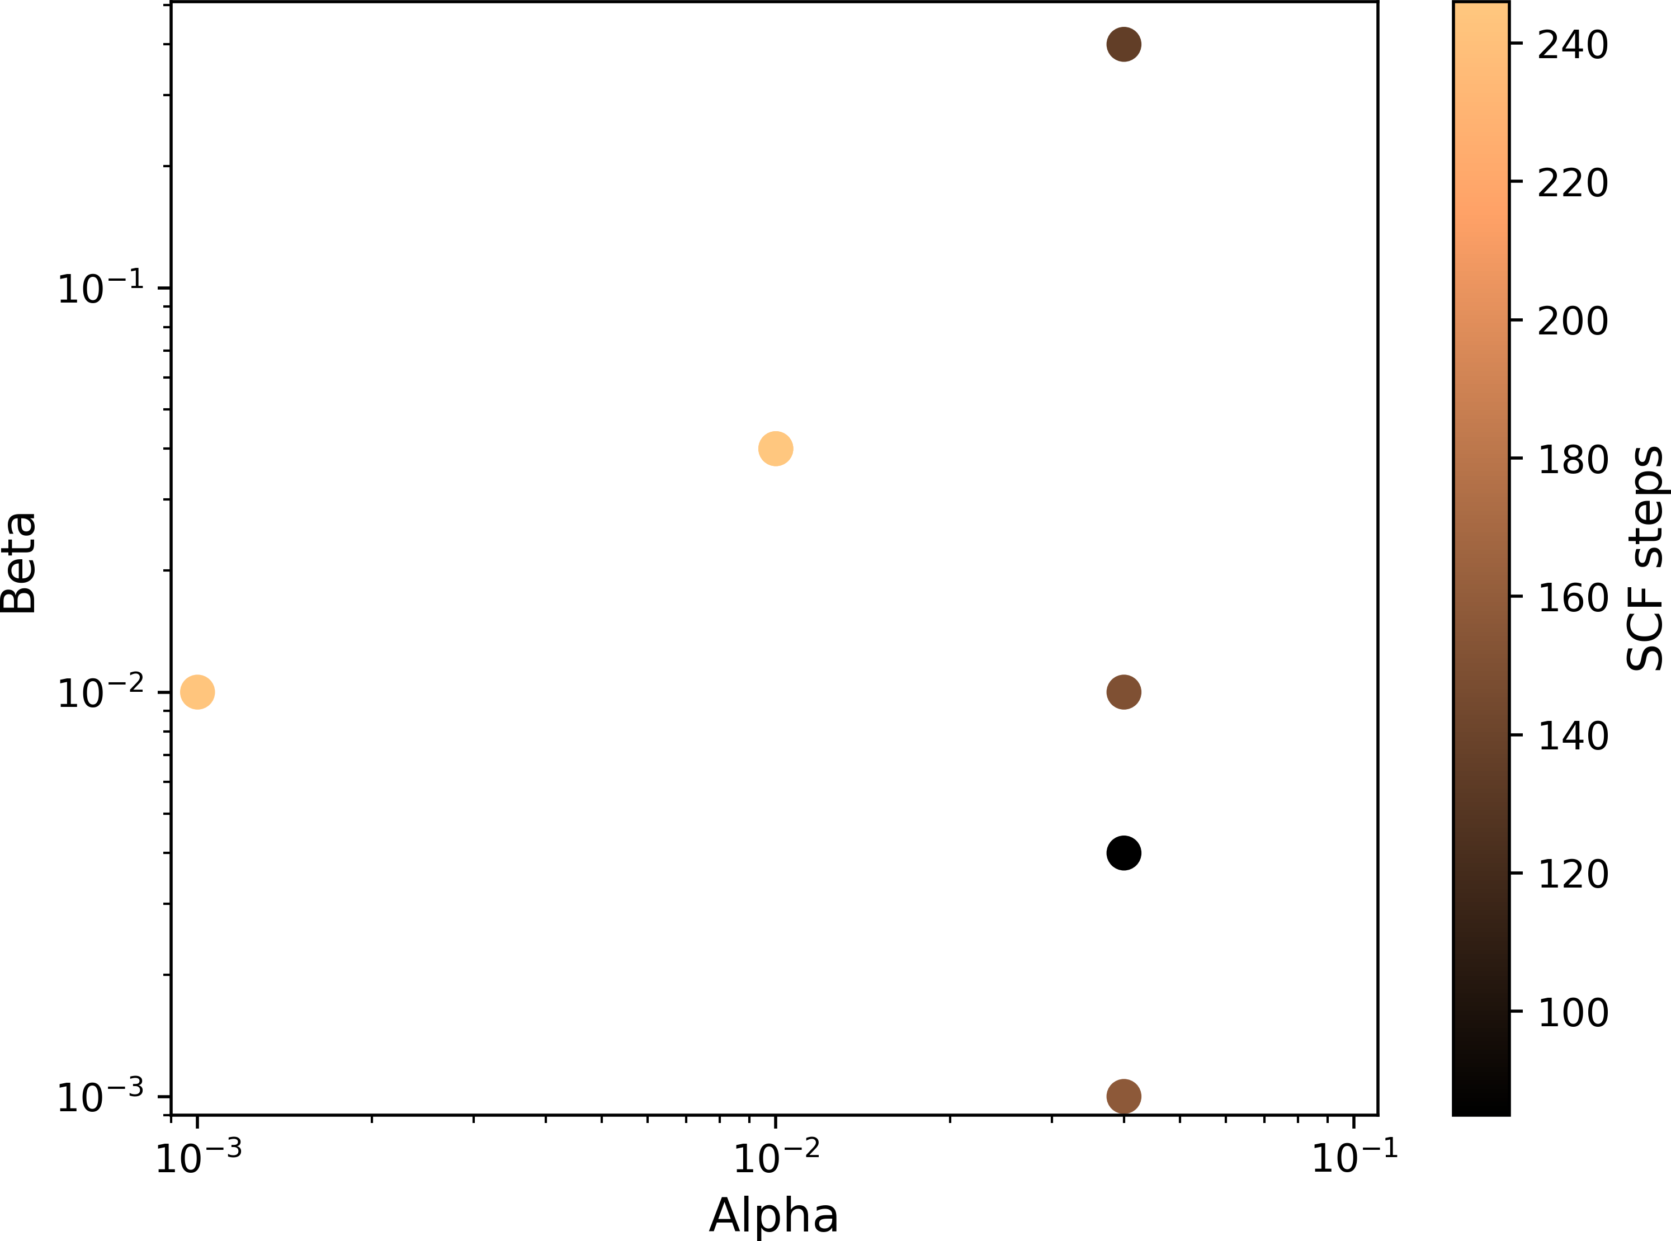
Pt₃Ni bulk optimization
Pt₃Ni 2x2x2 bulk: 24 Pt atoms, 8 Ni atoms. EPS_SCF=1.0E-6
8x8 2D grid search for BROYDEN_MIXING ALPHA, BETA
Minimum at ALPHA=4.0E-2, BETA=4.0E-3

Slide 5
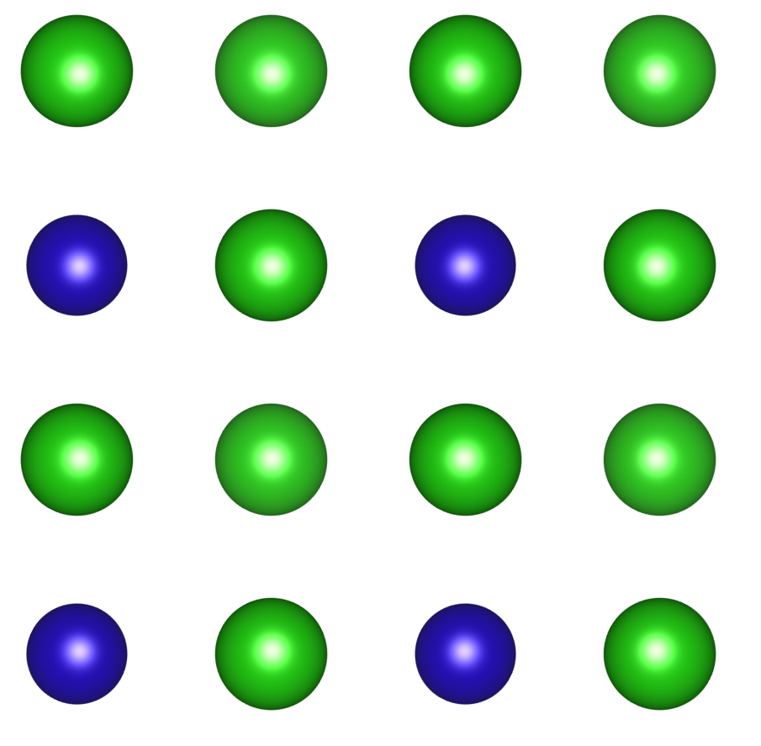
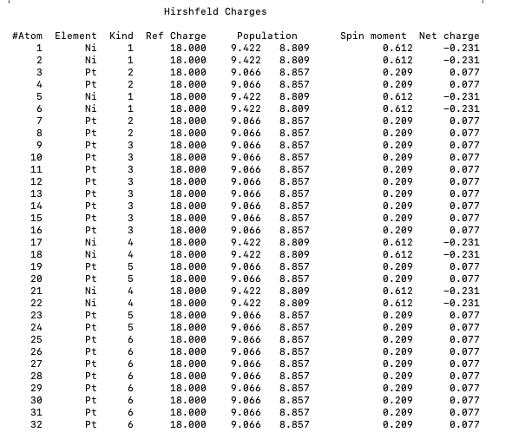
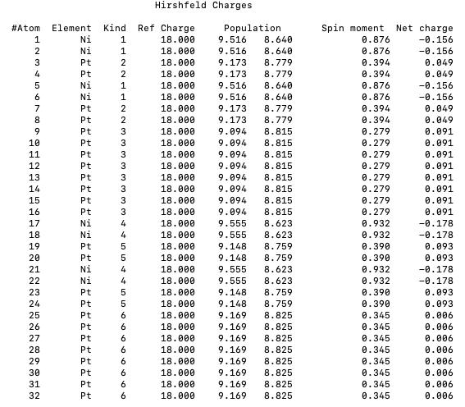
Pt₃Ni(001) slab in vacuum
0.345
0.932, 0.390
0.279
0.876 , 0.394
6
4
5
Convergence is challenging, EPS_SCF=1E-7 required 12 restarts to converge EPS_SCF=5.0E-7
Slab (right) spin moments larger than bulk (left), consistent with literature [1]
3
1
2
[1] Sharma, B. K., Kwon, O., Odkhuu, D. & Hong, S. C. Electronic structure and magnetism of various surfaces of the catalytic material Pt3Ni: Density-functional study. Journal of Magnetism and Magnetic Materials 339, 89–93 (2013).

Slide 6
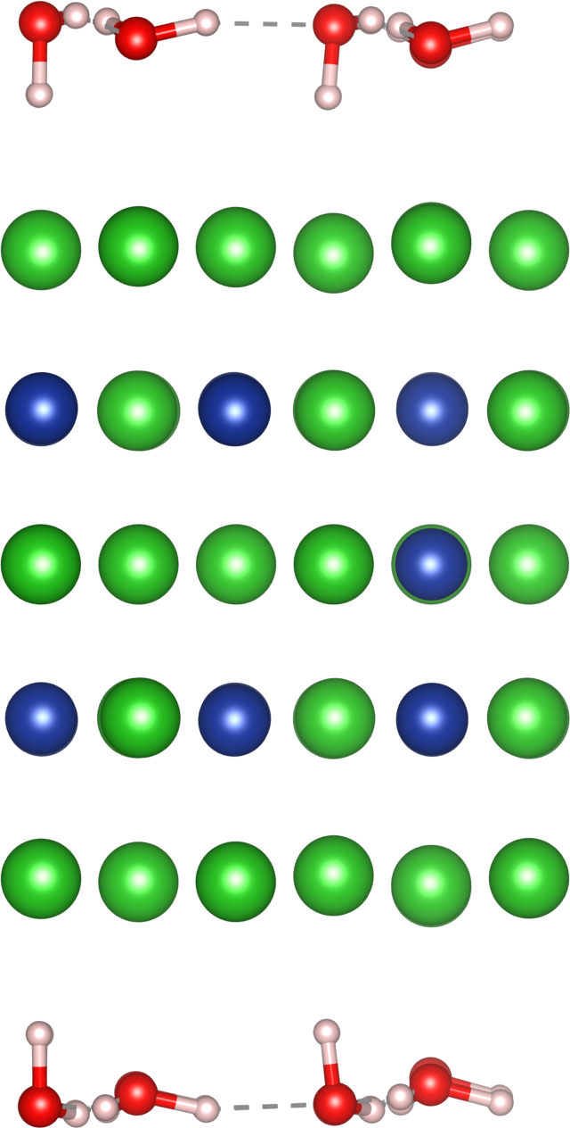
Pt₃Ni(111) Yike structure
1
Pt₃Ni(111) surface calculated by Yike using VASP. 45 Pt atoms, 15 Ni atoms
CUTOFF (600), ADDED_MOS (30), ELECTRONIC_TEMPERATURE (300)
2
3
4
5
2
3
Kpoints | Multiplicity | Energy / Ha | IASD | SCF steps | Restarts
1x1x1 | (0*15)+1=1 | -8223.3280 | 0.0 | 85 | 0
1x1x1 | (2*15)+1=31 | -8223.4133 | 28.6 | 286 | 19
4x4x1 | (0*15)+1=1 | -8223.6260 | 0.0 | 74 | 0
4x4x1 | (2*15)+1=31 | -8223.6865 | 24.4 | 245 | 19
1
[1] Sharma, B. K., Kwon, O., Odkhuu, D. & Hong, S. C. Electronic structure and magnetism of various surfaces of the catalytic material Pt3Ni: Density-functional study. Journal of Magnetism and Magnetic Materials 339, 89–93 (2013).

