Slide 1
Flacco – Expensive Features
Data Analytics 1 – Case Study Group 03

Slide 2
Agenda
Introduction
Exploratory Landscape Analysis, Cell Mapping Techniques
Flacco Dataset
Data Preprocessing
Visualization
Normality (Tests, Transformation)
Outlier Detection
Unsupervised Learning
Principal Component Analysis
Multi-Dimensional Scaling
Clustering

Slide 3

Visualization
Image: https://www.salesscreen.com/theartofsales/data-visualization/

Slide 4
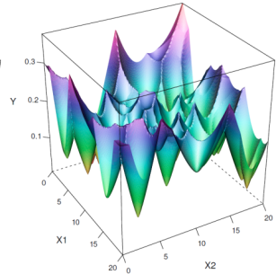
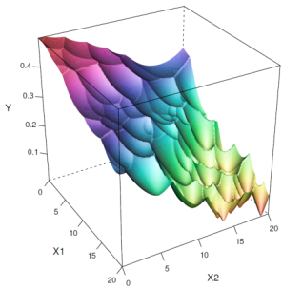


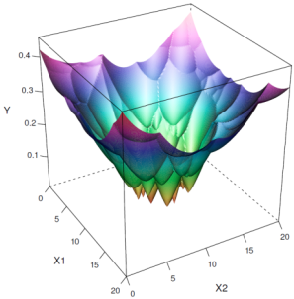

Exploraty Landscape Analysis (ELA)
analysis of Black-box Optimization Problems
Different problem instances …
… require different opt. algorithms
“ELA aims at characterizing the problem landscape and deriving rules for determining how problem properties influence algorithm performance”
Kerschke, P., Preuss, M., Wessing, S., Trautmann, H., Detecting Funnel Structures by Means of Exploratory Landscape Analysis 2015.
Notes:
Introduce basic idea of ELA

Slide 5
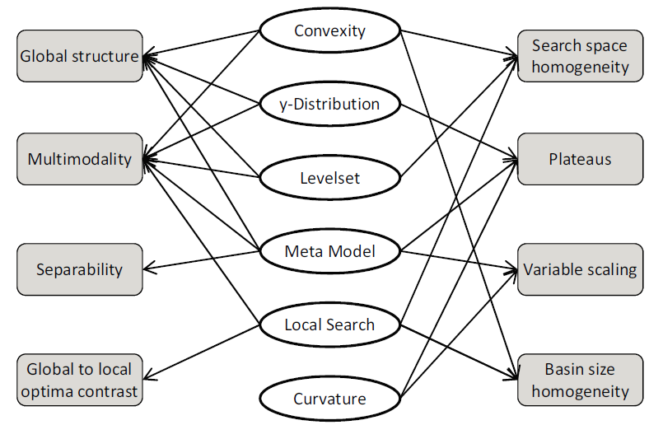

Exploraty Landscape Analysis (ELA)
ELA-Featureset
Unknown problem landscape …
… are overcome by ELA features
High dimensionality
Large landscape
Computational effort
Image: http://medcitynews.com/wp-content/uploads/Black-Box-Art.png
Mersmann, O., Bischl, B., Trautmann, H., Preuss, M., Weihs, C., Rudolph, G., Exploratory Landscape Analysis in Proceedings of GECCO 2011, pp. 829-836.
Notes:
How to overcome the unknown problem landscape? Introduction of high / low level ELA features.
High-level features in rectangles.

Slide 6
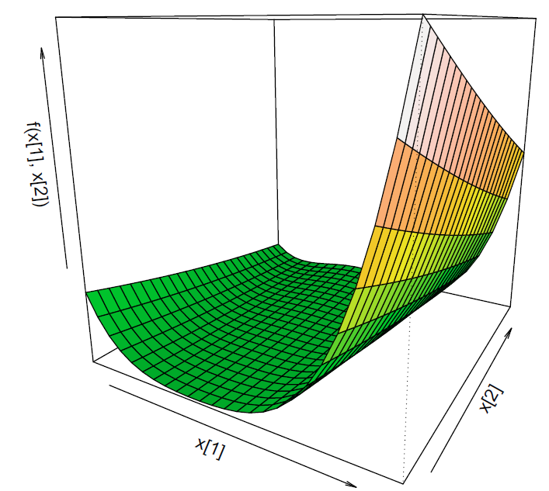
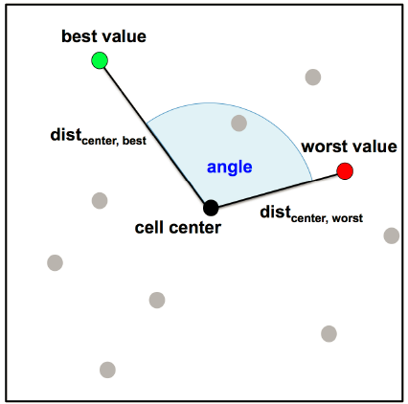
Cell Mapping Techniques (CM)
Broadening the ELA-Featureset
Cell mapping features give insight on global properties
Relatively cheap to compute
Kerschke, P., Preuss, M., Hernandez, C., Schütze, O., Sun, J.-Q., Grimme, C., Rudolph, G., Bischl, B., Trautmann, H.,
Cell Mapping Techniques for Exploratory Landscape Analysis in EVOLVE 2014, pp. 115-131.
Notes:
Cell mapping employs this discretization for dividing the state space into hypercubes.
Cells help to get insight in global landscape.

Slide 7
Thank you for your attention
Christian Siemen (394724)

