Slide 1
Flacco

Slide 2

Principal Component Analysis
Image: http://www.marksanborn.com/wp-content/uploads/2013/04/Screen-Shot-2013-04-03-at-11.58.31-AM1.png

Slide 3

Preparing the PCA
Scale of data varies largely
Feature ranges
cm_grad.mean: [0.12, 0.68]
ela_local.fun_evals.median: [20, 87]
ela_curv.grad_scale.max [58.73, 17054.68]
Overall Range: [-0.09, 17319.62]
Conclusion:
use correlation matrix as basis
Image: https://image.freepik.com/free-icon/below-sea-level_318-32748.png

Slide 4
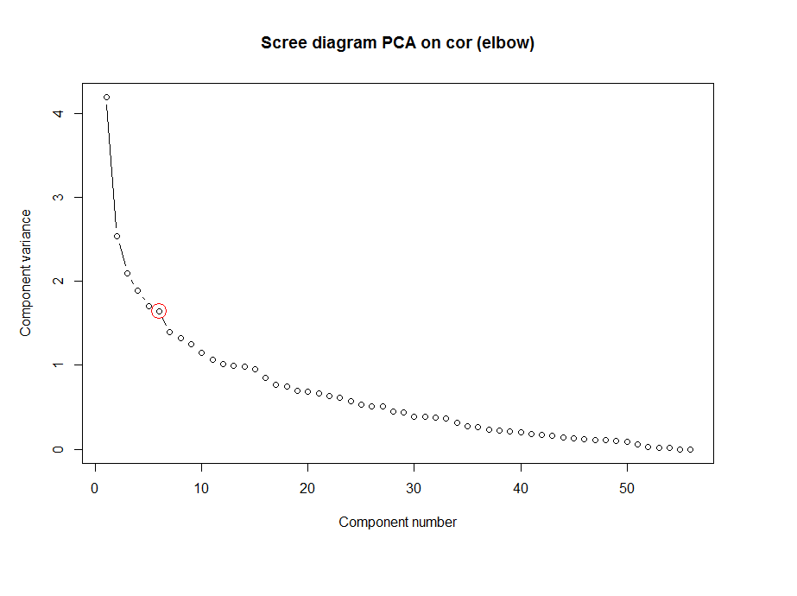
Choosing the right number of PCs
Variance levels
11 PCs explain 80% of overall variance
17 PCs explain 90% of overall variance
Scree diagram shows kink after 6 PCs
6 PCs explain 68% of variance
Practical amount for further analysis

Slide 5
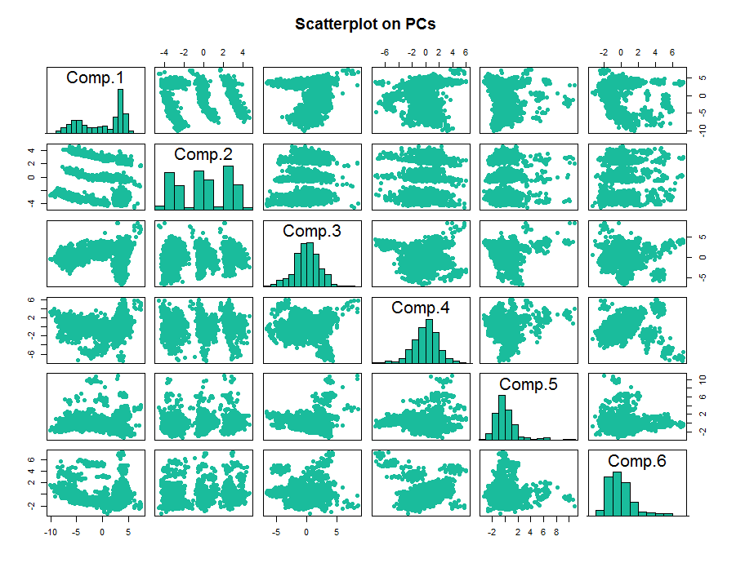
Scatterplots of Pcs
Data points could be clustered

Slide 6
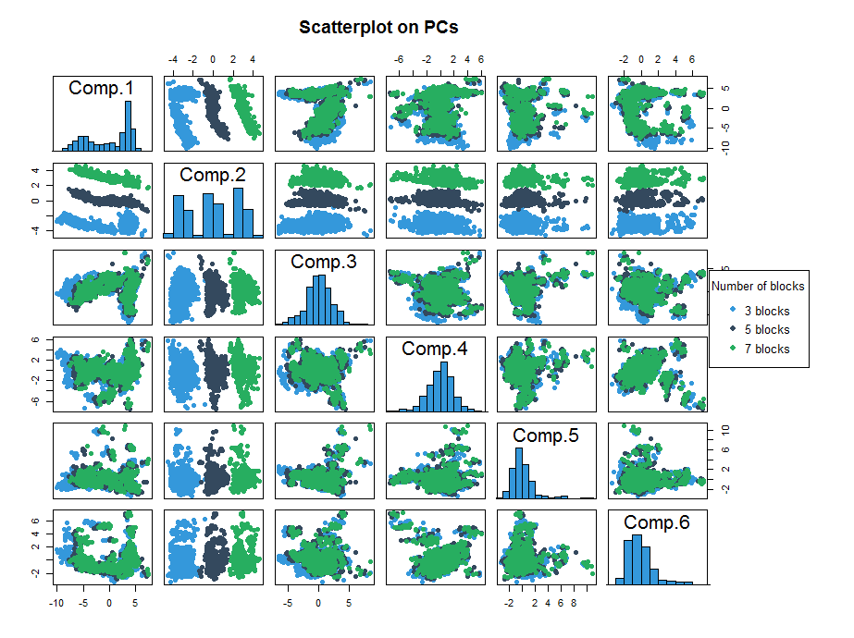
Scatterplots of Pcs (Blocks)
Number of Blocks co-determines clusters
Notes:
Clusters especially for PC2

Slide 7
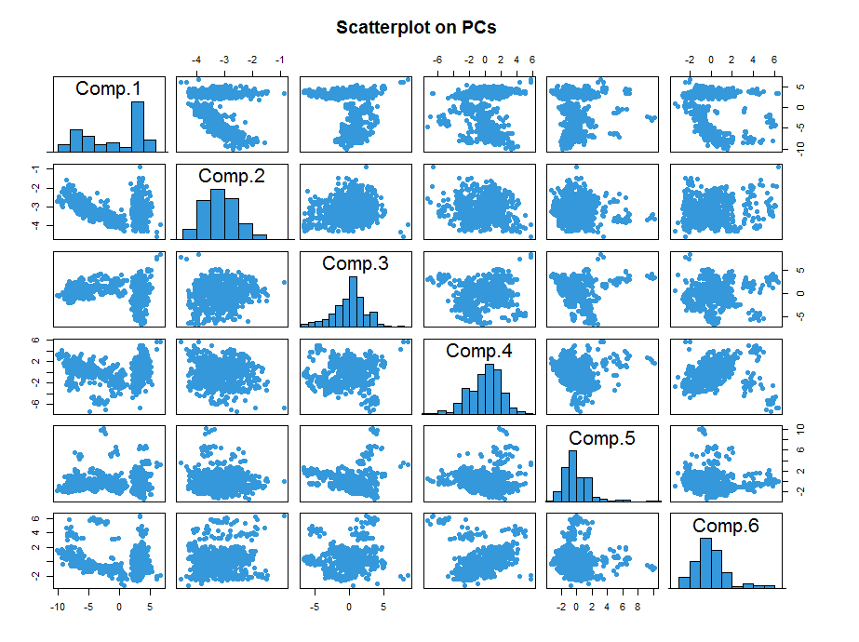
Scatterplots of Pcs (3 blocks only)
Further clusters exist, regardless of the number of blocks

Slide 8
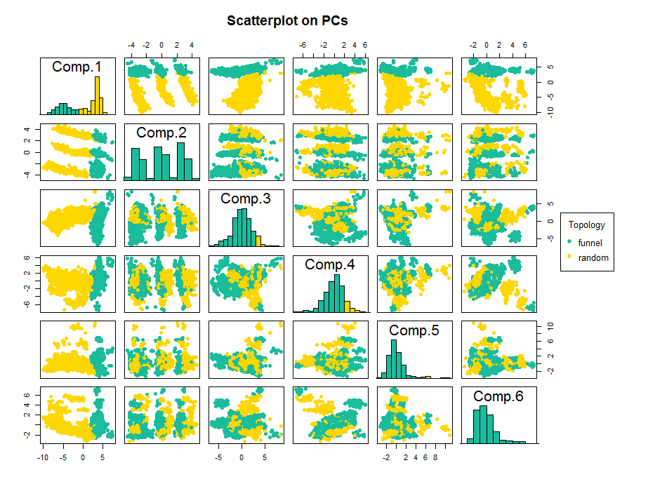
Scatterplots of Pcs (topology)
Non-meta Feature Topology co-determines clusters
Notes:
Clusters especially for PC1

Slide 9
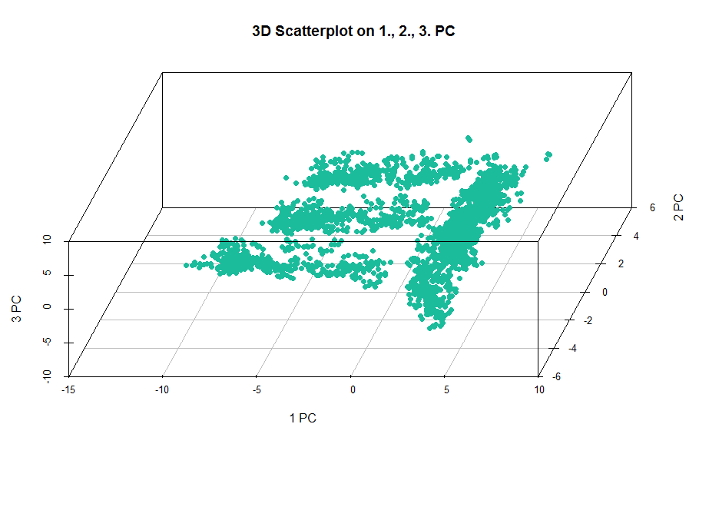
3d Scatterplot of first 3 PCs
Clusters are visible

Slide 10
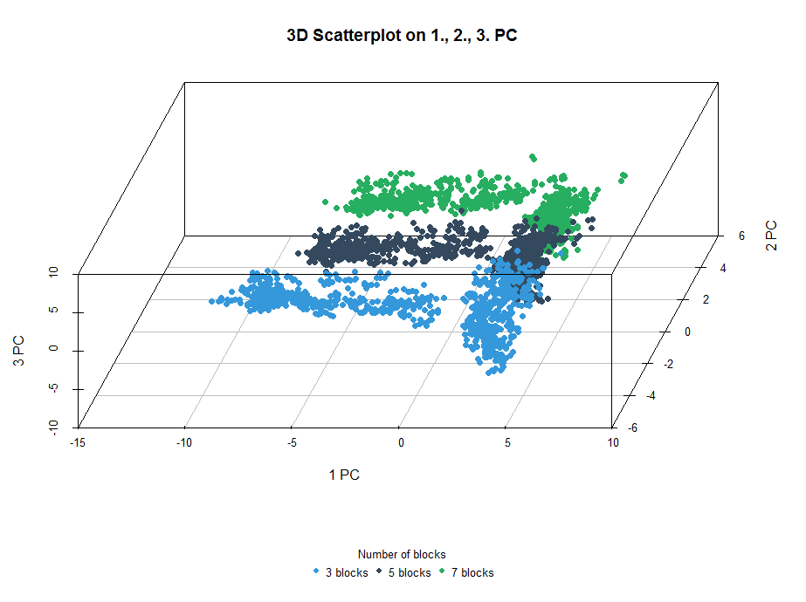
3d Scatterplot of first 3 PCs (Blocks)

Slide 11
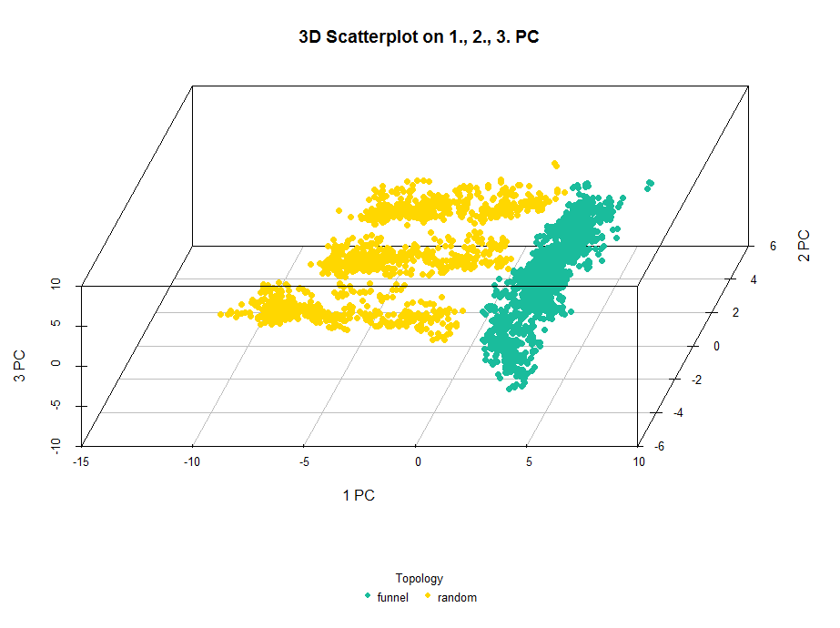
3d Scatterplot of first 3 PCs (Topology)

Slide 12
References

