Slide 1
Data hazards

Slide 2
Data hazard
IF
ID
MEM
WB
addi $s0, $0, 5
IF
ID
MEM
WB
add $s2,$s1,$s0
IF
ID
MEM
WB
add $s3,$s1,$s0
IF
ID
MEM
add $s4,$s1,$s0
1 2 3 4 5 6 7
Time->

Slide 3
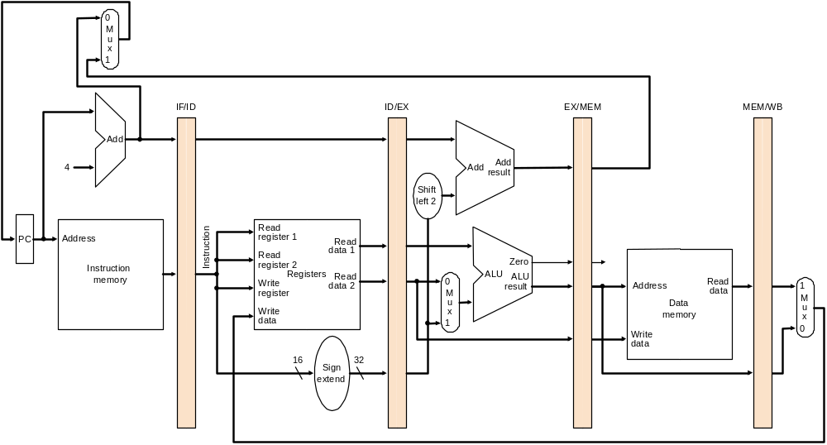
Data hazard

Slide 4
Data hazards
Needed data value:
Solution:

Slide 5
How to detect a data hazard

Slide 6
Forwarding for EX hazards

Slide 7
Forwarding for MEM hazards

Slide 8
With Forwarding
IF
ID
MEM
WB
add $s0, $0, $0
IF
ID
MEM
WB
add $s2,$s1,$s0
IF
ID
MEM
WB
add $s3,$s1,$s0
IF
ID
MEM
add $s4,$s1,$s0
1 2 3 4 5 6 7
Time->

Slide 9
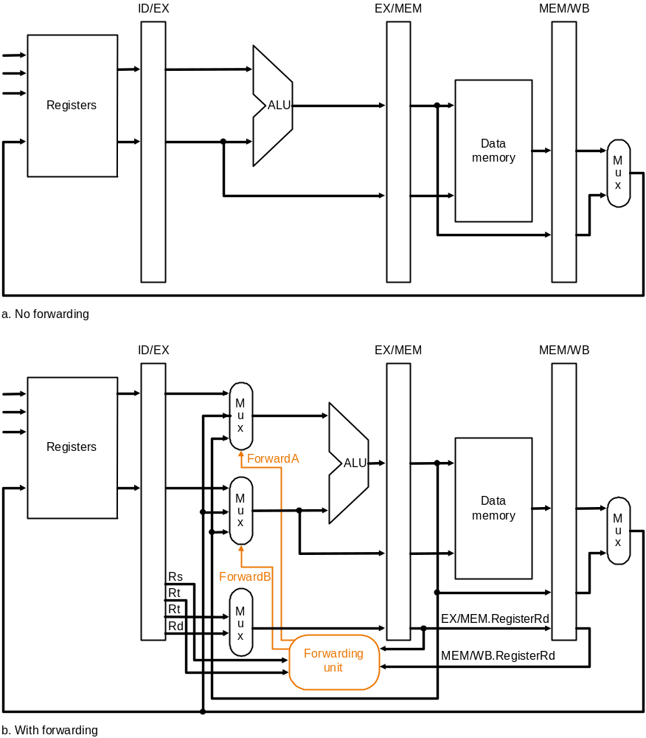

Slide 10
Forwarding limitations
Forwarding fixes most problems
Except one:

Slide 11
Use after Load
IF
ID
MEM
WB
lw $2, 0($1)
IF
ID
MEM
WB
add $4, $2, $3
1 2 3 4 5 6 7
Time->

Slide 12
Solution: Use after Load
IF
ID
MEM
WB
lw $2, 0($1)
IF
add $4, $2, $3
1 2 3 4 5 6 7
Time->

Slide 13
How to detect a use-after-load

Slide 14
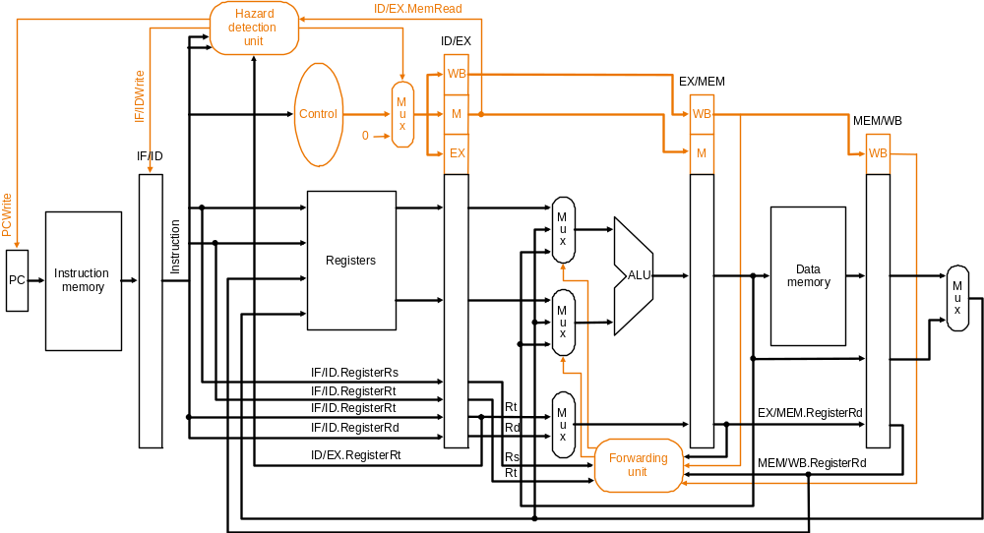

Slide 15
Eliminating pipeline stalls

