Slide 1
Generative Quantum Eigensolver
Pooja Rao, Senior Quantum Algorithm Engineer, NVIDIA

Slide 2
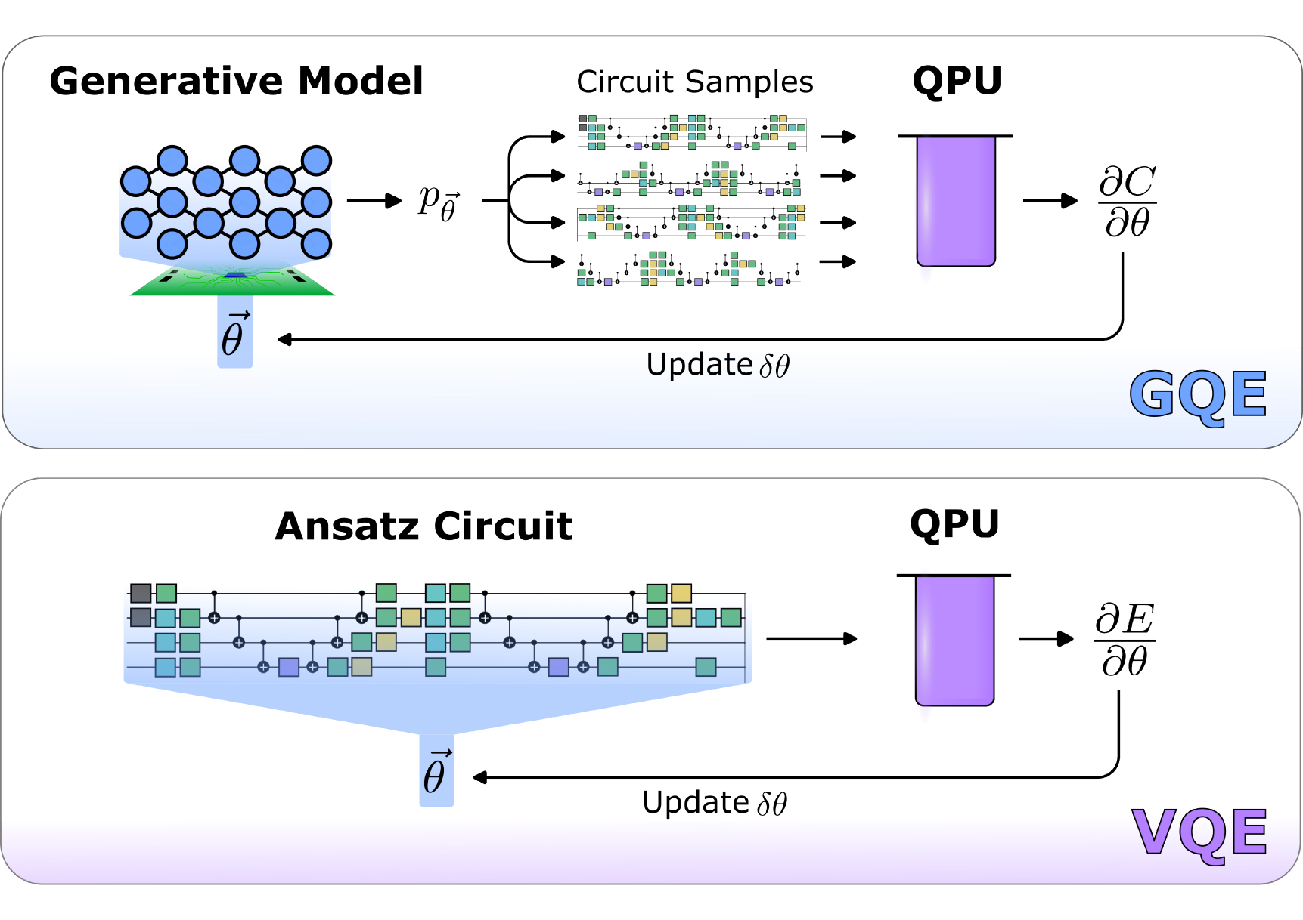



The Generative Quantum Eigensolver
The first demonstration of a GPT-generated quantum circuit in the literature
In VQE, the parameters to be optimized are a part of the quantum circuit computation.
Training and optimization limitations such as local minima for small-medium range for number of qubits and barren plateau for higher number of qubits.
The idea is to leverage the training capabilities and scalability of classical models to overcome the above limitations.
Circuit evaluations can be used in a classical machine learning feedback loop to train the weights in the neural network via a provided cost function
Each training epoch can produce more accurate circuits (based on the supplied cost function) without the need for a search over the valid circuit space such as in VQE.
https://arxiv.org/pdf/2401.09253.pdf

Slide 3
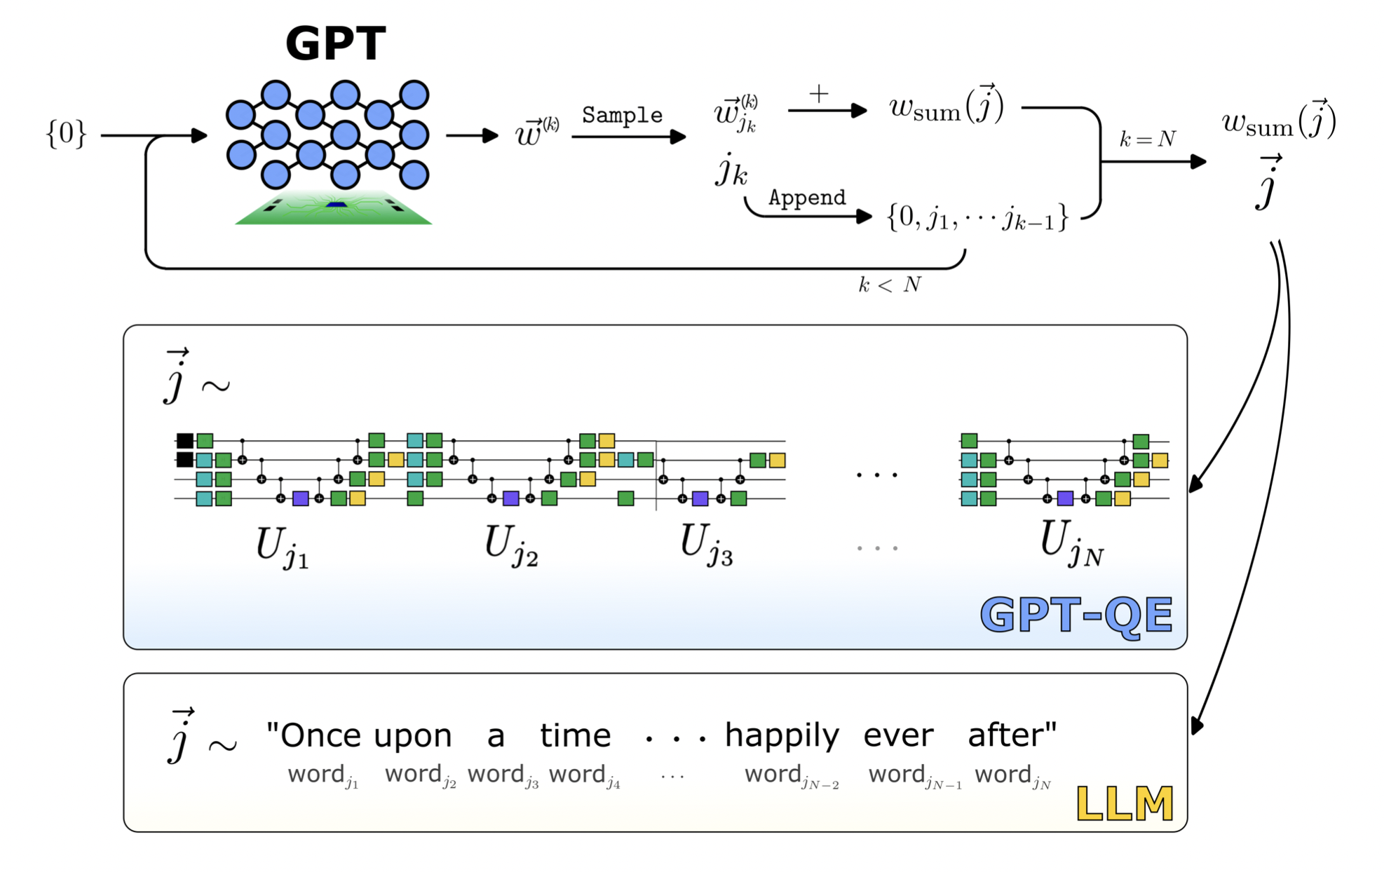
Generative Pre-trained Transformer Quantum Eigensolver
The first demonstration of a GPT-generated quantum circuit in the literature
Use the logic of the GPT architecture
Quantum Gates are analogous to words (tokens)
Quantum Circuits to sentences
https://arxiv.org/pdf/2401.09253.pdf

Slide 4
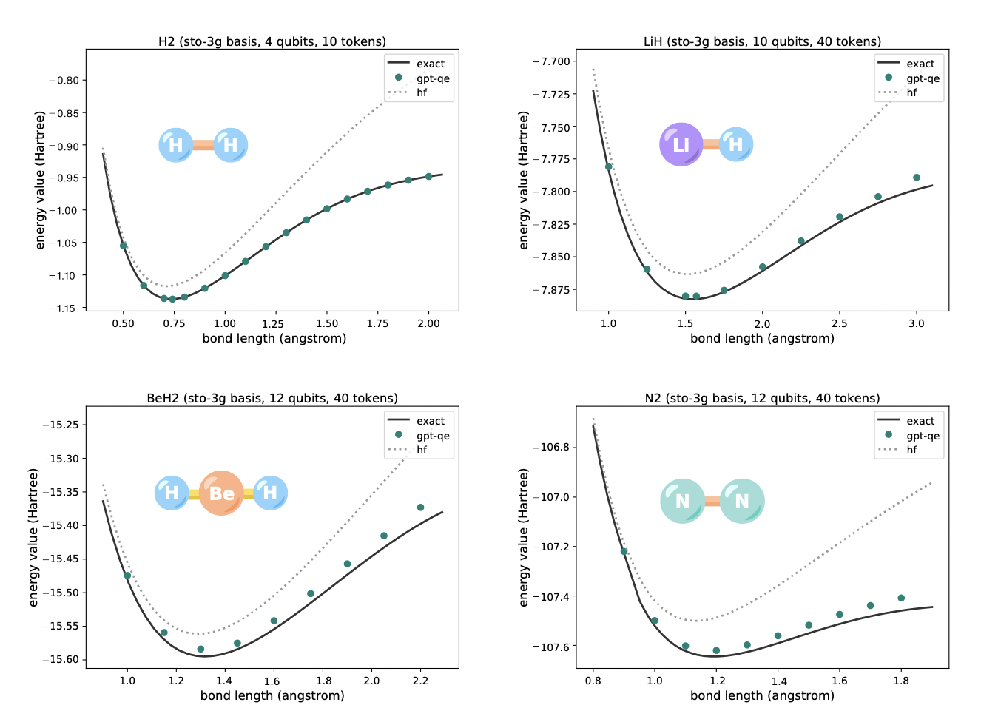
Ground state search
Verification
A powerful example of leveraging AI to accelerate quantum computing
Executed using CUDA Quantum on A100 GPUs on Perlmutter
Opens the door to a wide variety of novel Generative Quantum Algorithms (GQAs) for drug discovery, materials science, and environmental challenges
https://arxiv.org/pdf/2401.09253.pdf

Slide 5
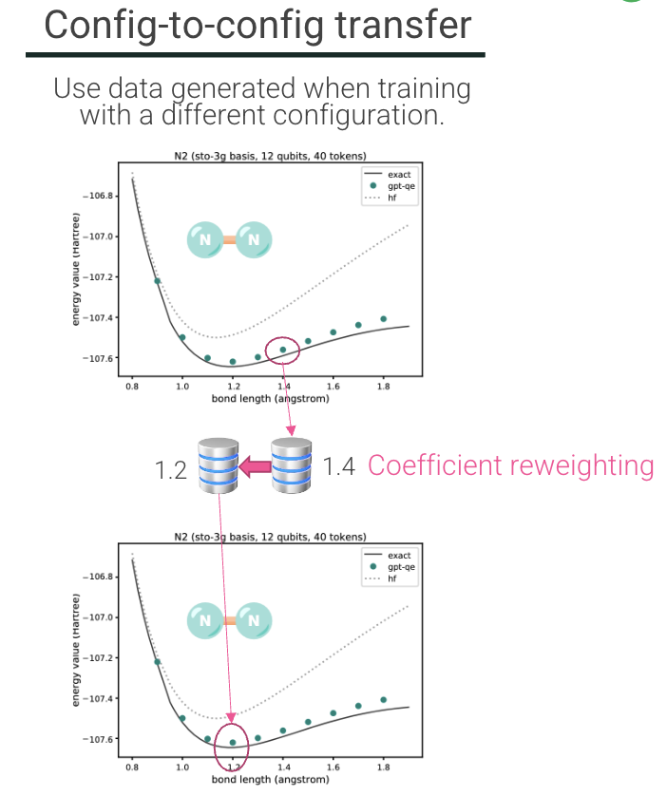
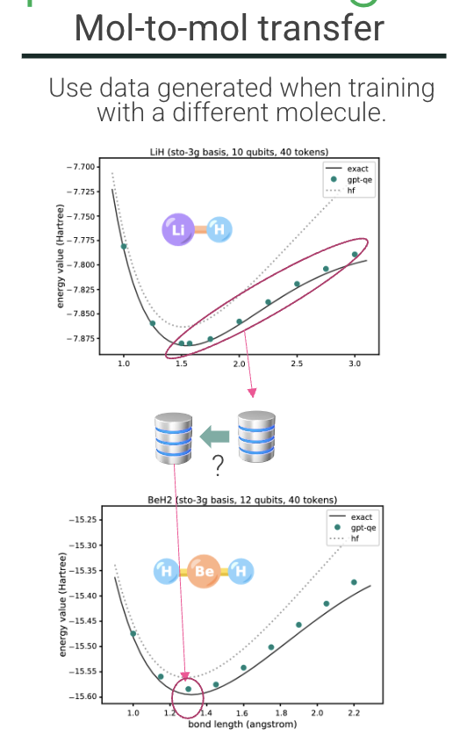
Pretraining
Possible ways to extend GQE
Using existing datasets of circuits and their expectation values, an entirely classical pretraining approach can be used in the GQE framework.
Model-to-model: Runs from an existing model can be used to train a modified network architecture for the same Hamiltonian and molecular configuration.
Config-to-config: Data from an existing molecular configuration can be used to in a pretraining configuration for a modified molecular configuration (e.g. a different distance).
Molecule-to-molecule: The most powerful pretraining example would use training data from one molecule to pretrain for a different molecule. This is not as straightforward as the other examples, requiring additional extensions to the base model.
https://arxiv.org/pdf/2401.09253.pdf

Slide 6
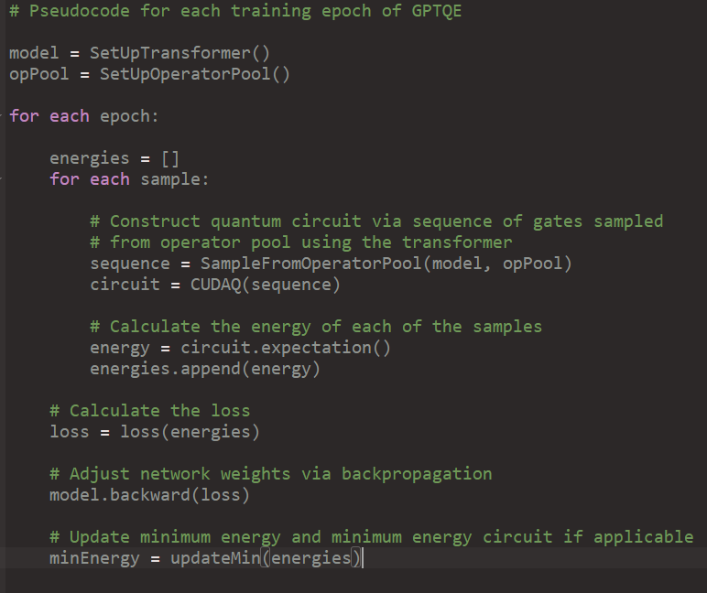
GPTQE Model Implementation
Training for the GPTQE Model using CUDA-Q
Set up the transformer model. E.g. number of layers, learning rate, etc.
Set up the operator pool.
For ground state energy of a molecule, operator pool consists of all combinations of Pauli Strings from the UCCSD operators (i.e. [IYZX, XXYX, XYYY, YXYY, YYYX, YZXI, IIII] for H2) and a chosen set of times ([0.003125,0.00625, …]) for trotter evolution.
For the H2 ground state search, the operator pool looks like [(IYZX, 0.003125), (IYZX, 0.00625), …, (XXYX, 0.003125), (XXYX, 0.00625), …].
Each training epoch does the following
For each circuit sample do the following
Transformer picks a sequence of a specified # of operators from this pool to construct a circuit.
The circuit is constructed from each of these sequences by Trotterizing the Pauli words over the specified times.
The circuit is evaluated to find the energy
Pseudocode

Slide 7
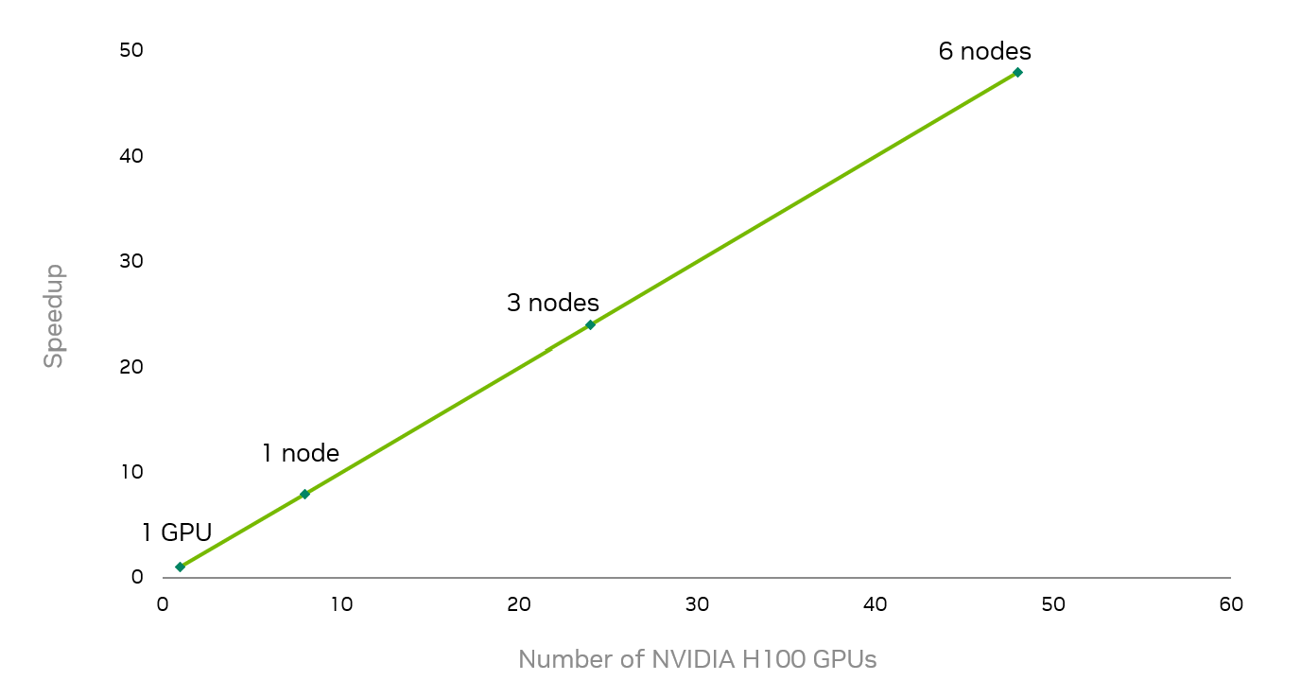
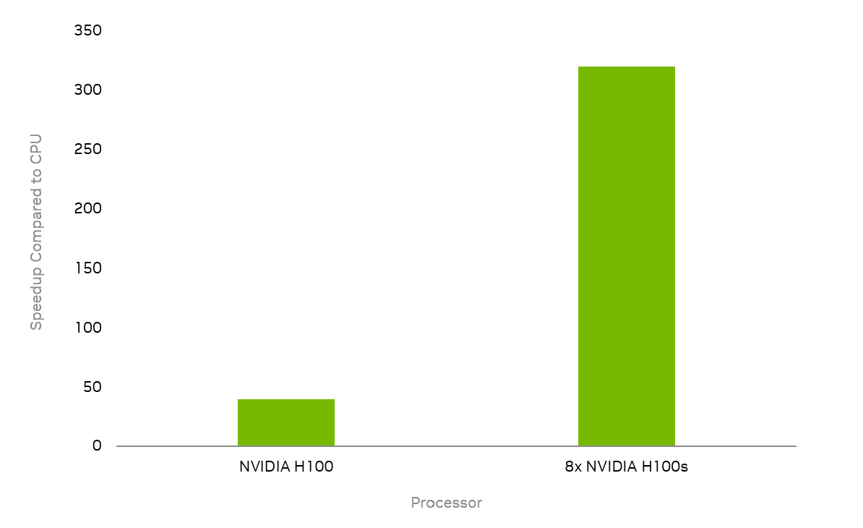
Multi-GPU Simulations
Utilizing CUDA-Q with GQE allows for multi-node multi-gpu parallelization with excellent scaling and performance
Ground state search for the CO₂ molecule using STO-3G basis with 30 qubits has been run on up to 48 NVIDIA (6 nodes) H100 GPUs.
Number of terms in the molecular Hamiltonian is 11433.
Operator pool consists of all the Pauli strings from the UCCSD operators combined with the chosen times for evolution.
Size of the operator pool for CO2 considered here is 21420. ((number of pauli strings=1785) * 12 = 21420)
For each of transformer generated circuit samples (48 here), 60 Pauli strings are chosen from the Operator Pool (tokens) and trotterized for the chosen times (converted to unitaries).
Scaling of 30-qubit CO₂ run with multi-node multi-QPU simulation
~40x speedup over CPU for 18-qubit CO2 runs. CPU runs did not succeed for the 30-qubit simulation.
320x over multi-core CPU​
40x over CPU with 56 cores
https://arxiv.org/pdf/2401.09253.pdf

Slide 8
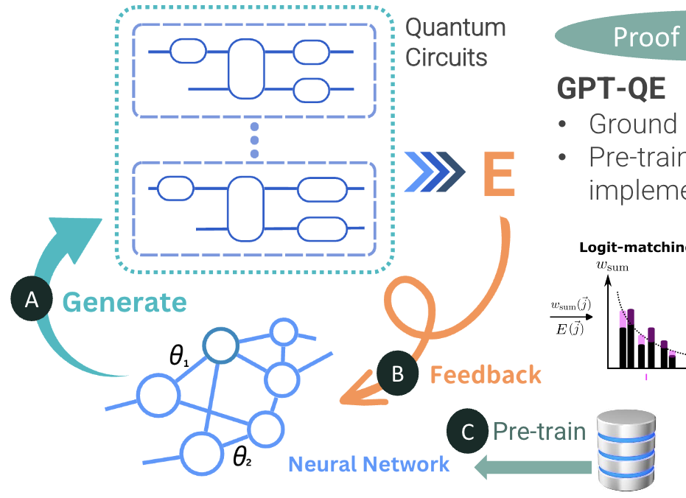
Extension of the Model to Other domains
The results from this collaboration are just the first step towards understanding how GPT models could enable quantum accelerated supercomputing.
Key benefits of the GQE is that the Hamiltonian and valid gate set (operator pool), can be swapped out easily to explore applications beyond chemistry.
New applications : QAOA, Quantum Geometric Machine Learning, etc.
Code to be made publicly available alongside CUDA-Q 0.8 release.
C
https://arxiv.org/pdf/2401.09253.pdf

Slide 9
Thank you

