Slide 1
Precision Interfaces Section Meeting

Slide 2
Section Meetings
Teams prepare a short presentation (max 5 slides) to share
1. goals & achievements
2. 1+ interesting things
3. Next steps
Paper Discussion/Presentations

Slide 3
6/8 Agenda
Updates on Warmup Tasks
Paper Discussion
Next Week
Read S4 and construct an explanation of the main concepts (in your opinion) via a simple example
What subset of the interface spec in github is SIGMOD 19 capable of expressing?
What are the limitations of the cost function and what should it also consider? For a suggestion, come up with a naïve function.

Slide 4
6/1 Agenda
Updates on Warmup Tasks

Slide 5
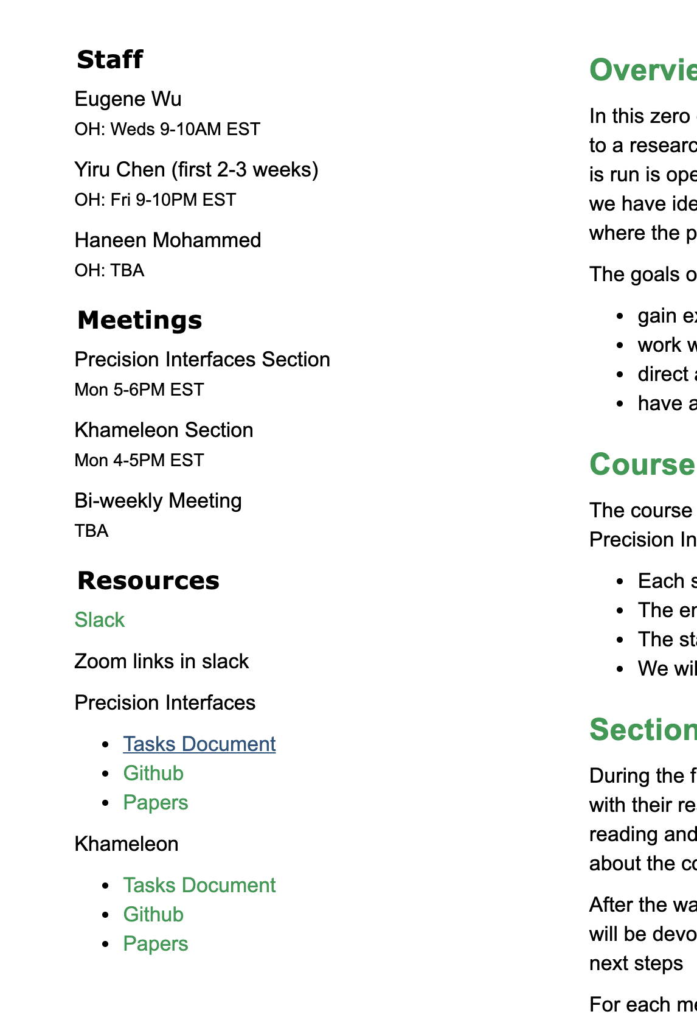
Assign reading: SIGMOD 19 paper
Everyone: S1
Jeffrey: S2-3
Guanjie+Sam: S4
Create your own example to walk through the model

