Slide 1
Khameleon Research Projects

Slide 2
Course Structure
0 –credit course
2 weeks
Section: Khameleon
Section: Precision Interfaces
weekly
Project 1
Project 2
Project 3
Project 4
slack

Slide 3
Course Structure
0 –credit course
2 weeks
Section: Khameleon
Section: Precision Interfaces
weekly
Project 1
Project 2
Project 3
Project 4
slack

Slide 4
https://cudbg.github.io/summer20/

Slide 5
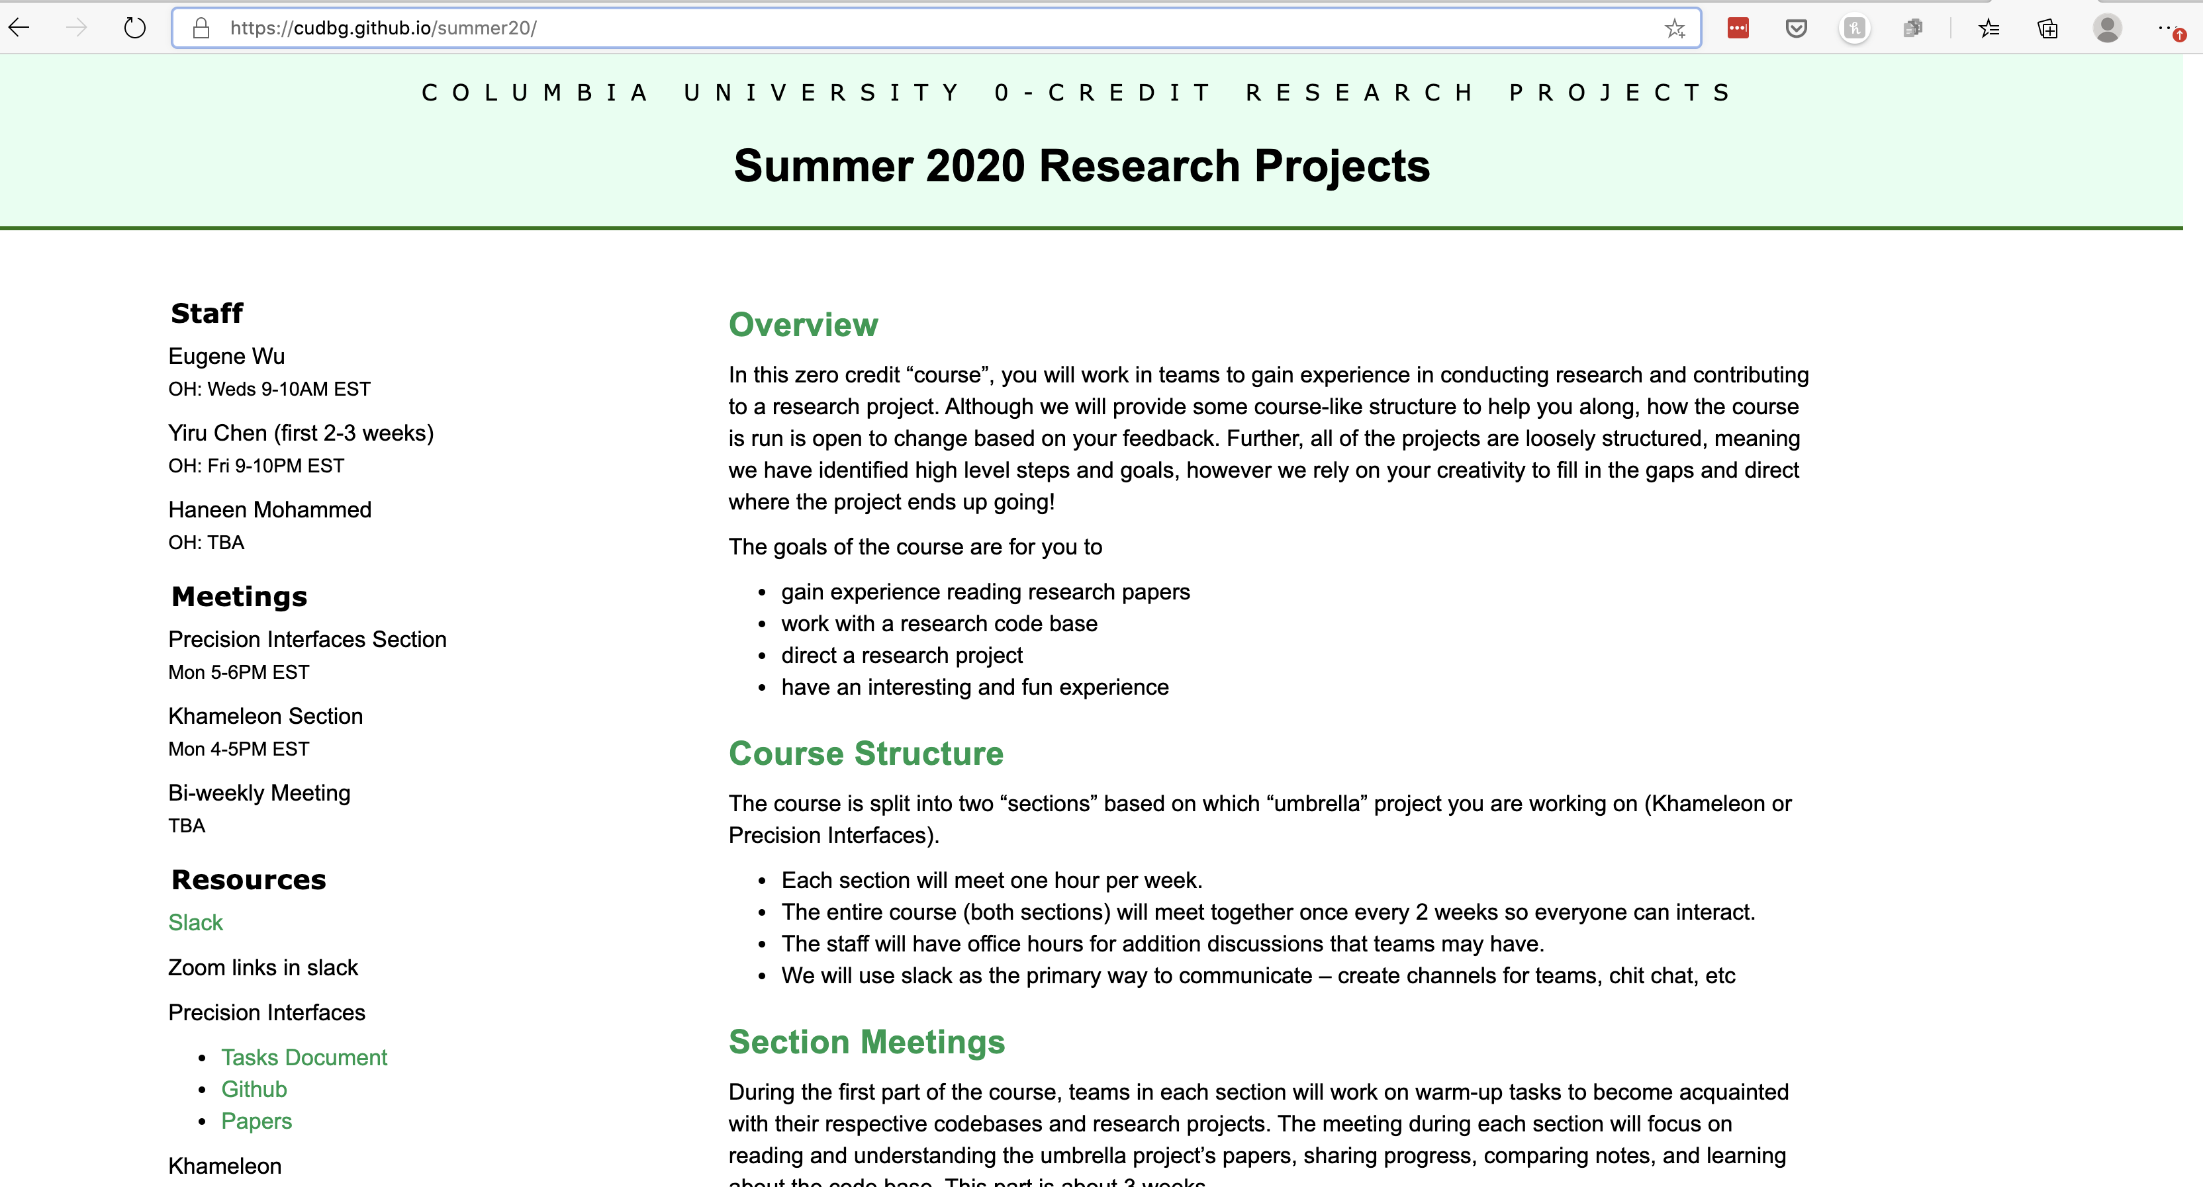

Slide 6
https://cudbg.github.io/summer20/
Slack: wulab2020summer.slack.com
Zoom: link shared in slack
Weekly Office Hours
Yiru Chen: Precision Interfaces
Haneen Mohammed: Khameleon
Eugene Wu

Slide 7
Weeks 1-3: Warmup
Tasks and small projects to get familiar with the code
Section meetings to discuss blockers, share insights, discuss papers
Weeks 4-beyond:
Work on summer projects
Biweekly meetings across both sections as meet and greet.

Slide 8
Section Meetings
Teams prepare a short presentation (max 5 slides) to share
1. What the team’s goals were and what has been achieved
2. 1+ interesting things that your team has learned
Parts of the code, a bug, a paper, a related product, …
3. Next steps
Demos, screenshots, storyboards are great!

Slide 9
Course Goals
Gain experience reading research papers
Work with a research code base
Direct a research project
Have an interesting and fun experience

Slide 10
Introduce yourself
Name
Year
Plans for the summer (other than this class)
What you hope will happen in the fall

Slide 11
Short Talk about Khameleon

Slide 12
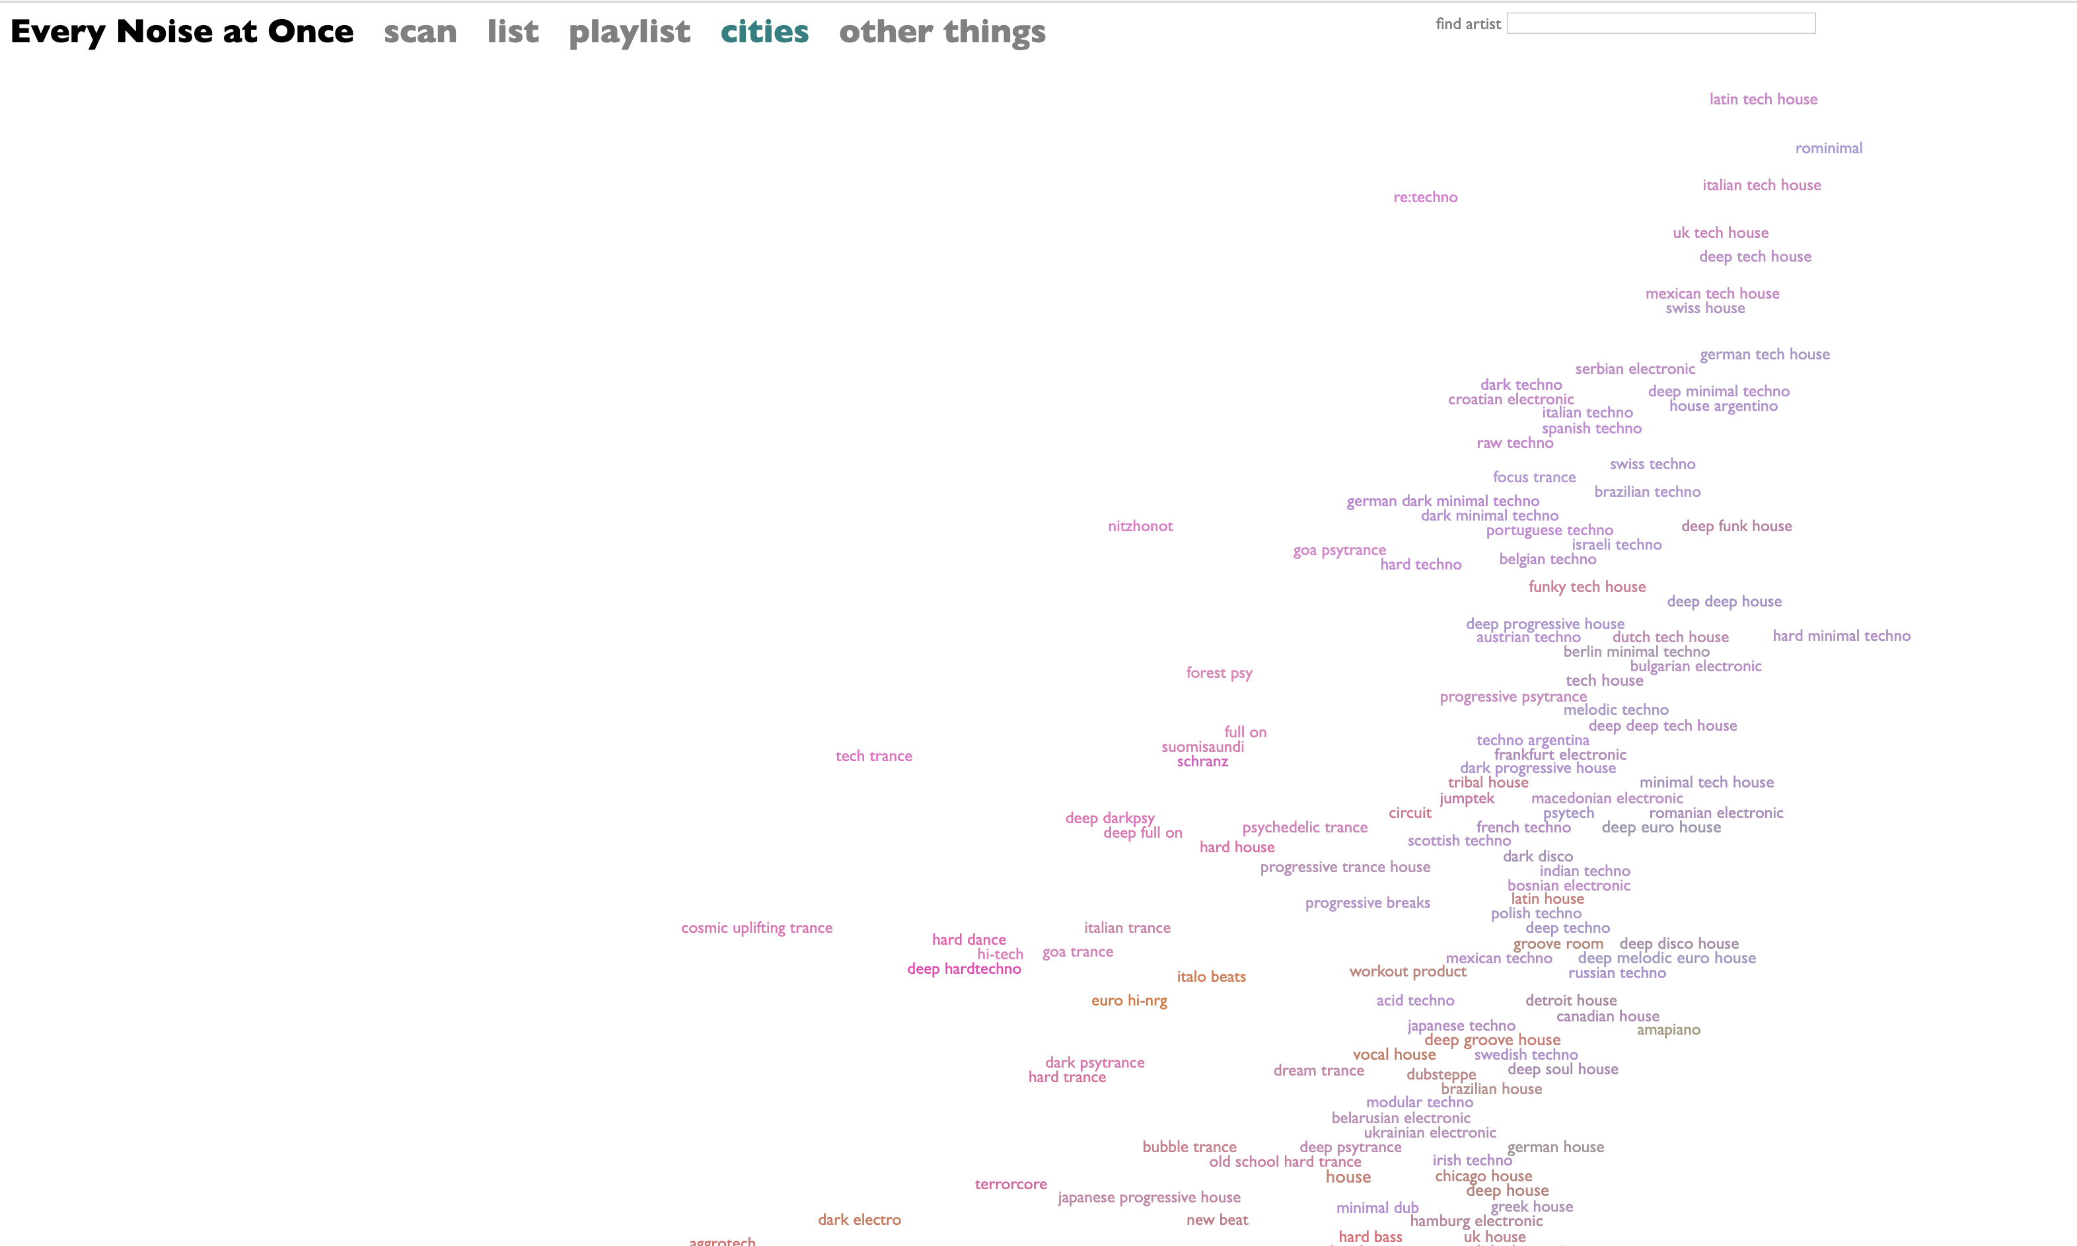

Slide 13
This Week
Start Warmup Tasks
Start reading Khameleon paper
Everyone: S1, 2, 3
Team 1: present S1, 2
Team 2: present S3
Note all the parts that were confusing – share on slack

