Slide 1
Precision Interfaces Section Meeting

Slide 2
Agenda
Updates on Warmup Tasks

Slide 3
Section Meetings
Teams prepare a short presentation (max 5 slides) to share
1. What the team’s goals were and what has been achieved
2. 1+ interesting things that your team has learned
Parts of the code, a bug, a paper, a related product, …
3. Next steps
Demos, screenshots, storyboards are great!

Slide 4
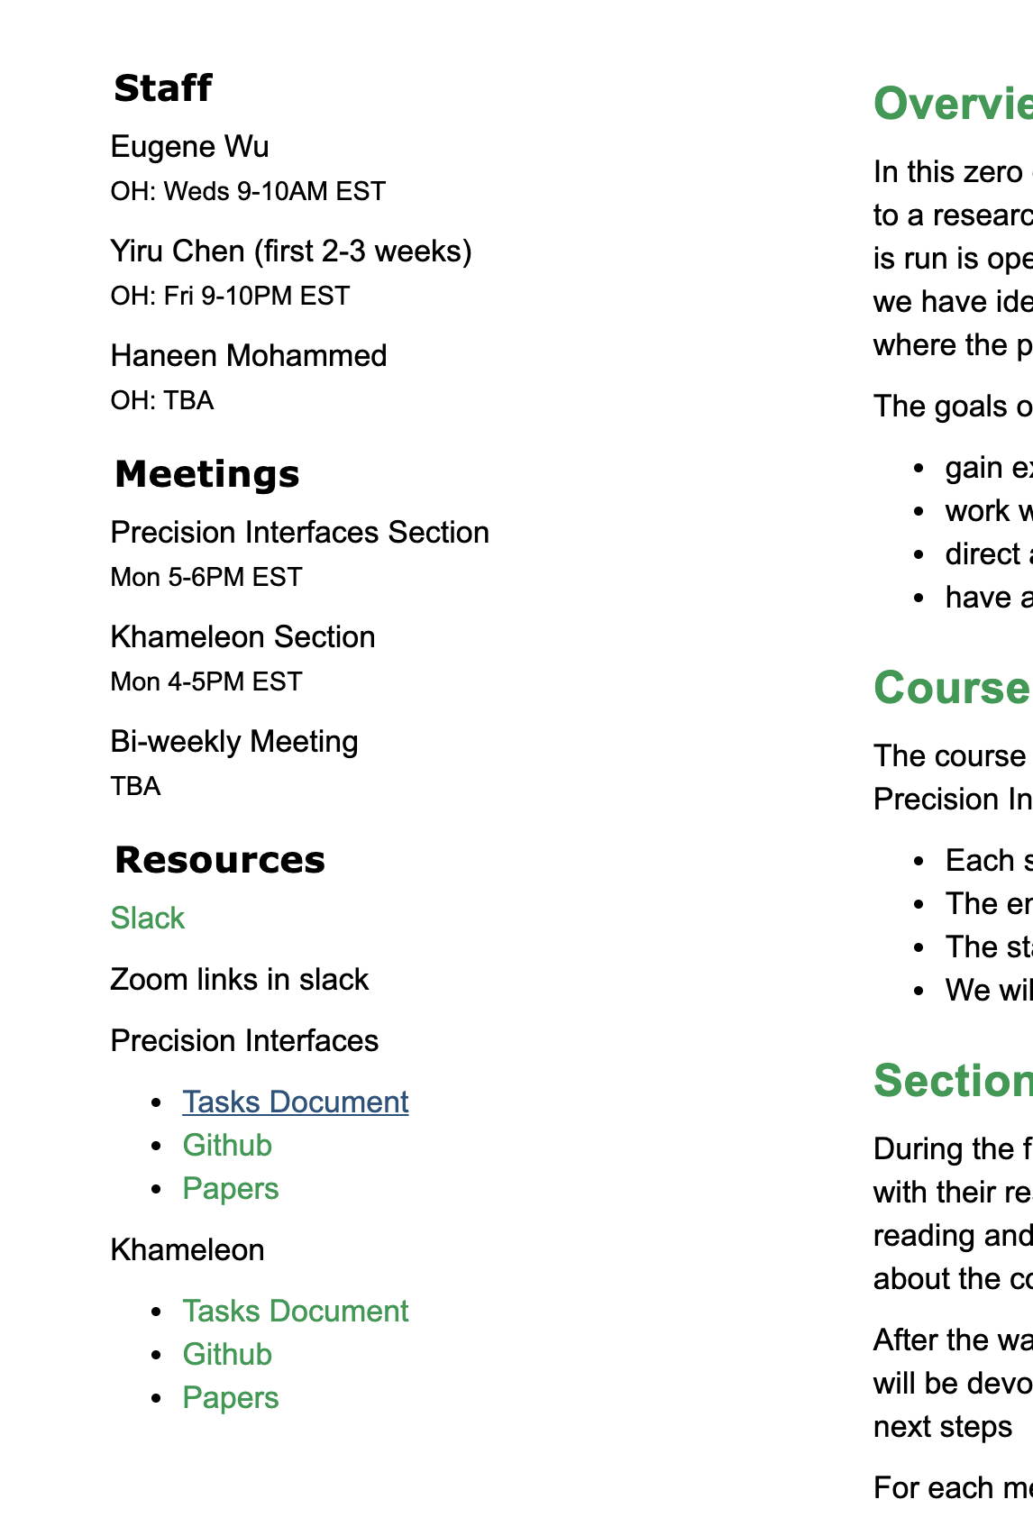
Assign reading: SIGMOD 19 paper
Everyone: S1
Jeffrey: S2-3
Guanjie+Sam: S4
Create your own example to walk through the model

