Slide 1
Precision Interfaces Section Meeting

Slide 2
Section Meetings
Teams prepare a short presentation (max 5 slides) to share
1. goals & achievements
2. 1+ interesting things
3. Next steps
Paper Discussion/Presentations

Slide 3
6/1 Agenda
Updates on Warmup Tasks

Slide 4
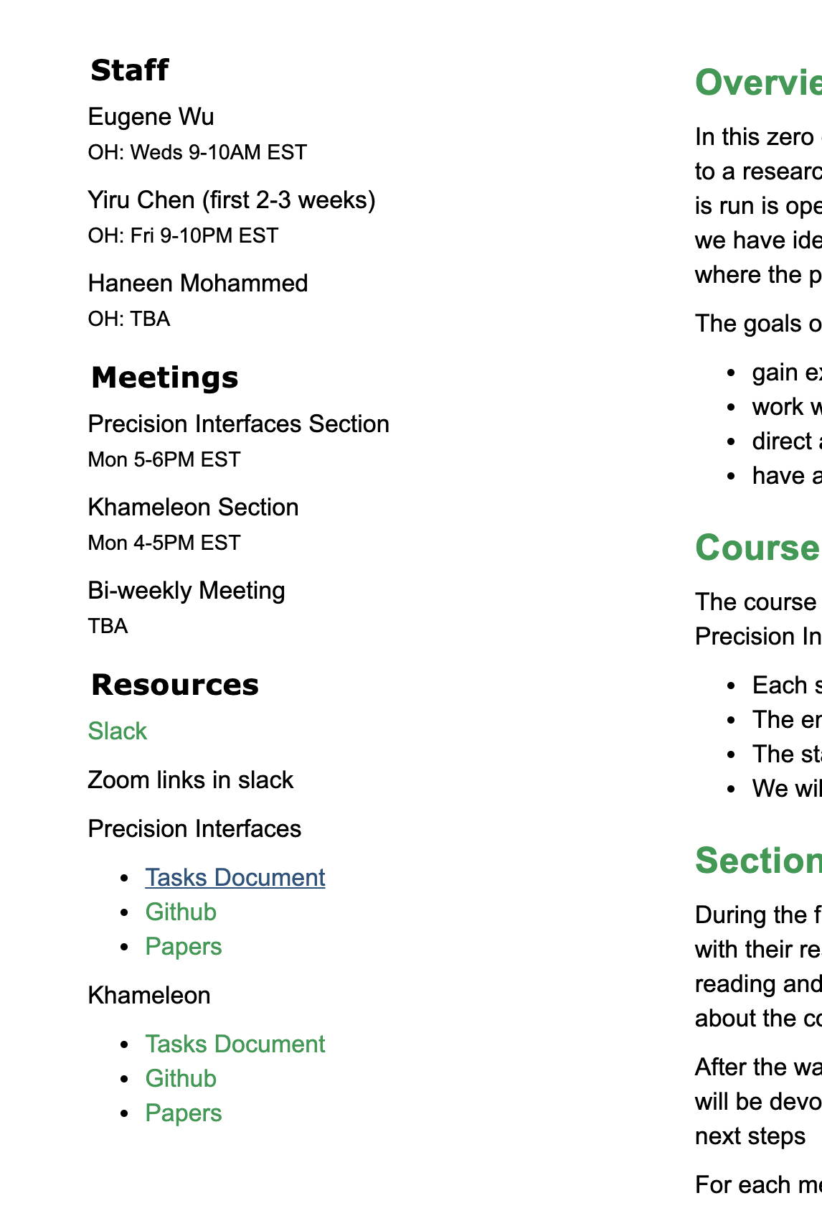
Assign reading: SIGMOD 19 paper
Everyone: S1
Jeffrey: S2-3
Guanjie+Sam: S4
Create your own example to walk through the model

Slide 5
6/8 Agenda
Updates on Warmup Tasks
Paper Discussion
Next Week
Read S4 and construct an explanation of the main concepts (in your opinion) via a simple example
What subset of the interface spec in github is SIGMOD 19 capable of expressing?
What are the limitations of the cost function and what should it also consider? For a suggestion, come up with a naïve function.

Slide 6
6/15 Agenda
Updates on Warmup Tasks
Paper Discussion
Next Week
read the IPA workshop paper, come with questions
Jeffrey: present the relationship between the diff tree and interfaces and how it differs from the SIGMOD paper.
Sam: present the cost function, and how different valid interfaces are (or should be assessed).
Guanjie: present the difftree transformations and the tree search approach.

Slide 7
6/22 Agenda
Updates on Warmup Tasks
Paper Discussion
Next Week

